Slide 1
第2張程式碼
導師:龍大大
學生:4070E001李建輝

Slide 2
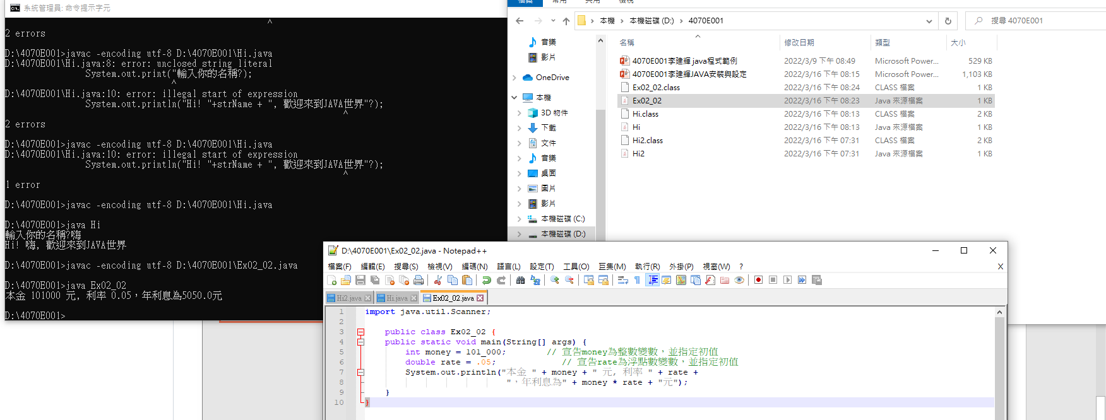
Ex02_02

Slide 3
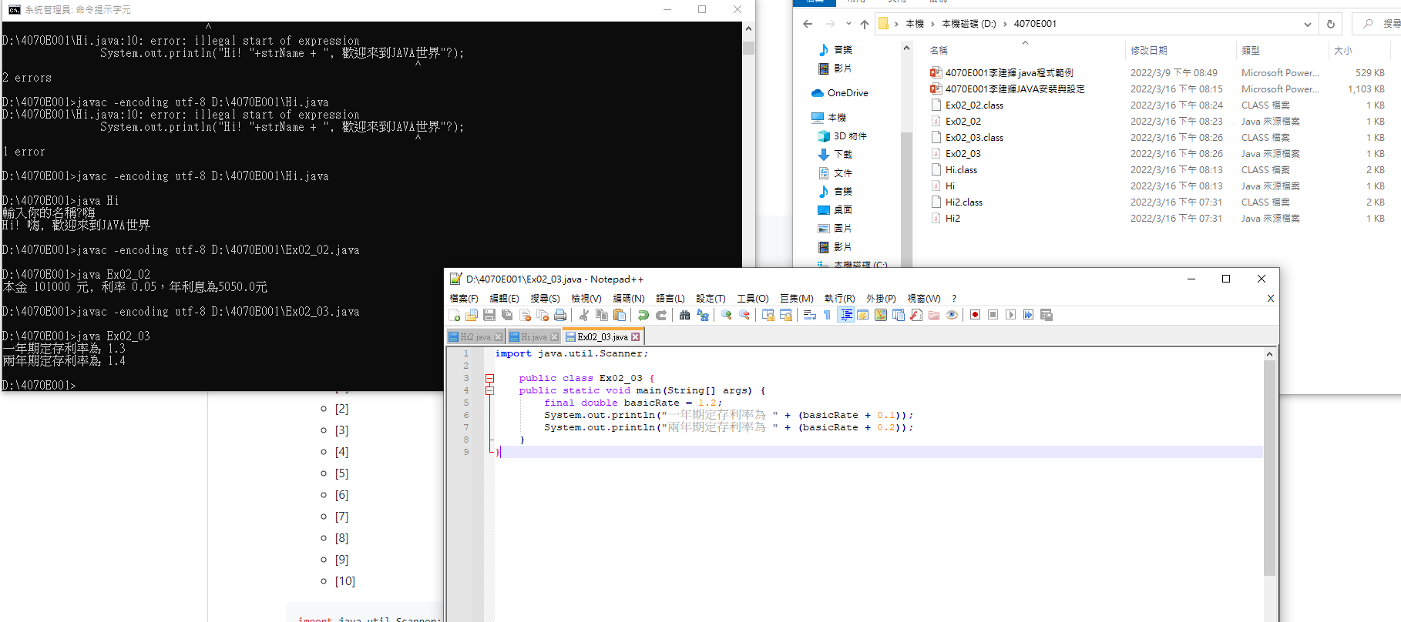
Ex02_03

Slide 4
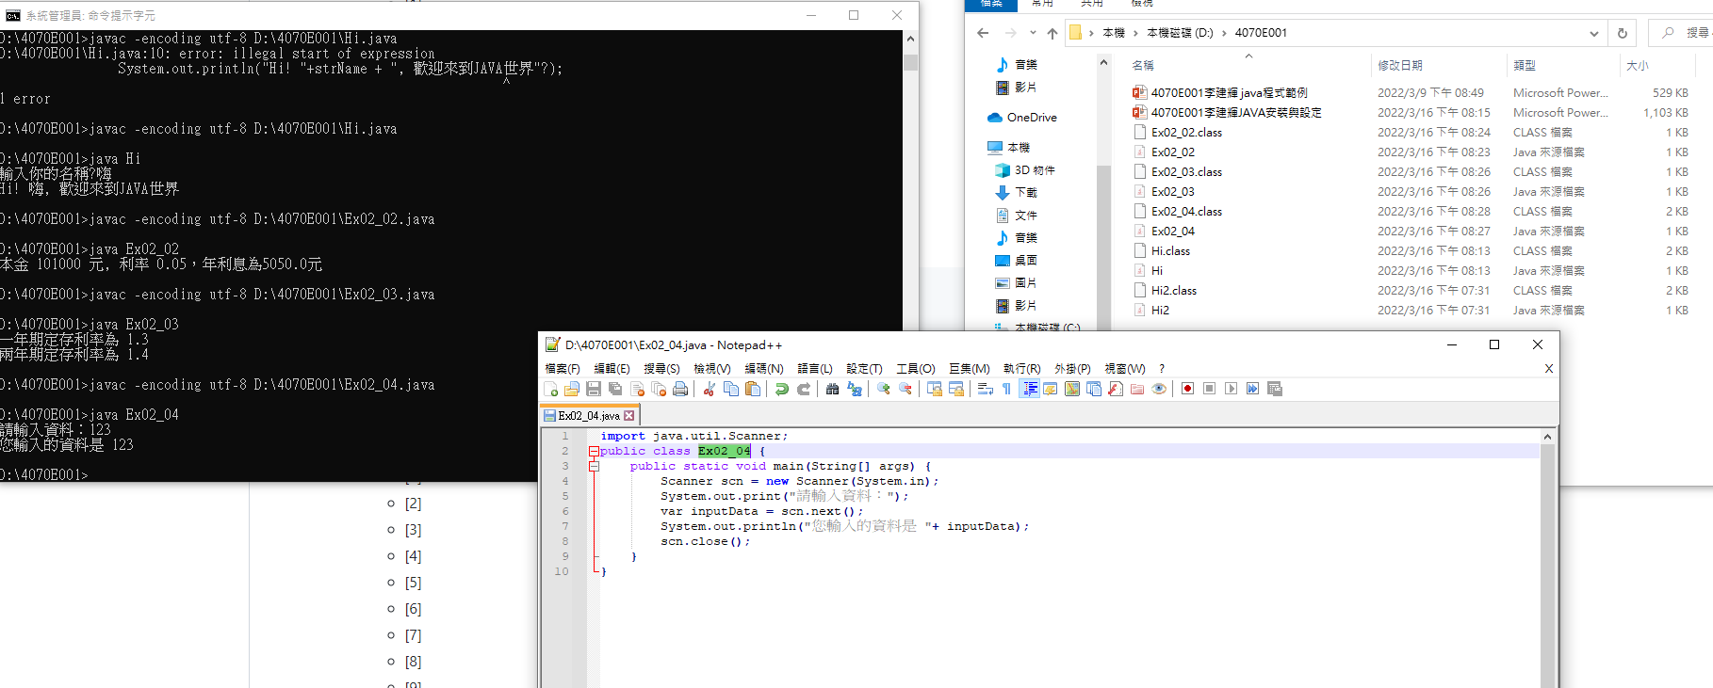
Ex02_04

Slide 5
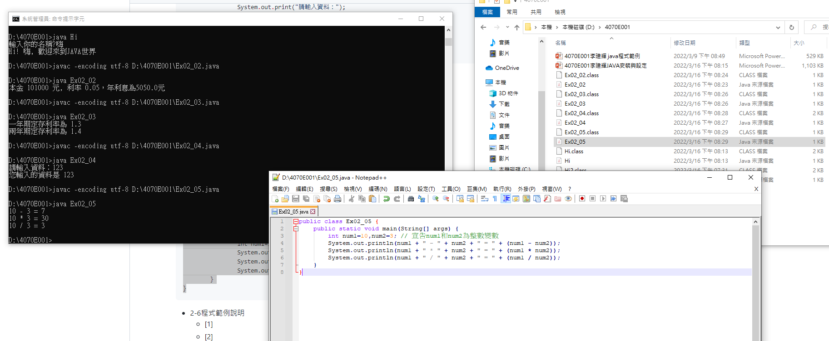
Ex02_05

Slide 6
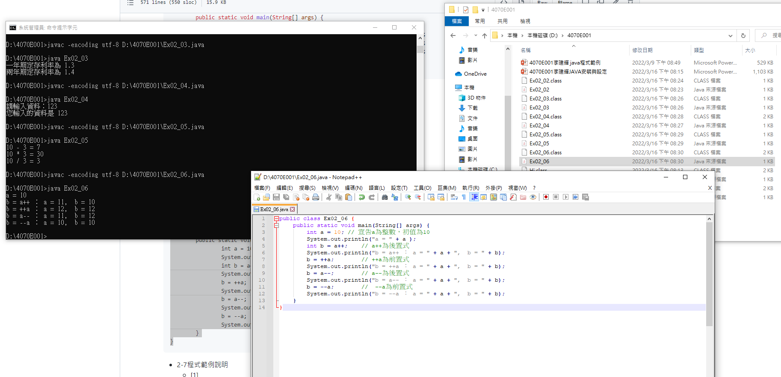
Ex02_06

Slide 7
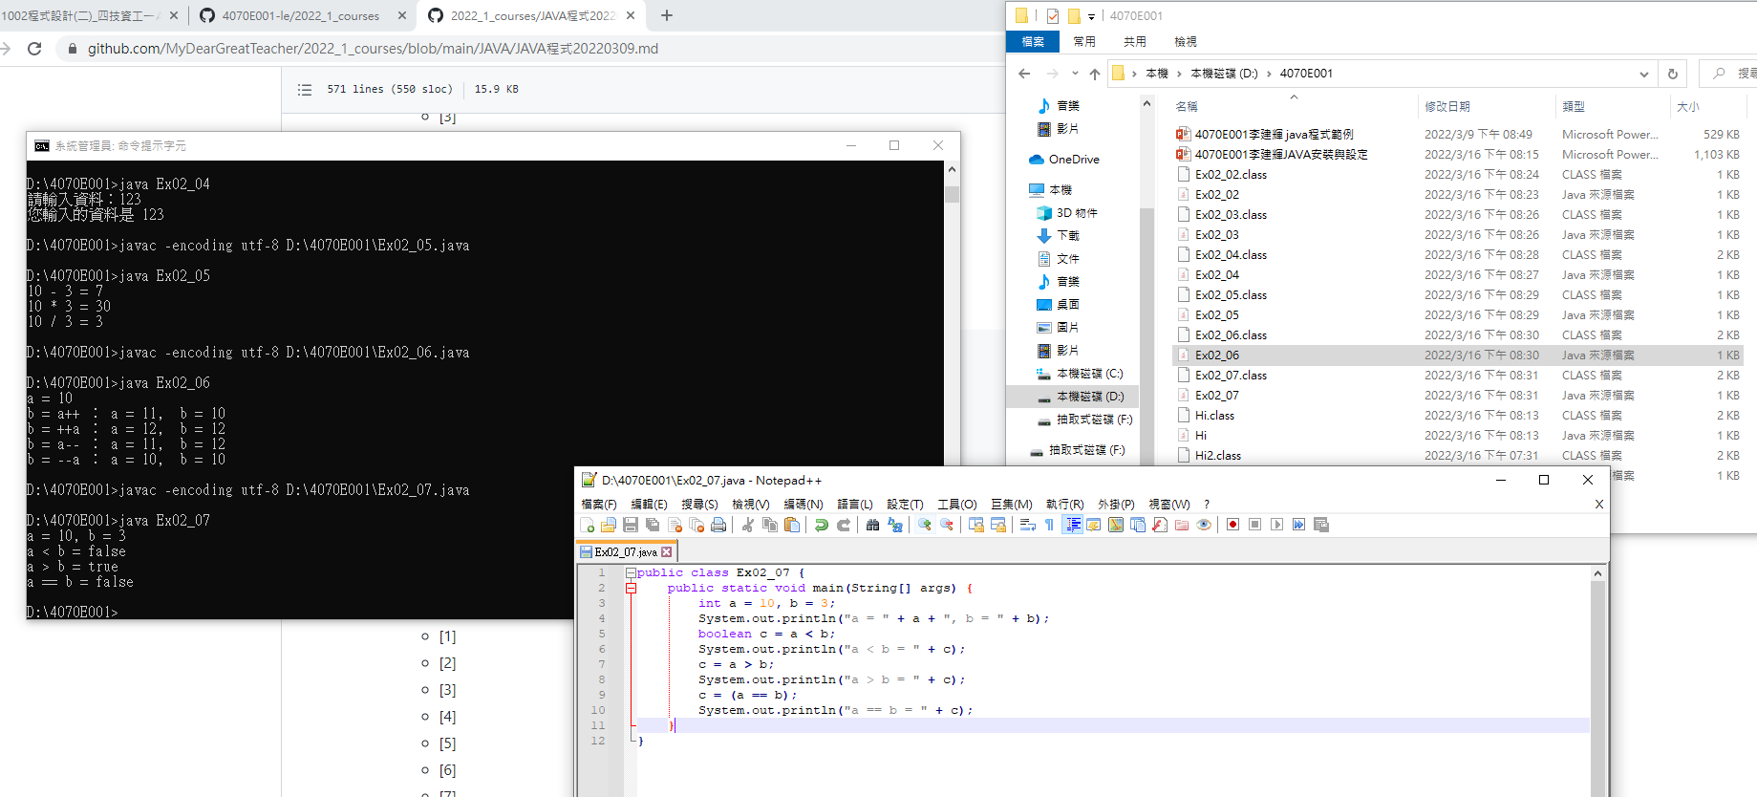
Ex02_07

Slide 8
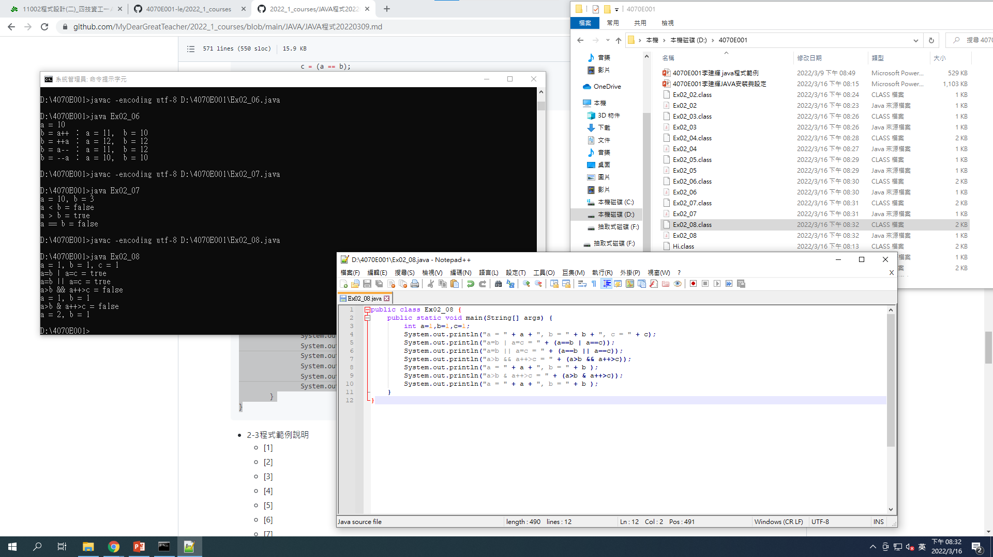
Ex02_08

Slide 9
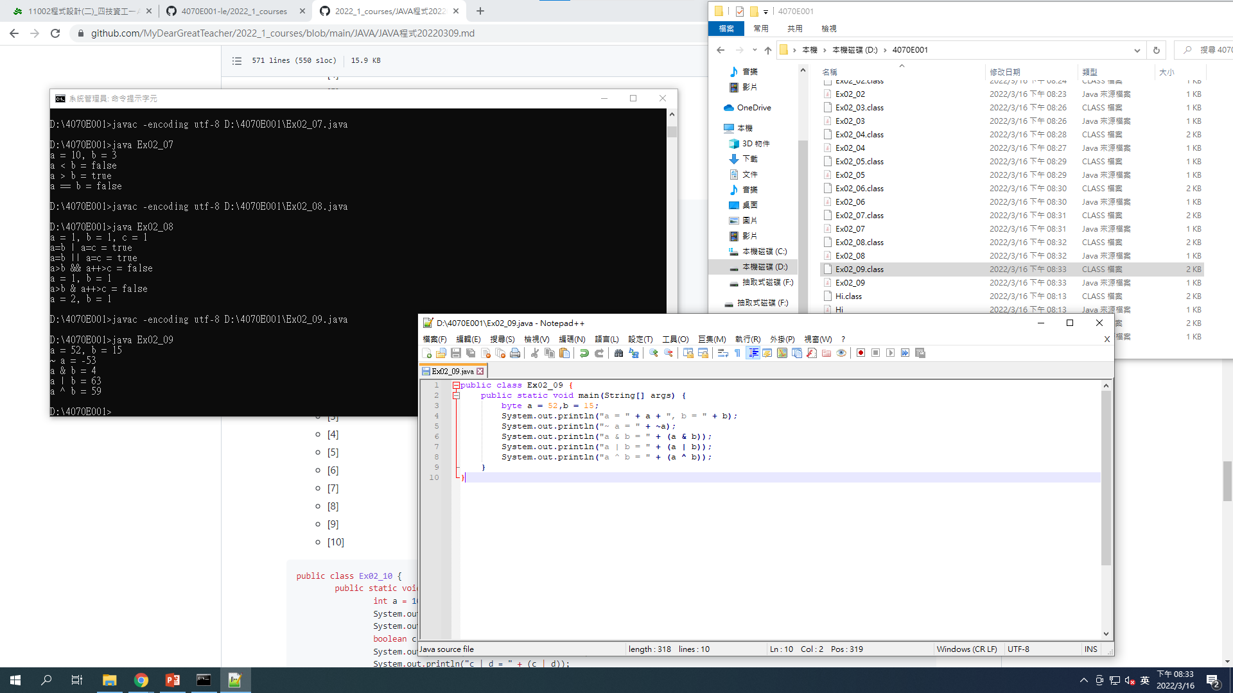
Ex02_09

Slide 10
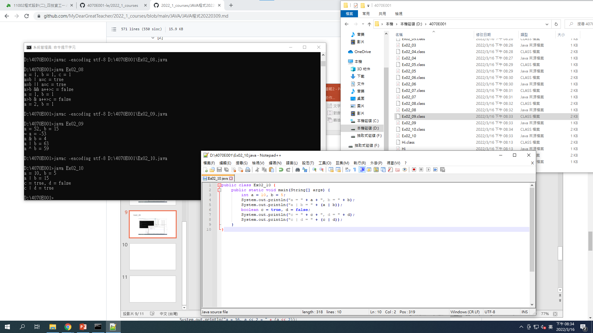
Ex02_10

