Slide 1
Modsecurity

Slide 2








Slide 3
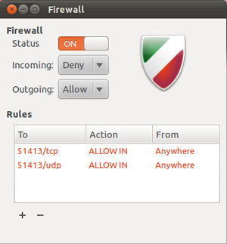


Slide 4



Slide 5
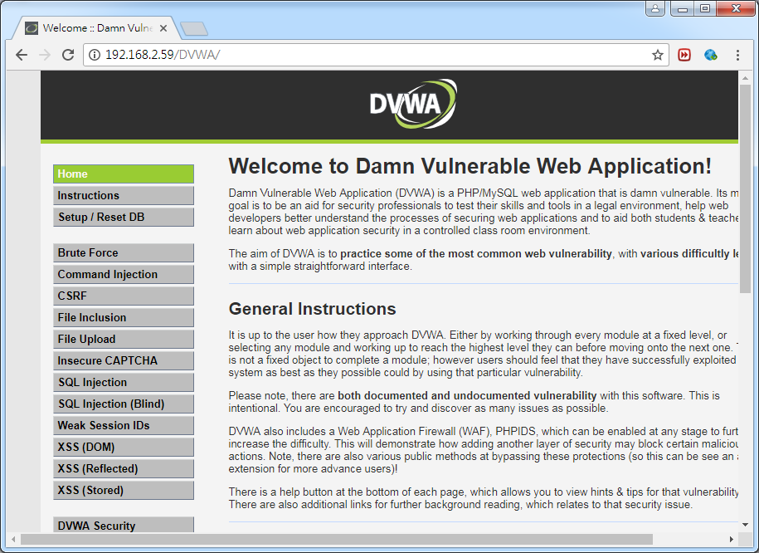
Install DVWA
sudo apt-get install apache2 php libapache2-mod-php php-curl php-mcrypt php-mbstring phpunit php-gd -y
sudo apt-get install mysql-server php-mysqli -y
sudo service apache2 restart
cd /var/www/html
sudo git clone https://github.com/ethicalhack3r/DVWA.git
sudo cp DVWA/config/config.inc.php.dist DVWA/config/config.inc.php
sudo vim DVWA/config/config.inc.php
-----------------------------------------------------
$_DVWA[ 'db_user' ] = 'root';
$_DVWA[ 'db_password' ] = 'xxxxxxxxxx';
$_DVWA[ 'recaptcha_public_key' ] = 'xxxxxxxxxxxxxx';
$_DVWA[ 'recaptcha_private_key' ] = 'xxxxxxxxxxxxx';
$_DVWA[ 'default_security_level' ] = 'low';
-----------------------------------------------------
sudo vim /etc/php/7.0/apache2/php.ini
-----------------------------------------------------
allow_url_include = On
-----------------------------------------------------
sudo chmod 777 /var/www/html/DVWA/hackable/uploads/
sudo chmod 777 /var/www/html/DVWA/external/phpids/0.6/lib/IDS/tmp/phpids_log.txt
sudo service apache2 restart

Slide 6
Install ModSecurity
sudo apt-get update
sudo apt-get install libapache2-mod-security2 –y
hostname
sudo vim /etc/apache2/conf-available/fqdn.conf
------------------------------
ServerName ksu-VirtualBox
------------------------------
sudo a2enconf fqdn && sudo systemctl reload apache2
sudo service apache2 reload
sudo apachectl -M | grep --color security2
sudo mv /etc/modsecurity/modsecurity.conf-recommended /etc/modsecurity/modsecurity.conf
sudo service apache2 reload
sudo sed -i "s/SecRuleEngine DetectionOnly/SecRuleEngine On/" /etc/modsecurity/modsecurity.conf
sudo sed -i "s/SecResponseBodyAccess On/SecResponseBodyAccess Off/" /etc/modsecurity/modsecurity.conf

Slide 7
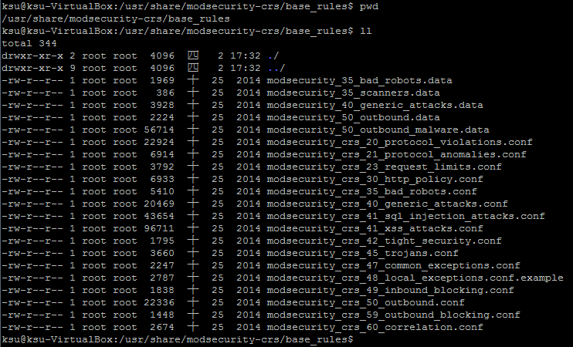
ModSecurity default rules
/usr/share/modsecurity-crs/base_rules

Slide 8
Include ModSecurity
sudo vim /etc/apache2/mods-enabled/security2.conf
------------------------------------------------------------------------------------
<IfModule security2_module>
# Default Debian dir for modsecurity's persistent data
SecDataDir /var/cache/modsecurity
# Include all the *.conf files in /etc/modsecurity.
# Keeping your local configuration in that directory
# will allow for an easy upgrade of THIS file and
# make your life easier
IncludeOptional /etc/modsecurity/*.conf
IncludeOptional "/usr/share/modsecurity-crs/*.conf"
IncludeOptional "/usr/share/modsecurity-crs/activated_rules/*.conf"
</IfModule>
------------------------------------------------------------------------------------
sudo service apache2 reload
sudo cp /usr/share/modsecurity-crs/base_rules/modsecurity_crs_41_sql_injection_attacks.conf /usr/share/modsecurity-crs/activated_rules/
sudo service apache2 reload
測試只加入sql injection規則

Slide 9
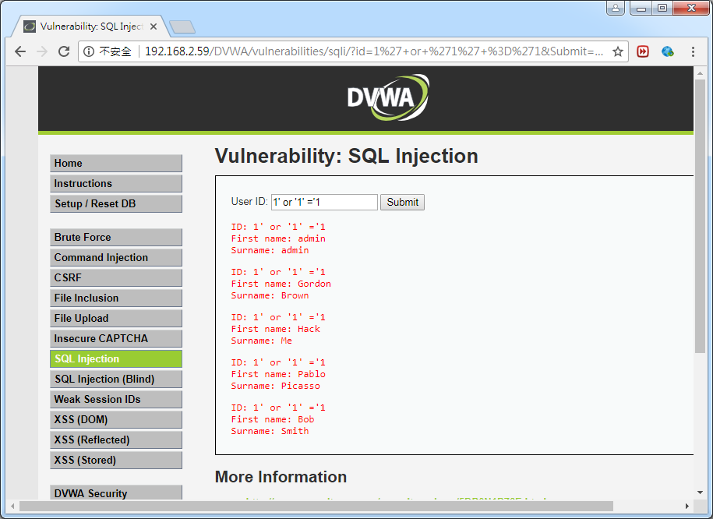
Before
1' or '1' ='1

Slide 10
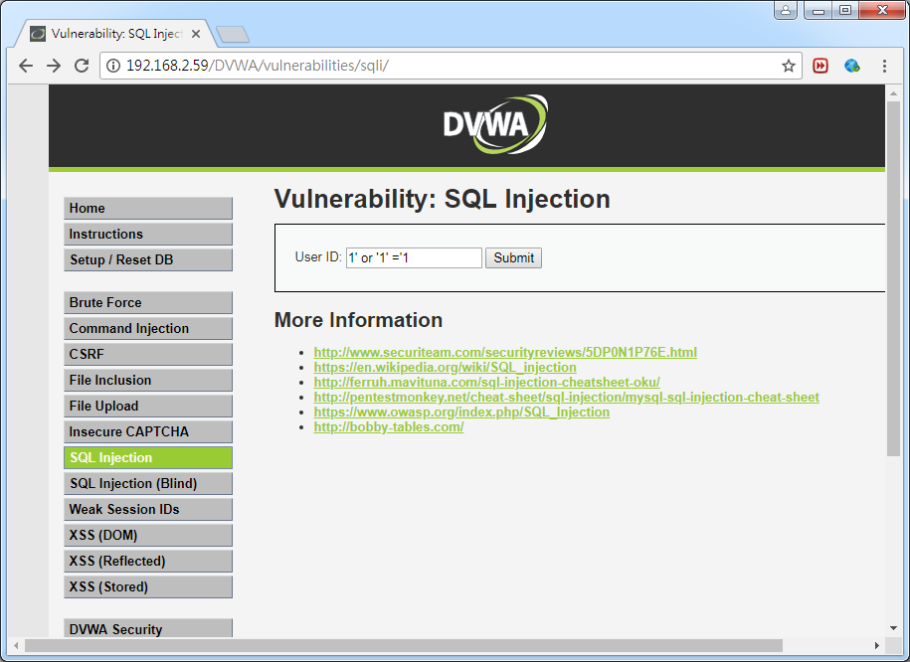
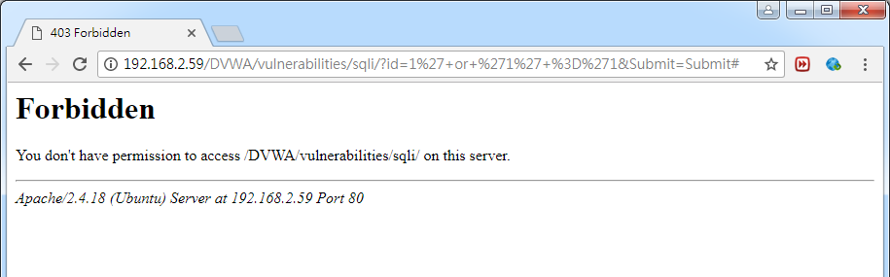
After
1' or '1' ='1

Slide 11
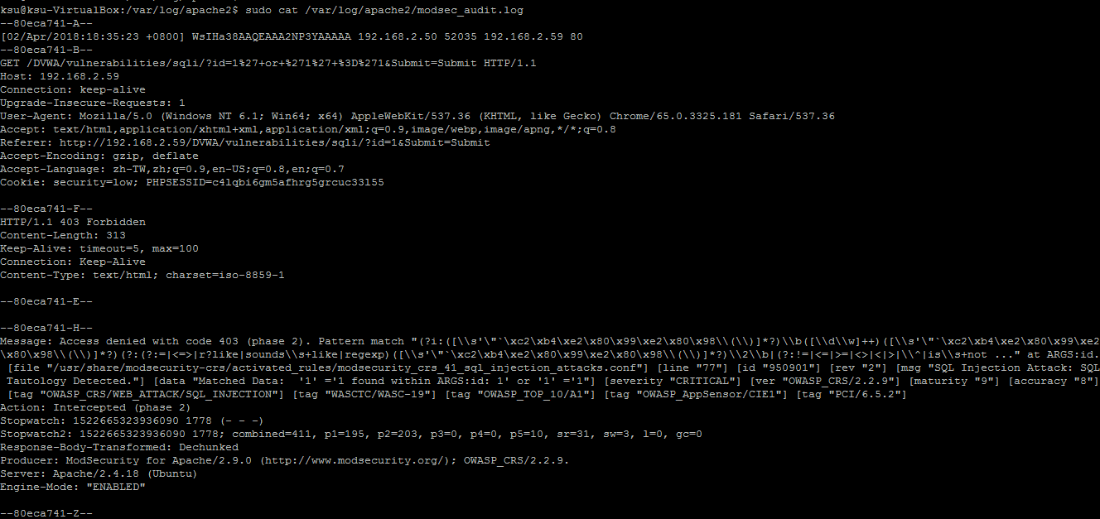
ModSecurity log
sudo cat /var/log/apache2/modsec_audit.log

