Slide 1

HASH 攻擊
破密分析-從古典密碼學到現代密碼學
By 外星人

Slide 2
HASH
單向雜湊函數

Slide 3
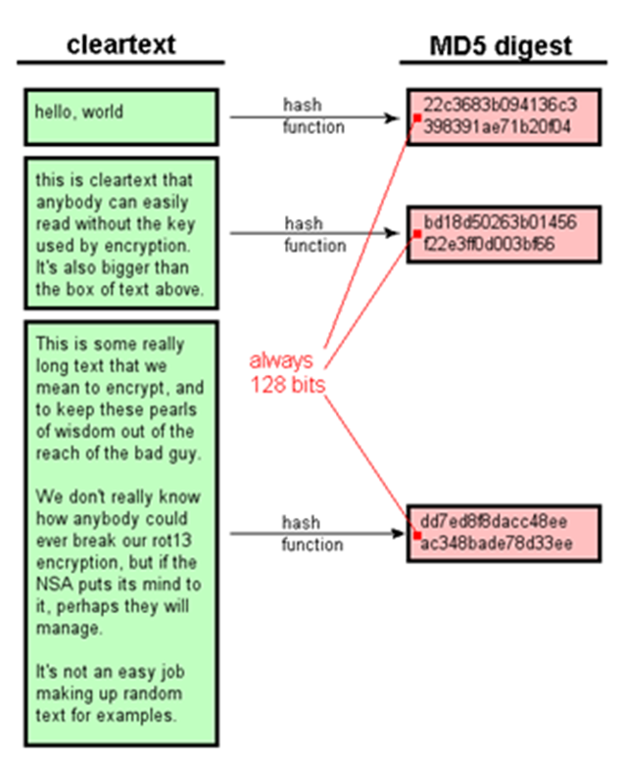
HASH 單向雜湊函數
訊息摘要函數message digest function
密碼雜湊函數cryptographic hash function
原像pre-image
只有單向
Message
訊息
單向雜湊函數
無法從雜湊值
反算出訊息
所以叫單向
Hash Value
雜湊值
任意長度的訊息計算後得到
固定長度的雜湊值
訊息摘要message digest
指紋fingerprint
http://www.unixwiz.net/techtips/iguide-crypto-hashes.html

Slide 4
著名的Hash function
[這些演算法及其不同程式的實作(python,c/c++,ruby,…) ➔上大學在學]
MD4 | Rivest(1990) | 雜湊值的長度為128 位元(RFC 1186 ，修改版RFC 1320) Dobbeertin 發現了MD4 雜湊值的碰撞方法，所以並不安全。
MD5 | Rivest (1991) |雜湊值的長度為128 位元(RFC l321) MD5 的強碰撞抵抗性已經被破解
SHA-1 | NIST (National Institute of Standards and Technology) 雜湊值的長度為160 位元 1993 年美國發表 FIPS PUB 180 稱為SHA 1995 年發表的修改版FIPS PUB 180-1 稱作SHA-1 2005 年SHA-I 的強碰撞抵抗性被破解
SHA-2 | NIST (National Institute of Standards and Technology) SHA-256 、SHA-384 、SHA-512 雜湊值的長度分別是256 位元、384 位元、512 位元。這些單向雜湊函數統稱為SHA-2 訊息的長度有限制(SHA-256 是不超過264 位元， SHA-384 與SHA-512 是不超過2128 位元) 這些SHA-2單向雜湊函數與SHA-1 公開為FIPS PUB 180-2(2002年)
RIPEMD-160 | European Union PIPE 計畫設計出的RIPEMD RIPEMD-160是RIPEMD修訂版,雜湊值長度為160 位元 Hans Dobbertin 、Antoon Bosselaers 、Bart Preneel(1996) 還有RIPEMD-128 、RIPEMD-256 、RIPEMD-320 等版本 RIPE MD 的強碰撞抵抗性在2004 年被破解，但是RIPEMD-160 還未被破解 比特幣使用RIPEMD-160
SHA-3 | NIST (National Institute of Standards and Technology) 2007|2012(KECCAK 演算法) SHA-3 在2015年8月5日由 NIST 通過 FIPS 202 正式發表
MD ==Message Digest 訊息摘要
SHA ==Secure Hash Algorithm
https://zh.wikipedia.org/wiki/SHA-2
https://zh.wikipedia.org/wiki/SHA-3

Slide 5
https://www.openfoundry.org/en/tech-column/8608-opensource-security-algorithm-tool-openssl1-basic-function-and-hash-algorithms-
Hashing with openssl
OpenSSL 支援常見的雜湊演算法 (Hash algorithms)，如 MD5, SHA1, SHA256 等。
1.列出所有支援的雜湊演算法➔openssl dgst -help
-md5 to use the md5 message digest algorithm (default)
-md4 to use the md4 message digest algorithm
-md2 to use the md2 message digest algorithm
-sha1 to use the sha1 message digest algorithm
-sha to use the sha message digest algorithm
-sha224 to use the sha224 message digest algorithm
-sha256 to use the sha256 message digest algorithm
-sha384 to use the sha384 message digest algorithm
-sha512 to use the sha512 message digest algorithm
-mdc2 to use the mdc2 message digest algorithm
-ripemd160 to use the ripemd160 message digest algorithm

Slide 6
https://www.openfoundry.org/en/tech-column/8608-opensource-security-algorithm-tool-openssl1-basic-function-and-hash-algorithms-
Hashing with openssl
2.計算與驗證檔案的md5 hash
echo 'HappyHackingDay' > test.txt
openssl dgst -md5 -c test.txt
➔MD5(test.txt)= 79:50:86:fd:74:d8:48:fe:7b:de:d8:77:10:a1:20:b4
md5sum test.txt
➔795086fd74d848fe7bded87710a120b4 test.txt
計算檔案的md5 hash
驗證檔案的md5 hash

Slide 7
https://www.openfoundry.org/en/tech-column/8608-opensource-security-algorithm-tool-openssl1-basic-function-and-hash-algorithms-
Hashing with openssl
3.計算與驗證檔案的SHA1 hash
openssl dgst -sha1 -c test.txt
➔SHA1(test.txt)= 64:56:39:fe:1d:f6:40:25:c9:1e:69:43:3b:d5:aa:b3:b2:87:2b:82
shasum test.txt
➔ 645639fe1df64025c91e69433bd5aab3b2872b82 test.txt
計算檔案的SHA1 hash
驗證檔案的SHA1 hash

Slide 8
Hashing with python
每一個程式語言(Python/ruby)幾乎都有Hash運算的相關模組
使用Hashlib模組
https://docs.python.org/2/library/hashlib.html
import hashlib
a = ‘HappyCTFP{It is FUN hashing with python hashlib}’
print hashlib.md5(a).hexdigest()
print hashlib.sha1(a).hexdigest()
print hashlib.sha224(a).hexdigest()
print hashlib.sha256(a).hexdigest()
print hashlib.sha384(a).hexdigest()
print hashlib.sha512(a).hexdigest()
2df8404191835aef870ee32ae6870317
fb2f51e7f2973bfed59218a1c446b9571ff3ac9d
cf526656fe98363230e603a8f975c623a288e183839103041392c9e1
bc395528e192147f03915733e47b89f8afe632404a559132a2236502b1afba71

Slide 9

Hashing with ruby
gedit ruby_hash.rb
chmod +x ruby_hash.rb
#!/usr/bin/ruby -w
require 'digest'
puts Digest::SHA256.hexdigest "Hello World"
puts Digest::SHA256.hexdigest "Hello MWorld"
puts Digest::MD5.hexdigest "Hello World"
puts Digest::MD5.hexdigest "Hello MWorld“
./ruby_hash.rb
只差一個字母,hash後完全不同
a591a6d40bf420404a011733cfb7b190d62c65bf0bcda32b57b277d9ad9f146e
dad0dd87b309c3d8b364541f2a69bdb347832ccec172ac8ebfa0f02945d9172d
b10a8db164e0754105b7a99be72e3fe5
2ad6f329c9f3a968941a38affa0af2fe

Slide 10
Cryptographic hash functions
& message authentication codes(MAC)
https://en.wikipedia.org/wiki/SHA-2
Common functions | MD5 SHA-1 SHA-2 SHA-3 BLAKE2
SHA-3 finalists | BLAKE Grøstl JH Skein Keccak (winner)
Other functions | ECOH FSB GOST HAS-160 HAVAL Kupyna LM hash MD2 MD4 MD6 MDC-2 N-Hash RIPEMD RadioGatún SWIFFT Snefru Streebog Tiger VSH WHIRLPOOL
Key derivation functions | Bcrypt crypt PBKDF2 scrypt Argon2 Lyra2
MAC functions | DAA CBC-MAC HMAC OMAC/CMAC PMAC VMAC UMAC Poly1305
Authenticated encryption modes | CCM CWC EAX GCM IAPM OCB
Attacks 遭受到的攻擊模式 | Collision attack Preimage attack Birthday attack Brute-force attack Rainbow table Side-channel attack Length extension attack
Design | Avalanche effect Hash collision Merkle–Damgård construction Sponge function HAIFA construction Unique Block Iteration
Standardization 標準化 | CRYPTREC NESSIE NIST hash function competition
Utilization | Hash-based cryptography Key stretching Merkle tree Message authentication Proof of work Salt(加鹽)

