Slide 1
20210305

Slide 2
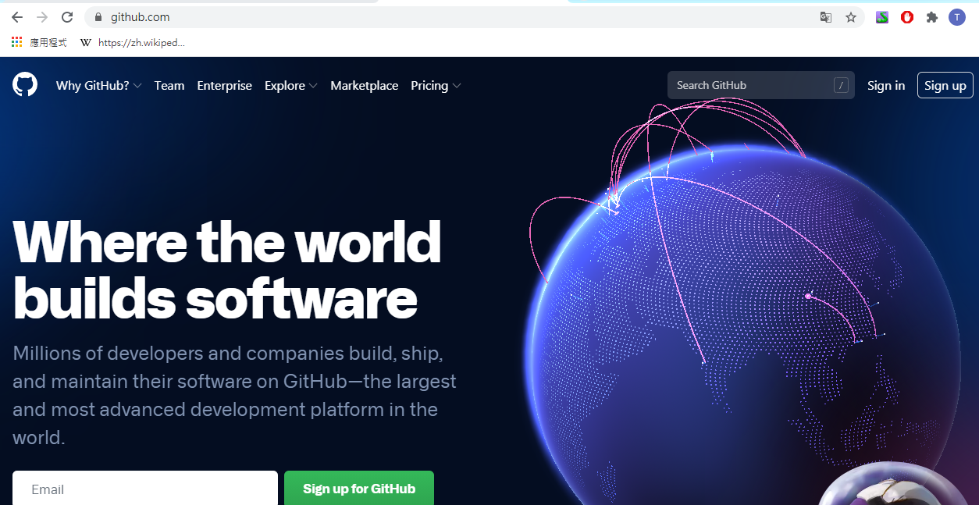

Slide 3
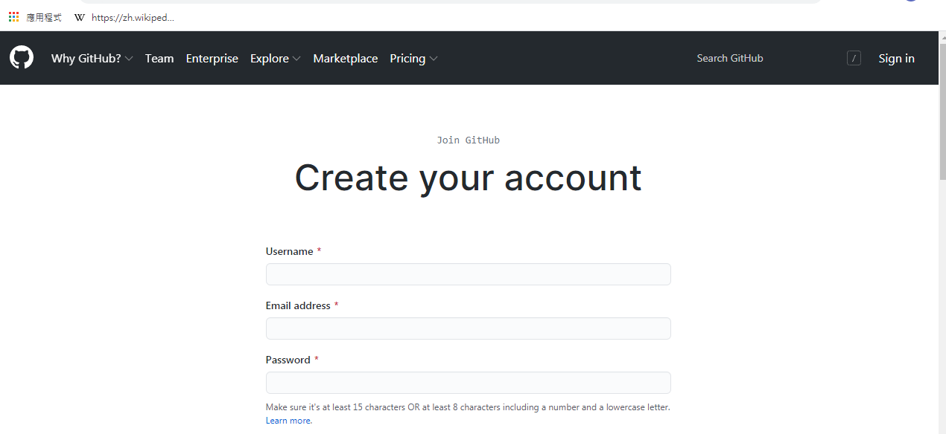
註冊

Slide 4
https://github.com/mydeargreatteacher
mydeargreatteacher

Slide 5
