Slide 1
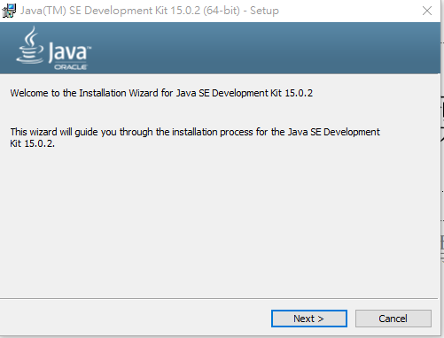

Slide 2
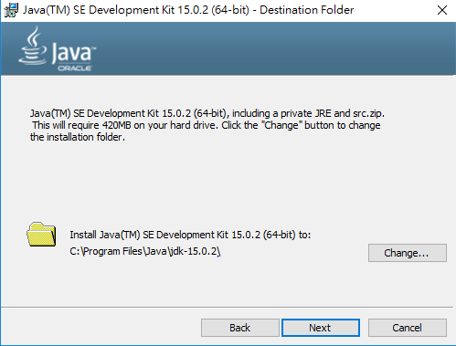

Slide 3
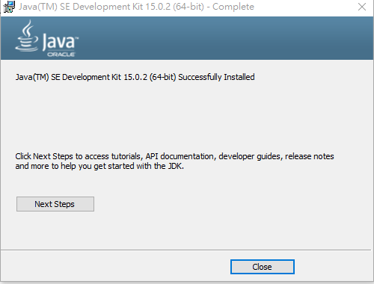

Slide 4
C:\WINDOWS\system32>javac
Usage: javac <options> <source files>
where possible options include:
@<filename> Read options and filenames from file
-Akey[=value] Options to pass to annotation processors
--add-modules <module>(,<module>)*
Root modules to resolve in addition to the initial modules, or all modules
on the module path if <module> is ALL-MODULE-PATH.
--boot-class-path <path>, -bootclasspath <path>
Override location of bootstrap class files
--class-path <path>, -classpath <path>, -cp <path>
Specify where to find user class files and annotation processors
-d <directory> Specify where to place generated class files
-deprecation
Output source locations where deprecated APIs are used
--enable-preview
Enable preview language features. To be used in conjunction with either -source or --release.
-encoding <encoding> Specify character encoding used by source files
-endorseddirs <dirs> Override location of endorsed standards path
-extdirs <dirs> Override location of installed extensions
-g Generate all debugging info
-g:{lines,vars,source} Generate only some debugging info
-g:none Generate no debugging info
-h <directory>
Specify where to place generated native header files
--help, -help, -? Print this help message
--help-extra, -X Print help on extra options
-implicit:{none,class}
Specify whether or not to generate class files for implicitly referenced files
-J<flag> Pass <flag> directly to the runtime system
--limit-modules <module>(,<module>)*
Limit the universe of observable modules
--module <module>(,<module>)*, -m <module>(,<module>)*
Compile only the specified module(s), check timestamps
--module-path <path>, -p <path>
Specify where to find application modules

Slide 5
--module-source-path <module-source-path>
Specify where to find input source files for multiple modules
--module-version <version>
Specify version of modules that are being compiled
-nowarn Generate no warnings
-parameters
Generate metadata for reflection on method parameters
-proc:{none,only}
Control whether annotation processing and/or compilation is done.
-processor <class1>[,<class2>,<class3>...]
Names of the annotation processors to run; bypasses default discovery process
--processor-module-path <path>
Specify a module path where to find annotation processors
--processor-path <path>, -processorpath <path>
Specify where to find annotation processors
-profile <profile>
Check that API used is available in the specified profile
--release <release>
Compile for the specified Java SE release. Supported releases: 7, 8, 9, 10, 11, 12, 13, 14, 15
-s <directory> Specify where to place generated source files
--source <release>, -source <release>
Provide source compatibility with the specified Java SE release. Supported releases: 7, 8, 9, 10, 11, 12, 13, 14, 15
--source-path <path>, -sourcepath <path>
Specify where to find input source files
--system <jdk>|none Override location of system modules
--target <release>, -target <release>
Generate class files suitable for the specified Java SE release. Supported releases: 7, 8, 9, 10, 11, 12, 13, 14, 15
--upgrade-module-path <path>
Override location of upgradeable modules
-verbose Output messages about what the compiler is doing
--version, -version Version information
-Werror Terminate compilation if warnings occur

Slide 6
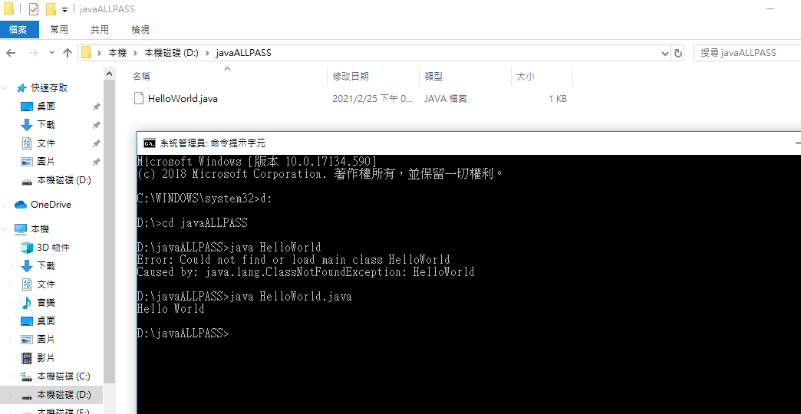

Slide 7
