Slide 1
Solving CTV

Slide 2
What is Colaboratory?
Colaboratory, or "Colab" for short, allows you to write and execute Python in your browser, with
Zero configuration required
Free access to GPUs
Easy sharing
Whether you're a student, a data scientist or an AI researcher, Colab can make your work easier. Watch Introduction to Colab to learn more, or just get started below!

Slide 3
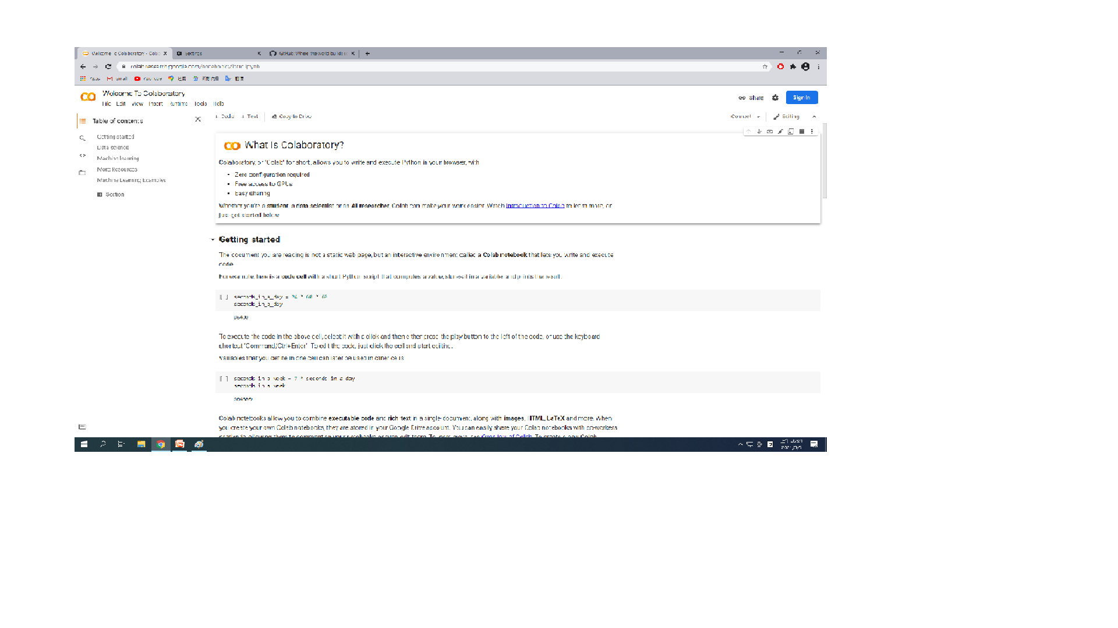

Slide 4


Slide 5
https://github.com/mydeargreatteachar
mydeargreatteachar

Slide 6
