Slide 1
Powershell技術報告
2021 系統安全期末平時報告
報告者:
指導教授: 偉大的恩師 龍大大

Slide 2
Agenda
powershell
Powershell core
Powershell實戰
Powershell programming實戰
惡意powershell
惡意powershell偵測
學習心得

Slide 3
Powershell
實戰

Slide 4
Powershell
https://zh.wikipedia.org/wiki/Windows_PowerShell

Slide 5
Powershell
本節介紹Powershell
基本觀念

Slide 6
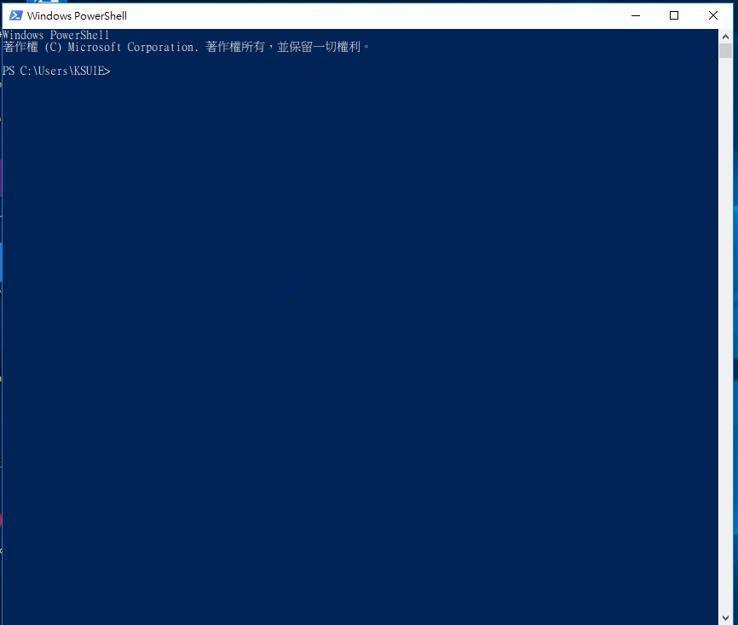
使用系統管理員身分執行powershell

Slide 7
Powershell 指令(cmdlet)格式
動詞-名詞
Verb-Noun
Get-Command
取得
拿到
指令

Slide 8
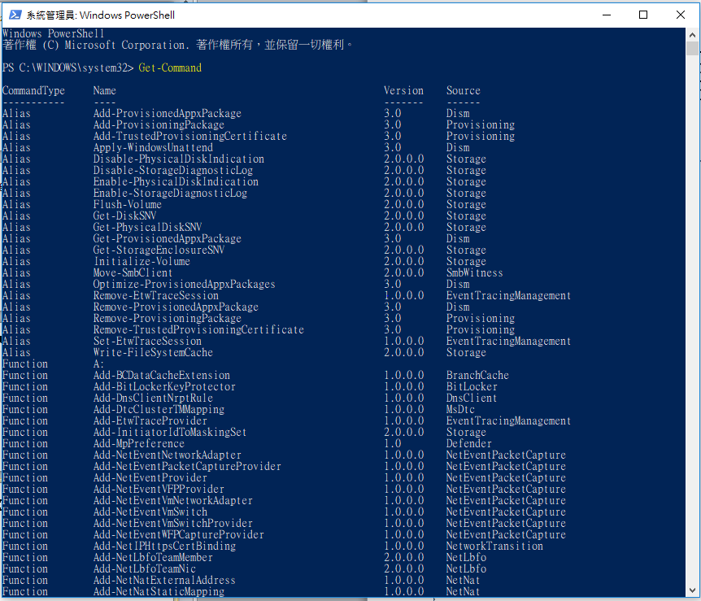
【實作練習 lab】 Get-Command
cmdlets, functions, aliases(別名), and sometimes external scripts.

Slide 9
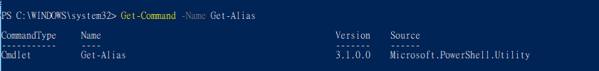
【實作練習 lab】 Get-Command -Name Get-Alias

Slide 10
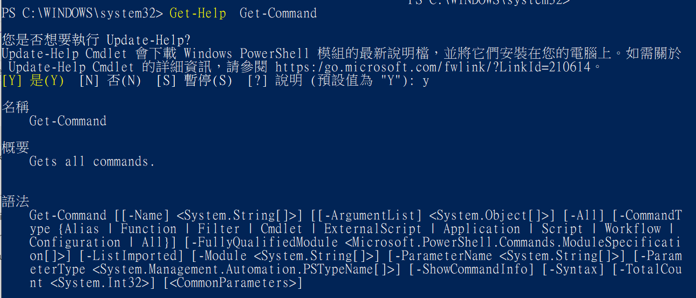
【實作練習 lab】Get-Help Get-Command

Slide 11
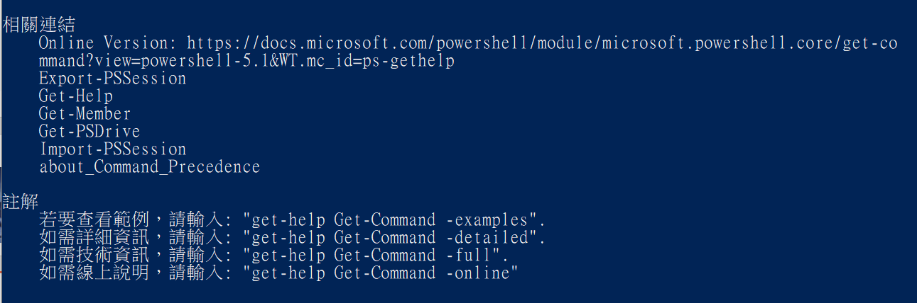

Slide 12
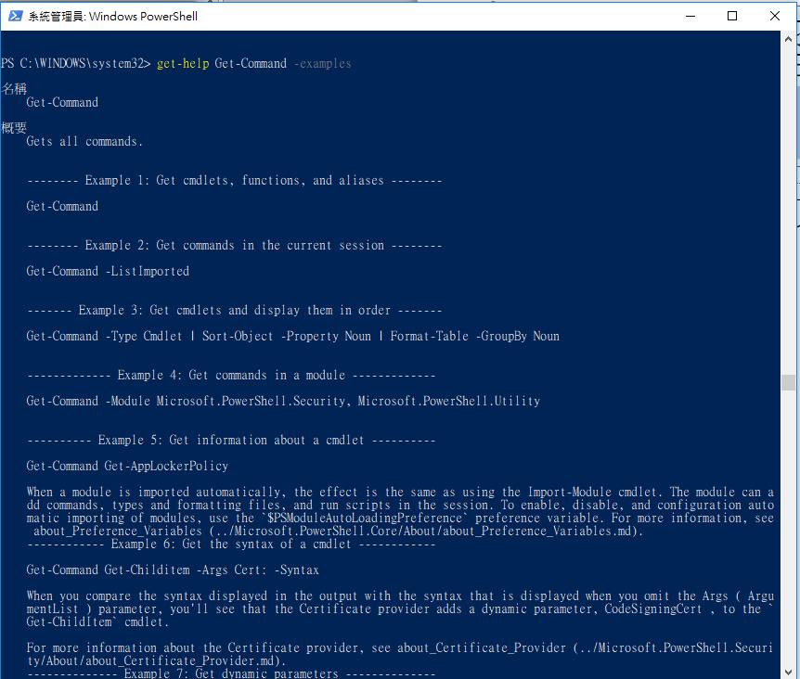
【實作練習 lab】get-help Get-Command -examples

Slide 13
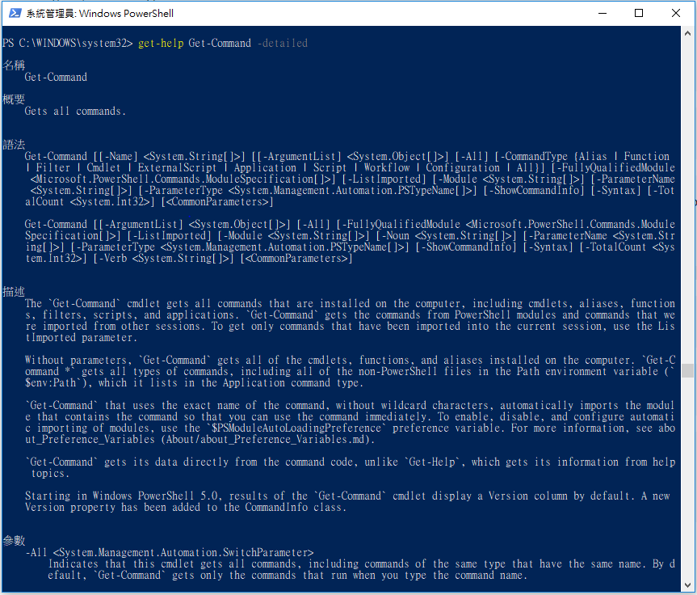
【實作練習 lab】get-help Get-Command -detailed

Slide 14
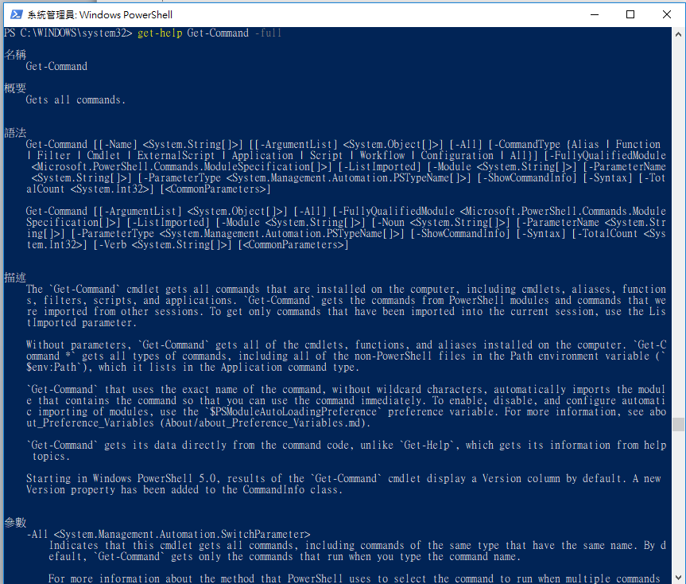
【實作練習 lab】get-help Get-Command -full

Slide 15
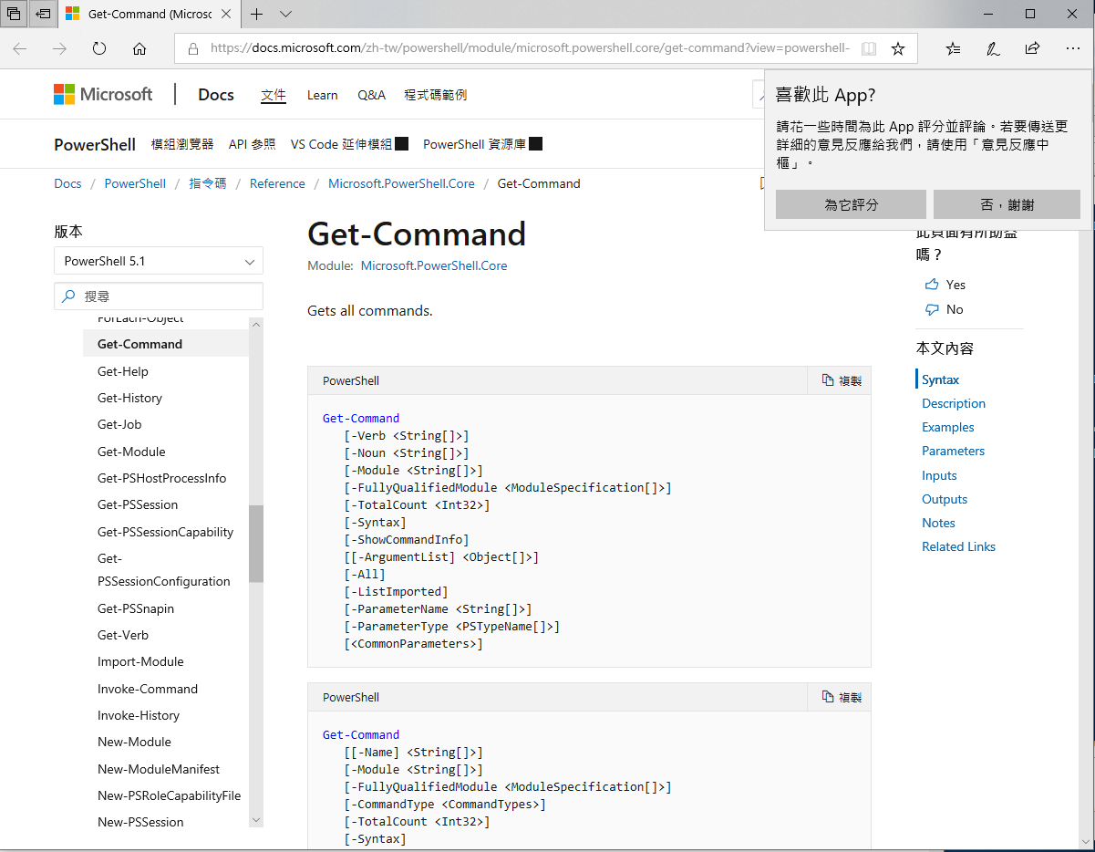
【實作練習 lab】get-help Get-Command -online

Slide 16
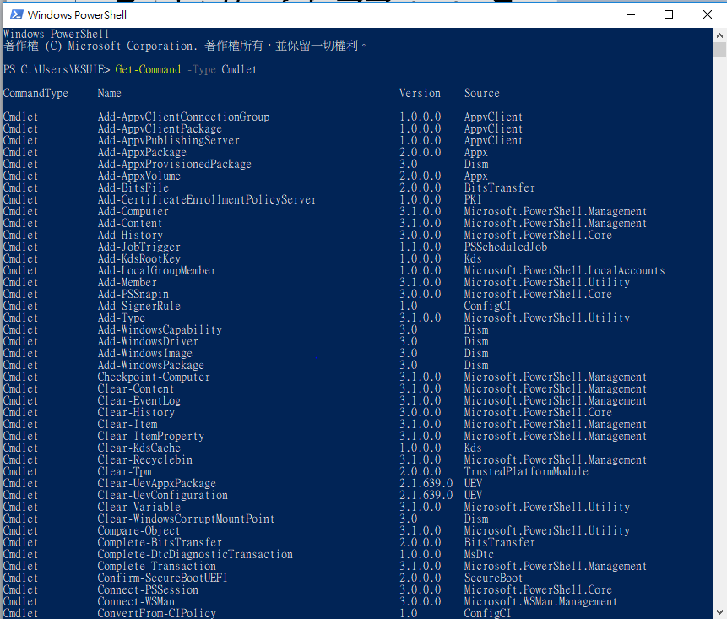
Get-Command -Type Cmdlet

Slide 17
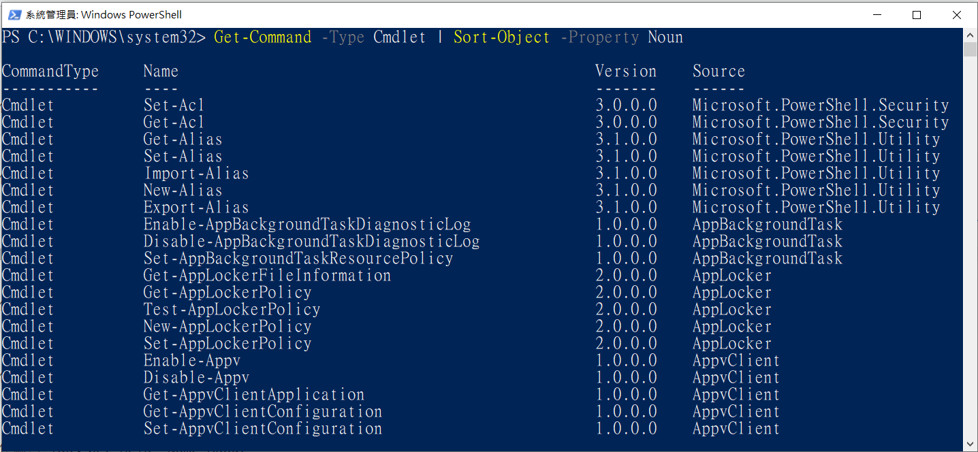
【實作練習 lab】 Get-Command -Type Cmdlet | Sort-Object -Property Noun 名詞排序

Slide 18
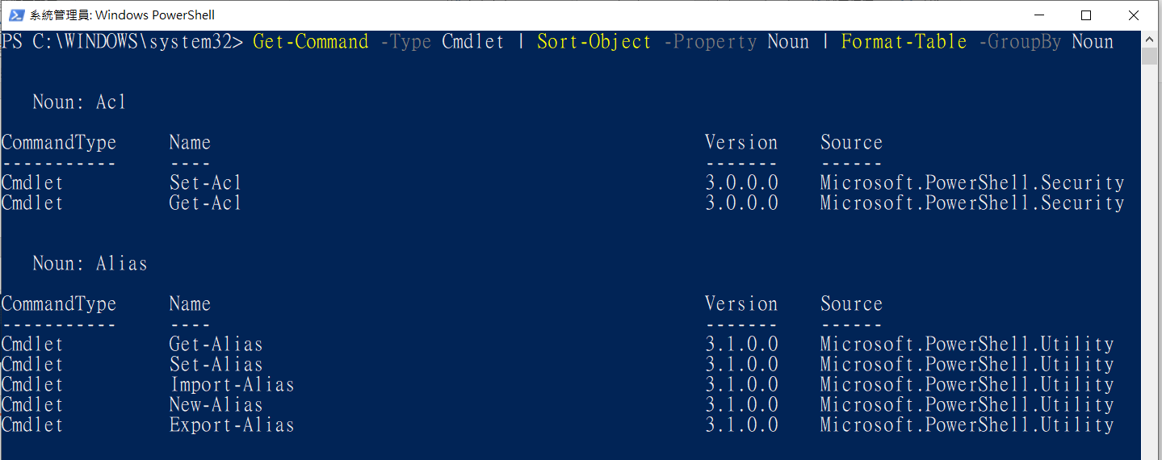
【實作練習 lab】 Get-Command -Type Cmdlet | Sort-Object -Property Noun | Format-Table -GroupBy Noun 分類

Slide 19
Powershell
本節介紹Powershell script language
基本觀念

Slide 20
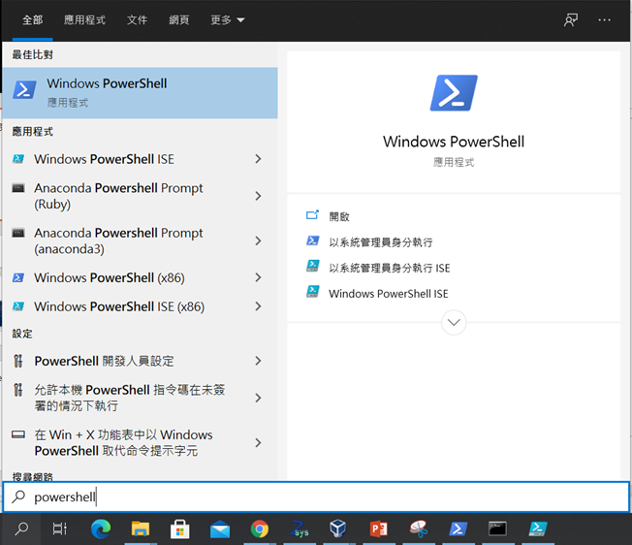
使用系統管理員身分執行powershell ISE

Slide 21
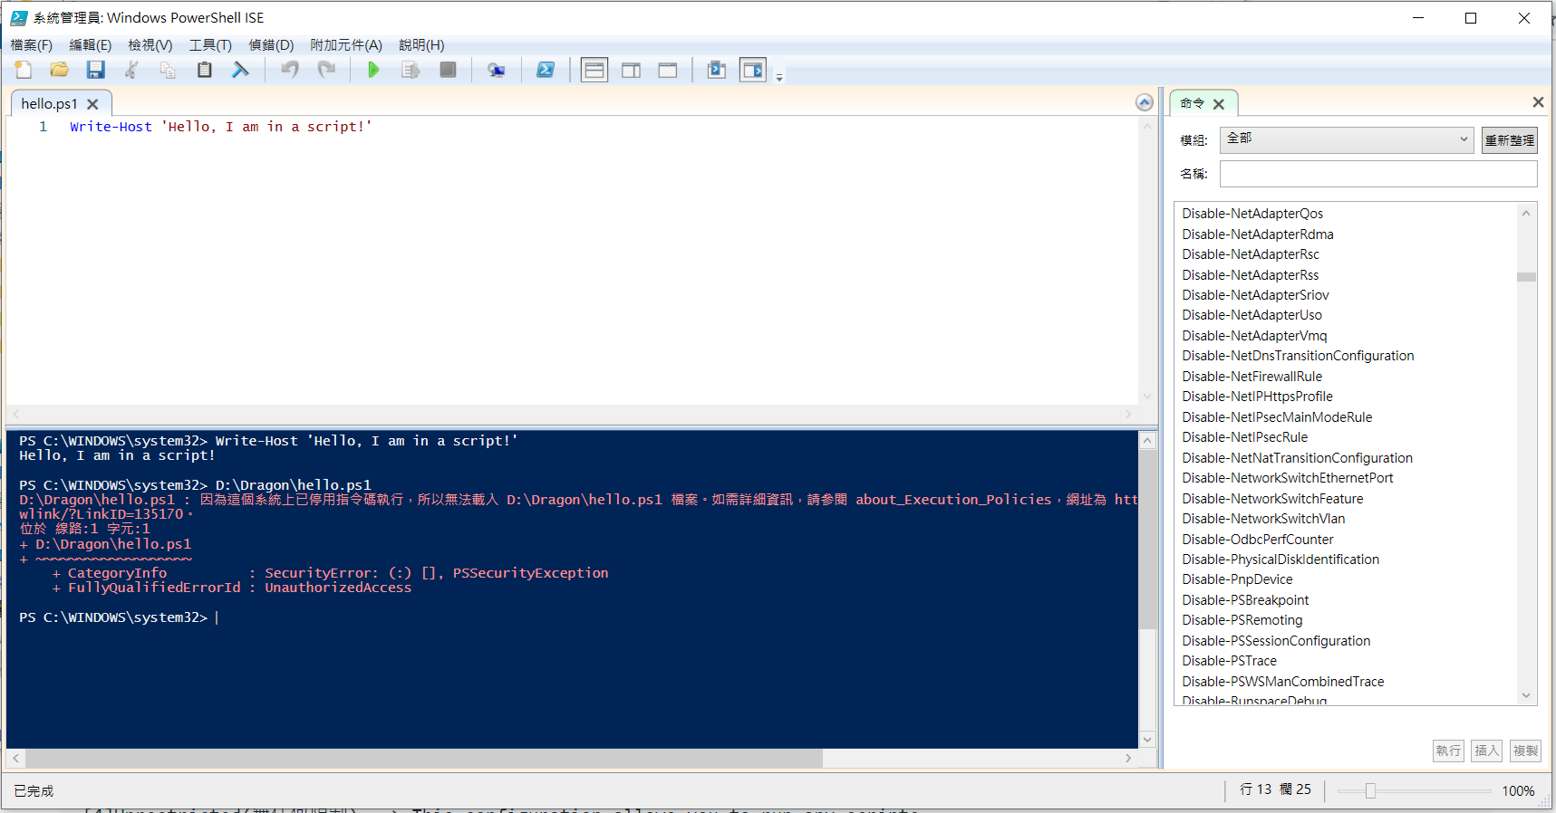
powershell ISE
execution policy 執行策略

Slide 22
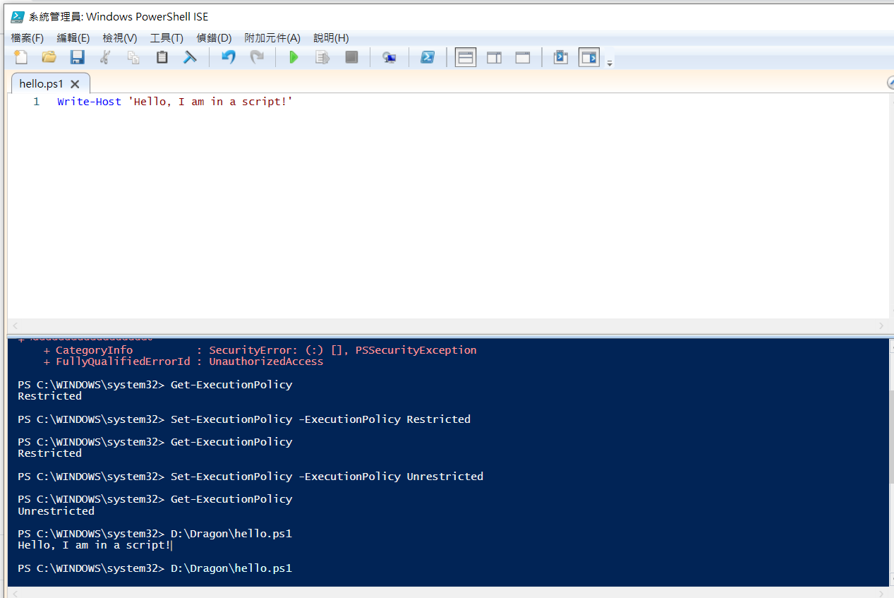
execution policy 執行策略

Slide 23
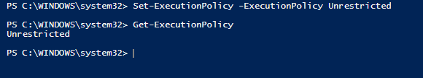
WriteHostExample.ps1執行程式 錯誤
execution policy 執行策略
The execution policy has four main configurations:
[1]Restricted(限制) ==> default, doesn’t allow you to run scripts.
[2]AllSigned This configuration allows you to run only scripts that have been
cryptographically signed by a trusted party (more on this later).
[3]RemoteSigned This configuration allows you to run any script you write,
and any script you download as long as it’s been cryptographically signed by a trusted party.
[4]Unrestricted(無任何限制) ==> This configuration allows you to run any scripts.

Slide 27
學習心得

