Slide 1
Binary search
Binary search introduction

Slide 2
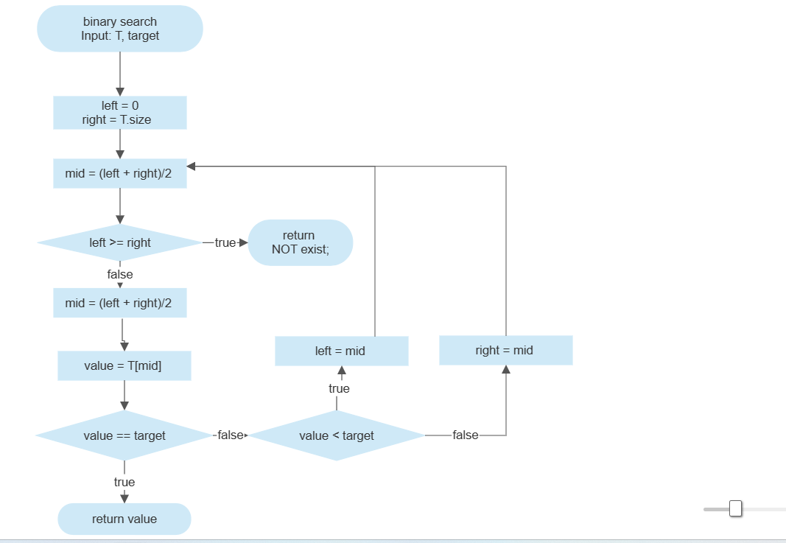
FlowChart

Slide 3
Mark
Orange Node: Node that are searching in this round.
Gray Node: Node that are inserted
(so that the sorted order is NOT changed.)
Blue Node: Other node

Slide 4
Example

Slide 5
Example 1
2
9
14
21
25
Available in code in ch17/sect3/ex1 in Github.
Kotlin_Code_Practice/Code/IDE/IntelliJ/ch17/sect3/ex1/README.md at

Slide 6
Search 21
When we want to search the target 21.

Slide 7
2
9
14
21
25
size = 5
left = 0
right = 4
Note that
We use array to store these datas.
We start index from 0. (e.g. T[0] == 2)

Slide 8
2
9
14
21
25
mid = (left+right)/2
=>mid = 2
=>T[mid] = 14 < target = 21
=>left = mid = 2
size = 5 , left = 0 , right = 4
=> size = 5 , left = 2 , right = 4

Slide 9
2
9
14
21
25
mid = (left+right)/2
=>mid = 3
=>T[mid] = 21 == target = 21
=> return (mid,target)
size = 5 , left = 2 , right = 4
=> size = 5 , left = 3 , right = 4

Slide 10

Time complexity
O($\log_{2}{n}$) where n refers size (i.e. the number of node of data)

Slide 11
Reference
Binary search algorithm - Wikipedia
Binary Search - Data Structure and Algorithm Tutorials - GeeksforGeeks

