Slide 1
Eurovision 2018 Tweets
MongoDB Prototype
CS 498 Cloud Computing Applications · Stage 3
Srikar Pisupati · Anirudh Venkatraman · Adam El Bahey

Slide 2
Data Model
One BSON document per tweet — keep it natural, flatten only what queries need
Why MongoDB
Tweets ship as JSON. BSON is JSON.
Less reshaping at ingest, native arrays for hashtags.
What we extract (the 6 queries' hot fields)
tweet id, time, user, verified, reply links,
retweet/quote ids, hashtags, place country
tweet_type precomputed at load time
Example document
{
_id: 993723742768549888,
created_at: ISODate("2018-05-08..."),
tweet_type: "retweet",
user: { id: 4210815083,
screen_name: "PaulaKarwacka",
verified: false },
reply: { in_reply_to_status_id: null, ... },
retweeted_status_id: 9937234..,
entities: {
hashtags: ["eurovision","eurowizja"]
},
place: { country: "United Kingdom" }
}
2 / 8

Slide 3
Loading & Indexing
Stream NDJSON → trim → upsert in 5k batches → create indexes after
ETL pipeline
Indexes used by the demo queries
Read tweets line-by-line (NDJSON)
Skip stream-control records (limit/delete)
Lowercase hashtags so #ESC = #esc
Compute tweet_type at ingest
bulk_write upserts in 5,000-doc batches
db.tweets.createIndex({ "place.country": 1 })
db.tweets.createIndex({ "entities.hashtags": 1 })
// multikey
Stage 2 plan listed 7 indexes; only the two above are needed for the queries we demo today.
795,473
tweets ingested
173 s
load time (local)
39 MB
on-disk footprint
3 / 8

Slide 4
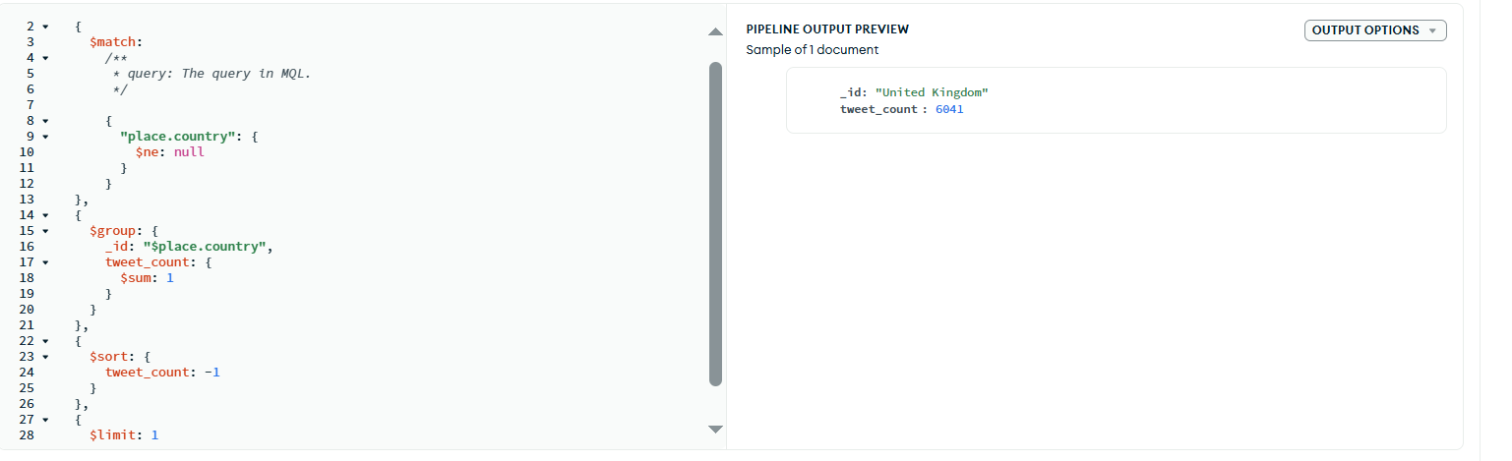
Query 2 — Country with the most tweets
Group by place.country, sort desc, take top
Aggregation pipeline
db.tweets.aggregate([
{ $match: { "place.country": { $ne: null } } },
{ $group: {
_id: "$place.country",
tweet_count: { $sum: 1 } } },
{ $sort: { tweet_count: -1 } },
{ $limit: 1 }
])
[ paste screenshot of query running here ]
Atlas UI / mongosh / Compass output
United Kingdom
6,041 tweets
4 / 8

Slide 5
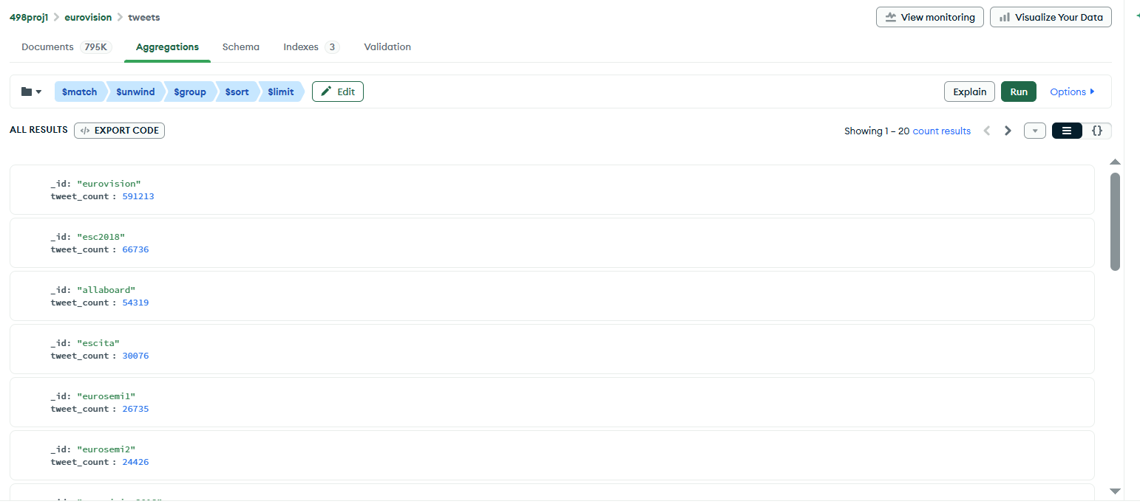
Query 4 — Top 100 hashtags by tweet count
$unwind the multikey hashtag array, group, sort, limit
Aggregation pipeline
db.tweets.aggregate([
{ $match: {
"entities.hashtags": { $exists: true,
$ne: [] } } },
{ $unwind: "$entities.hashtags" },
{ $group: {
_id: "$entities.hashtags",
tweet_count: { $sum: 1 } } },
{ $sort: { tweet_count: -1 } },
{ $limit: 100 }
])
[ paste screenshot of query running here ]
show top 25 of 100 in the screenshot
Top 5 (full list of 100 in results JSON)
# | hashtag | tweets
1 | #eurovision | 591,213
2 | #esc2018 | 66,736
3 | #allaboard | 54,319
5 / 8

Slide 6
Critique
What we'd change with hindsight
What worked
What we'd change
One doc per tweet kept the model close to the wire format — minimal ETL bugs.
Multikey index on entities.hashtags made the top-100 query a 6-second aggregate on 800k docs.
place.country index turned Q2 into a sub-second covered group-and-sort.
Lowercasing hashtags at load avoided GROUP BY surprises (#ESC vs #esc).
Materialize a (hashtag, count) summary collection for repeat dashboards instead of $unwind every time.
Pre-extract user→user reply edges into an interactions collection — Q5 (mutual-reply trios) needs a graph view we don't have.
Reconsider compound (verified, tweet_type) index — Q6 doesn't filter on verified, it groups; the index helps less than expected.
Drop fields we never query (urls, source, profile_*) at load — would shave ~30% off raw doc size.
6 / 8

Slide 7
Lessons learned
About MongoDB, and about cloud data work in general
Indexes matter more than schema
Trim at ingest, not at query
Switching one field from scan to index turned Q4 from minutes to seconds. The biggest performance levers were index choices, not document shape.
Raw tweets carry ~80 fields we never read. Dropping them in the loader cut storage 10x and made every aggregation faster.
Atlas free tier is real
Eventual consistency isn't free
M0 on GCP loaded the same 39 MB collection in under 10 minutes over residential internet. Useful for demos, capped at 512 MB.
Single-doc reads are strong. The moment you cross documents (e.g. mutual replies) you have to think about it yourself.
7 / 8

Slide 8
Advice if you're considering MongoDB
Pick it for
semi-structured data with arrays and nested objects, evolving schemas, read-heavy analytics over JSON-shaped sources.
Skip it for
tightly-relational workloads with heavy multi-table joins or strict ACID across many entities.
Plan indexes early
list your queries first, then design the index set. Multikey + compound covers most analytical needs.
Use Atlas to start
M0 free tier gets you running on GCP in 5 minutes. Upgrade only when storage or RAM forces you.
Trim at load
raw API JSON is expensive to store. Keep the doc but drop fields no query reads.
Thank you · Questions?

