Slide 1
瑕疵檢測
409410197 劉柏辰 409416541 周騏軍

Slide 2
目錄
01
用不同filter和offset大小偵測瑕疵
03
把選定好的filter合併
Modern PowerPoint Presentation
Modern PowerPoint Presentation
PowerPoint Presentation
PowerPoint Presentation
Modern PowerPoint Presentation
Modern PowerPoint Presentation
02
選定各filter可用的數值
04
針對彼此影響的filter進行改善
Modern PowerPoint Presentation
Modern PowerPoint Presentation
PowerPoint Presentation
PowerPoint Presentation
Modern PowerPoint Presentation
Modern PowerPoint Presentation

Slide 3
用不同filter和
offset大小偵測瑕疵

Slide 4
如何實現
關於offset
用offset來控制圖片大小，使圖片切割的足夠小，以便我們能用我們選的算法(Correlation,Contrast,Uniformity。)
關於Filter
不一樣的filter會偵測出不同的瑕疵影像，所以在最一開始我們先試著看看，哪個filter大小較符合我們的需求。

Slide 5
選定各filter
可用的數值

Slide 6
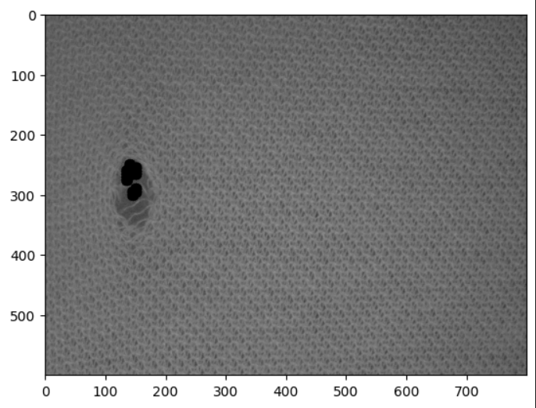
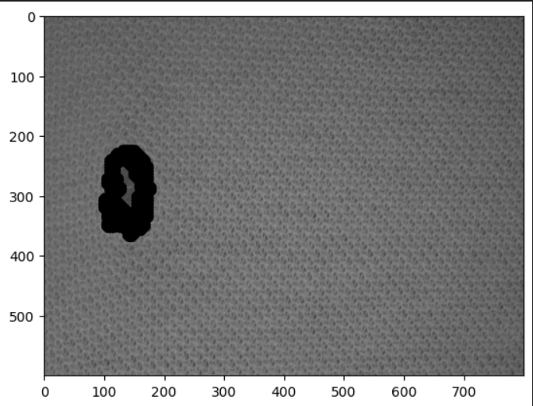

圓點Filter
Filter = 15
Filter = 23
Filter = 33
程式碼

Slide 7
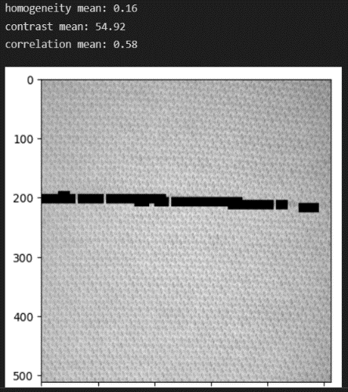
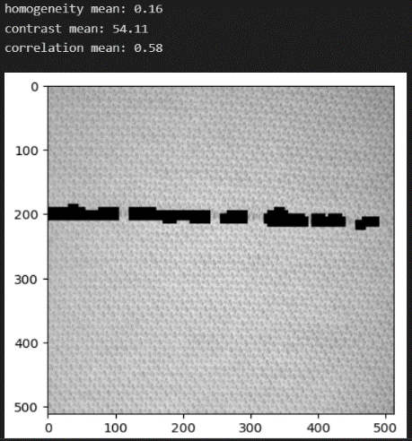
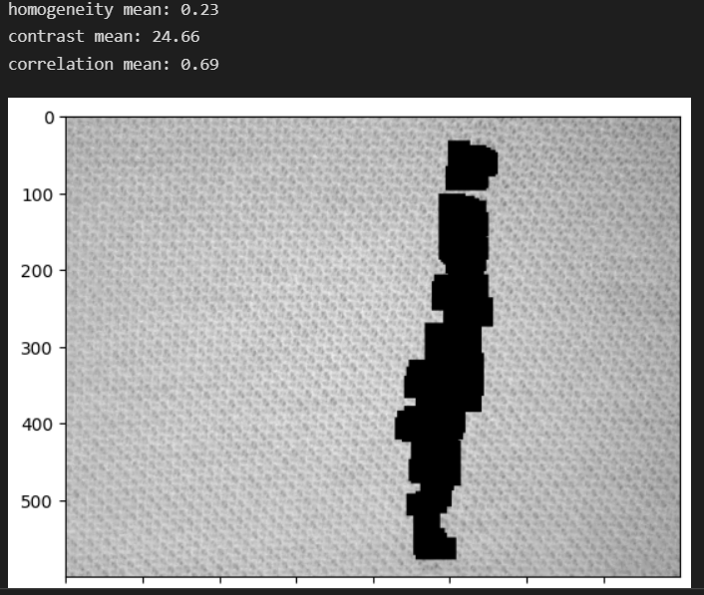
直線Filter
Filter = 17
Filter = 22
Filter = 40
程式碼

Slide 8
把選定
好的filter合併

Slide 9
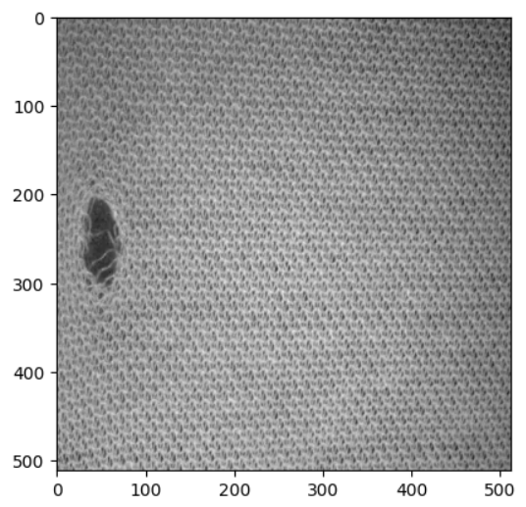
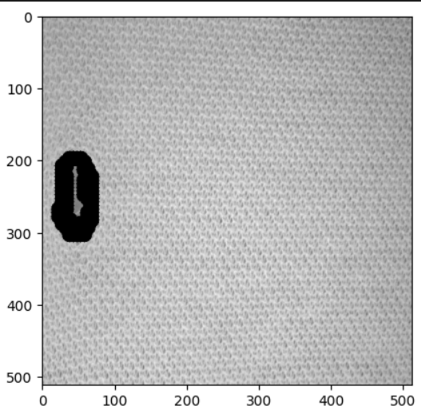
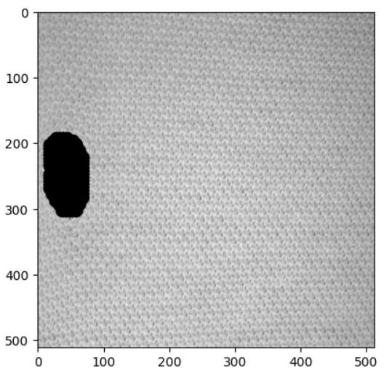
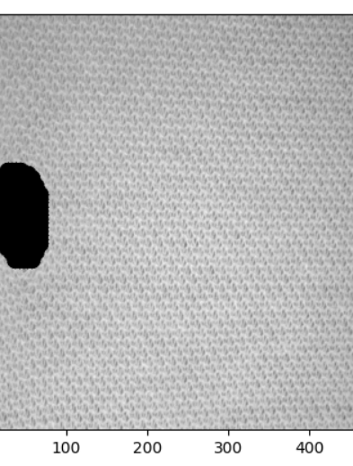
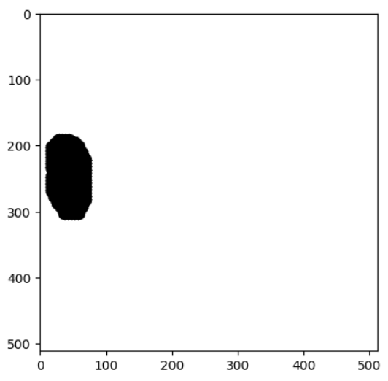
合併Filter
Filter = 15
Filter = 23
Filter = 33
Filter = 40
最終結果
程式碼

Slide 10
針對彼此影響
的filter進行改善

Slide 11
步驟
1
偵測是否有被覆蓋
A Contents
2
初始檢測（用texture video 的img154）
B Contents
3
檢測洞的邊緣
（用texture video 的img2-img154）
C Contents
4
D Contents
檢測filter23沒有覆蓋的
（用texture video 的img154-img172）

Slide 12
步驟
5
檢測直線 用image1
E Contents
6
檢測filter17沒有覆蓋的
F Contents
7
檢測直線（用texture video 的img313）
G Contents
8
因為檢測部分是別人寫的，
所以較弱，它也會檢測無缺陷的，
如果filter 23跟33沒偵測到任何東西，就跳過
H Contents

Slide 13
THANK YOU
409410197 劉柏辰 409416541 周騏軍

Slide 14
Modern Portfolio Designed
AWESOME
PRESENTATION
We Create Quality
Professional PPT Presentation
ALLPPT Layout
Clean Text Slide for your Presentation
Portfolio Designed
You can simply impress your audience and add a unique zing and appeal to your Presentations. I hope and I believe that this Template will your Time, Money and Reputation. Get a modern PowerPoint Presentation that is beautifully designed.
Get a modern PowerPoint Presentation that is beautifully designed.

Slide 15
Columns Style
01
02
03
You can simply impress your audience and add a unique zing and appeal to your Presentations. I hope and I believe that this Template will your Time, Money and Reputation. Easy to change colors, photos and Text. I hope and I believe that this Template will your Time, Money and Reputation.
Easy to change colors, photos and Text.
Easy to change colors, photos and Text.
Easy to change colors, photos and Text.
Easy to change colors, photos and Text. Get a modern PowerPoint Presentation that is beautifully designed. I hope and I believe that this Template will your Time, Money and Reputation. Easy to change colors, photos and Text. Easy to change colors, photos and Text.
Get a modern PowerPoint Presentation that is beautifully designed.
Easy to change colors, photos and Text. Get a modern PowerPoint Presentation that is beautifully designed. I hope and I believe that this Template will your Time, Money and Reputation. Easy to change colors, photos and Text. Easy to change colors, photos and Text.
Get a modern PowerPoint Presentation that is beautifully designed.
Easy to change colors, photos and Text. Get a modern PowerPoint Presentation that is beautifully designed. I hope and I believe that this Template will your Time, Money and Reputation. Easy to change colors, photos and Text. Easy to change colors, photos and Text.
Get a modern PowerPoint Presentation that is beautifully designed.

