Slide 1


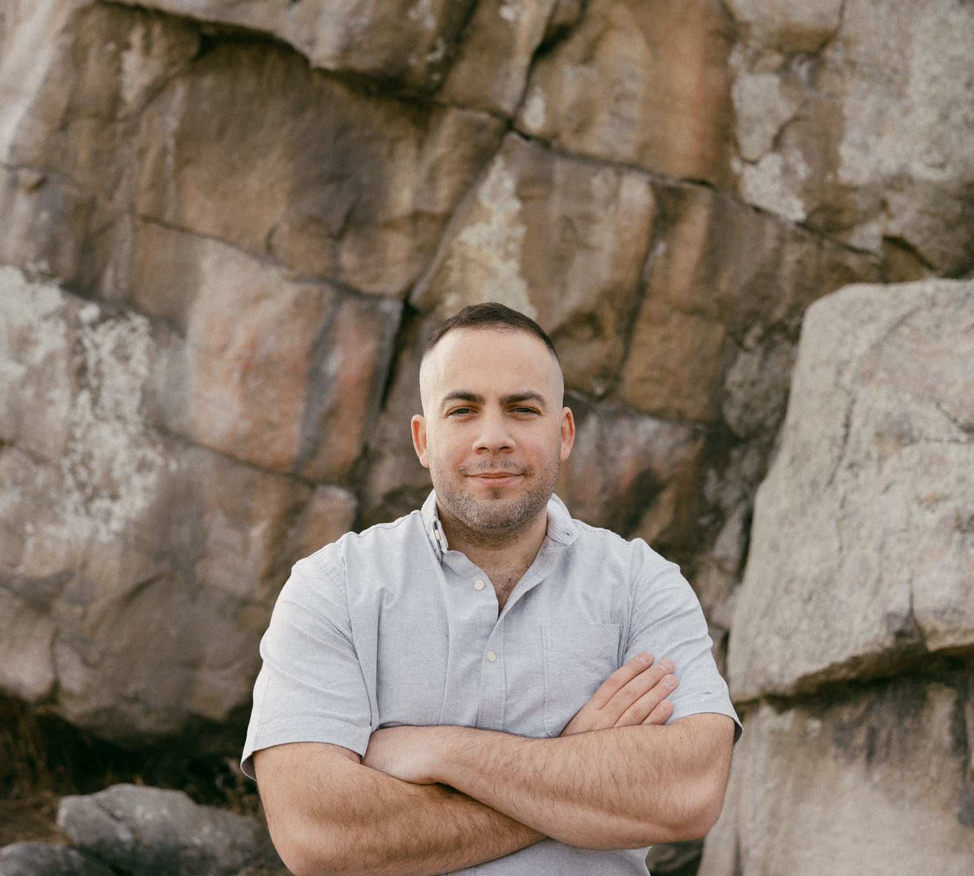
Accelerating Time to Market in a Cloud-Driven Compliance Era
Alexandre Jammes Cloud Architect, Canada Fortinet
Notes:
Hi and welcome to “Accelerating time to market in a cloud-driven compliance era, My name is Alex, and I’ll be your guide!”!

