Slide 1

Notes:
Hi welcome to the Cloud Cybersecurity talks! Happy to have you join us here in Kansas

Slide 2
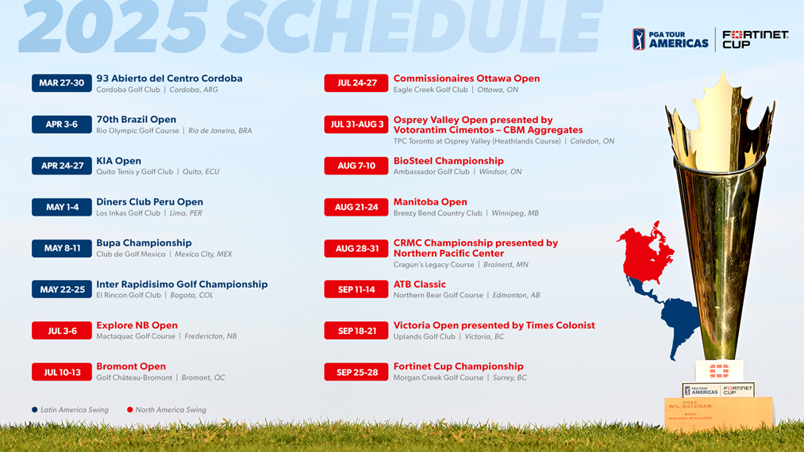
Notes:
Here are our sponsored golf events. Last years event in your region had 1000 attendees! Great job!

Slide 3
Today’s speakers

Slide 4

Director of blah blah experience topic
Sean Weiss
Notes:
Sean is the director of the BDE organization, today he’ll be talking to us about cloud transformation!

Slide 5
Speaker 2
Notes:
This speaker will talk to us about automation.

