Slide 1
EZShop
BY:
Gilad Meir
Shahar Ariel

Slide 2
Introduction
Our project aims to make online shopping for groceries easy and predict the next costumer’s shopping list.
The project will connect between the retail supermarkets data and our system for a prediction of the next shopping list, based on date, time and consumption habit.

Slide 3
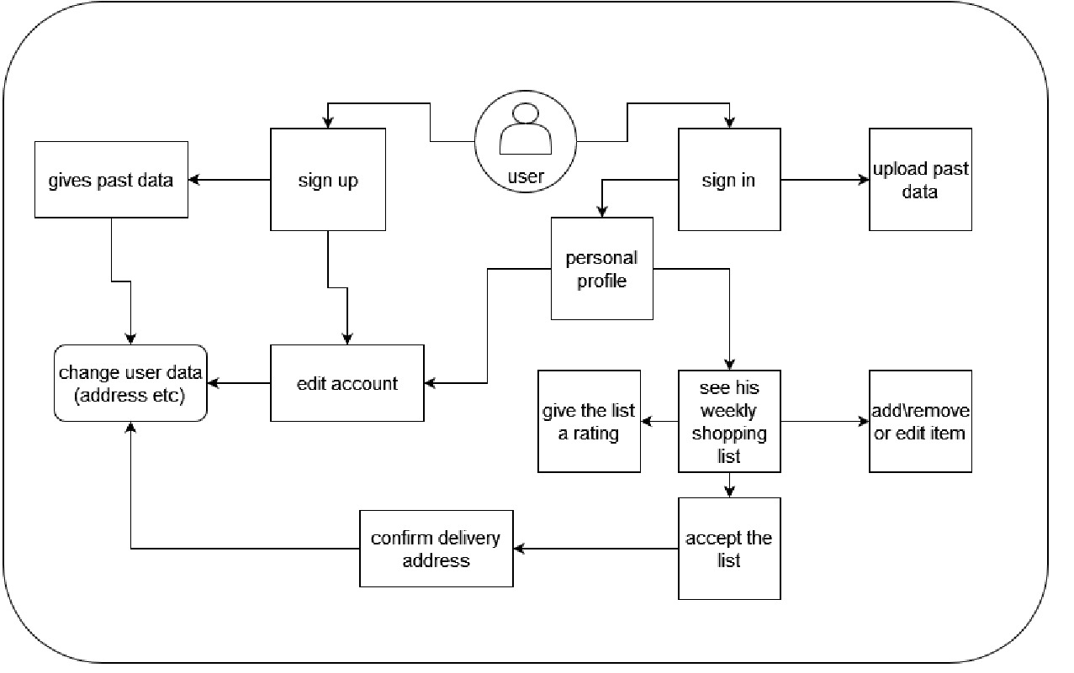
System Flows

Slide 4
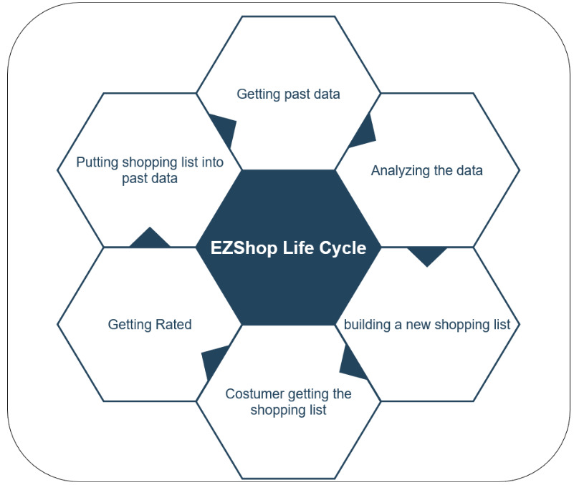
The Prediction Algorithm
Based on KNN algorithm and data mining

Slide 5
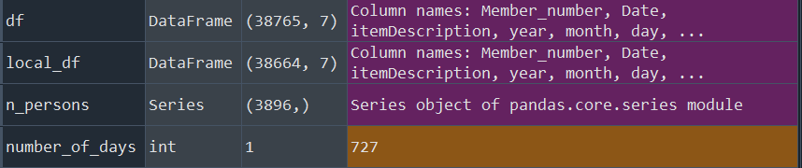
Why Data Mining

Slide 6
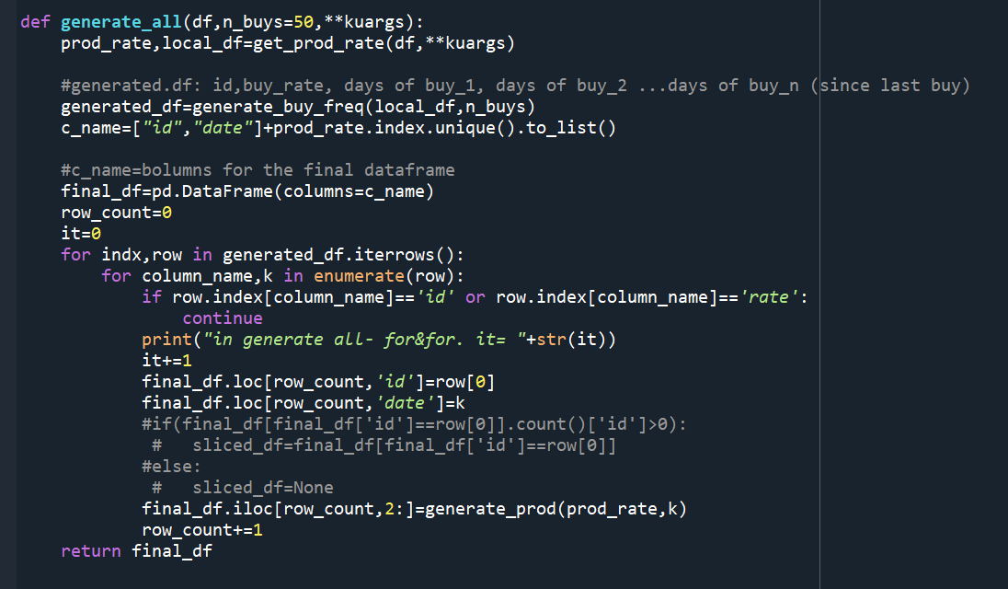

Slide 7
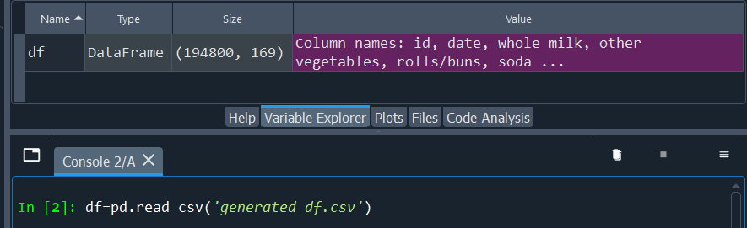
The new DataFrame

Slide 8
Server Side
We are building the Server in Django with MySQL integration, We are still in the beginning of the Server and we have faced a lot of issues but now we understand more and have a clear view on how to work, Now we are going to Fly through it!

