Slide 1
1
<CONDUCT>
Harassment, bullying, reporting & enforcement
2
<AGREEMENT>
Conduct, work, attendance, communication, leaving the course
3
<OTHER RULES>
Be considerate, take charge of your learning, respect the community

Slide 2
<CODE OF CONDUCT>
You don’t have to be the ‘target’
You are responsible for avoiding offence
Report harassment and bullying
Warning → Exclusion

Slide 3
<AGREEMENT>
Communicate
Do the work, turn up
Identify collaboration
We will ask you to sign the Agreement

Slide 4
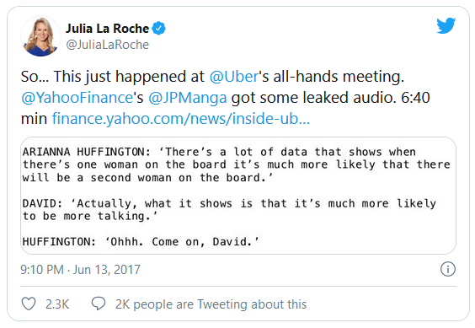

Slide 5
Verbal comments that reinforce social structures of domination related to gender, gender identity and expression, sexual orientation, disability, physical appearance, body size, race, age, religion
Offensive and suggestive remarks (including via emails, messages and other electronic communications, posters, objects, written materials or graffiti)
Intimate questions
Foul or obscene language
Innuendo and derogatory comments
Jokes, banter, teasing, nicknames, ridicule or insults
Inappropriate comments about dress, appearance, physique or abilities
Persistent requests for social activities (after it has been made clear that such requests are unwelcome) or other persistent unwelcome attention of a personal nature
Whistling, winking or suggestive or offensive gestures
Deliberate ignoring or isolation of a community member
Inappropriate physical contact (including touching, standing too close, pinching, pushing and grabbing)
Sustained disruption of talks, working groups or other events
Unwelcome sexual attention or suggestive behaviour (which the harasser may perceive as harmless)
Threats, assault or coercing sexual acts
Racist, sexist, homophobic or ageist jokes, or derogatory or stereotypical remarks about a particular ethnic or religious group or gender
Mocking, mimicking or belittling a person's disability
Sexual images in public spaces
Deliberate intimidation, stalking, or following
Harassing photography or recording
Advocating for, or encouraging, any of the above behaviour
Harassment
Shouting in public
Persistent or unfair criticism
Ostracising people
Physical or psychological threats and instilling fear
Spreading malicious rumours
Constantly undervaluing effort/achievement
Withholding information
Bullying

Slide 6




Reflecting on one very, very strange year at Uber
– Susan Fowler (2017)
H1
H15
…
Not a Black Chair
– Amélie Lamont (2016)
B1
H4
H15
…
Emotional baggage
– Zoe Schiffer (2019)
B2
H1
…
This Is How Sexism Works in Silicon Valley – Ellen Pao (2017)
B3
…

