Slide 1
Steam Project
author : philippe.baucour@gmail.com
specs : https://app.jedha.co/course/project-steam-ft/steam-ft
files : https://github.com/40tude/fullstack_mars_2024_3/tree/main/04_big_data/99_Project_Steam
https://databricks-prod-cloudfront.cloud.databricks.com/public/4027ec902e239c93eaaa8714f173bcfc/3208668746250363/3820867594722529/1163468565521033/latest.html
https://databricks-prod-cloudfront.cloud.databricks.com/public/4027ec902e239c93eaaa8714f173bcfc/3208668746250363/3820867594722590/1163468565521033/latest.html
https://databricks-prod-cloudfront.cloud.databricks.com/public/4027ec902e239c93eaaa8714f173bcfc/3208668746250363/3391531865810786/1163468565521033/latest.html
The content of the following slides is mainly a cut-and-paste of what's already available in the project notebook(s). The idea is that the slides can be used to guide and frame the presentation and discussion.
Notes:
Criteria :
The chosen dataset is able to answer the set problem:
Relevance of the elements and the data cleaning methodology (management of missing or inconsistent values, etc.)
Clarity of the database
Availability of data for analysis
The analyses defined are effective in answering the set problem:
Relevance of the choice of analyses performed (univariate analyses of means & variances performed, detection of anomalies by distribution analysis performed, correlation analysis (Pearson Matrix) performed, etc.)
Efficiency of the analyses performed
Effectiveness of the parallelized treatment applied
The recommendations that emerge from the results of these analyses are relevant:
Clarity and simplicity of the graphs constructed and presented.
Clarity of the presentation

Slide 2
Specifications
Analysis at the "macro" level
Which publisher has released the most games on Steam?
What are the best rated games?
Are there years with more releases? Were there more or fewer game releases during the Covid, for example?
How are the prizes distributed? Are there many games with a discount?
What are the most represented languages?
Are there many games prohibited for children under 16/18?
Genres analysis
What are the most represented genres?
Are there any genres that have a better positive/negative review ratio?
Do some publishers have favorite genres?
What are the most lucrative genres?
Platform analysis
Are most games available on Windows/Mac/Linux instead?
Do certain genres tend to be preferentially available on certain platforms?
BONUS - Is there any publisher dedicated to one platform ?
You're free to follow these guidelines, or to choose a different angle of analysis, as long as your analysis reveals relevant and useful information. 🤓

Slide 3
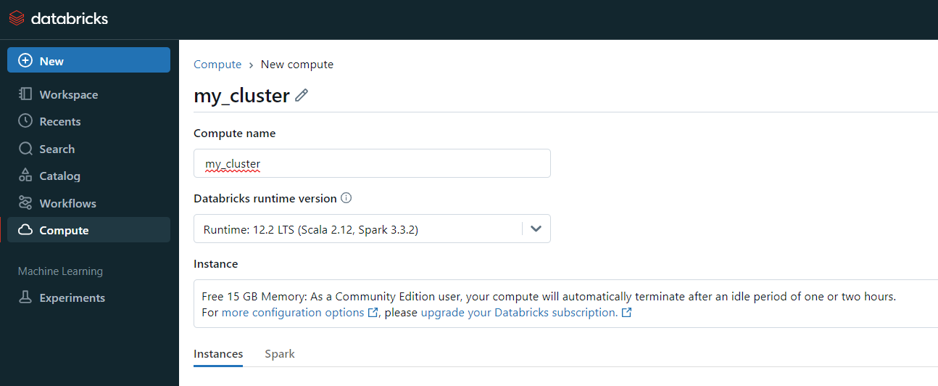
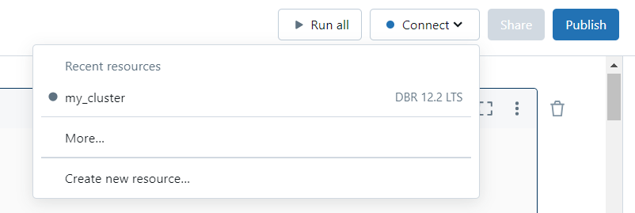
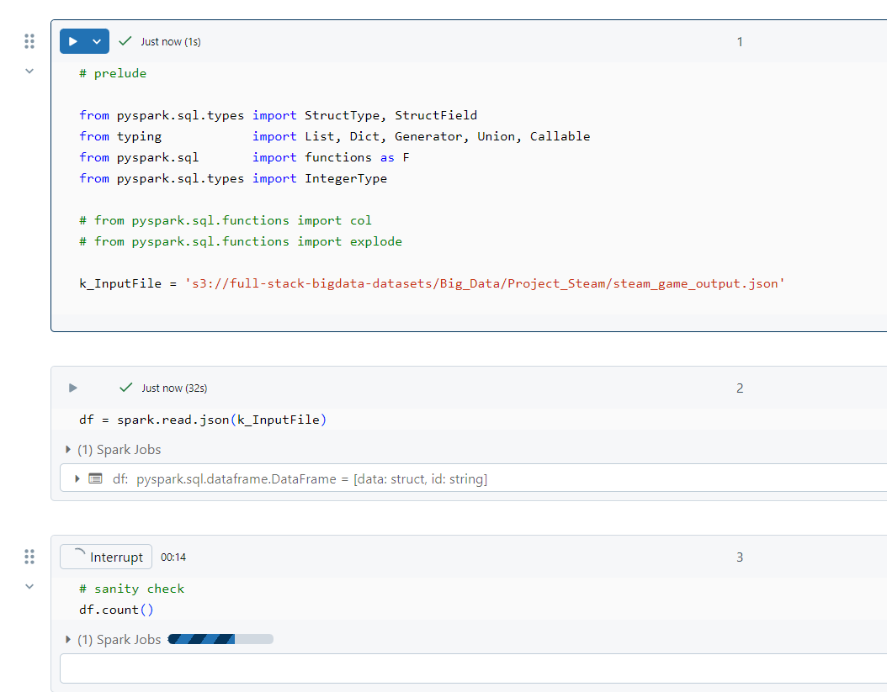
Create a computing resource on Databricks

Slide 4
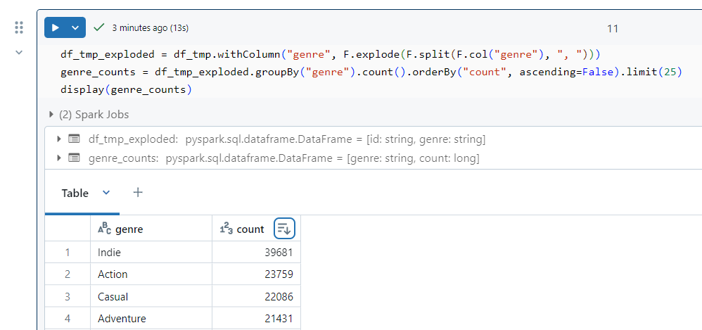

Slide 5
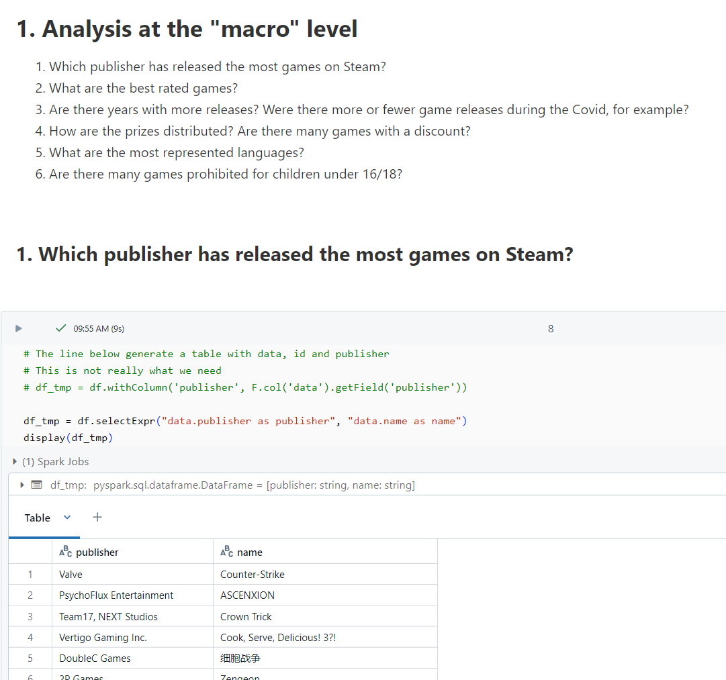
About the notebooks
One notebook per group of questions (macro, genres, platforms)
Questions are listed
Then addressed
When .display() (vs .show()) is used to list results, feel free to use "ordering arrow" to display the data in the order that you wish

Slide 6
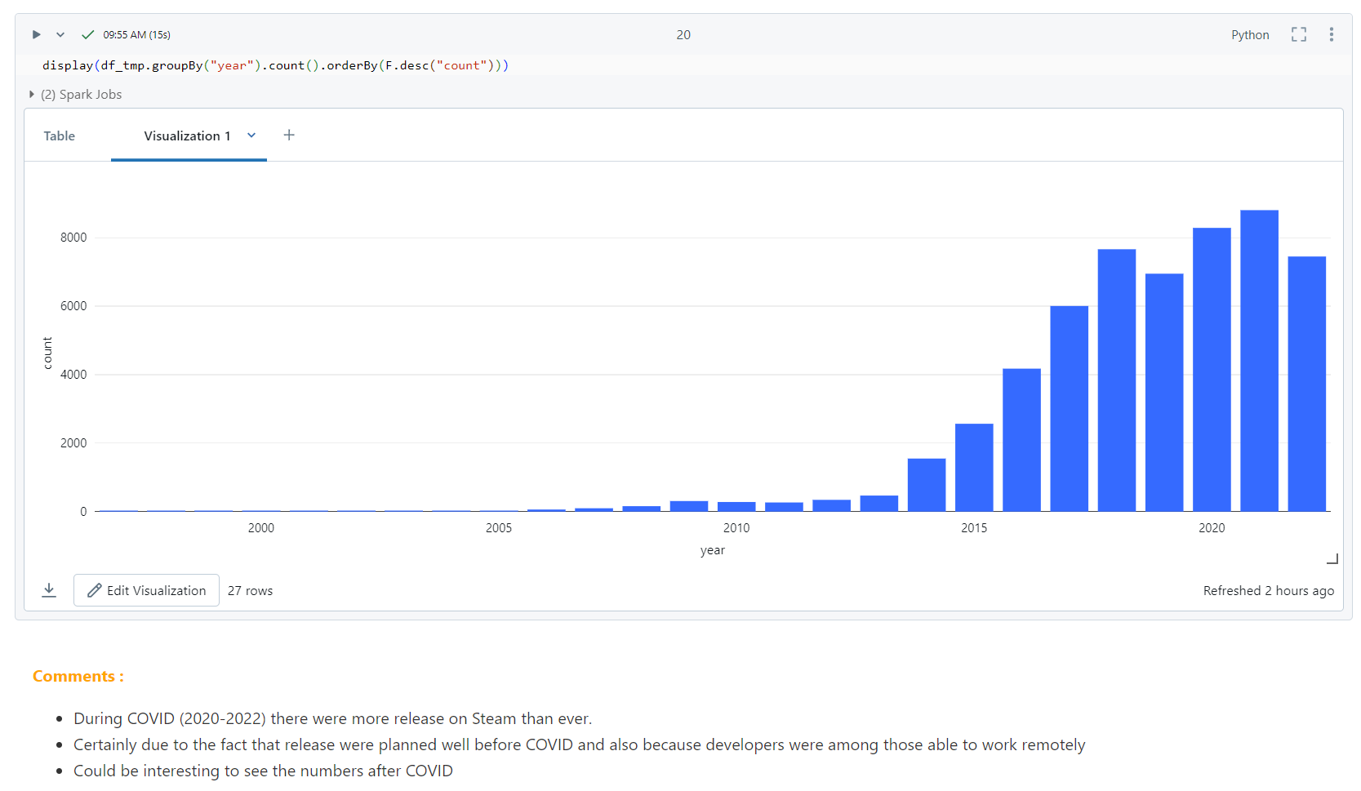
About the notebooks
Graphics may be used
You may have to click the Visualization tab
Comments sections of the notebook either answers the question or underline some facts

Slide 7
Take away
Not really impressed by the speed
May be this is a limitation of the Community Edition
Sometimes obvious tasks seems overcomplicated
See de % display with 2 digits in part 3, question 2
Surprisingly, while only 55_000 observations were involved, some operations were way too slooooow
Notes:
EDA : The recipe
Features Engineering : The secret sauce
Baseline model : The first taste
Interpreting results : The tasting notes
Don't mess with EDA : Never!
Feature engineering : Smart!
Get a baseline model : Fast!
Results analysis : Always!

Slide 8
Code Review

