Slide 1
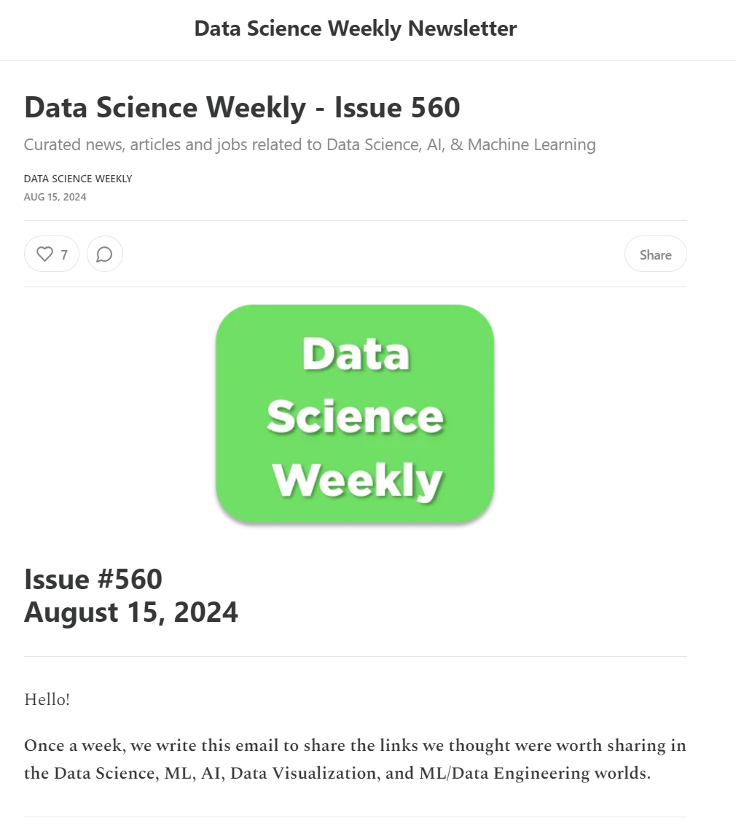
Conversion Rate Challenge
author : philippe.baucour@gmail.com
specs : https://app.jedha.co/course/projects-supervised-machine-learning-ft/conversion-rate-challenge-ft
files : https://github.com/40tude/fullstack_mars_2024_3/tree/main/05_supervised_ML/99_Project_Conversion_rate_challenge

Slide 2
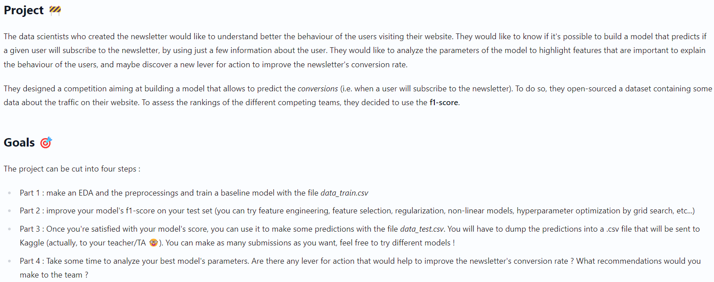





Specifications

Slide 3
Take away

Slide 4
Code Review

