Slide 1
Walmart Project
author : philippe.baucour@gmail.com
specs : https://app.jedha.co/course/projects-supervised-machine-learning-ft/walmart-sales-ft
files : https://github.com/40tude/fullstack_mars_2024_3/tree/main/05_supervised_ML/98_Project_Walmart
The content of the following slides is mainly a cut-and-paste of what's already available in the project notebook(s). The idea is that the slides can be used to guide and frame the presentation and discussion.
Notes:
Criteria :
The predictive analysis processes defined are effective:
Relevance of the choice of the type of algorithm used (supervised or unsupervised machine learning)
Design of a data preparation pipeline for algorithm training
Quality of the clustering optimization (method of choice of the K indicator for K—Mean or Epsilon for DBScan)
Cleanliness of the code (respect of PEP8 standards in Python)
Performance of the programmed algorithm (determined by analysis of R2 for regression, F1_Score for classification, use of K—Fold Crossvalidation and verification tests for overfitting or underfitting)
The performance of Machine Learning algorithms is optimized:
Relevance of the choice of criteria for evaluating the performance of an algorithm (choice of an F1_Score or sensitivity for classification according to the type of problem, for example)
Measured indicators are better than in the previous version (comparison of the new model with what is already in place)
The predictive analyses are acurate and the recommendations made are relevant.

Slide 2
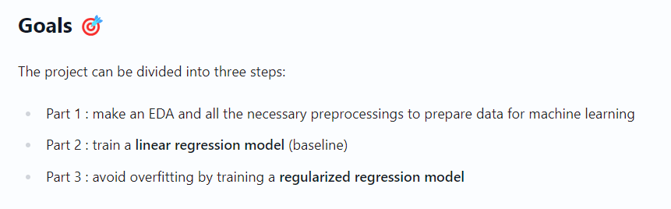
Specifications

Slide 3
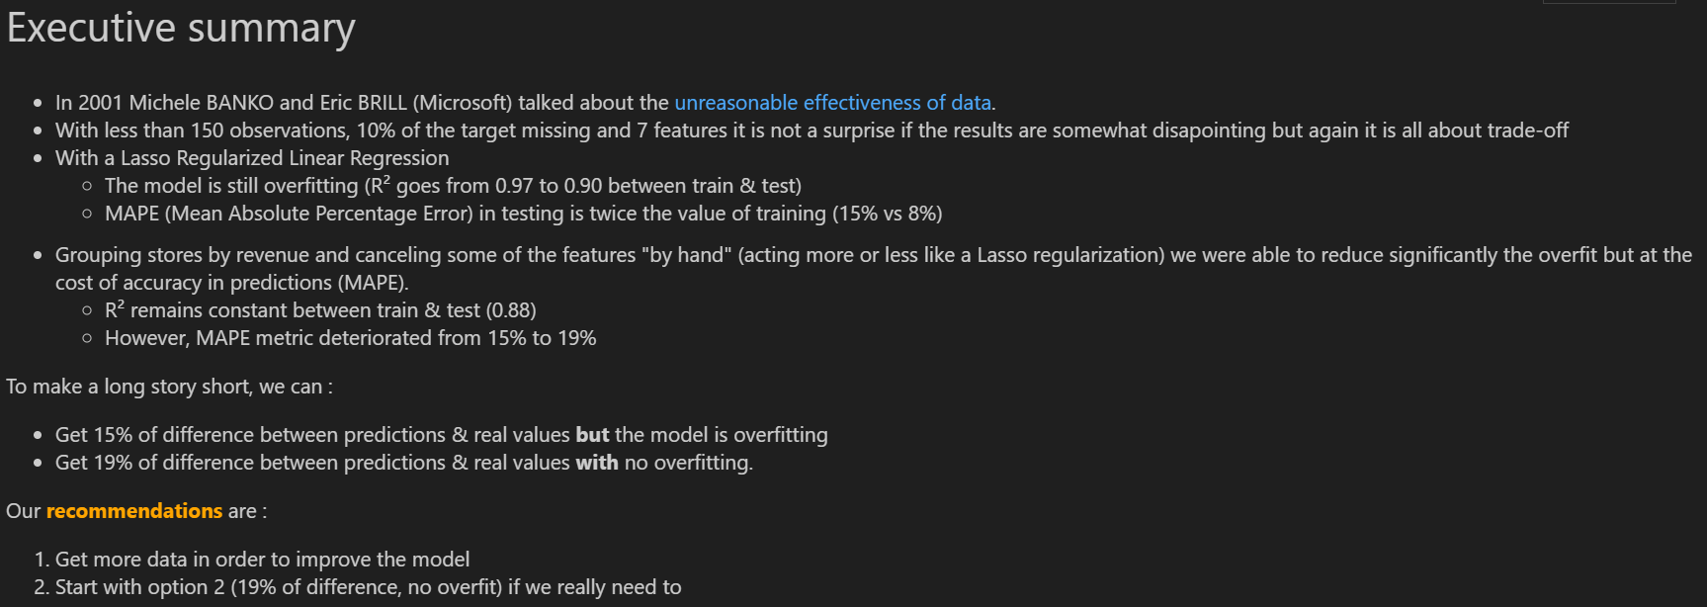
Executive summary
Notes:
MAPE : mean absolute percentage error

Slide 4
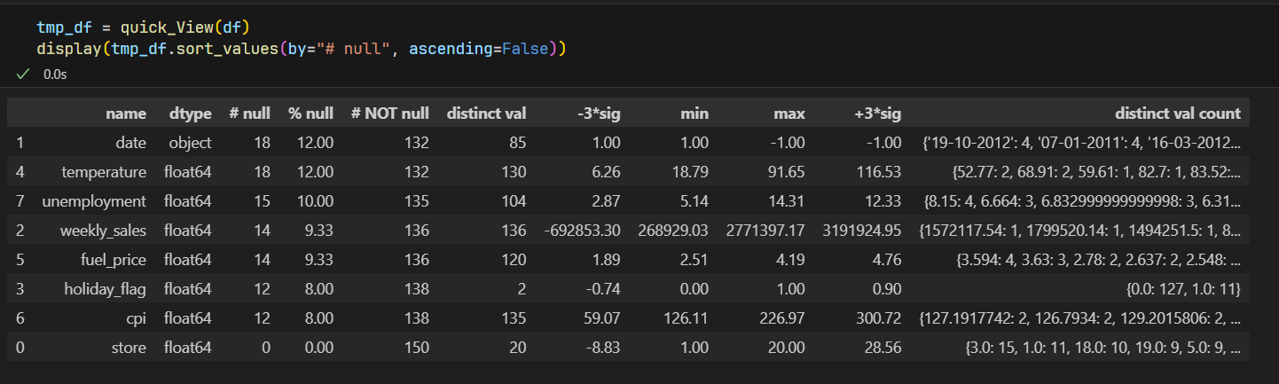
1 - EDA & Preprocessing
150 observations
The target is "weekly_sales"
No duplicate
Outliers in "unemployment"
store & holiday_flag are categories (20 and 2 values respectively)
Notes:
30 x Nb Features
CPI = Consumer Price Index

Slide 5
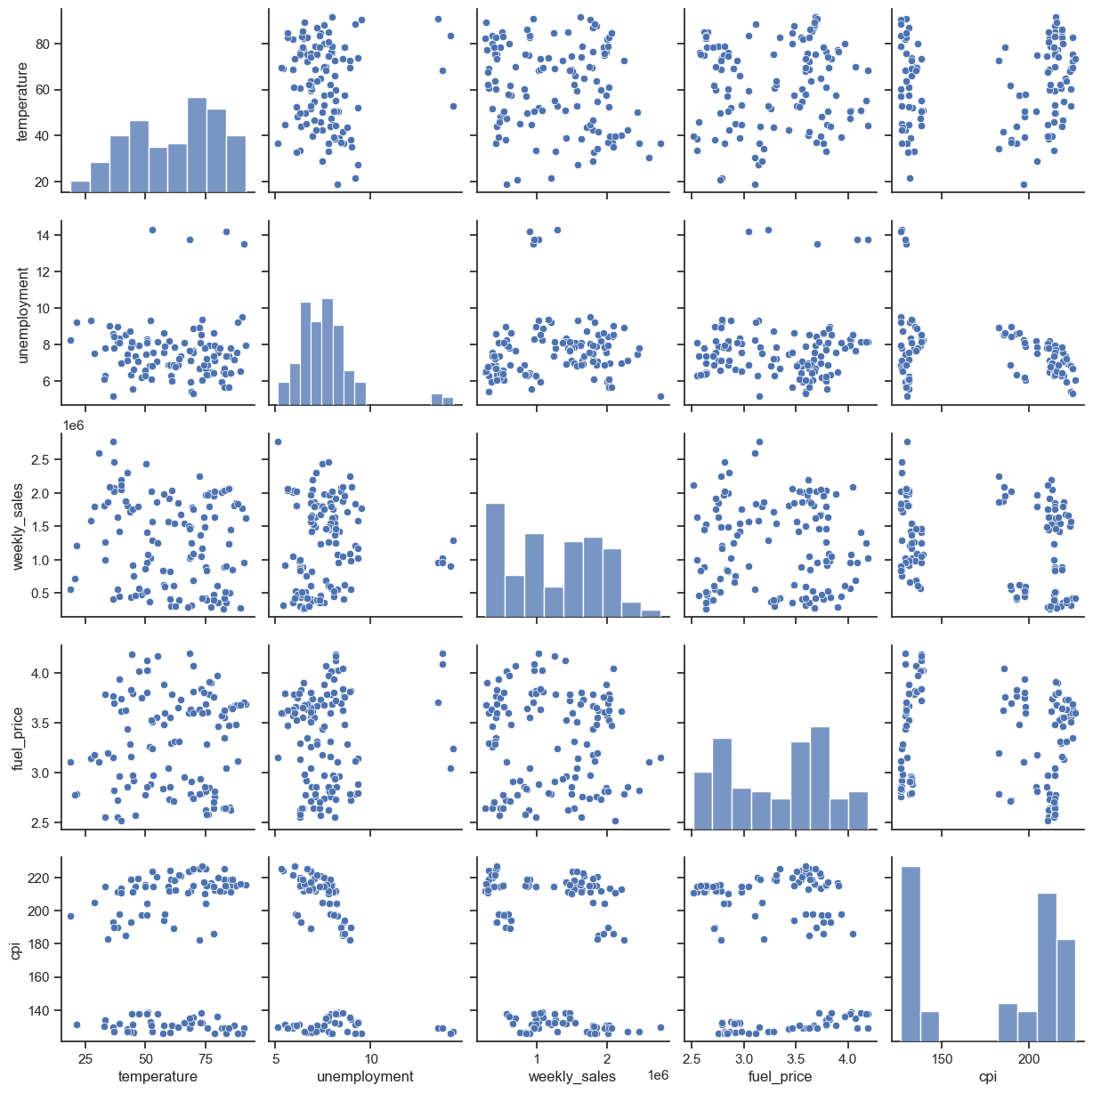
1 - EDA & Preprocessing
unemployment : outliers
cpi : 2 modes
Preprocessing
drop lines were the `weekly_sales` is empty
Remove outliers
`store` to be converted into categories
see quick_View() output
20 disctincts values
`holiday_flag` to be converted to categories
2 distincts values
`date` to convert to date type
create : year, month, day, day of week
Convert `temperature` to °C
Notes:
Consumer Price Index

Slide 6
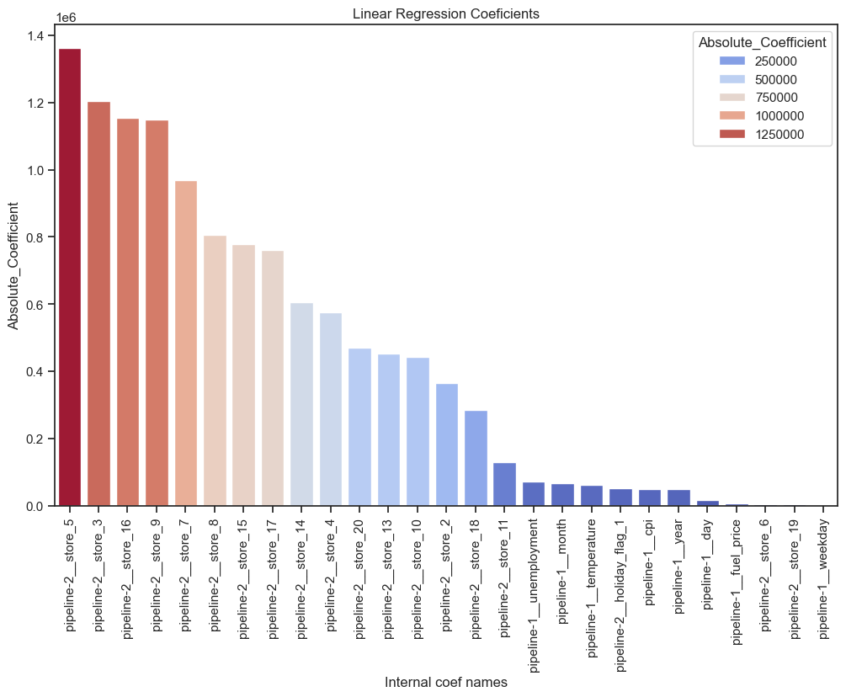
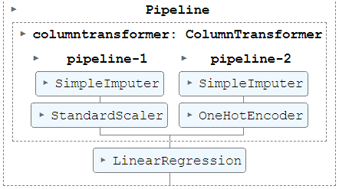
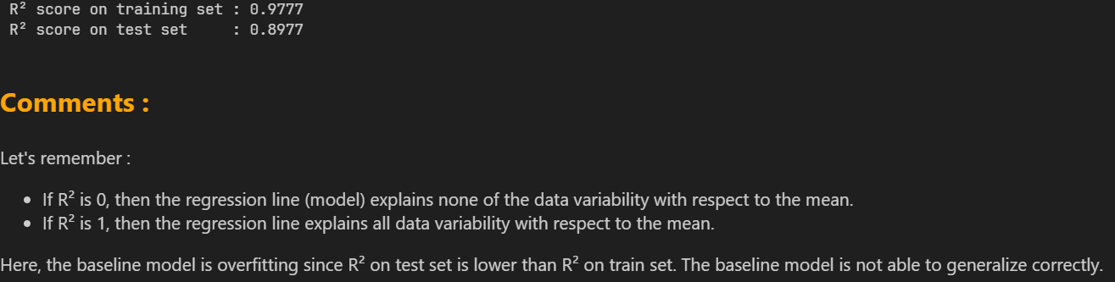
2 - Baseline model

Slide 7
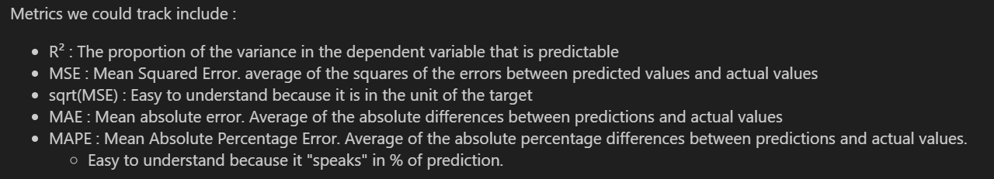
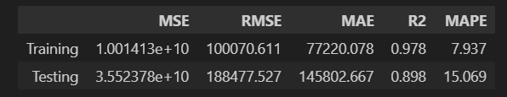
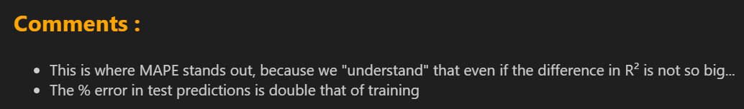
2 - Baseline model
Notes:
RMSE généralement préférée dans les pb de régression
Si outliers, faut peut-être prendre en compte la MAE
RMSE (L2 based) est plus sensible aux outliers que MAE (L1 based)
MAE et RMSE sont 2 mesures de distance entre vecteurs (prédictions et target)
Différentes mesures de distances sont possibles:
RMSE : norme euclidienne, L2
MAE : norme de Manhattan, L1
Plus le n de Ln augmente et plus la norme focalise sur les grandes valeurs en négligeant les petites
Quand les outliers sont exponentiellement rares (bell curve) RMSE est plus efficace
MAPE :
Erreur Absolue Moyenne en % de la vraie valeur
Exprimée en %, c'est une mesure simple et intuitive de l'accuracy d'un modèle
Important de l'utiliser avec prudence quand les valeurs vraies sont proches de zéro.
MAPE=0% : modèle parfait.
MAPE élevé : erreurs importantes dans les prédictions

Slide 8
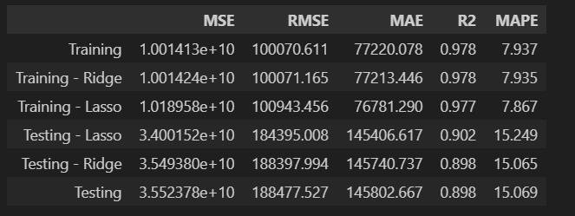

3 - Fight overfitting
Notes:
La régularisation Lasso ajoute, à la fonction de coût, une pénalité proportionnelle à la valeur absolue des coefficients du modèle. Favorise la sélection de caractéristiques importantes et conduit à une certaine sparsité (certains coefficients à 0)
La régularisation Ridge utilise une pénalité proportionnelle au carré des coefficients, ce qui réduit la magnitude des coefficients sans les éliminer complètement.
Use GridSearchCV to find the best values for :
ridge__alpha + ridge__solver
lasso__alpha

Slide 9
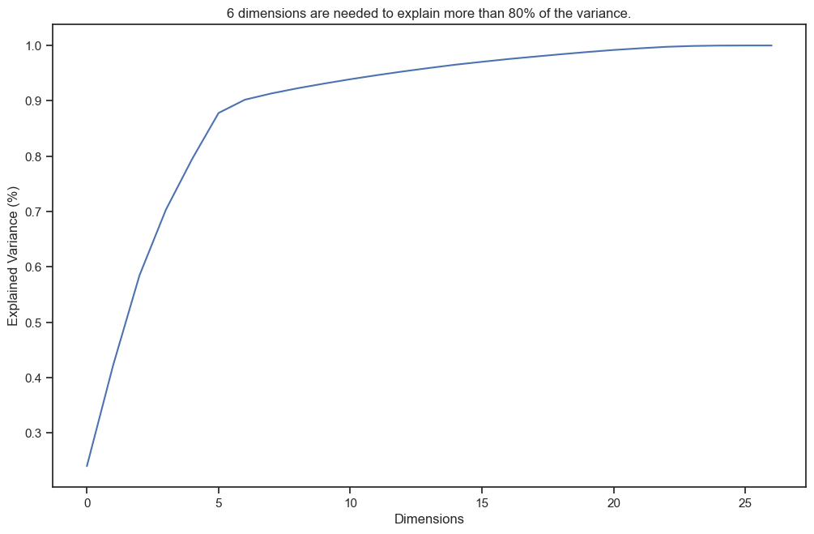
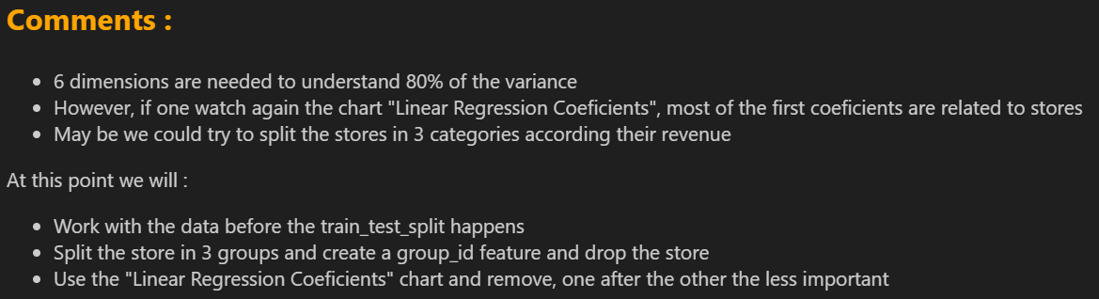
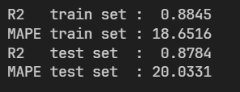
Custom solution - features engineering

Slide 10
Take away
EDA : The recipe
Features Engineering : The secret sauce
Baseline model : The first taste
Metrics Analysis : The critics' score
API & App : Sharing with friends
Deployment Monitoring : Serve the dish, maintain quality
Getting enough data is crucial
Same pipeline for training and test datasets
MAPE metric is meaningful
GridSearchCV to find the best parameters did help
Features engineering => better results
We quantify 2 options and express our recommendation
Notes:
Features engineering => better results… create categories of stores + use PCA to remove useless features
EDA : The recipe
Features Engineering : The secret sauce
Baseline model : The first taste
Metrics Analysis : The critics' score
API & App : Sharing with friends
Deployment & Monitoring : Serve the dish, maintain quality

Slide 11
Code Review

