Slide 1
Speed Dating Project
author : philippe.baucour@gmail.com
specs : https://app.jedha.co/course/project-speed-dating-ft/speed-dating-ft
files : https://github.com/40tude/fullstack_mars_2024_3/tree/main/02_EDA/99_Project_Speed_Dating
The content of the following slides is mainly a cut-and-paste of what's already available in the project notebook(s). The idea is that the slides can be used to guide and frame the presentation and discussion.
Notes:
Criteria :
The chosen dataset is able to answer the set problem:
Relevance of the elements and the data cleaning methodology (management of missing or inconsistent values, etc.)
Clarity of the database
Availability of data for analysis
The analyses defined are effective in answering the set problem:
Relevance of the choice of analyses performed (univariate analyses of means & variances performed, detection of anomalies by distribution analysis performed, correlation analysis (Pearson Matrix) performed, etc.)
Efficiency of the analyses performed
Effectiveness of the parallelized treatment applied
The recommendations that emerge from the results of these analyses are relevant:
Clarity and simplicity of the graphs constructed and presented.
Clarity of the presentation

Slide 2
Specifications
Tinder is experiencing a decrease in the number of matches
They are trying to find a way to understand what makes people interested into each other.
Use the dataset to understand what makes people interested into each other to go on a second date together

Slide 3
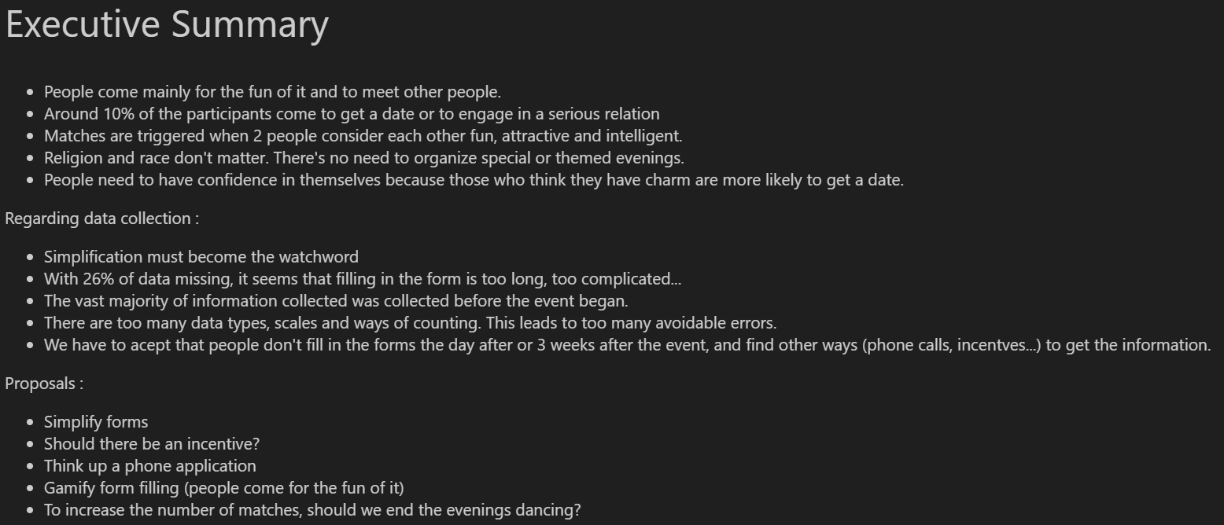
Executive Summary
See 02_speed_dating.ipynb
Notes:
Un match tous les 6 RdV 16,5 %
On propose de finir la soirée sur le dance floor car clubing est l'activité qui déclenche le plus de matches

Slide 4
How data were collected ?
Data was gathered from participants
In experimental speed dating events from 2002-2004.
During the events, the attendees would have a four minute "first date" with every other participant of the opposite sex.
At the end of their four minutes, participants were asked if they would like to see their date again
They were also asked to rate their date on six attributes: Attractiveness, Sincerity, Intelligence, Fun, Ambition, and Shared Interests.
The dataset also includes questionnaire data gathered from participants at different points in the process.
These fields include: demographics, dating habits, self-perception across key attributes, beliefs on what others find valuable in a mate, and lifestyle information.

Slide 5





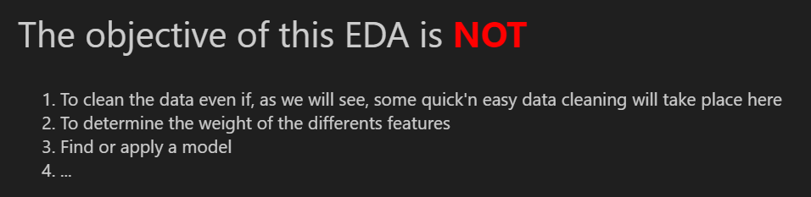
Where are we in the process ?
Collecting
Preprocessing
Exploration
Modelisation
Linear Regression
What is available?
Conclusion
Cleaning
Merging
Display Target
Meaning?
…
…
…
Download
More cleaning?
Web
Data lake
Data warehouse
Data for modelisation
Information
The Notebook explains what the EDA is and what it is NOT

Slide 6
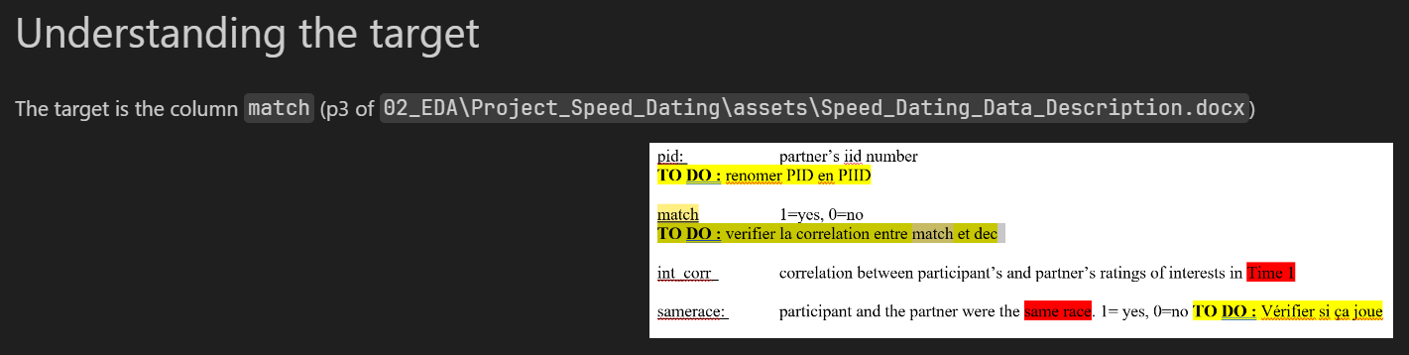
Understanding the documentation
Time spent on the Word document : 4H + 3H + 1H
Target = 'match' feature

Slide 7









Speed Dating principle

Slide 8


Questionnaires
attr3_ - Q11 - How I think I measure up
Q1 - primary goal
Q4 - intended career
Q6 – expectation happy
Q7 – expectation num
attr1_ - Q8 - what you look for in opp sex
attr7_ - Q15 – Importance of attr to the decision
attr2_ - Q10 - what I think they look for a date
attr4_ - Q9 - what they look for in opp sex
Attributes
Q2 - How often on date
Q3 - How often out
Q5 - Activities
Undergraduate school
Race
Religion
Age
attr5_ - Q12 - How I think they perceive me

Slide 9
Data collection phases
Before Event | Halfway | The day after | 3-4 weeks after
_1 | _s | _2 | _3
3
3
3
3
1
1
1
1
4
7
4
7
4
2
2
2
5
5
5

Slide 10
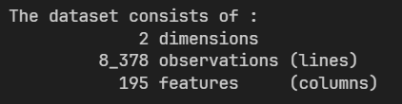
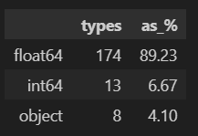
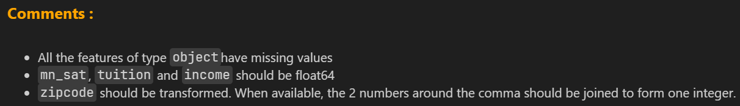
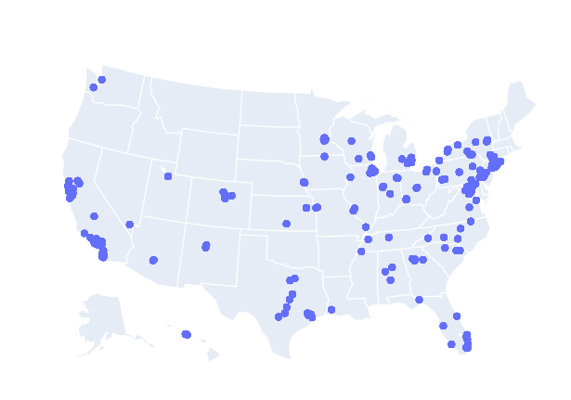
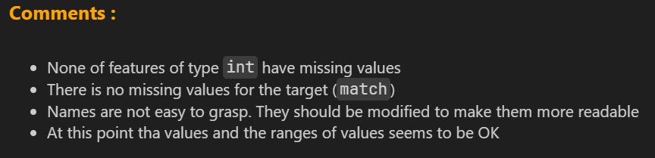
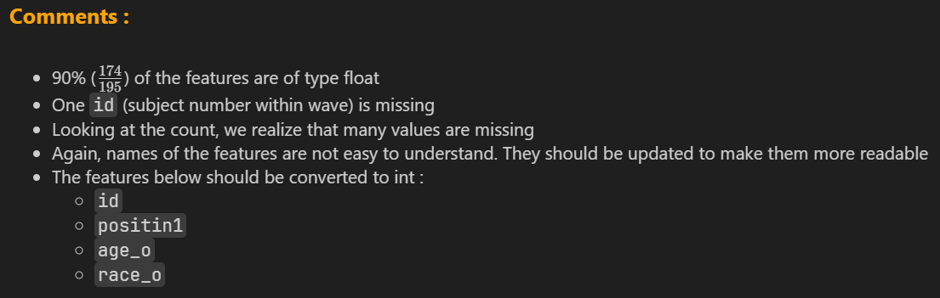
Understanding the dataset
About features of type object
About features of type int
About features of type float

Slide 11
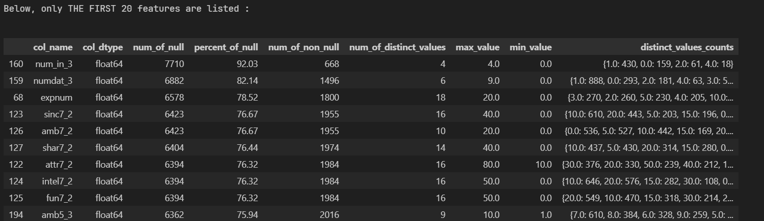
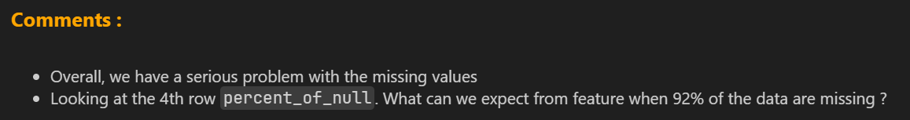
Result from quick_view()

Slide 12
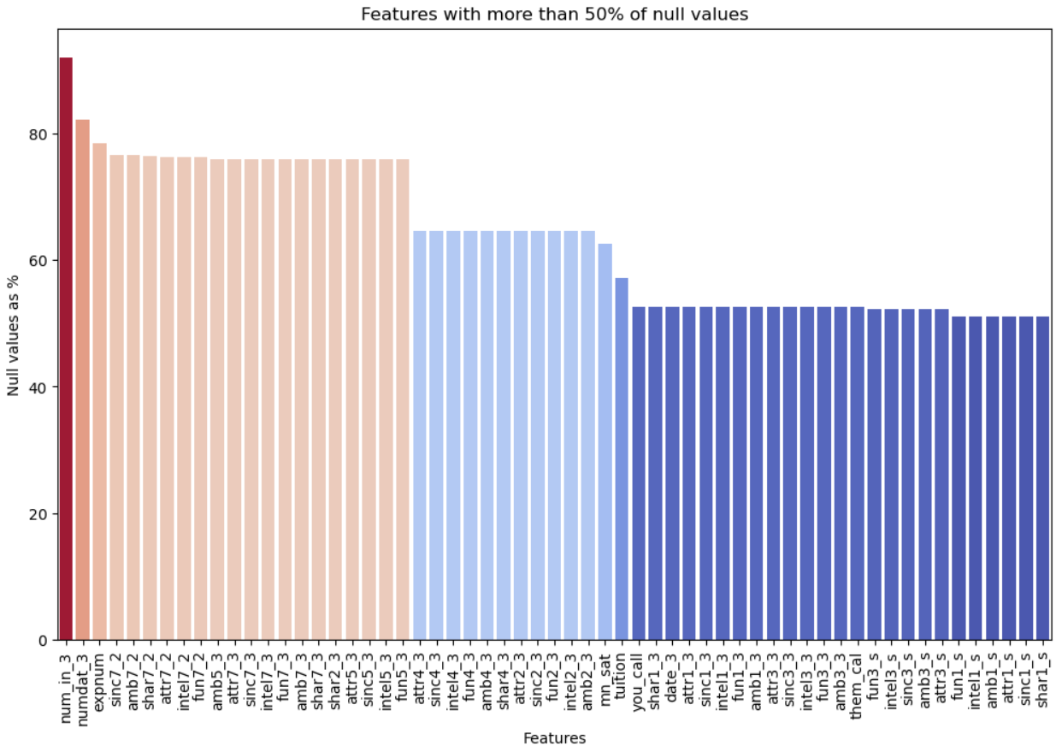
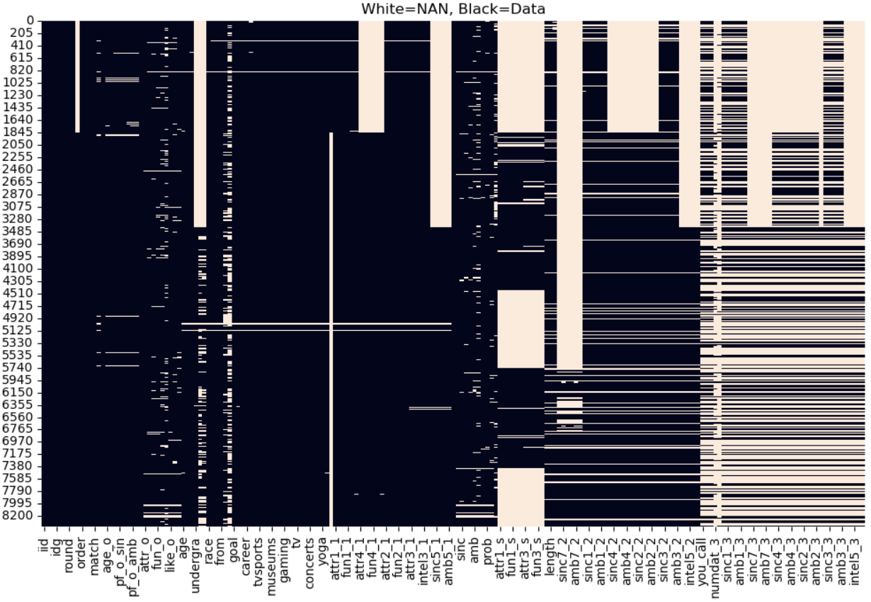
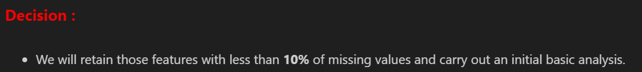
Visualizing empty features

Slide 13
Transforming the dataset
Remove features with more than 10% of missing values
Remove some observations (pid missing for ex.)
Renaming features
Droping `field` and `career` features (too many modalities)
Adding a `gender_description` feature (man, woman)
Replacing `career_code`, `race_code`, `field_code` and `goal_participating` with descriptions
Updating some data types
Checking and correcting the range of feature values
Scaling & Categorizing Attributes
Notes:
Je prends le parti d'utiliser des noms de features longs et descriptifs
There are :
260 unique fields of study in the 'field' features.
368 unique cerreers in the 'career' features.

Slide 14
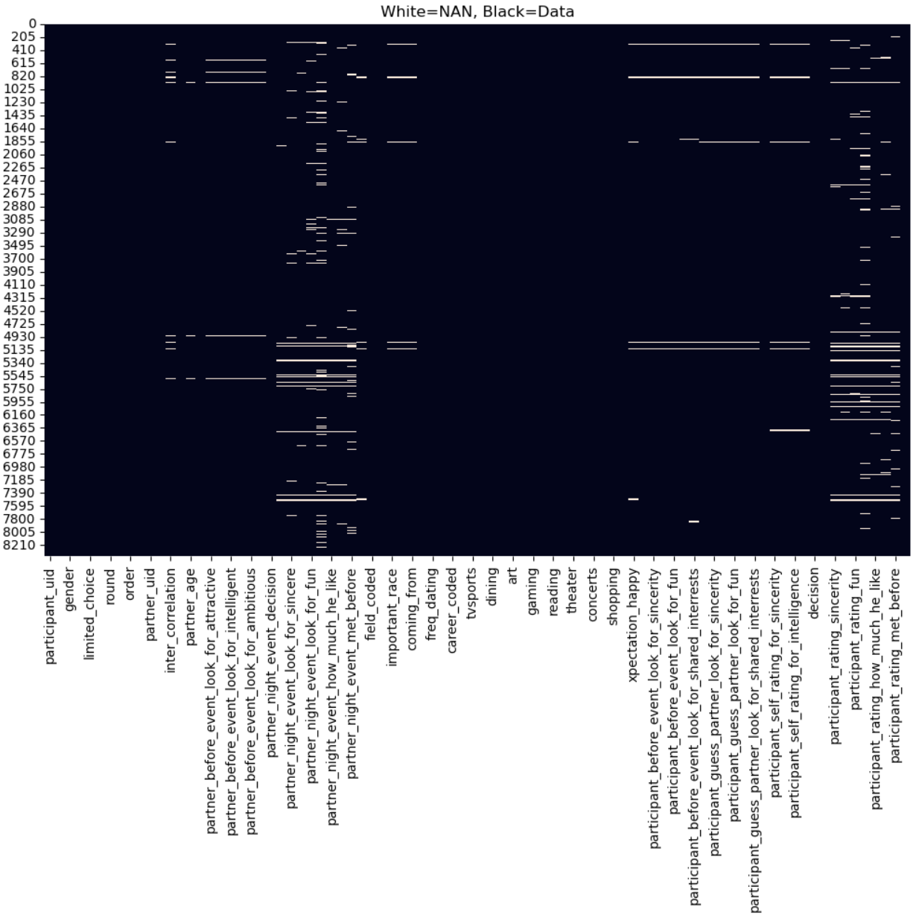
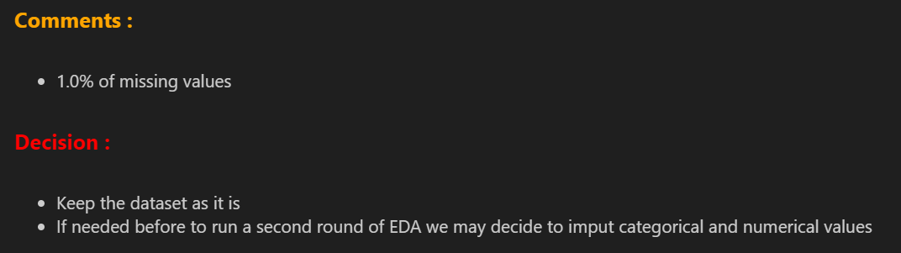
Missing values at this stage

Slide 15
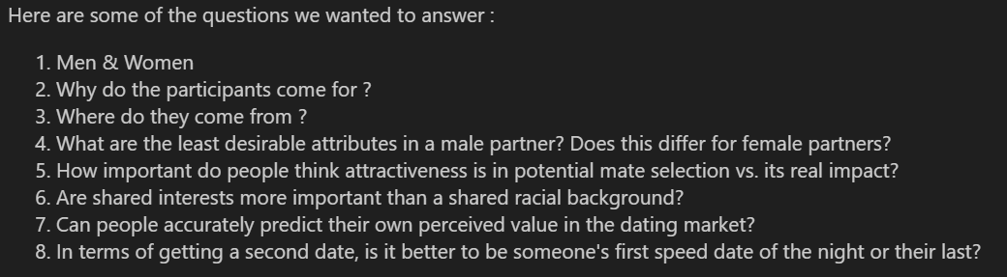
What we learn about participants
Avoid duplicates : 551 unique participants
Notes:
J'ai créé un dataframe "traits" avec que les features qui m'intéresse : genre, age, clubbing…
Avec les user unique id
Supprimé les duplicates
Après je fais de pivot tables et/ou des graphiques directement
pivot_df = traits.pivot_table(index='gender_description', columns='age', values='participant_uid', aggfunc='count', margins=True, margins_name="Total")

Slide 16
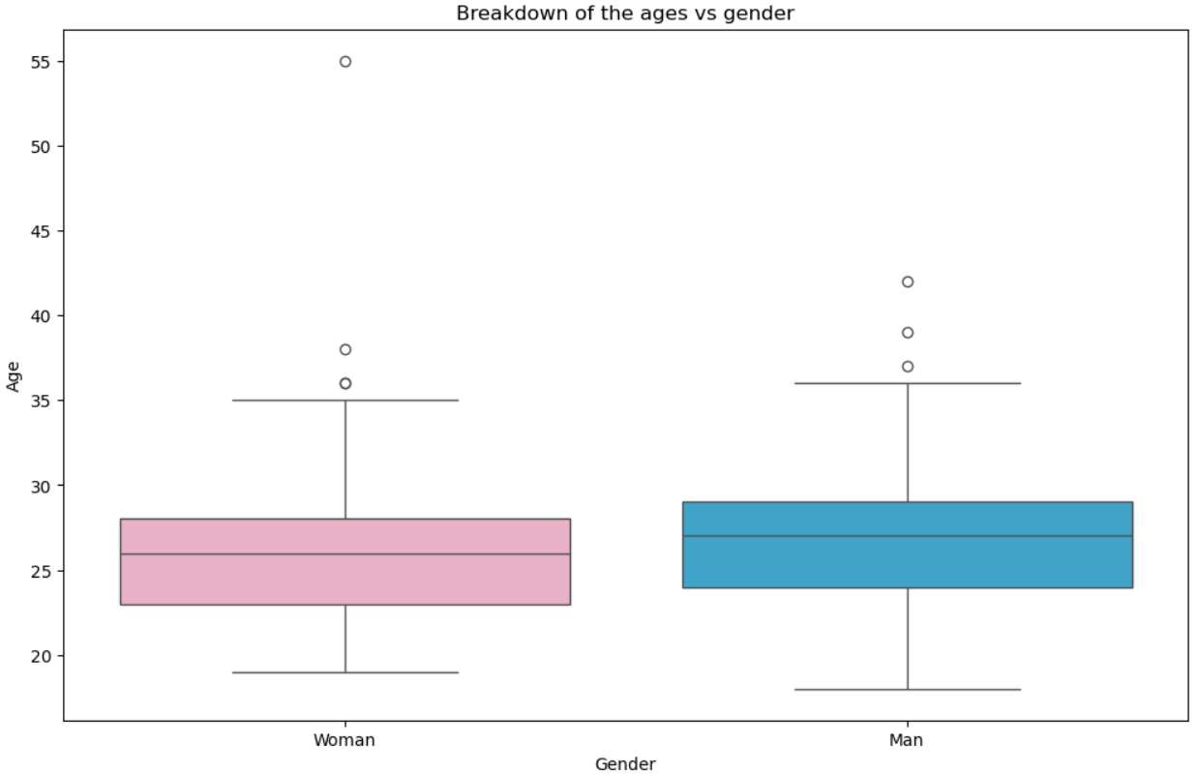
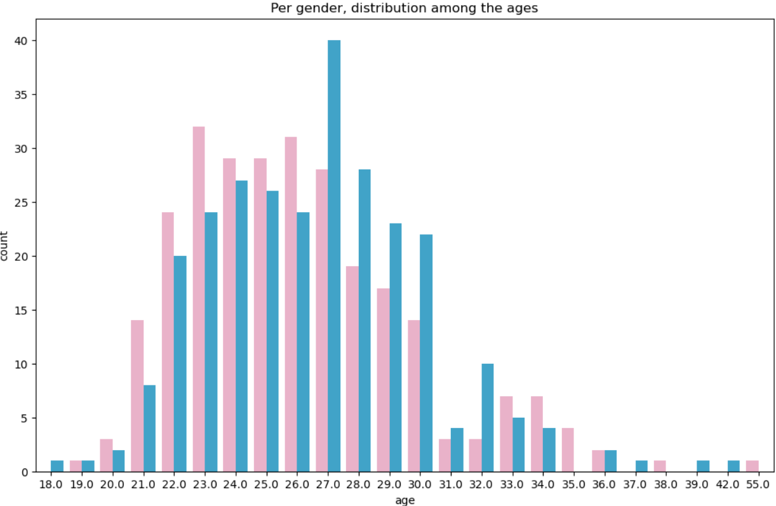
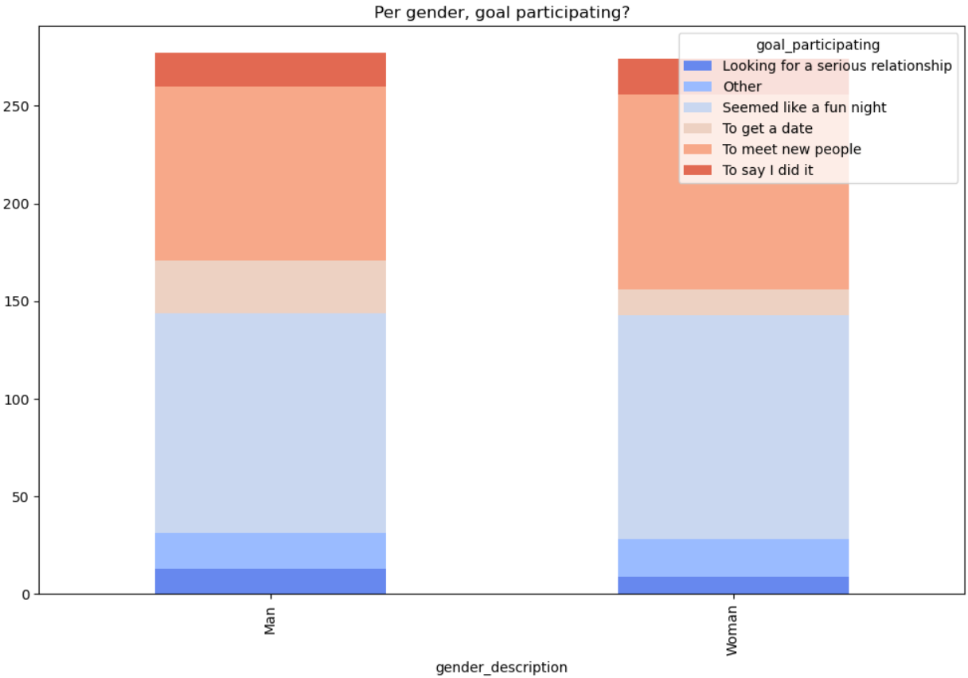
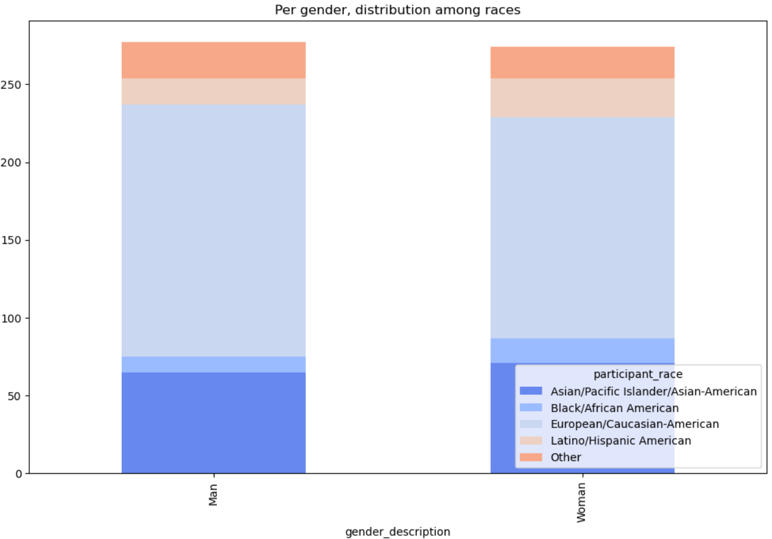
Men, women populations are very similar
Notes:
551 unique participants

Slide 17
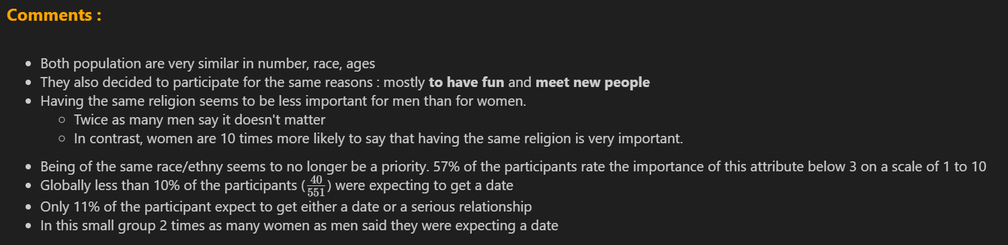
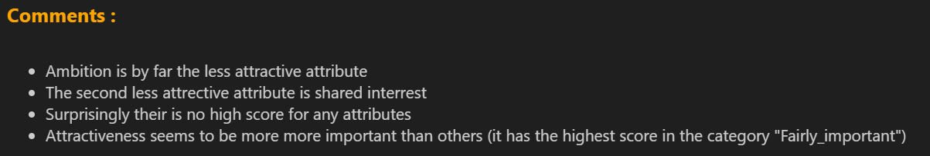
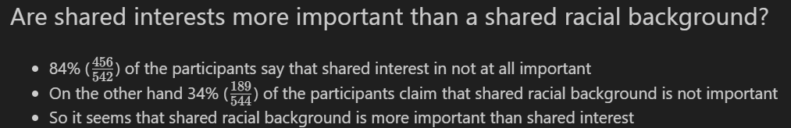
What we learn about participants

Slide 18
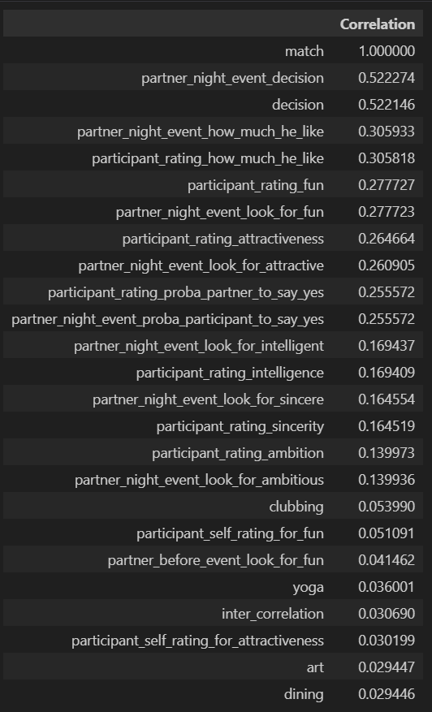
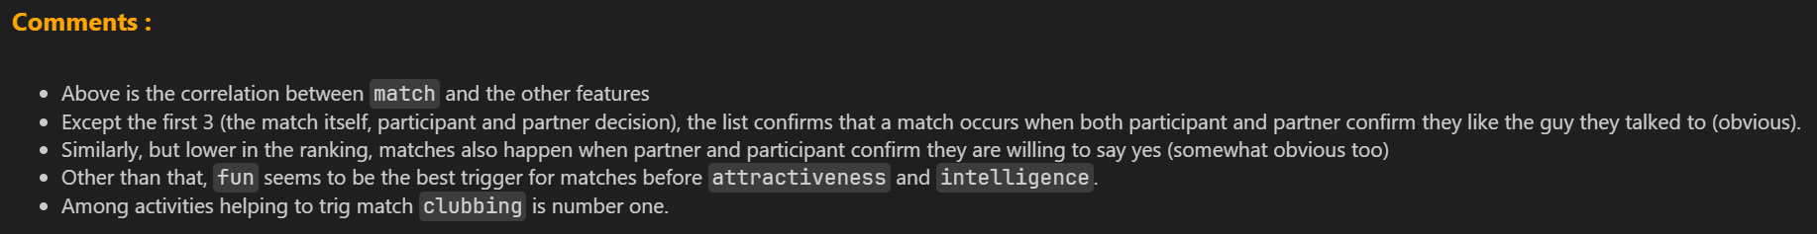
What we learn about the matches

Slide 19

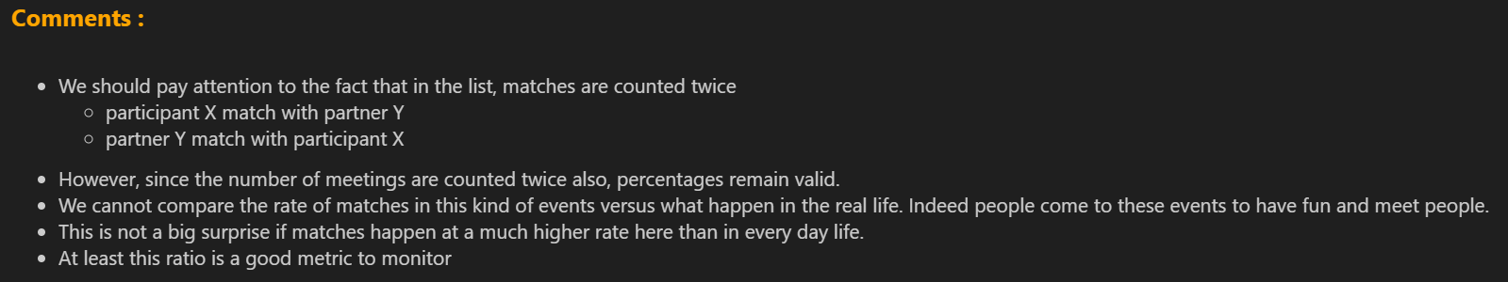
What we learn about matches
Notes:
Z! Population de "students" (cf. le doc)
pas des travailleurs en situation
Est-ce que c'est la majorité des clients de Tinder ?

Slide 20
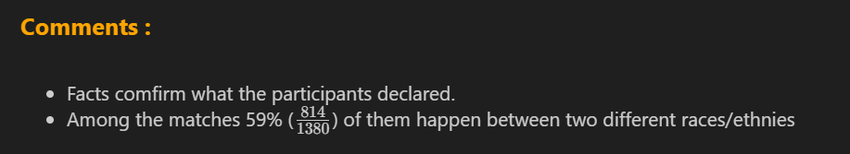
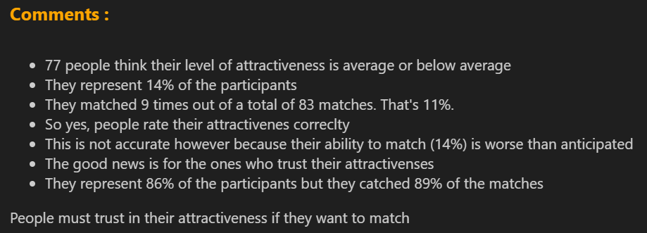
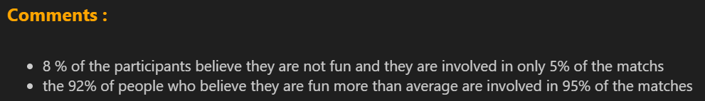
What we learn about matches
Does race really does'nt matter ?
Is there a correlation between how I rate my attractiveness and my ability to match ?
Is there a correlation between how fun I think I am and my ability to match ?
Notes:
Q1 : la confiance n'interdit pas le contrôle ☺
Suffit de faire une pivot table sur le dataset en regardant sur l'ensemble des "matches" ceux où les participants repérés par leur user_id avaient la même race ou pas

Slide 21
Take away
80% of the time spent on understanding, cleaning and preparing the data
It is crucial to automate it as much as possible
The quality of the document was poor, but no doubt representative of what one encounters in real life
At the end we know which number to monitor and we are are able to deliver some advises
Notes:
EDA : The recipe
Features Engineering : The secret sauce
Baseline model : The first taste
Interpreting results : The tasting notes
Don't mess with EDA : Never!
Feature engineering : Smart!
Get a baseline model : Fast!
Results analysis : Always!

Slide 22
Code Review

