Slide 1
getaround Project
author : philippe.baucour@gmail.com
specs : https://app.jedha.co/course/project-deployment-ft/getaround-analysis-ft
files : project https://github.com/40tude/fullstack_mars_2024_3/tree/main/08_deployment/99_Project_getaround API https://api-getaround-4ece015745ea.herokuapp.com/ Dashboard https://dashboard-getaround-ab69d6a429e9.herokuapp.com/
The content of the following slides is mainly a cut-and-paste of what's already available in the project notebook(s). The idea is that the slides can be used to guide and frame the presentation and discussion.
Notes:
Criteria :
The use of machine learning algorithms is automated and accessible through a web interface :
Accessibility of the machine learning algorithm construction process in an environment (Containerization via Docker and normalization via MLFlow)
Quality of the data returned by the application programming interface (API) incorporating the predictions of the algorithm implemented
Cleanliness of the code (compliance with PEP8 standards in Python)
Practicality of the web interface including the use of the application programming interface
Usefulness of the web interface including the use of the application programming interface
Accessibility of the web interface including the use of the application programming interface

Slide 2
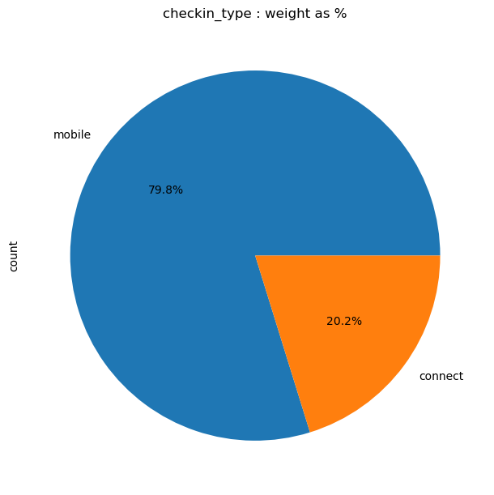
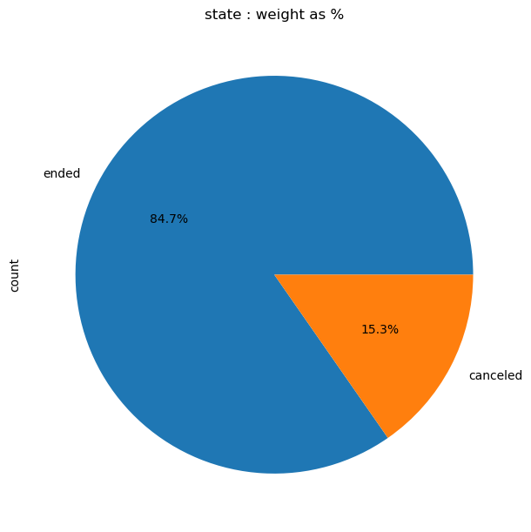
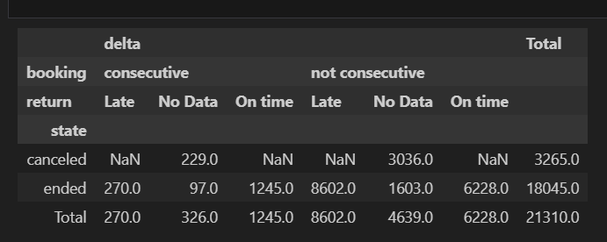
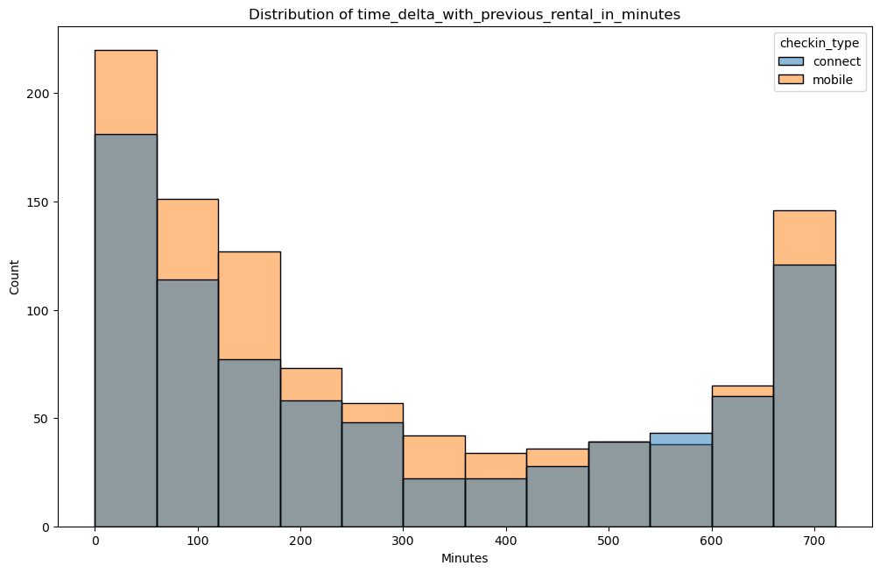
Delays - EDA
With a Time ∆ most of the returns are NOT late (270 vs 1_245)
Notes:
* When 2 bookings are consecutive with a Time $\Delta$ between them most of the rentals are on time (returns happen before `time_delta_with_previous_rental_in_minutes`)
* See 270 vs 1245
* When there is no Time $\Delta$ (no previous driver) most of the returns are late
* See 8602 vs 6228

Slide 3
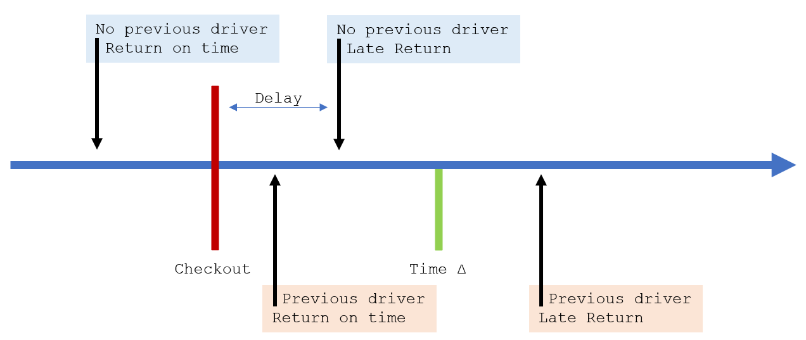
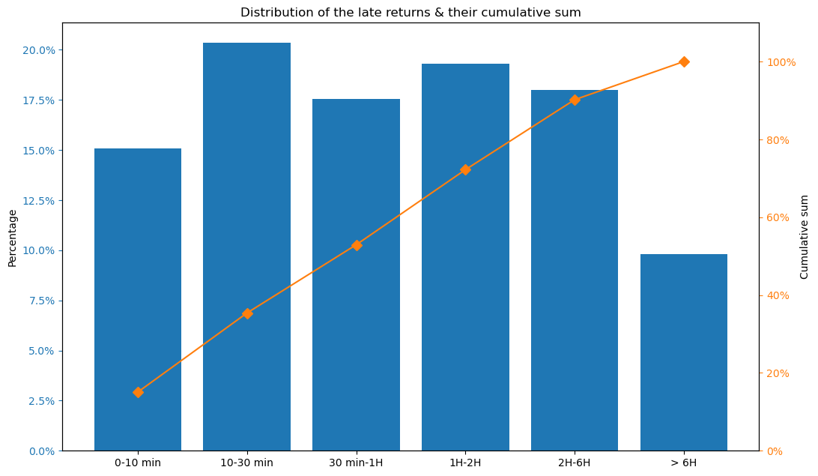
Delays – Answering questions
How often are drivers late for the next check-in?
55%
1. Cars returned after Checkout
* Owner can't use the car
2. Cars returned after Time ∆
* Next driver can't use the car
3. Bookings canceled because the previous driver is late
* There is a previous_ended_rental_id
Notes:
Q2
We consider as problematic the following kind of returns :
1. Cars returned after Checkout
* Because the owner of the car can't use it
1. Cars returned after Time $\Delta$
* Because the next driver can't get the car
The number of bookings which are canceled because the previous driver is late
* There is a previous_ended_rental_id

Slide 4
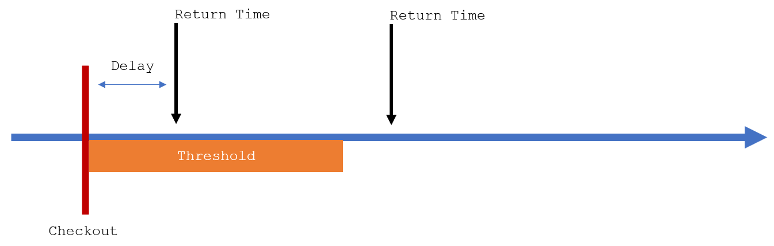
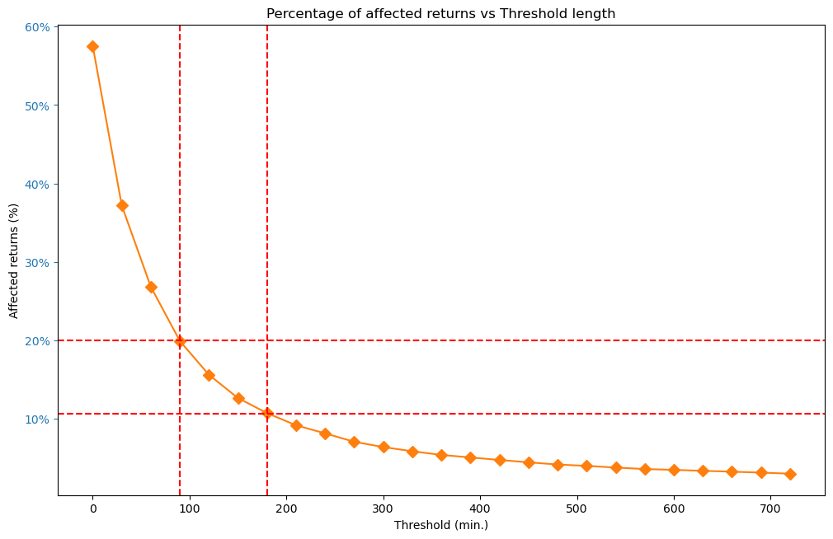
Delays – Answering questions
How many rentals would be affected by the feature depending on the threshold and scope we choose?
We understand that Threshold replaces Time ∆

Slide 5
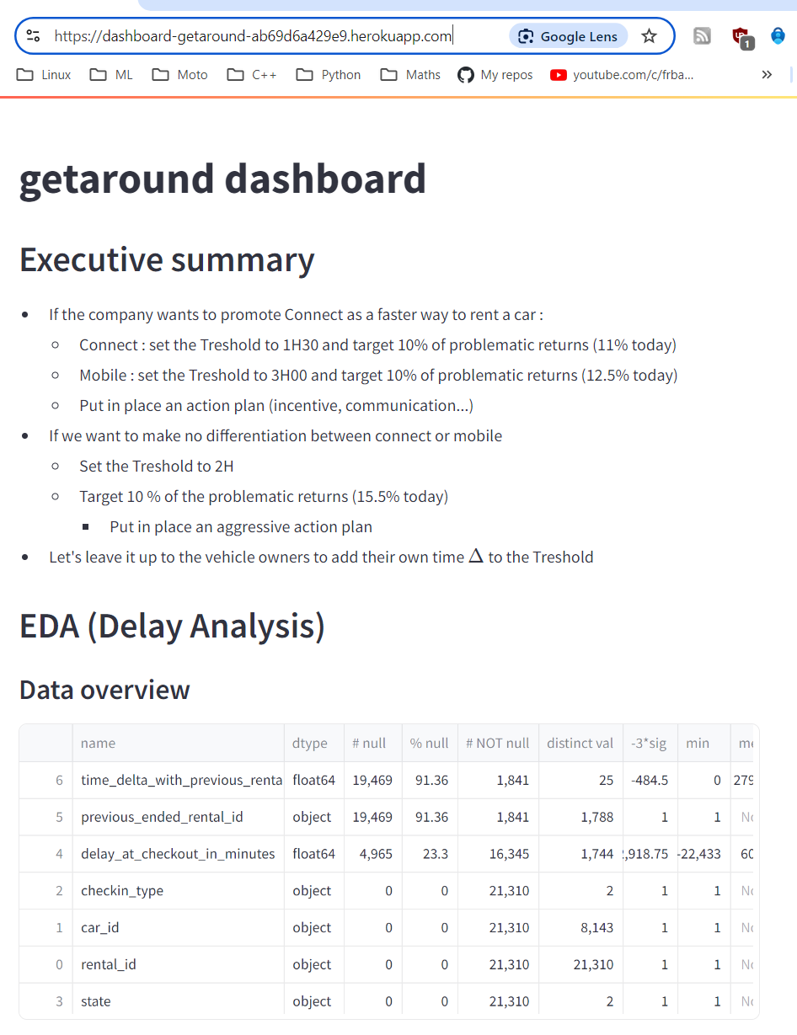
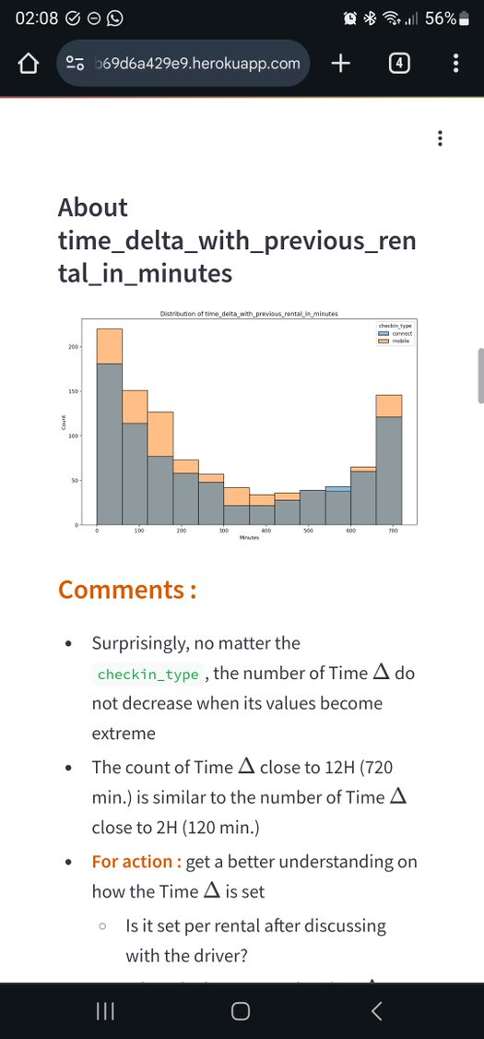
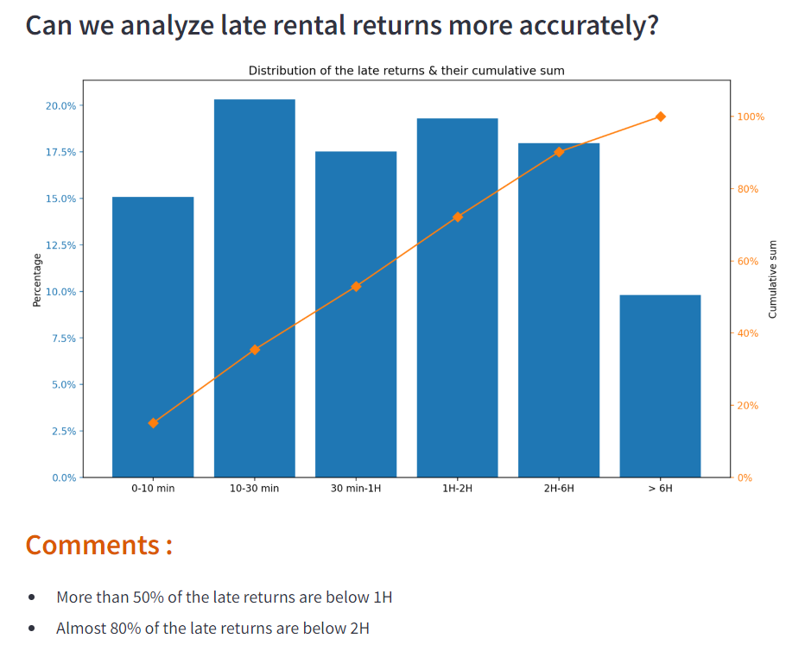
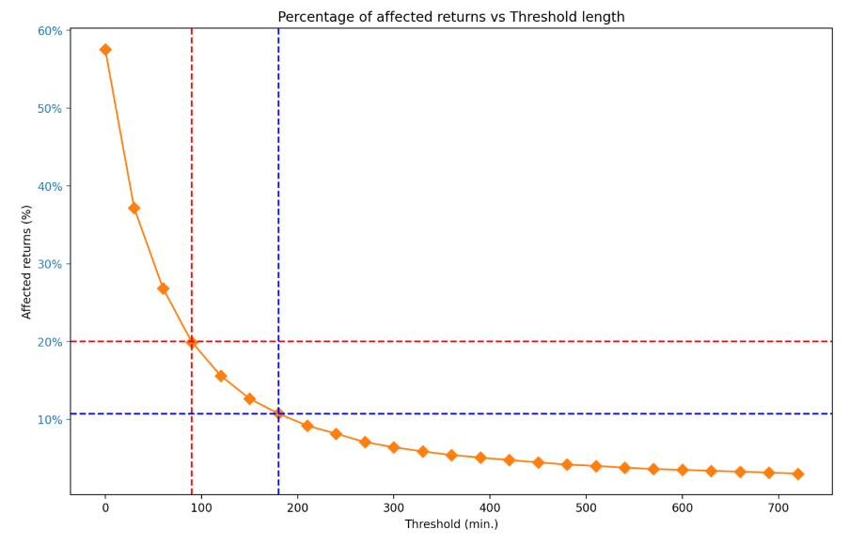
Delays - Dashboard
Notes:
Now it's just a matter of taste and color.
We can discuss all day long about the graphs, the comments, the colors, too much text, not enough…
It's a never-ending story

Slide 6
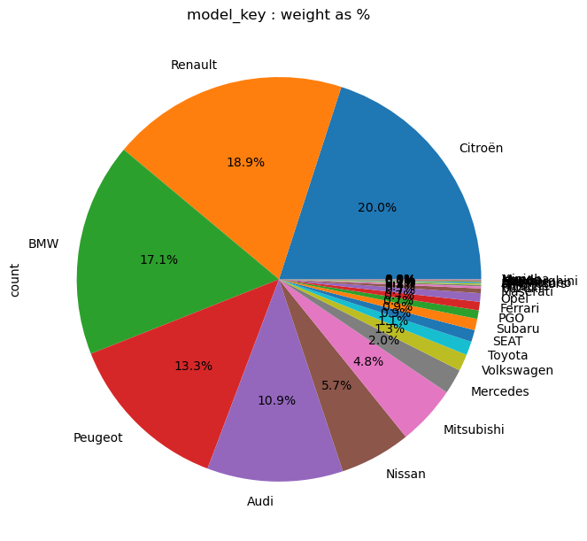
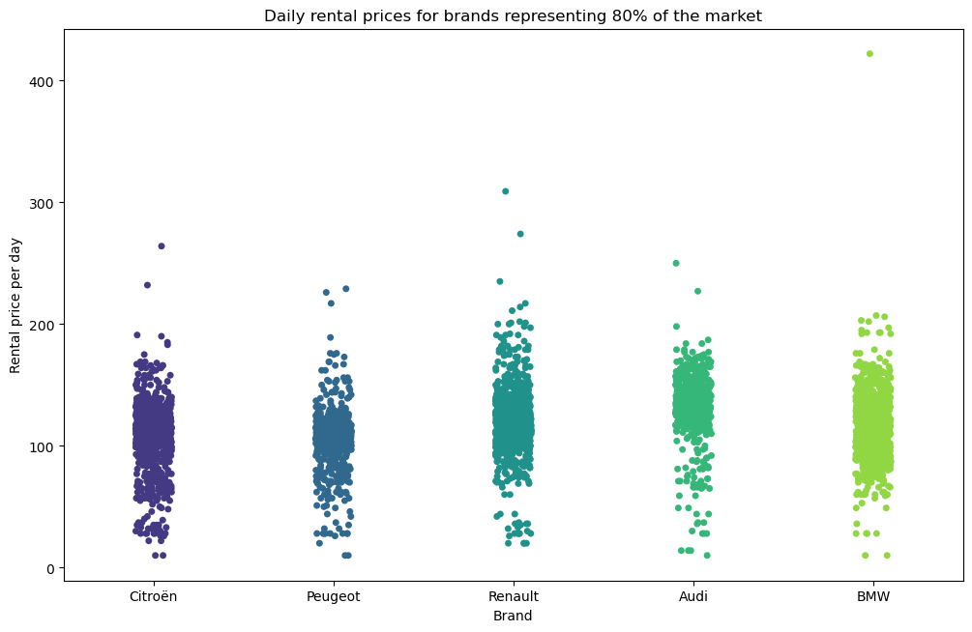
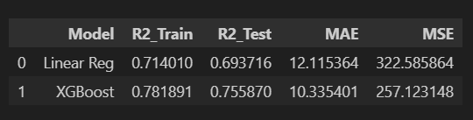
Pricing - EDA & model
We keep the outliers
Linear baseline model
XGBoost model
The pipeline and the model are saved as .pkl
5 brands cover 80% of the market
Notes:
R² : measures the proportion of variance explained by the model
It is used to judge how close the predictions are to the actual values
An R² close to 1 means that the model explains 100% of data variability
MSE (Mean Squared Error): penalizes larger errors, which can be useful for detecting inaccurate extreme predictions
MAE (Mean Absolute Error): measures the mean absolute error, giving a simpler, more intuitive idea of the errors committed by the model
R² train vs. R² test: Compare these two values to check whether your model is overfitting.
A large difference between R² train and R² test may indicate overfitting.
MSE and MAE: These metrics give you an idea of the magnitude of errors.
If MSE is much larger than MAE, this may indicate the presence of outliers with a strong impact on the error.
A good model will have a high test R², close to the train R², and relatively low errors (MSE/MAE)
If these errors are low on the test set, this indicates a good ability to generalize.

Slide 7
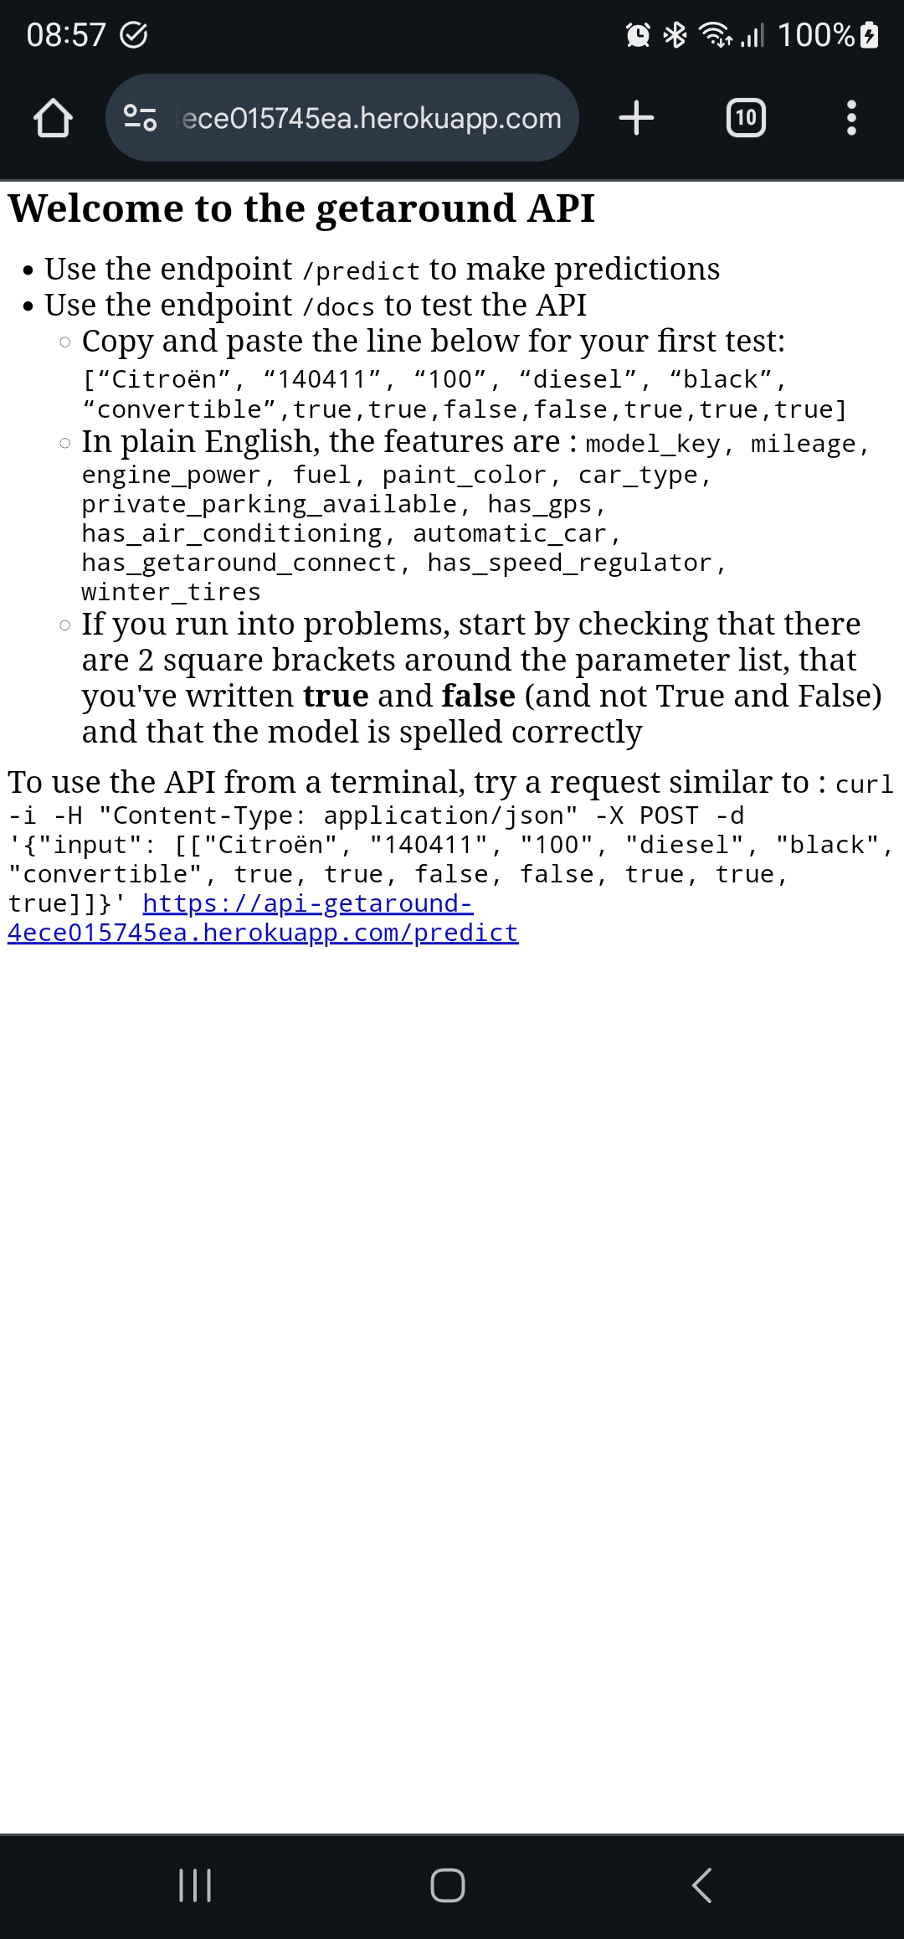
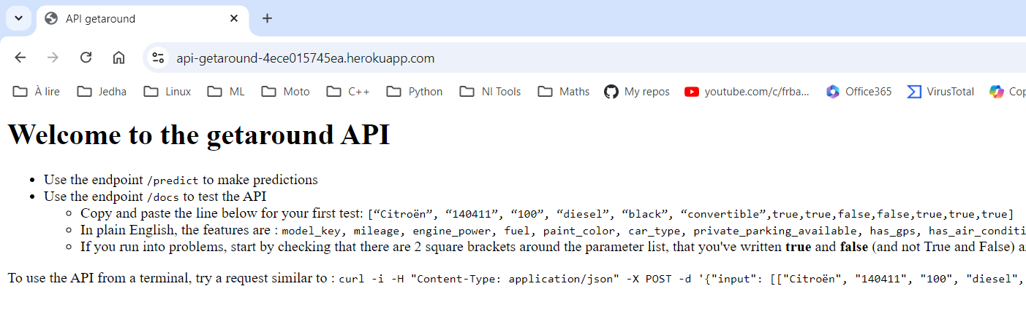
Pricing - API
As the Dashboard, the API works
Locally (python ./api_getaround.py)
Locally in Docker
Online : https://api-getaround-4ece015745ea.herokuapp.com/
3 endpoints :
/
/docs
/predict

Slide 8
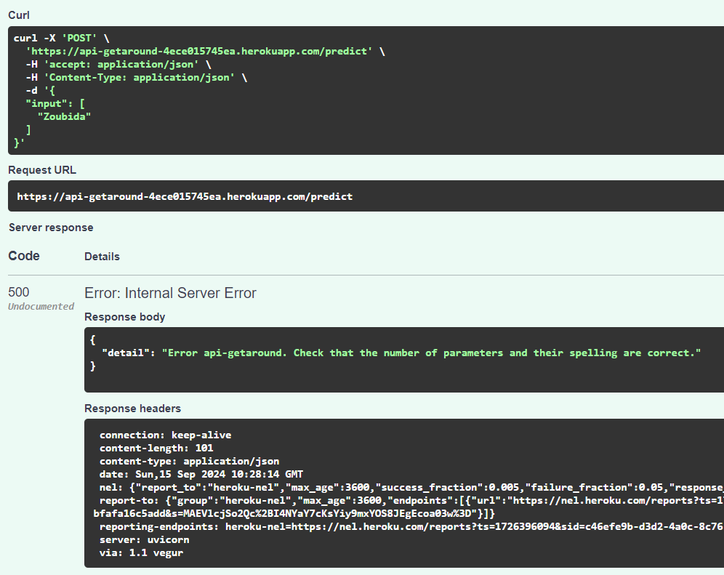

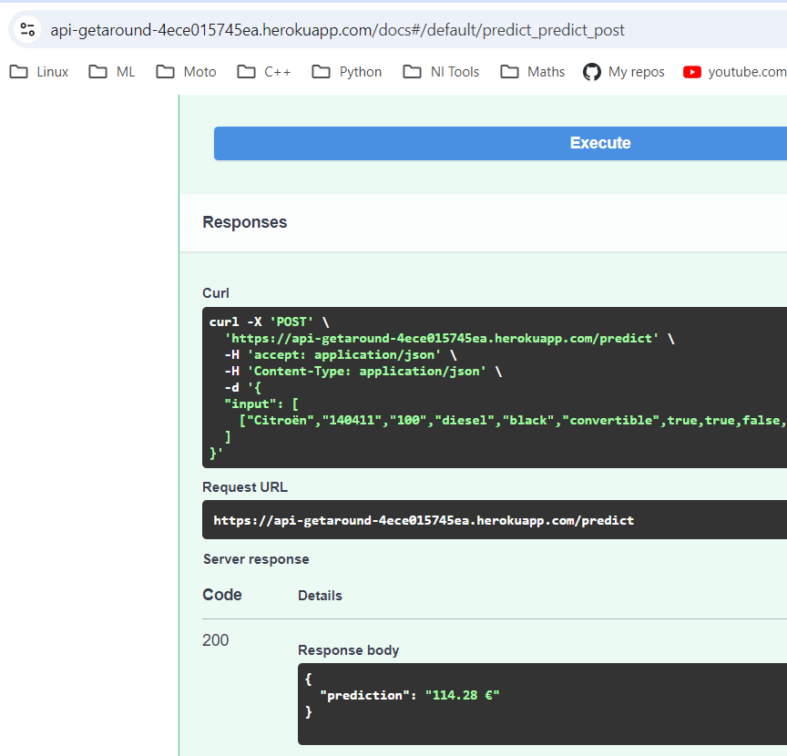

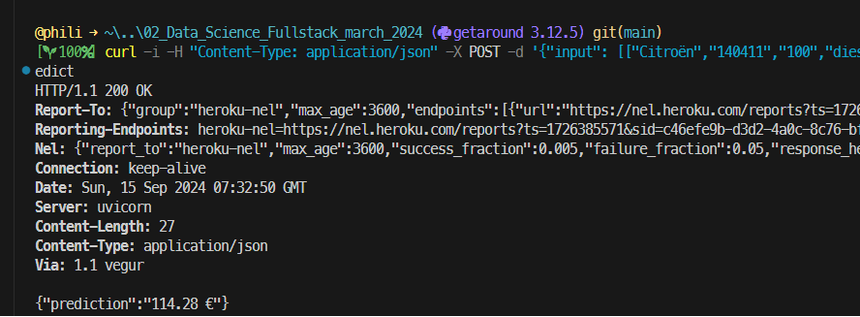

Pricing - API
Exception management
Auto documentation
Using curl

Slide 9
Take away
EDA : The recipe
Features Engineering : The secret sauce
Baseline model : The first taste
Metrics Analysis : The critics' score
API & App : Sharing with friends
Deployment Monitoring : Serve the dish, maintain quality
Fun project that goes beyond the model and EDA EDA, model, pipeline and model in pkl format, API, Docker, Heroku servers for an API and a dashboard...
Streamlit is not designed for the analysis & research phase (way too slow)
Switching from Jupyter to Streamlit means you almost have to do the job twice (can Jinja2 help?)
As with php, Streamlit mixes form and content
Analysis code with presentation code
Notes:
EDA : The recipe
Features Engineering : The secret sauce
Baseline model : The first taste
Metrics Analysis : The critics' score
API & App : Sharing with friends
Deployment & Monitoring : Serve the dish, maintain quality

Slide 10
Code Review

Slide 11
No Theshold
No previous driver
Return on time
No previous driver
Late Return
Delay
Checkout
Time ∆
Previous driver
Return on time
Previous driver
Late Return

Slide 12
Theshold
Late Return
No previous driver
Late Return
Previous driver
Delay
Checkout
Time ∆
Return Time
Return Time
Return Time
Delay
Threshold
Time ∆
Checkout

Slide 13
Specifications

