Slide 1





AT&T Project
author : philippe.baucour@gmail.com
specs : https://app.jedha.co/course/projects-deep-learning-ft/att-spam-detector-ft
files : https://github.com/40tude/fullstack_mars_2024_3/tree/main/07_deep_learning/99_Project_ATT
The content of the following slides is mainly a cut-and-paste of what's already available in the project notebook(s). The idea is that the slides can be used to guide and frame the presentation and discussion.
Notes:
Criteria :
The predictive analysis processes by defined deep machine learning algorithms are effective and address the problem:
Quality of data preparation (creation of tensors, use of data augmentation techniques)
Relevance of the choice of neural network type (classical, convolutional or recursive)
Efficiency of the neural networks constructed (verified by performance generalization tests, on test and validation data)
Clarity of signal detection from unstructured data
Cleanliness of the code (compliance with PEP8 standards in Python)
Relevance of the choice of criteria for evaluating the performance of an algorithm (development of a cost function: Cross Entropy, Mean Squared Error)
Quality of the unstructured data generated

Slide 2
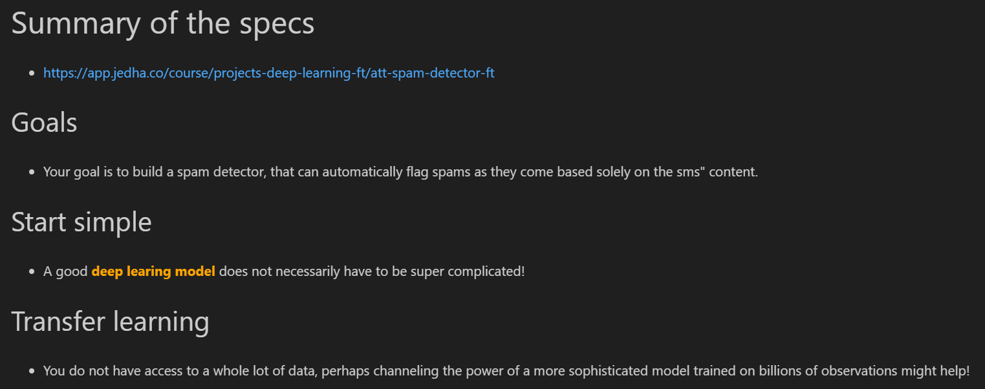
Specifications
Spam detection
Deep Learning

Slide 3
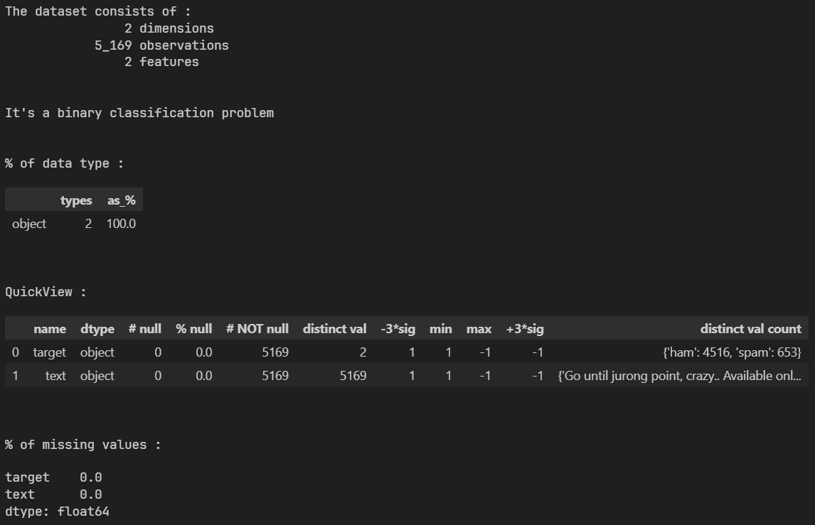
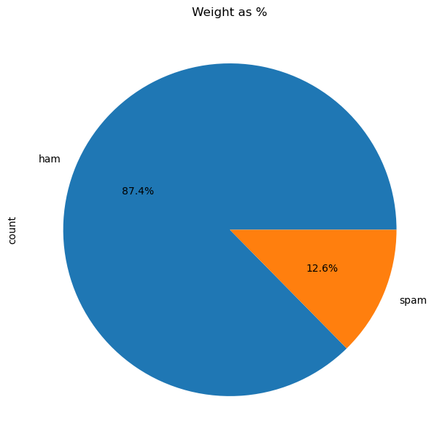
EDA
Notes:
Pas beaucoup de sms
Ca peut être un pb avec des modèles deep learning qui ont besoin de brasser bcp de données

Slide 4
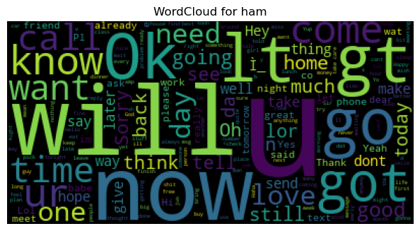
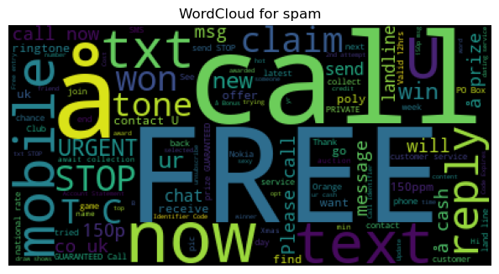
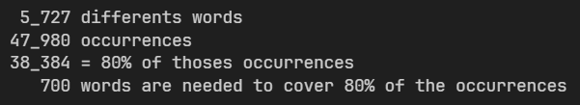
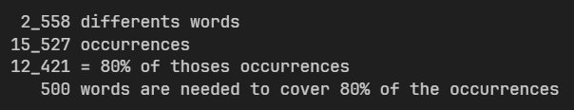
Text processing
Cleaning, Tokenization, Encoding, Padding, Splitting, Create Tensor
Notes:
SPAM : 20% des mots représentent 80% des occurrences. Pareto
HAM : 12% des mots représentent 80% des occurrences

Slide 5
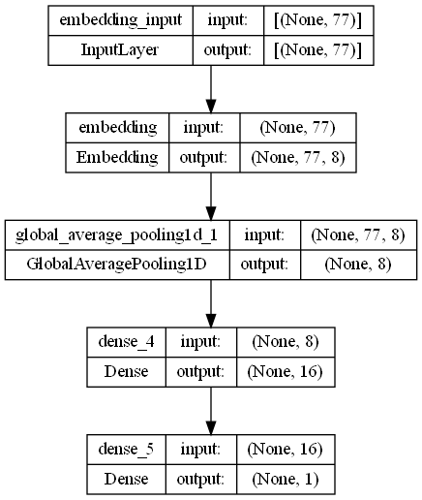
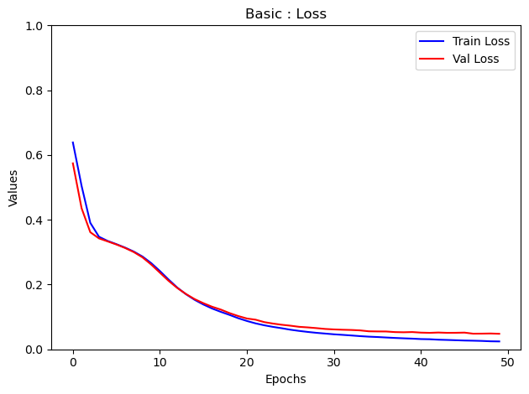
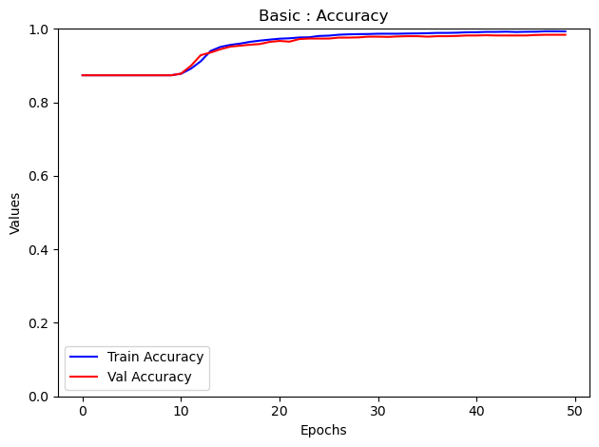
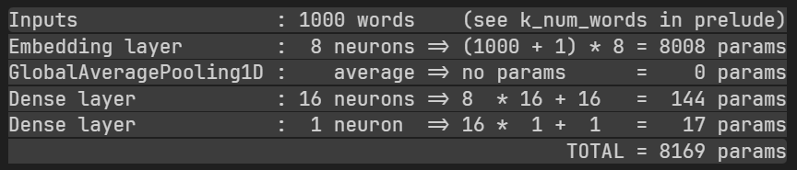
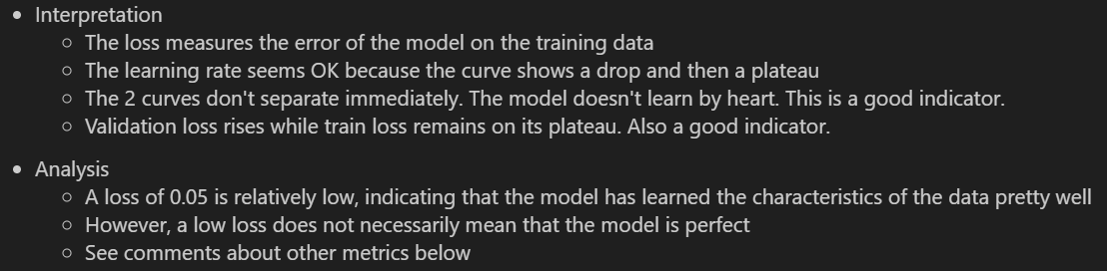
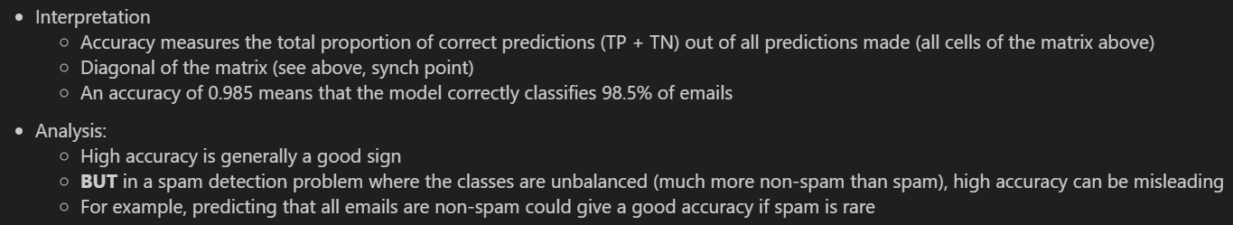
Baseline model
Notes:
* Sms identified as spam (=1)
* Can I accept spam in my sms? I don't know...
* Can I accept to see an sms from my beloved CEO classified as spam? No!
* So I want FP to tend towards 0 and precision $\frac{TP}{TP+FP}$ towards 1 (even if the recall, $\frac{TP}{TP+FN}$, is not that great )
I decide to favour precision over recall
# This Embedding layer converts integer-encoded words (from the tokenizer) into dense vectors of size 8
# tokenizer.num_words should be equal to k_num_words
# +1 because TensorFlow reserves an index for padding or the OOV token
# sms.shape[1] is the length of the input sequence. See the output of the previous cell (77)
# For the output I tried : 16 8 4 and 2
# I like 8
tf.keras.layers.Embedding(tokenizer.num_words + 1, 8, input_shape=[sms.shape[1],], name="embedding"),
# Gobal average pooling
# Reduces the dimensionality by averaging the vectors across the sequence length
# The model loose the order of the words but we don't care
tf.keras.layers.GlobalAveragePooling1D(),
# Fully connected (Dense) layer with 16 neurons.
# relu activation function introduces non-linearity (this helps the model to capture more complex patterns)
tf.keras.layers.Dense(16, activation="relu"),
# Since this is a binary classification problem (based on the sigmoid activation), there's a single output neuron.
tf.keras.layers.Dense(1, activation="sigmoid")

Slide 6
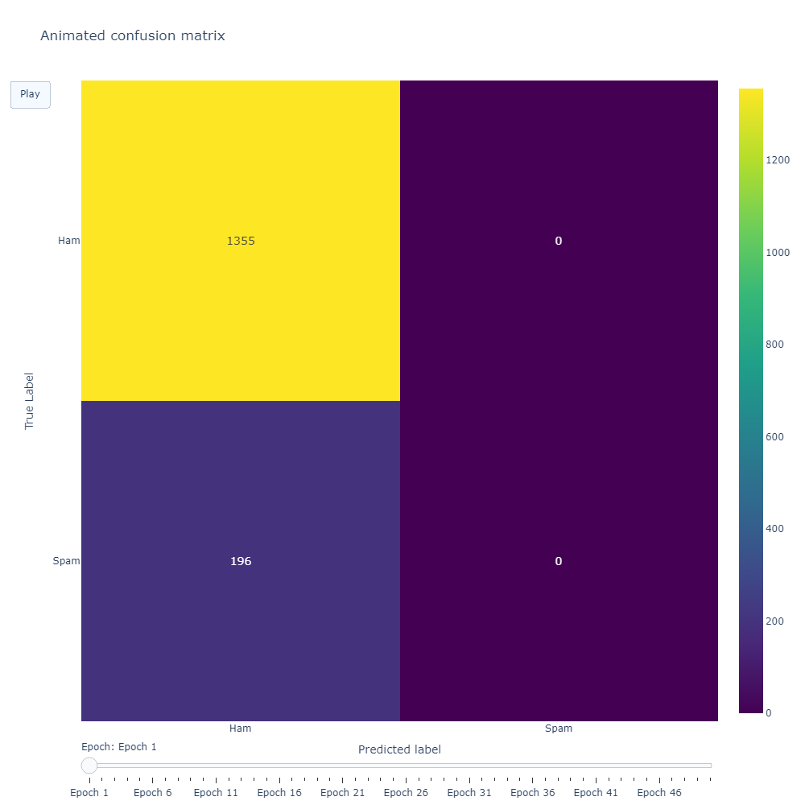
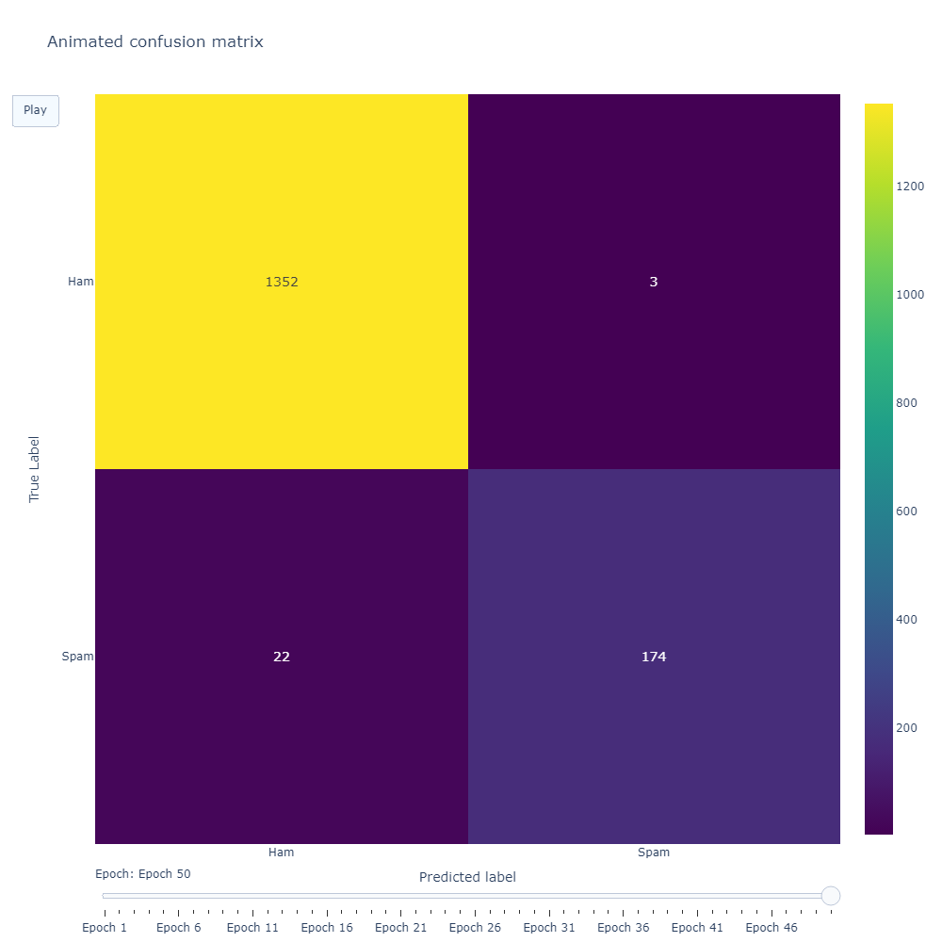
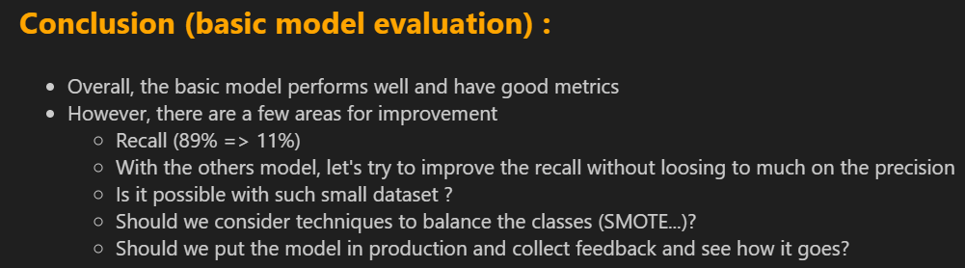
Basic model – Animated Confusion Matrix
Precision : 0.98
Recall : 0.89
F1 : 0.93
Notes:
installer une callback dans model.fit
y remplir une liste confusion_matrices de 50 matrices
Pour l'affichage
Créer une figure qui contient des frames (une des 50 matrices de confusion)
Ajouter un bouton Play
Après faut ajouter ce qu'il faut pour les annotations, les axes etc.
Ajouter un slider

Slide 7
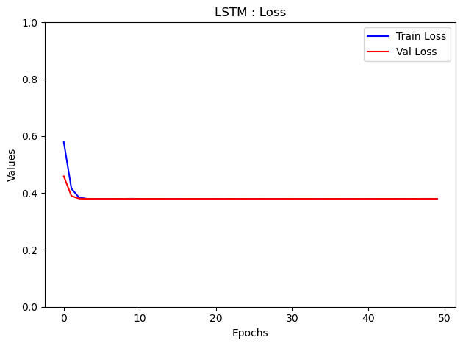
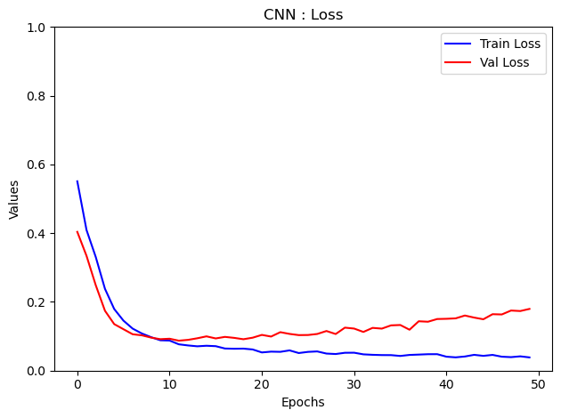
RNN & LSTM - CNN
Recurrent Neural Networks with Long Short-Term Memory
They efficiently capture word relationships and handle long, complex sequences.
Much slower to train than CNN-type models. Risk of overlearning if data is limited (which is the case here (5K sms)
Convolutional Neural Network can be used also for text classification
Indeed, they can capture local patterns (phrases, words combinations)
Quick to train (1:12 min)
Can be less effective at capturing long-distance relationships in text
Not an issue here since sms are short

Slide 8
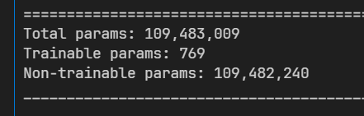
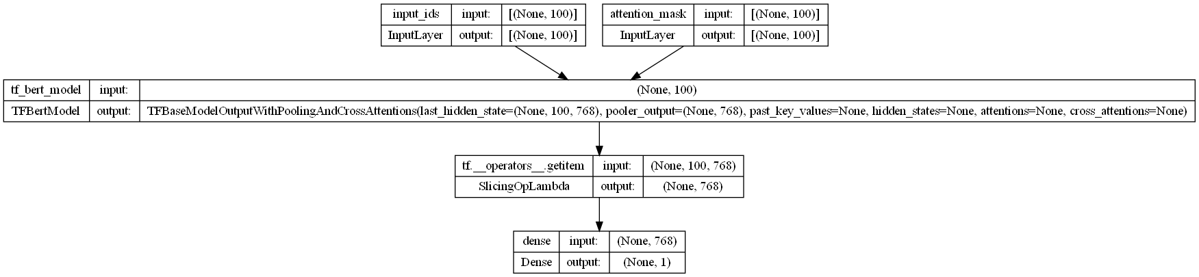
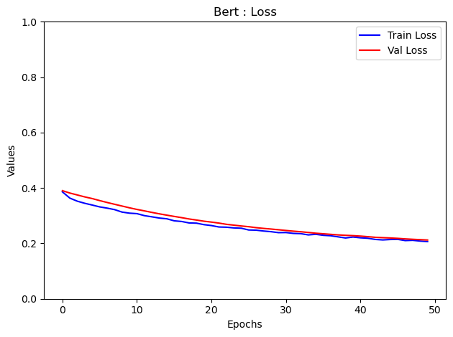
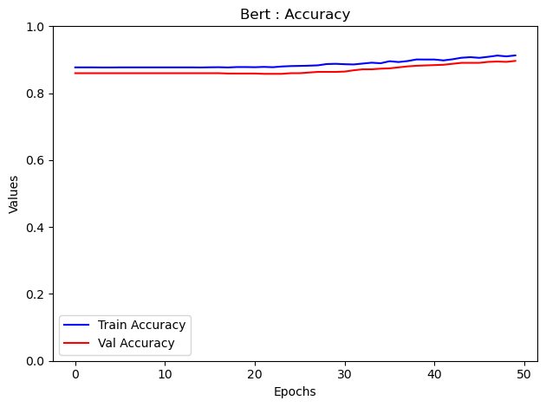
Transfer learning : BERT (freezed, uncased)
Precision : 0.82 vs 0.98
Recall : 0.33 vs 0.89
F1 : 0.47 vs 0.93
Notes:
Bidirectional Encoder Representations from Transformers
On avait 8 169 paramètres entrainables avec le modèle de base
On a pris le parti de geler TOUTES les couches de BERT et de juste rajouter une dernière couche dense avec une activation sigmoïde
Du coup même si BERT a 110 M de para entrainables, on en a que 769 à entrainer
Par contre ça reste très très lent à entrainer
Les résultats sont pas top

Slide 9
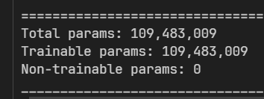
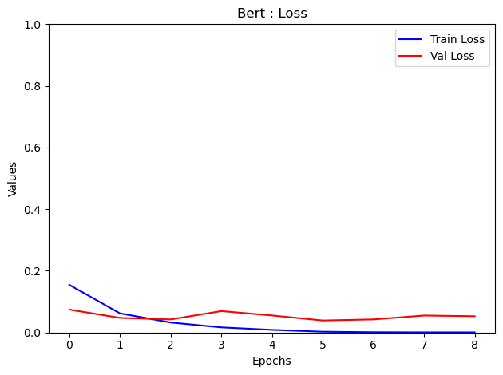
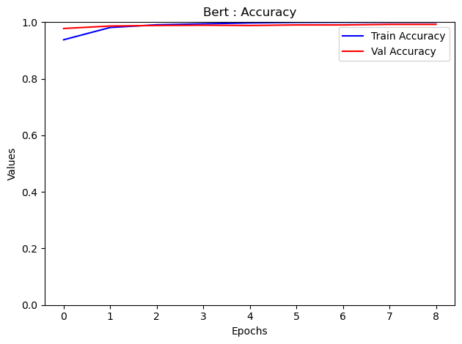
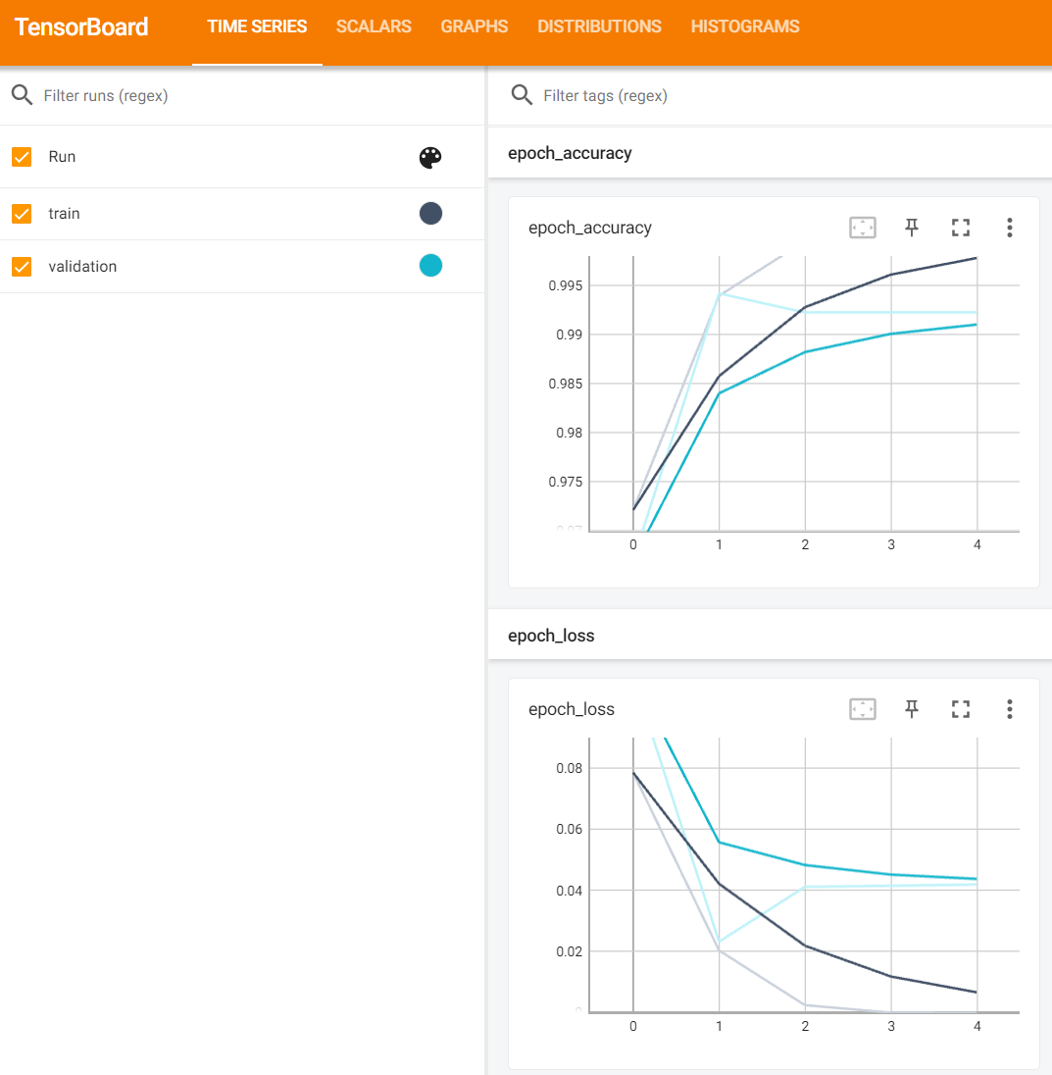
Transfer learning : BERT (unfreezed)
BERT uncased
BERT cased
Precision : 0.99 vs 0.98
Recall : 0.95 vs 0.89
F1 : 0.97 vs 0.93
Notes:
On avait 8 169 paramètres entrainables avec le modèle de base
On a pris le parti de geler TOUTES les couches de BERT et de juste rajouter une dernière couche dense avec une activation sigmoide
Du coup même si BERT a 110 M de para entrainables, on en a que 769 à entrainer
Par contre c'est reste très très lent à entrainer

Slide 10

Take away
So far, working on the projects I keep in mind :
EDA : The recipe
Features Engineering : The secret sauce
Baseline model : The first taste
Metrics Analysis : The critics' score
API & App : Sharing with friends
Deployment & Monitoring : Serve the dish, maintain quality
Impressed by the results of the baseline model
BERT (unfreezed) help to keep the Precision while improving the Accuracy but at the cost of training time
Notes:
EDA : The recipe
Features Engineering : The secret sauce
Baseline model : The first taste
Metrics Analysis : The critics' score
API & App : Sharing with friends
Deployment & Monitoring : Serve the dish, maintain quality

Slide 11
Code Review

