Slide 1
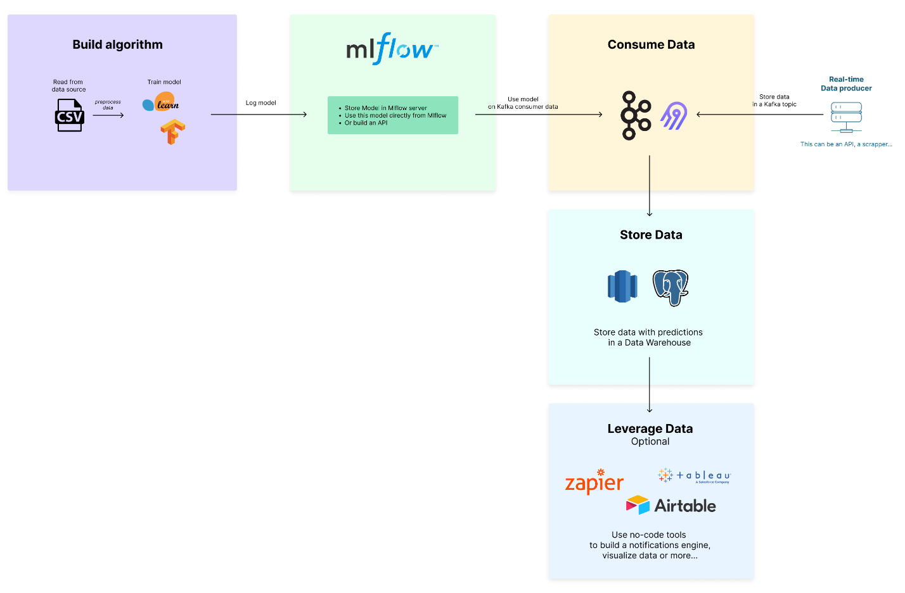

lead-program-assets.s3.eu-west-3.amazonaws.com
Train set :
Validated set : s3://fraud-bucket-202406/data/

Slide 3


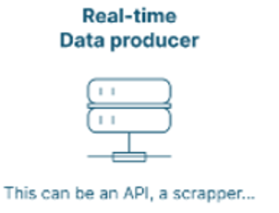



request prediction - speed 2
get prediction - speed 2
store - speed 3
subcribe - speed 1
Topic 2
Topic 1

