Slide 1
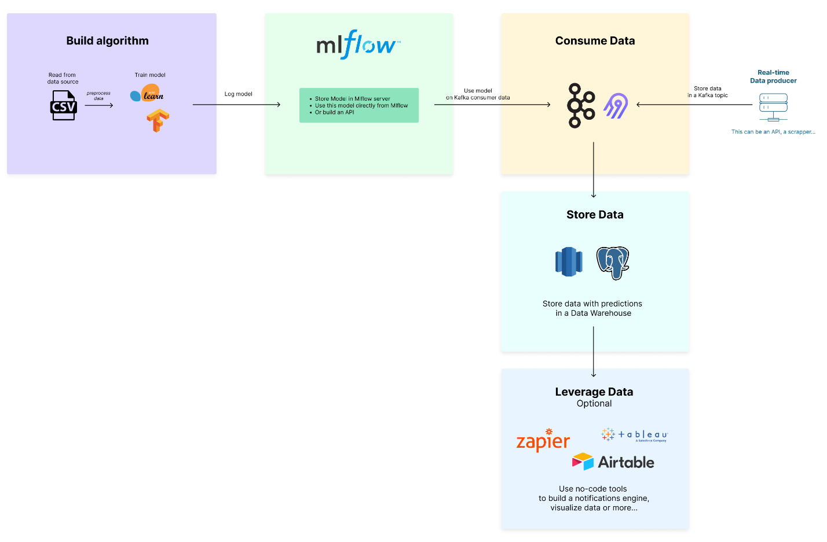

lead-program-assets.s3.eu-west-3.amazonaws.com
Train set :
Validated set : s3://fraud-bucket-202406/data/

