Slide 1





fraud_detection_2
author : philippe.baucour@gmail.com
specs : https://app.jedha.co/course/become-certified-ai-architect-lds/data-analyst-certificate-lds
URL : https://github.com/40tude/fraud_detection_2
The content of the following slides is mainly a cut-and-paste of what's already available in the project notebook(s) or screen captures of running applications. The idea is that the slides can be used to guide and frame the presentation and discussion.
Notes:
See also : https://app.jedha.co/course/project-prep-lds/project-overview-lds Criteria :
The use of machine learning algorithms is automated and accessible through a web interface :
Accessibility of the machine learning algorithm construction process in an environment (Containerization via Docker and normalization via MLFlow)
Quality of the data returned by the application programming interface (API) incorporating the predictions of the algorithm implemented
Cleanliness of the code (compliance with PEP8 standards in Python)
Practicality of the web interface including the use of the application programming interface
Usefulness of the web interface including the use of the application programming interface
Accessibility of the web interface including the use of the application programming interface

Slide 2
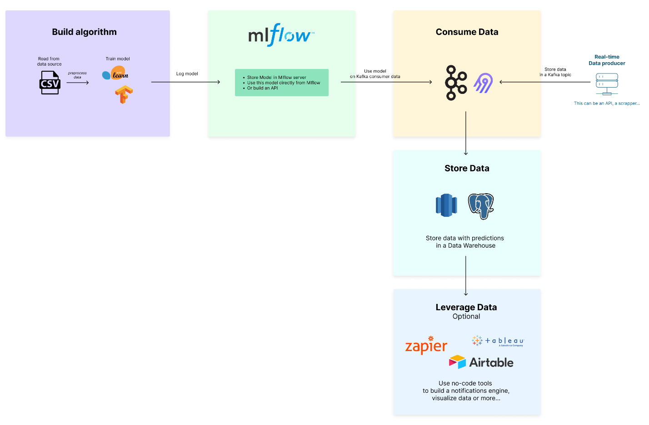

Slide 3
Build algorithm
MLflow
Consume Data
RT Data
Store Data
Leverage Data

Slide 4
Build algorithm
MLflow
RT Data
Consume Data
Store Data
Leverage Data

Slide 5
Build algorithm
MLflow
RT Data
Consume Data
Store Data
Leverage Data

Slide 6
Train
Models
Consumer
Logger SQL
Transactions
End User

Slide 7



Training Data Set
Train
Validated Data
Models
Extractor SQL
Consumer
Logger SQL
Transactions
End User

Slide 8





Training Data Set
Train
Validated Data
Models
What's moving?
How fast?
What if speed=0?
Daily
Extractor SQL
Speed 1?
Consumer
Logger SQL
Speed 1
Speed 1?
Speed 3
Daily
Transactions
End User

Slide 9
Training Data Set
Train
Validated Data
Models
Extractor SQL
Producer
Consumer
Logger SQL
Transactions
End User

Slide 10

Training Data Set
Train
Validated Data
Models
Extractor SQL
Producer
Consumer
Logger SQL
Speed 1
Speed 1
Speed 2
Speed 2
Speed 3
Speed 3
Transactions
End User

Slide 11


Training Data Set
Train
Validated Data
Models
Daily
On request
Modelizer Last Previous
Extractor SQL
Producer
Consumer
Logger SQL
Speed 1
Speed 1
Speed 2
Speed 2
Speed 3
Speed 3
Daily
Transactions
Alert
End User

Slide 12
Training Data Set
Docker 5
Train
Validated Data
AWS S3 1
AWS S3 2
Mlflow
Heroku AWS S3 2
Models
Daily
PostgreSQL
On request
Modelizer Last Previous
Docker 6
Extractor SQL
Docker 4
API
Producer
Consumer
Logger SQL
Speed 1
Speed 1
Speed 2
Speed 2
Speed 3
Speed 3
Daily
Transactions
API
Docker 1
Docker 2
Docker 3
Alert
PostgreSQL
Topic_1
End User
Topic_2
Confluent
Confluent

Slide 13
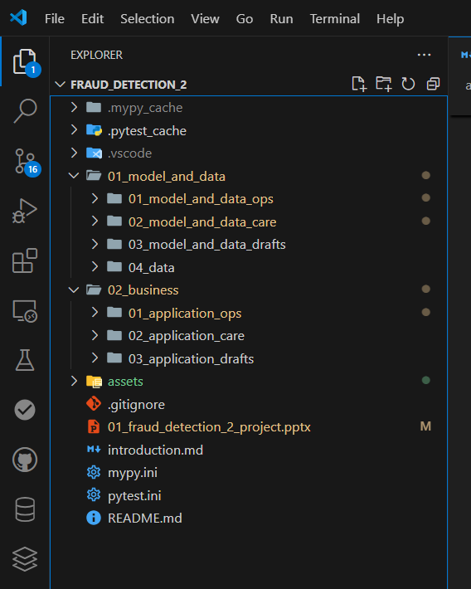


Training Data Set
Train
Validated Data
Models
Model and Data
Ops - Care
Modelizer Last Previous
Extractor SQL
Producer
Consumer
Logger SQL
Transactions
Business
Ops - Care
Topic_1
End User
Topic_2

Slide 14
Training Data Set
Train
Validated Data
Models
Modelizer Last Previous
Extractor SQL
Producer
Consumer
Logger SQL
Transactions
Topic_1
End User
Topic_2

Slide 15
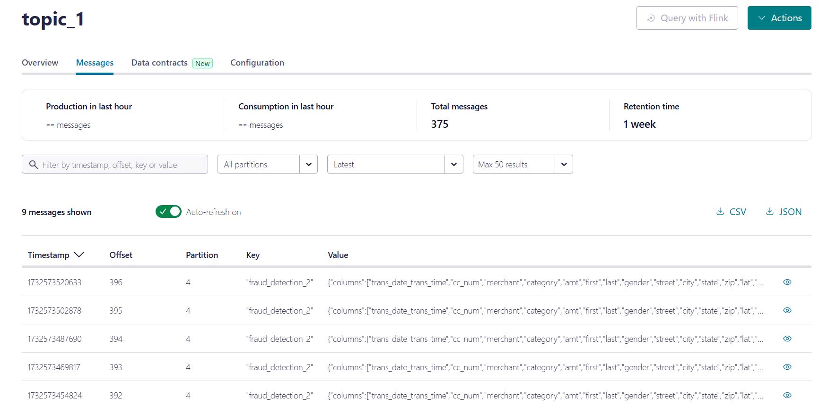
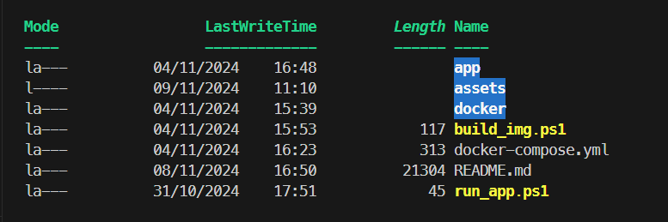
Producer

Slide 16
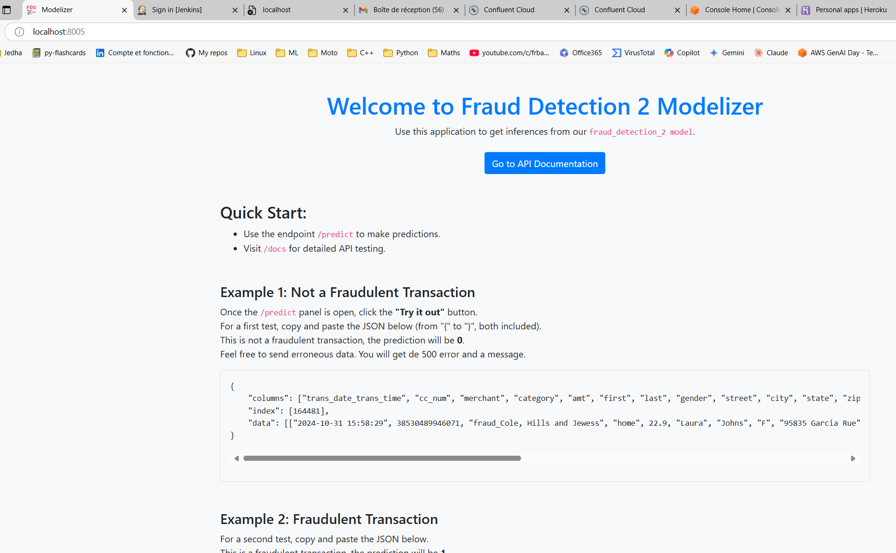
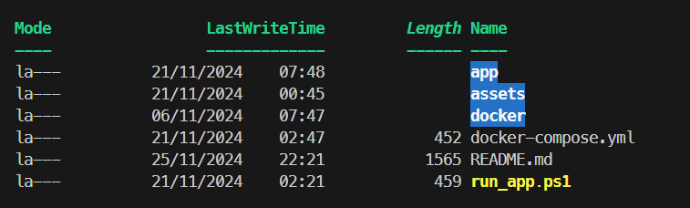
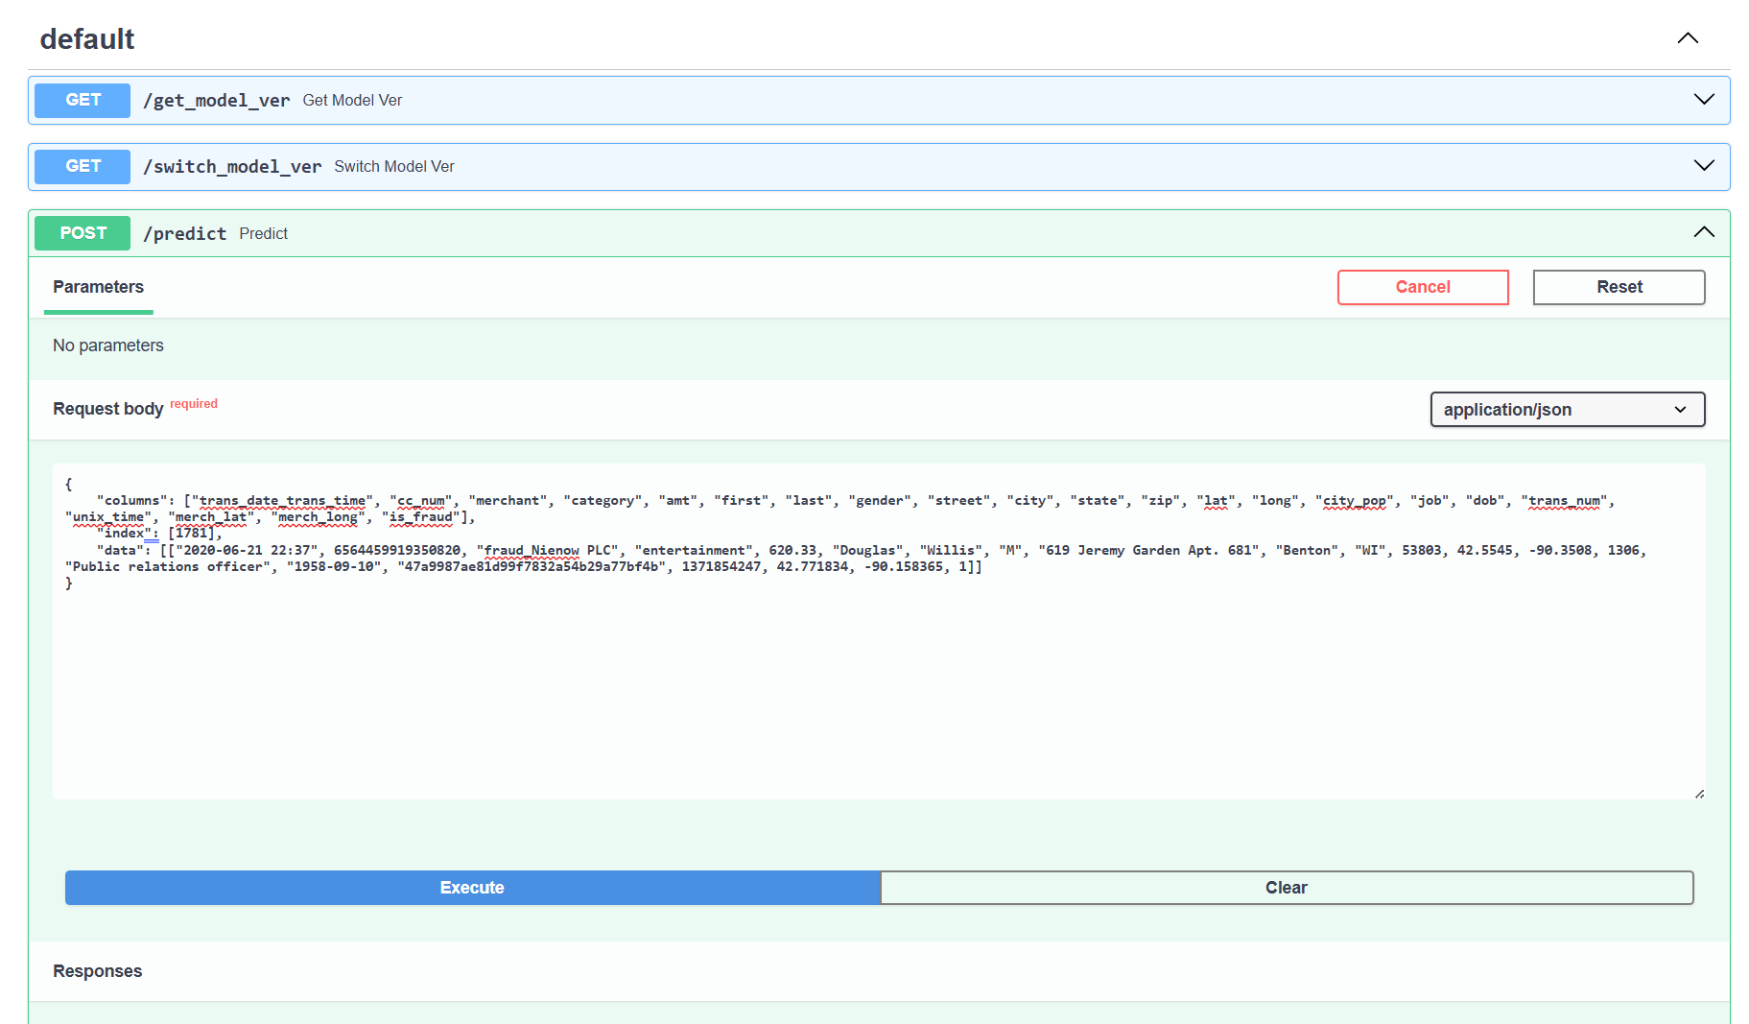
Modelizer

Slide 17
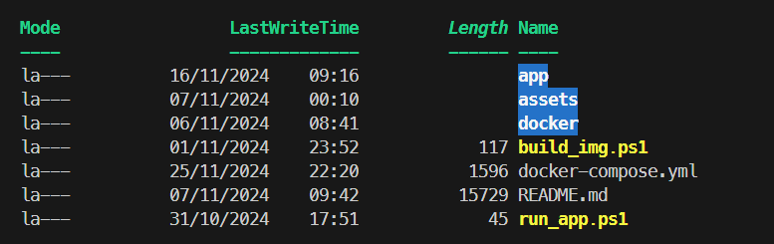
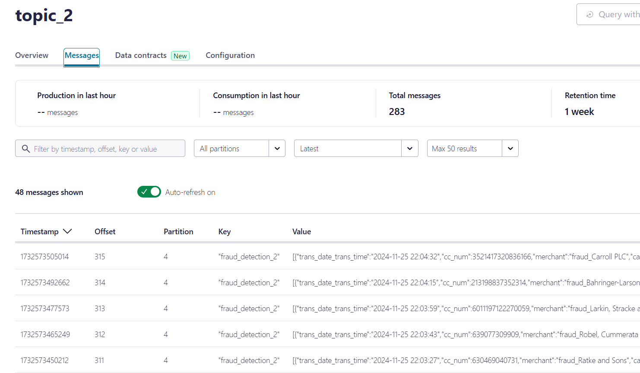
Consumer

Slide 18
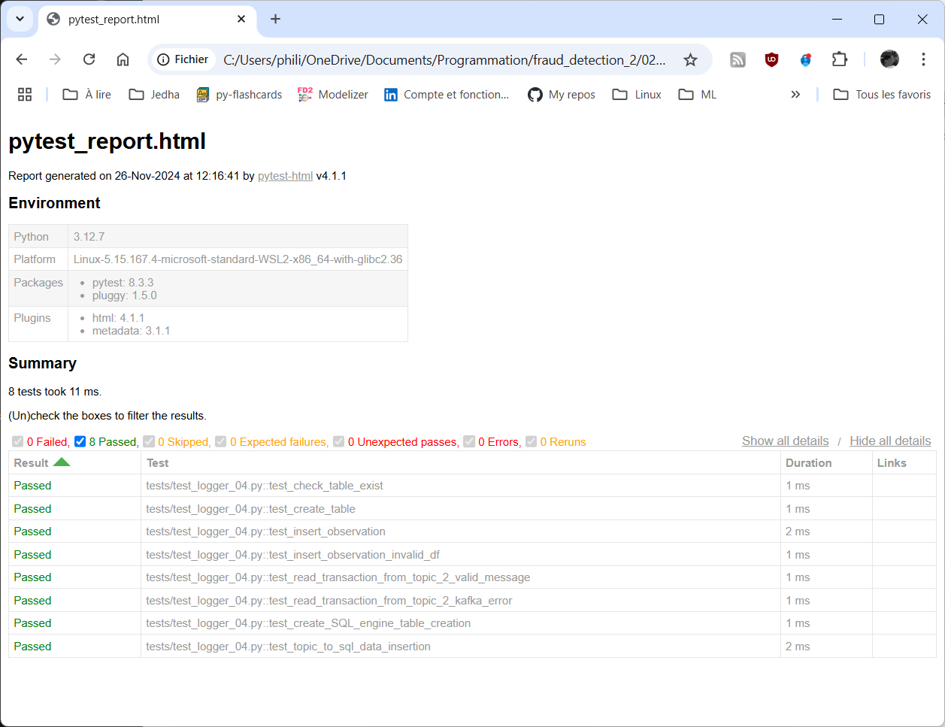
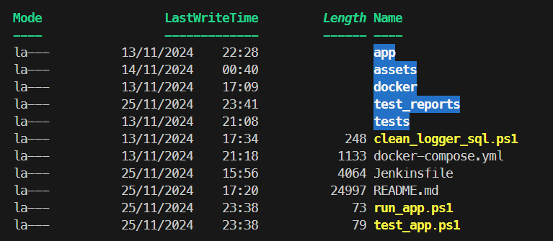
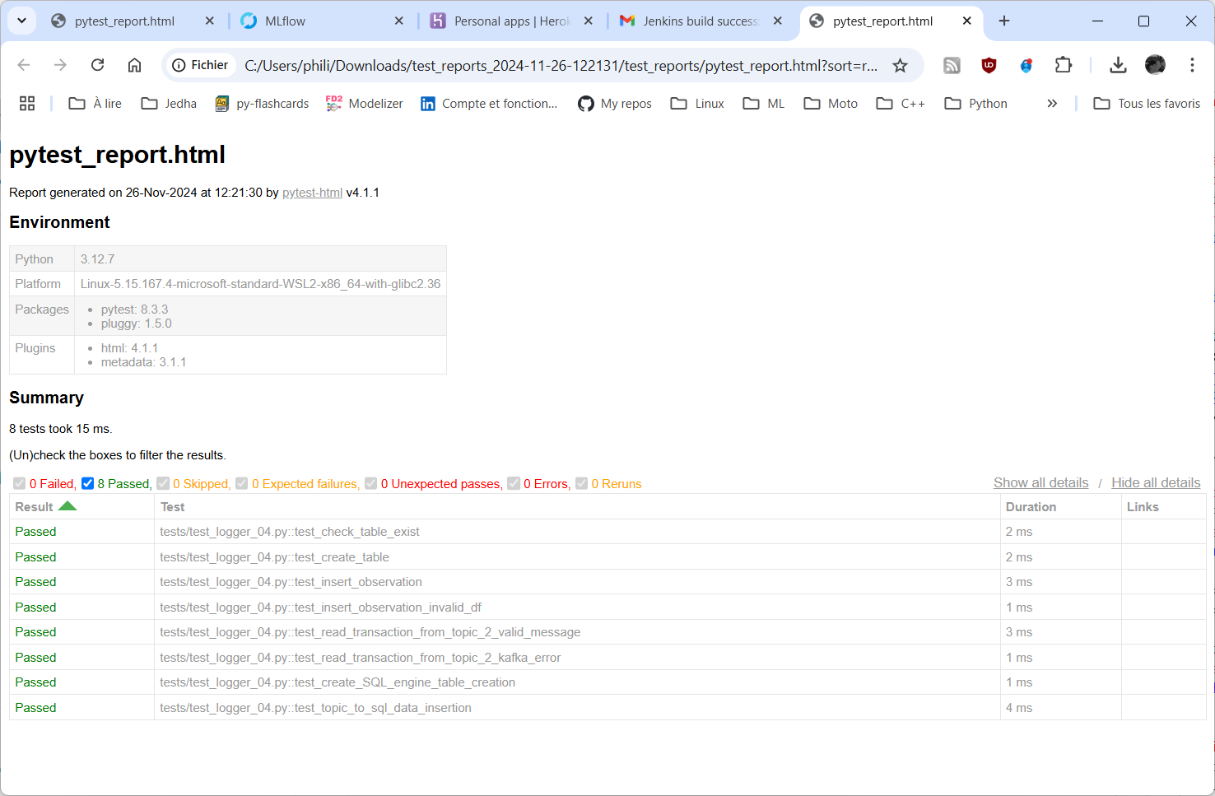
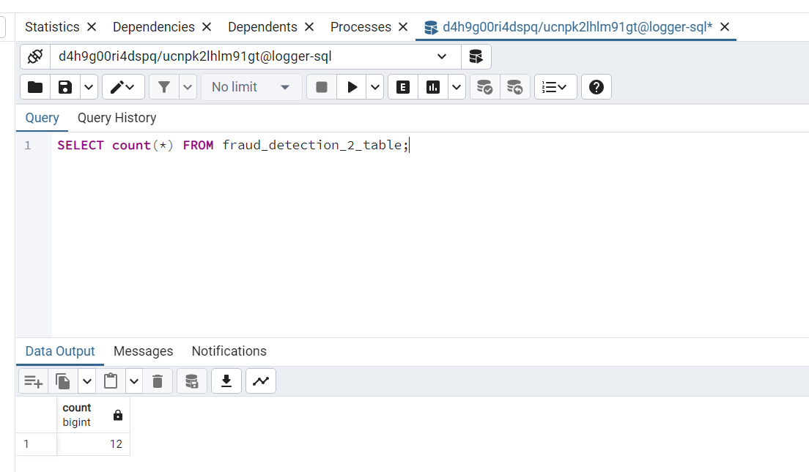
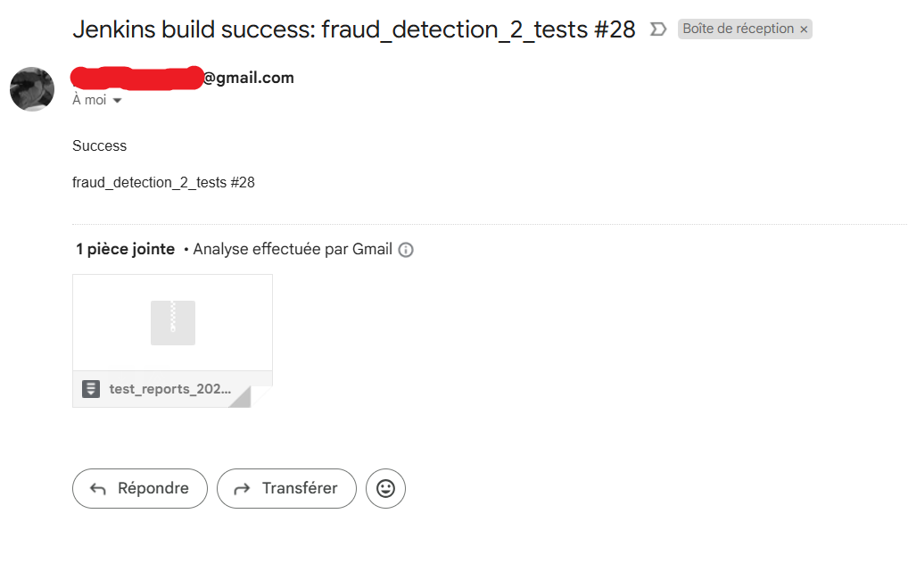
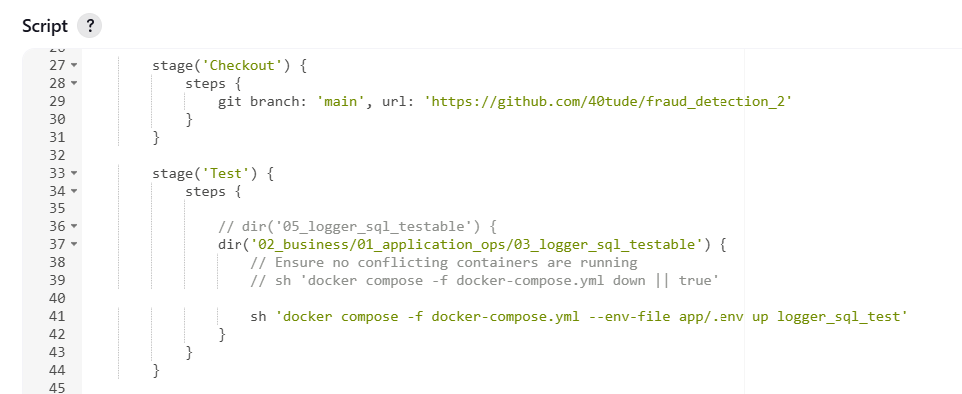
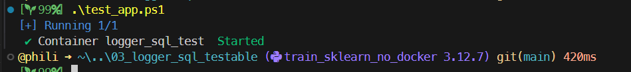
Logger SQL + Tests in Jenkins

Slide 19
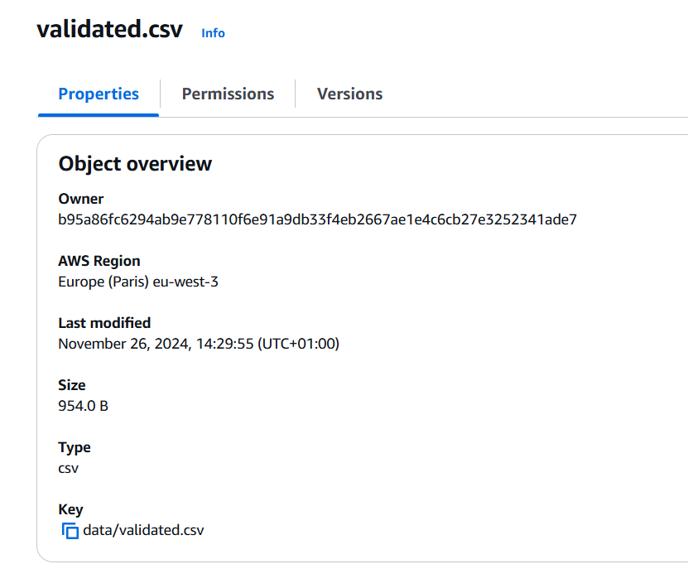
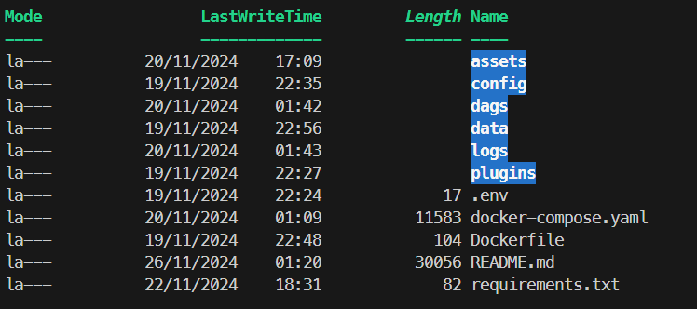
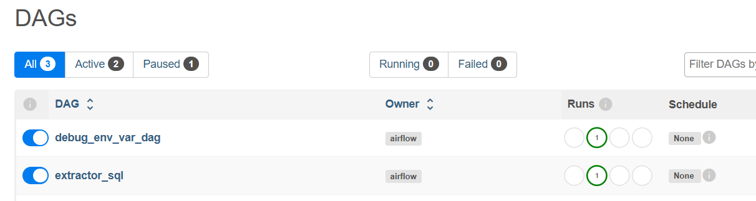
Extract SQL – DAG Airflow

Slide 20
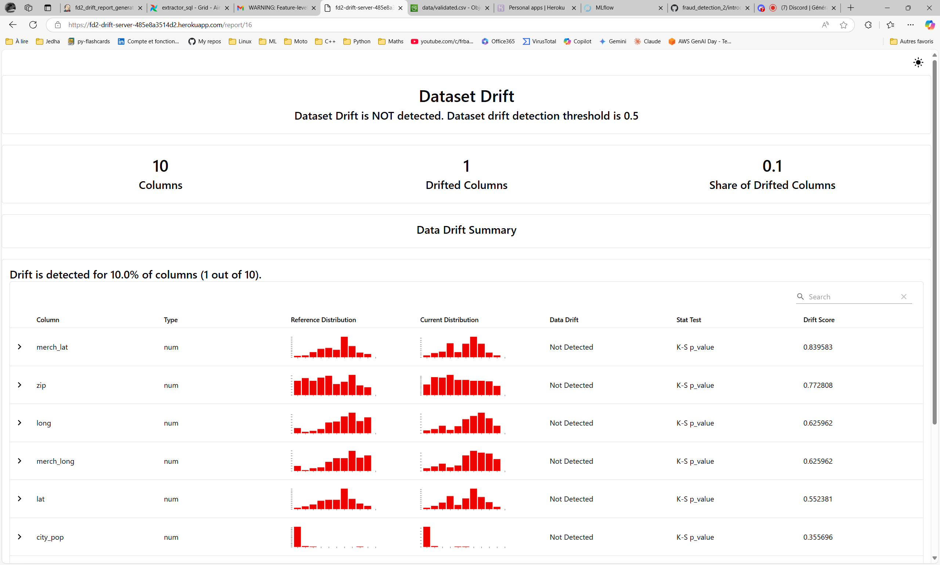
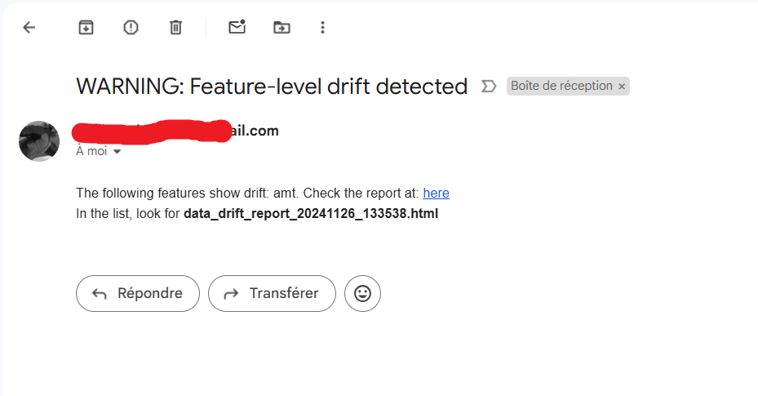
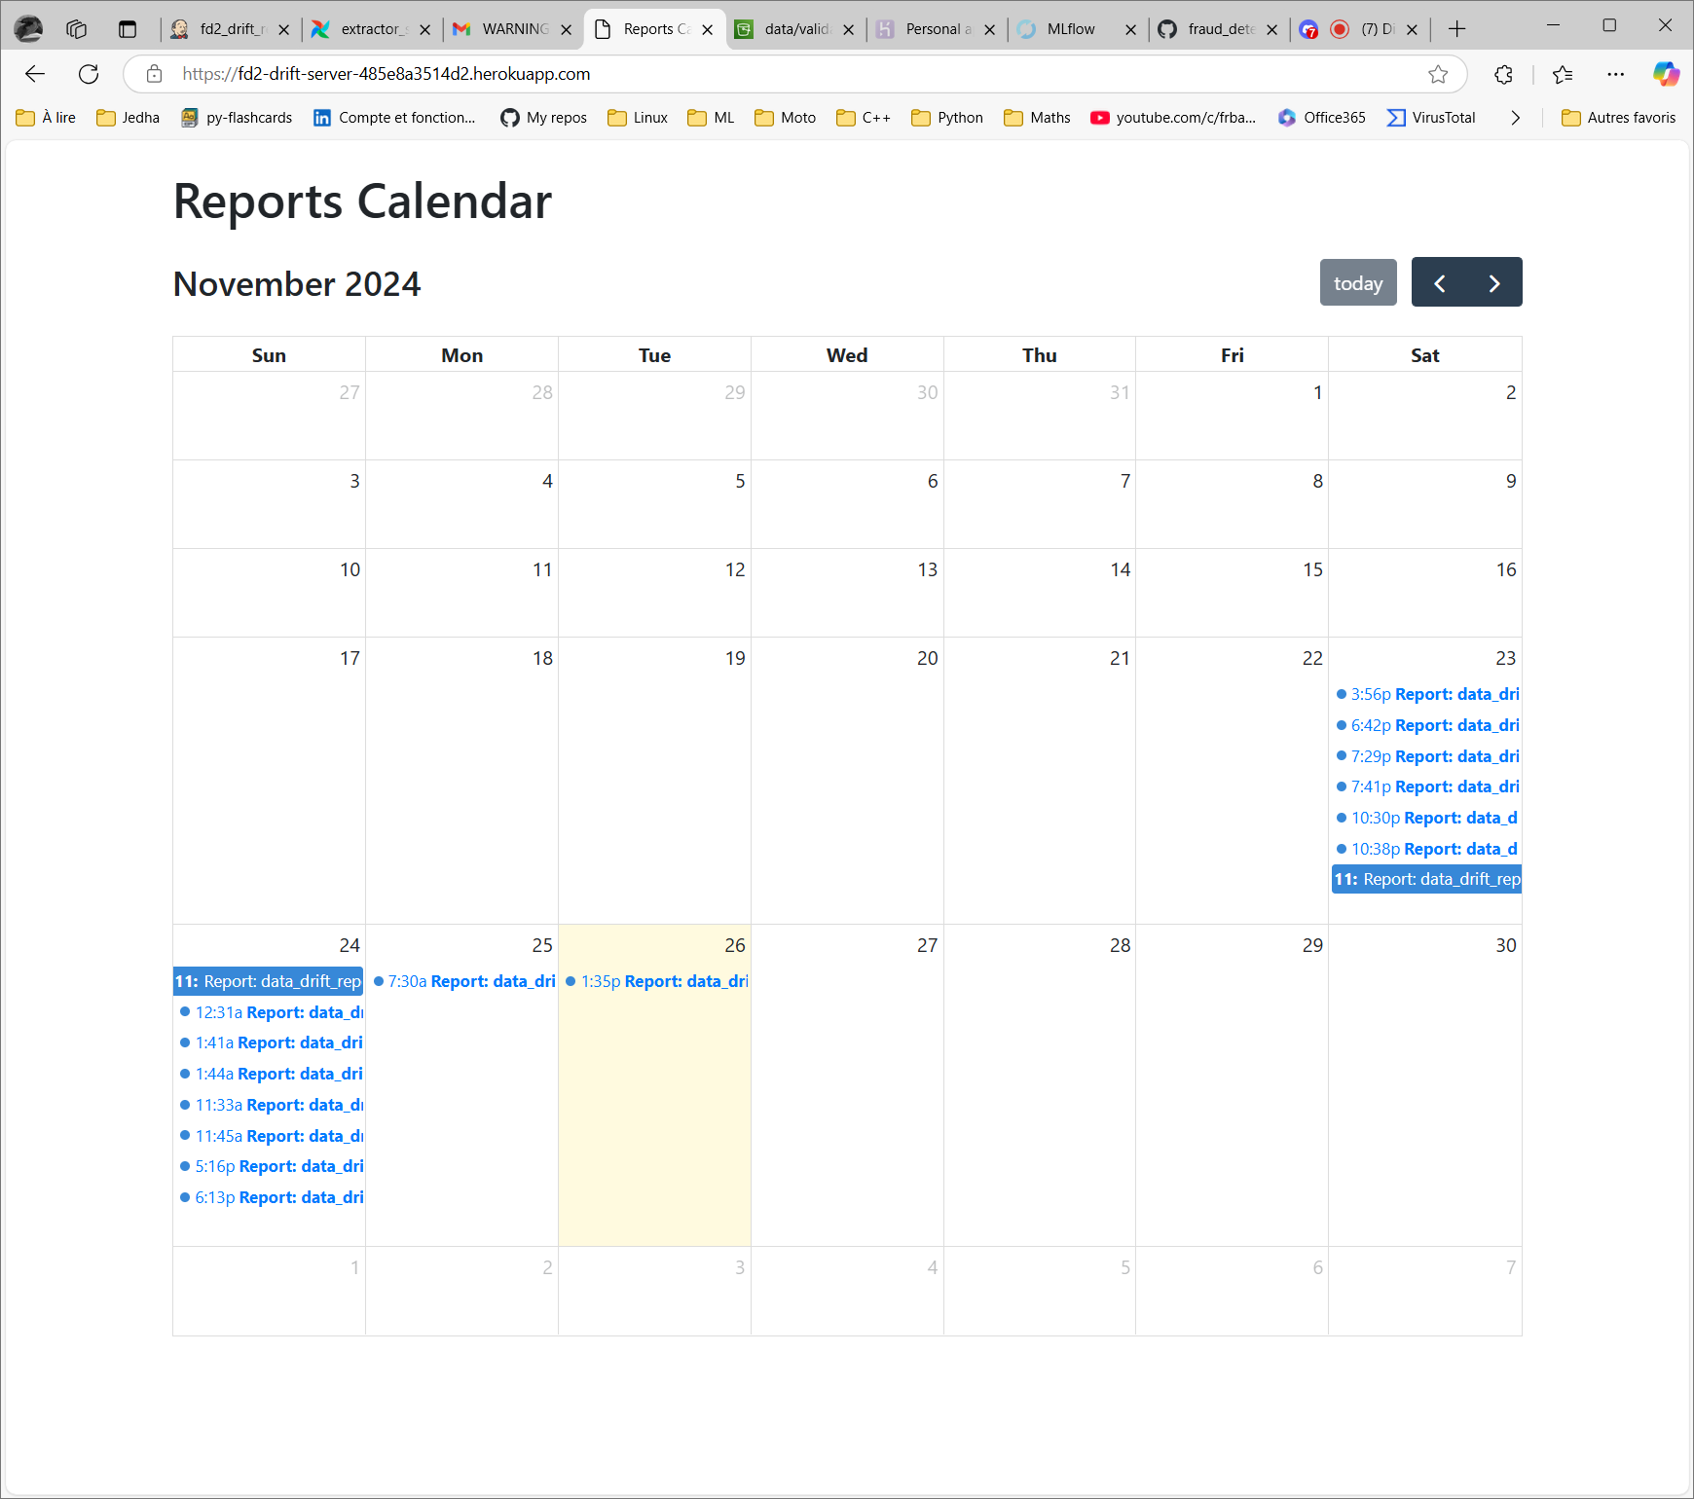
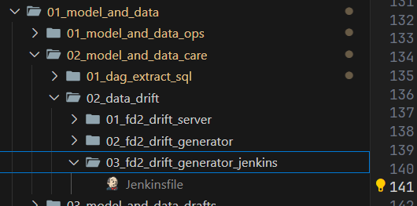
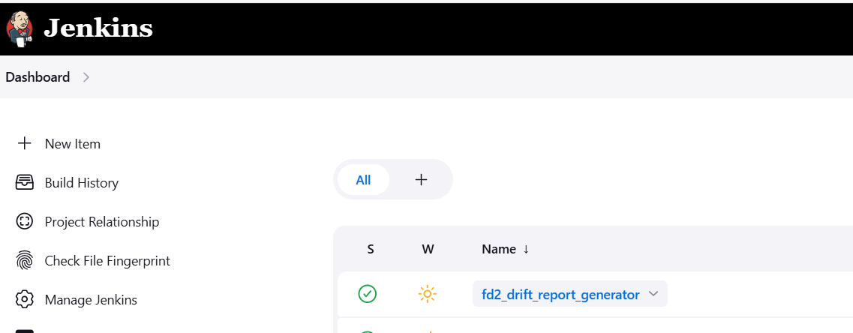
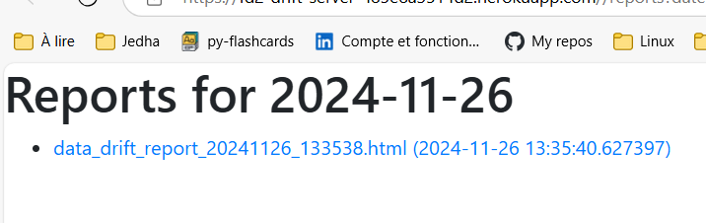
Drift Analysis - Jenkins

Slide 21
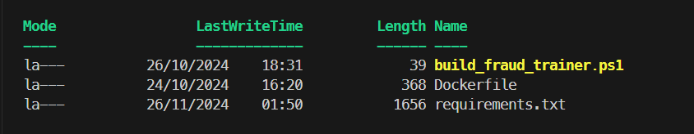
Create Model Training Image

Slide 22
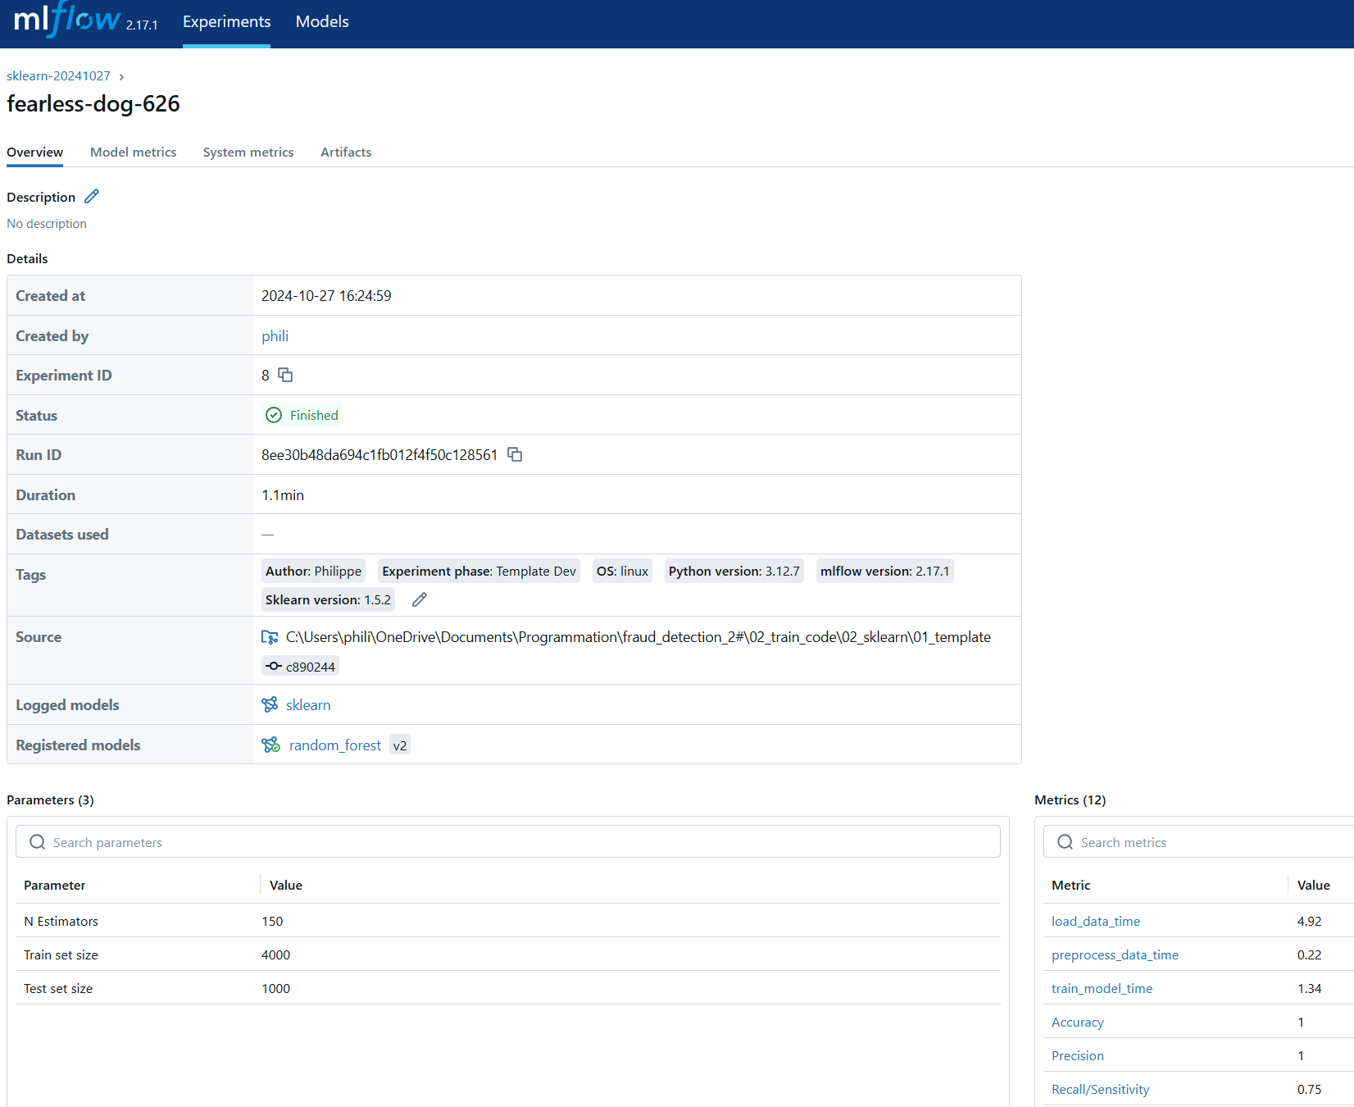
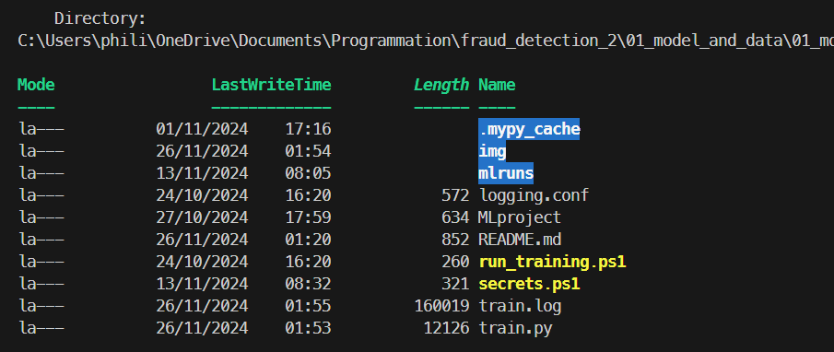
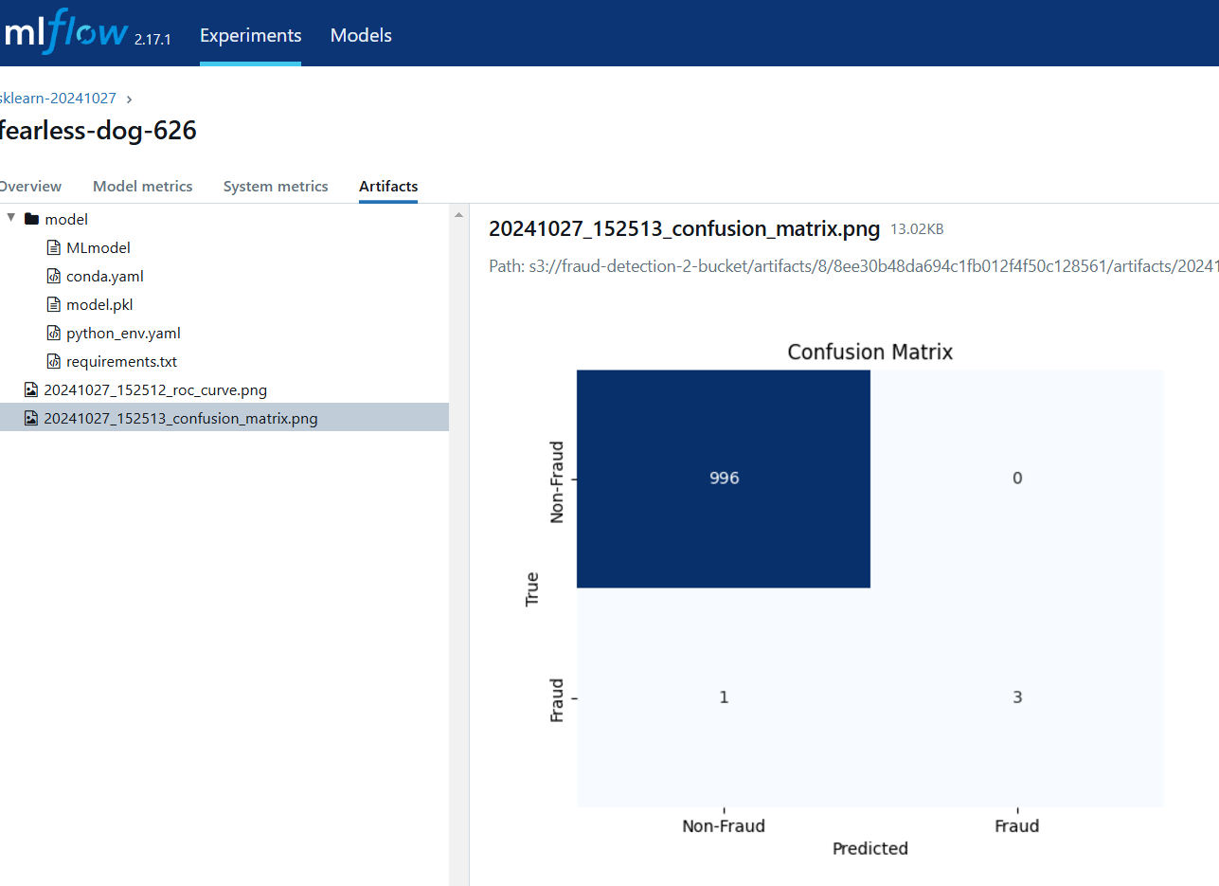
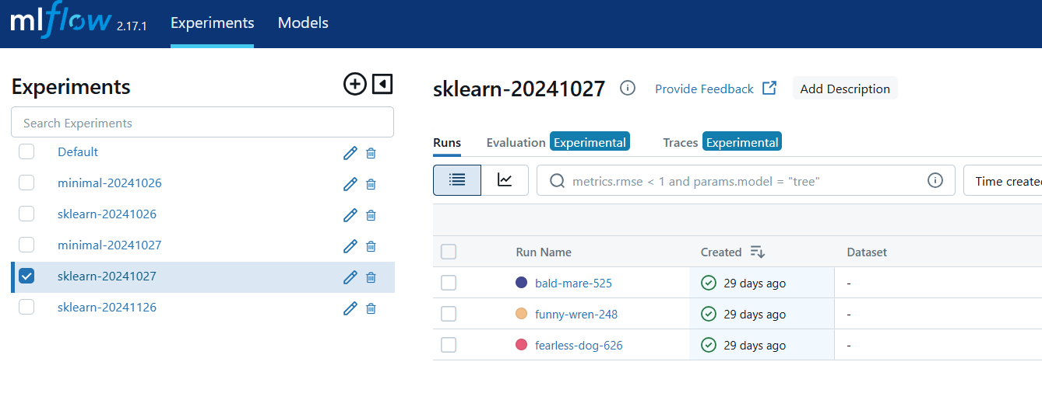
Model Training

Slide 23

Take away
EDA : The recipe
Features Engineering : The secret sauce
Baseline model : The first taste
Metrics Analysis : The critics' score
API & App : Sharing with friends
Deployment & Monitoring : Serve the dish, maintain quality
Notes:
Le rat c'est Rémy
EDA : The recipe
Features Engineering : The secret sauce
Baseline model : The first taste
Metrics Analysis : The critics' score
API & App : Sharing with friends
Deployment & Monitoring : Serve the dish, maintain quality

