Slide 1





fraud_detection_2 Project
author : philippe.baucour@gmail.com
specs : https://app.jedha.co/course/become-certified-ai-architect-lds/data-analyst-certificate-lds
URLs : project https://github.com/40tude/fraud_detection_2
The content of the following slides is mainly a cut-and-paste of what's already available in the project notebook(s) or screen captures of running applications. The idea is that the slides can be used to guide and frame the presentation and discussion.
Notes:
See also : https://app.jedha.co/course/project-prep-lds/project-overview-lds Criteria :
The use of machine learning algorithms is automated and accessible through a web interface :
Accessibility of the machine learning algorithm construction process in an environment (Containerization via Docker and normalization via MLFlow)
Quality of the data returned by the application programming interface (API) incorporating the predictions of the algorithm implemented
Cleanliness of the code (compliance with PEP8 standards in Python)
Practicality of the web interface including the use of the application programming interface
Usefulness of the web interface including the use of the application programming interface
Accessibility of the web interface including the use of the application programming interface

Slide 2
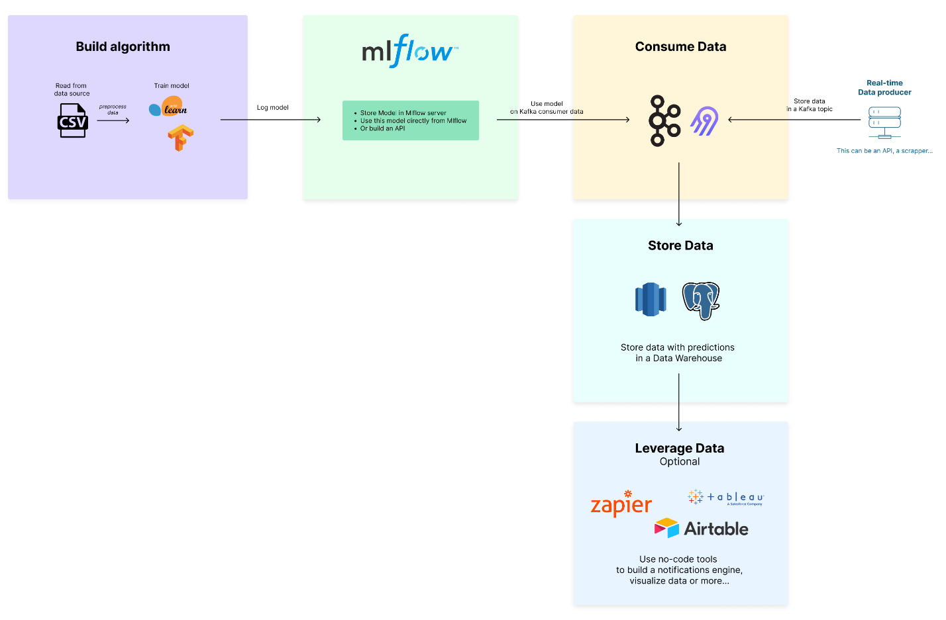

Slide 3
Build algorithm
MLflow
Consume Data
RT Data
Store Data
Leverage Data

Slide 4
Build algorithm
MLflow
RT Data
Consume Data
Store Data
Leverage Data

Slide 5
Build algorithm
MLflow
RT Data
Consume Data
Store Data
Leverage Data

Slide 6
Train
Models
Consumer
Logger SQL
Transactions
End User

Slide 7



Training Data Set
Train
Validated Data
Models
Extractor SQL
Consumer
Logger SQL
Transactions
End User

Slide 8





Training Data Set
Train
Validated Data
Models
What's moving?
How fast?
What if speed=0?
Daily
Extractor SQL
Speed 1?
Consumer
Logger SQL
Speed 1
Speed 1?
Speed 3
Daily
Transactions
End User

Slide 9
Training Data Set
Train
Validated Data
Models
Extractor SQL
Producer
Consumer
Logger SQL
Transactions
End User

Slide 10

Training Data Set
Train
Validated Data
Models
Extractor SQL
Producer
Consumer
Logger SQL
Speed 1
Speed 1
Speed 2
Speed 2
Speed 3
Speed 3
Transactions
End User

Slide 11


Training Data Set
Train
Validated Data
Models
Daily
On request
Modelizer Last Previous
Extractor SQL
Producer
Consumer
Logger SQL
Speed 1
Speed 1
Speed 2
Speed 2
Speed 3
Speed 3
Daily
Transactions
Alert
End User

Slide 12
Training Data Set
Docker 5
Train
Validated Data
AWS S3 1
AWS S3 2
Mlflow
Heroku AWS S3 2
Models
Daily
PostgreSQL
On request
Modelizer Last Previous
Docker 6
Extractor SQL
Docker 4
API
Producer
Consumer
Logger SQL
Speed 1
Speed 1
Speed 2
Speed 2
Speed 3
Speed 3
Daily
Transactions
API
Docker 1
Docker 2
Docker 3
Alert
PostgreSQL
Topic_1
End User
Topic_2
Confluent
Confluent

Slide 13
Training Data Set
Train
Validated Data
Models
Model and Data
Ops - Care
Modelizer Last Previous
Extractor SQL
Producer
Consumer
Logger SQL
Transactions
Business
Ops - Care
Topic_1
End User
Topic_2

Slide 14

Take away
So far, working on the projects I keep in mind :
EDA : The recipe
Features Engineering : The secret sauce
Baseline model : The first taste
Metrics Analysis : The critics' score
API & App : Sharing with friends
Deployment & Monitoring : Serve the dish, maintain quality
Impressed by the results of the baseline model
BERT (unfreezed) help to keep the Precision while improving the Accuracy but at the cost of training time
Notes:
EDA : The recipe
Features Engineering : The secret sauce
Baseline model : The first taste
Metrics Analysis : The critics' score
API & App : Sharing with friends
Deployment & Monitoring : Serve the dish, maintain quality

Slide 15
Training Data Set
Docker 5
Train
Validated Data
AWS S3 1
AWS S3 2
Mlflow
Heroku AWS S3 2
Models
Daily
PostgreSQL
On request
Modelizer Last Previous
Docker 6
Extractor SQL
Docker 4
API
Producer
Consumer
Logger SQL
Speed 1
Speed 1
Speed 2
Speed 2
Speed 3
Speed 3
Daily
Transactions
API
Docker 1
Docker 2
Docker 3
Alert
PostgreSQL
Topic_1
End User
Topic_2
Confluent
Confluent

Slide 16
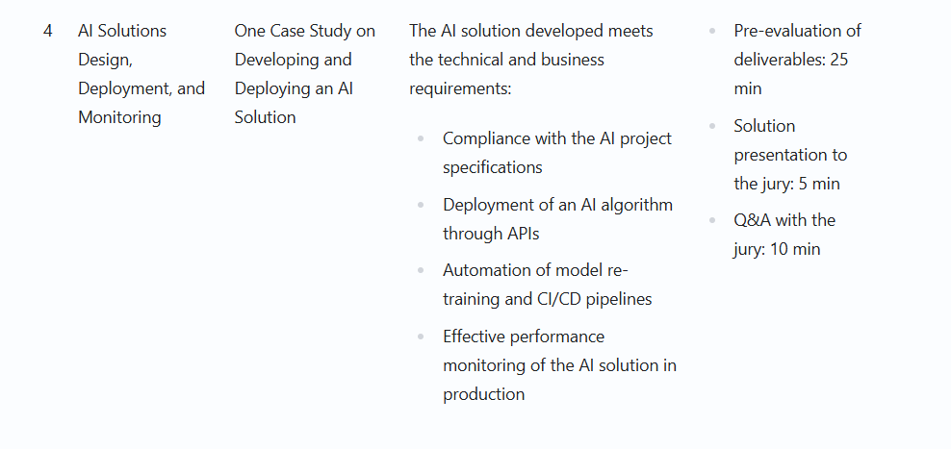
https://app.jedha.co/course/become-certified-ai-architect-lds/data-analyst-certificate-lds
Block 4

Slide 17

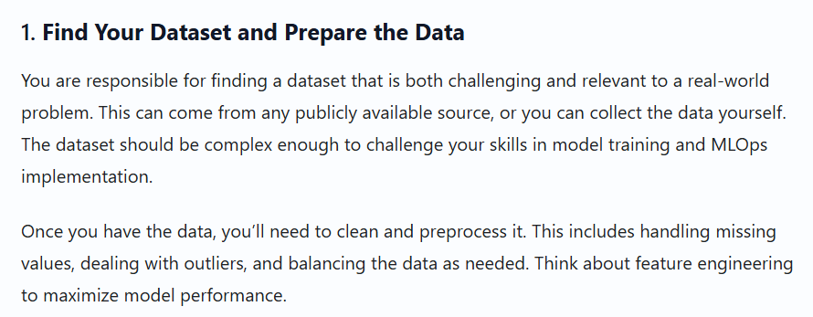

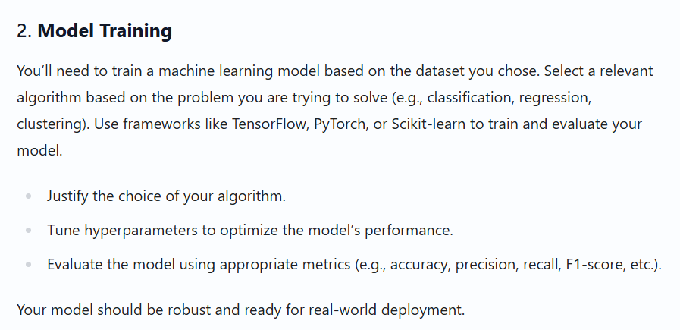
https://app.jedha.co/course/project-prep-lds/project-overview-lds

Slide 18
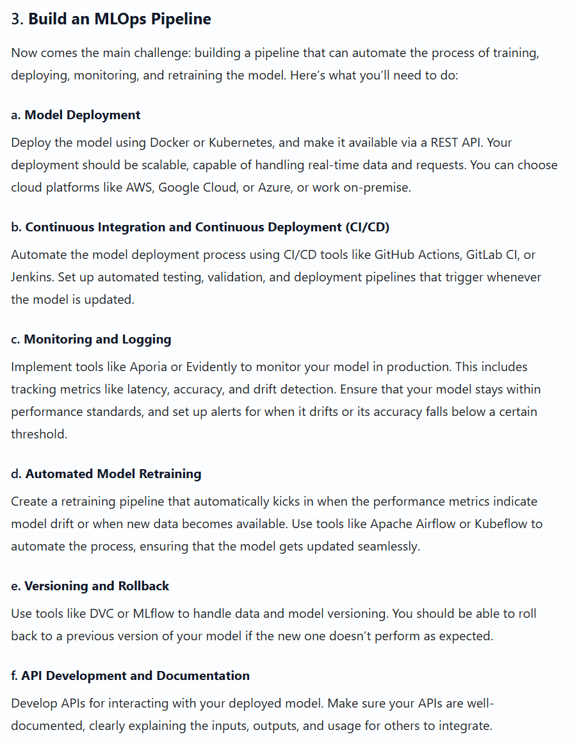
https://app.jedha.co/course/project-prep-lds/project-overview-lds

Slide 19
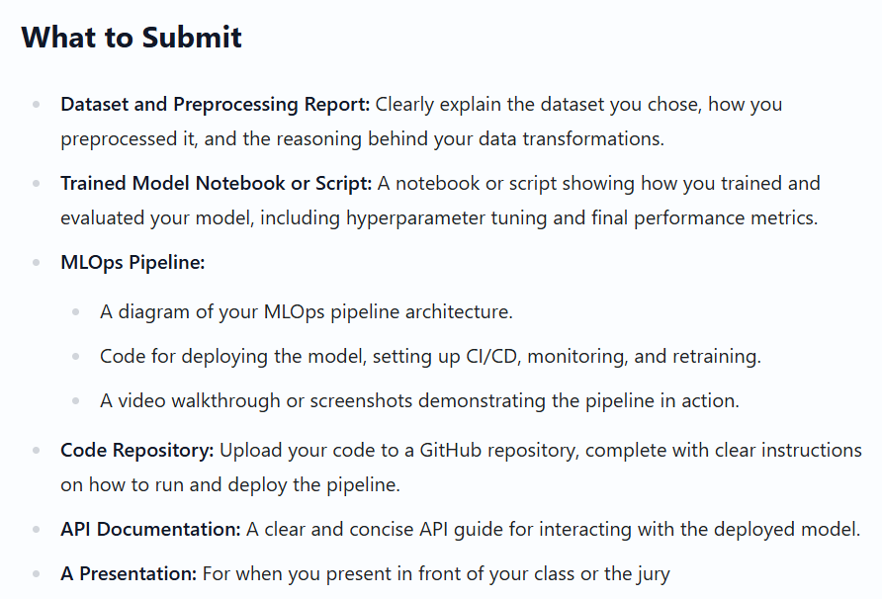

https://app.jedha.co/course/project-prep-lds/project-overview-lds
Notes:
Key Evaluation Criteria
Data Preparation and Model Performance: Did you select a meaningful dataset, preprocess it properly, and train a high-performance model?
Pipeline Completeness: Does your MLOps pipeline handle the entire lifecycle from deployment to monitoring and retraining?
Automation: How well have you automated the processes for deployment and retraining? Is the system robust enough to handle changes in data or performance?
Scalability and Monitoring: Can your pipeline scale to handle larger data volumes and heavier user loads? Is the monitoring system proactive and effective?
Documentation and Usability: Is the pipeline clearly documented and accessible for future developers or stakeholders?

Slide 20
EDA
Notes:
* When 2 bookings are consecutive with a Time $\Delta$ between them most of the rentals are on time (returns happen before `time_delta_with_previous_rental_in_minutes`)
* See 270 vs 1245
* When there is no Time $\Delta$ (no previous driver) most of the returns are late
* See 8602 vs 6228

Slide 21
Take away
EDA : The recipe
Features Engineering : The secret sauce
Baseline model : The first taste
Metrics Analysis : The critics' score
API & App : Sharing with friends
Deployment Monitoring : Serve the dish, maintain quality

Slide 22
Code Review

Slide 24


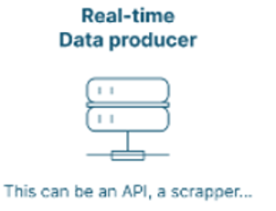



request prediction - speed 2
get prediction - speed 2
store - speed 3
subcribe - speed 1
Topic 2
Topic 1

Slide 25
Training Data Set
Train
Validated Data
Daily
AWS S3 1
Docker 5
AWS S3 2
On request
Models
Extractor SQL
Mlflow
Heroku AWS S3 2
Heroku
PostgreSQL
Docker 4
Producer
Consumer
Logger SQL
Speed 1
Speed 1
Speed 2
Speed 2
Speed 3
Speed 3
Transactions
API
Docker 1
Docker 2
Docker 3
Daily
Alert
PostgreSQL
Topic_1
End User
Topic_2
Confluent
Confluent

Slide 26
Training Data Set
Docker 5
Train
Validated Data
AWS S3 1
AWS S3 2
Mlflow
Heroku AWS S3 2
Models
Daily
Heroku
PostgreSQL
On request
Modelizer Last Previous
Docker 6
Extractor SQL
Docker 4
API
Producer
Consumer
Logger SQL
Speed 1
Speed 1
Speed 2
Speed 2
Speed 3
Speed 3
Daily
Transactions
API
Docker 1
Docker 2
Docker 3
Alert
PostgreSQL
Topic_1
End User
Topic_2
Confluent
Confluent

Slide 27

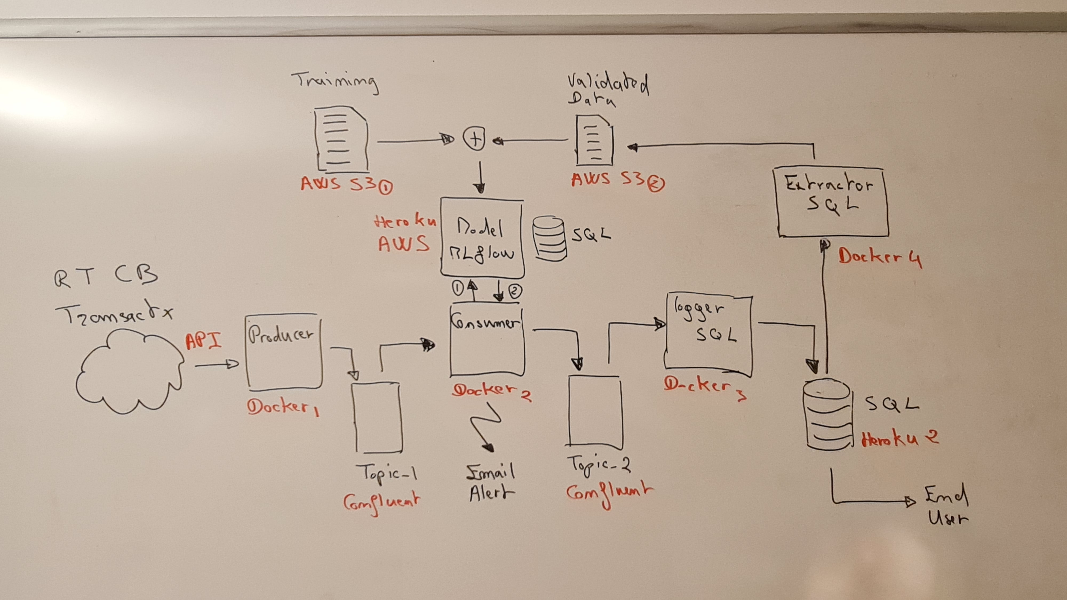

Slide 28
FD2

Slide 29
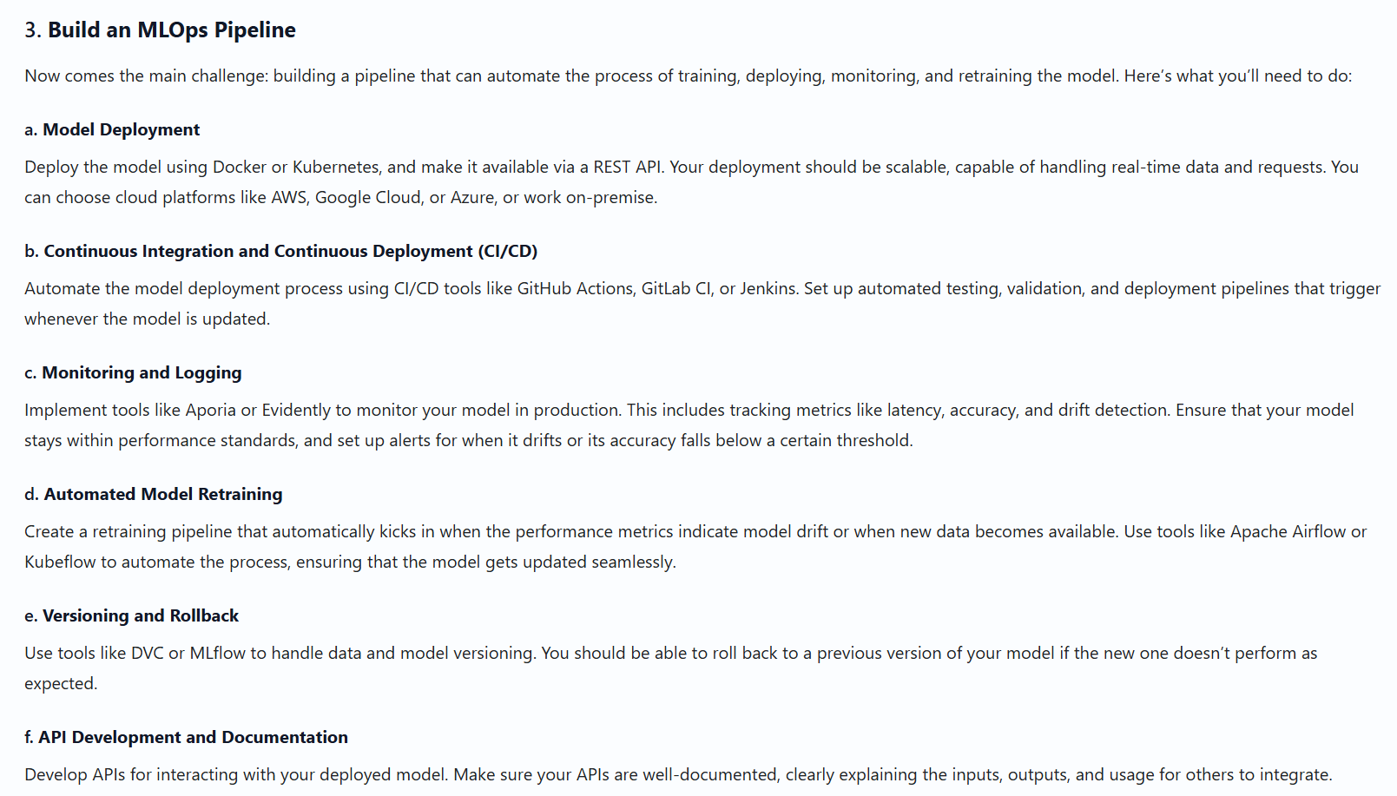
Notes:
https://app.jedha.co/course/project-prep-lds/project-overview-lds

Slide 30



${pwd}/hosted
/home/hosted
WIN11
first_container
extractor_sql_dag_img
/home/hosted/app
/home/app
extractor_sql_dag_shared_app

Slide 32
lead-program-assets.s3.eu-west-3.amazonaws.com
Train set :
Validated set : s3://fraud-bucket-202406/data/

Slide 34
request prediction - speed 2
get prediction - speed 2
store - speed 3
subcribe - speed 1
topic_2
topic_1

Slide 35


