Slide 1
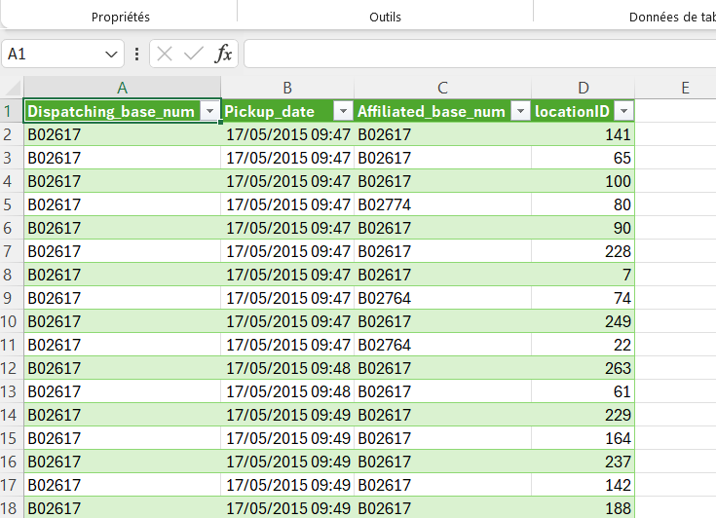
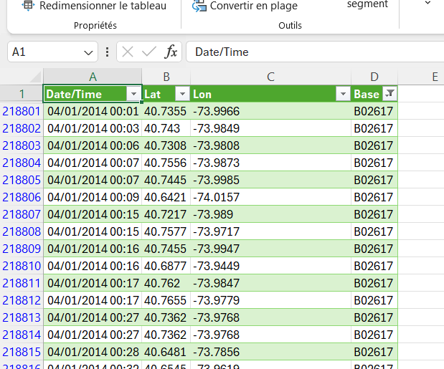
Uber raw jan jun 15
Uber raw data april 14

Slide 2
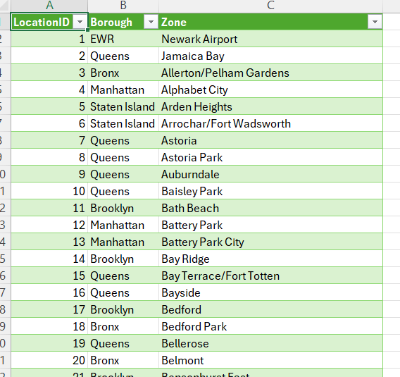
Taxi zone lookup

Slide 3
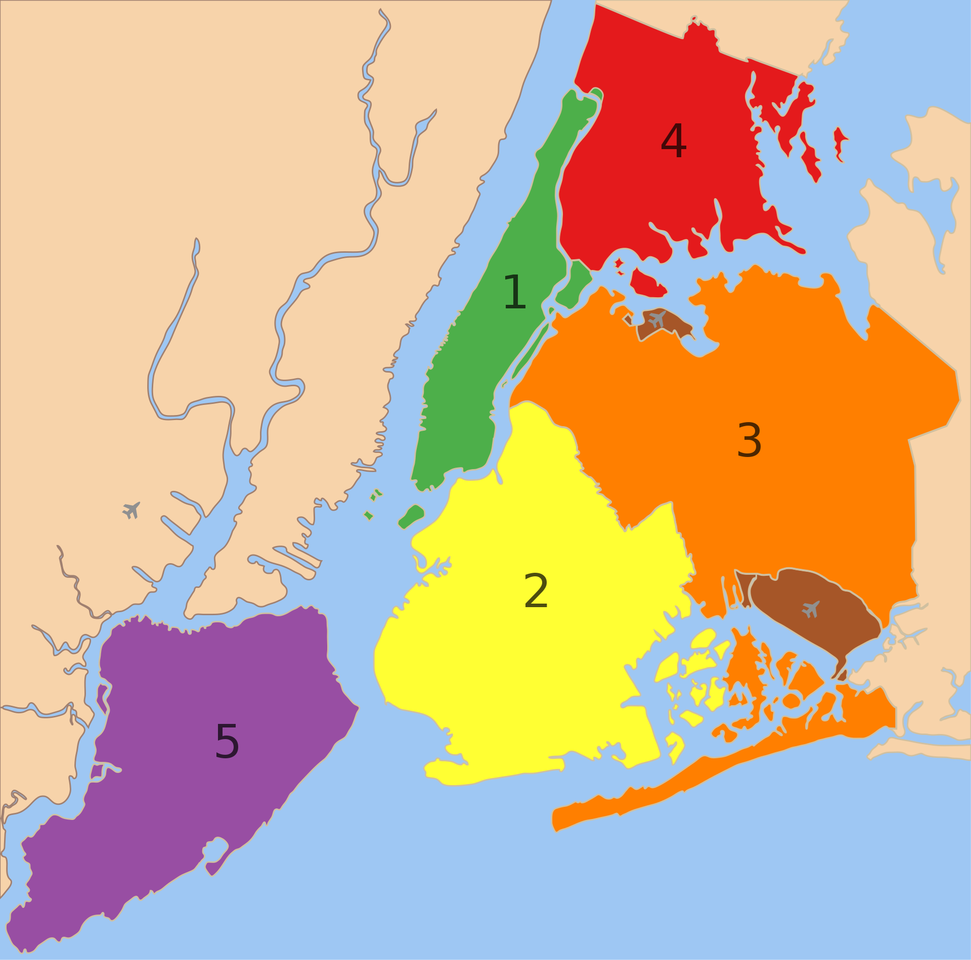
The Bronx
Manhattan
Queens
Brooklyn
Staten Island

Slide 4
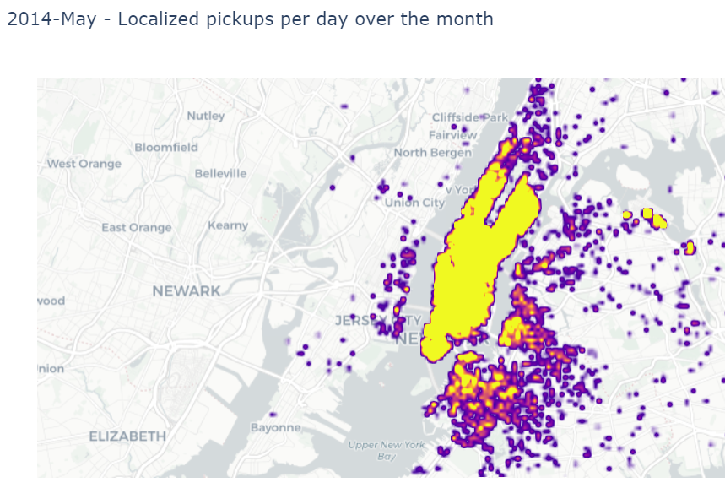
LaGuardia
Manhattan
Greenpoint
Brooklyn

Slide 5
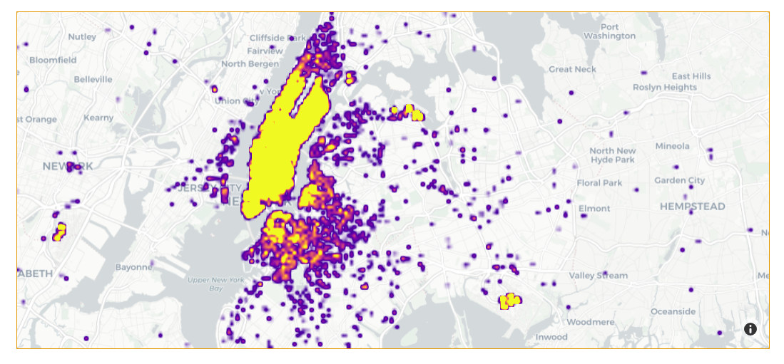
LaGuardia
Manhattan
Greenpoint
Newark
Brooklyn
JFK

