Slide 1

IoT project - Phase 2:
DEPARTMENT OF COMPUTER SCIENCE AND ENGINEERING
TEAM NAME: Proj_224780_Team_3
PROJECT NAME: Smart Public Restroom
Team Members:
SWARNADARSINI V 113321104101
UKKISALA LAKSMI 113321104104
VAISHNAVI G 113321104107
VAISHALI G 113321104106
VAKATI PRANAVI 113321104108

Slide 2
INNOVATION:
Smart Public Restroom is an IoT project that looks into fulfilling the public’s needs, providing a good experience for the people who use them and making sure their health is not in line every time they use these restrooms is the main goal.
Creating smart public restrooms can greatly improve the overall experience for users while also promoting hygiene and resource efficiency. Here are some innovative ideas for smart public restrooms:
1.Automatic Sanitization: Install UV-C or other disinfection systems that automatically clean and sanitize restroom fixtures and surfaces after each use. UV-C lights can kill bacteria and viruses, ensuring a cleaner environment
.
2.Occupancy Tracking: Implement occupancy sensors to monitor the number of people inside the restroom. Display real-time occupancy information outside the restroom, so users can see if it's crowded or available.
3.Touchless Fixtures: Use touchless faucets, soap dispensers, and hand dryers to minimize contact with surfaces, reducing the spread of germs.
4.Water Conservation: Use water-saving toilets and urinals with adjustable flush settings based on usage. Implement waterless urinals or grey water recycling systems to conserve water.
5.Toilet Health Sensors: Incorporate sensors to monitor toilet health and detect issues like clogs or leaks. This information can be sent to maintenance staff for proactive repairs.
6.Real-time Cleanliness Feedback: Install buttons or touchless sensors for users to provide real-time feedback on cleanliness. This data can help restroom staff prioritize cleaning tasks.

Slide 3
7. Occupancy-Linked Cleaning: Use occupancy data to schedule cleaning tasks more efficiently. For instance, if occupancy is low, cleaning staff can be alerted to perform deep cleaning.
8. Scent Management: Implement scent management systems that release pleasant fragrances periodically to maintain a fresh atmosphere.
9. Accessible Technology: Ensure that smart restroom features are accessible to all users, including those with disabilities. Incorporate braille signage and audio cues where necessary.
10. Smart Toilet Paper Dispensers: Install toilet paper dispensers that monitor usage and automatically order refills when supplies are low.
11. Energy-Efficient Lighting: Use motion-activated LED lighting to save energy when the restroom is unoccupied and provide adequate lighting when users enter.
12. Hygiene Stations: Offer hygiene stations with hand sanitizer dispensers and disposable face masks for users who may need them.
13. Art and Greenery: Enhance the aesthetics of the restroom with art installations, greenery, or living walls to create a more pleasant and calming environment.
14. Solar-Powered Amenities: If possible, power some of the restroom's features with solar panels to reduce energy costs and environmental impact.

Slide 4
PROJECT OBJECTIVES:
1. Improved Hygiene: Enhance public health by providing clean and well-maintained restroom facilities with touchless fixtures to reduce the spread of germs.
2. Water and Energy Efficiency: Implement water-saving technologies like low-flow toilets and energy-efficient lighting to reduce resource consumption and operational costs.
3. Accessibility: Ensure inclusivity by designing restrooms that meet ADA (Americans with Disabilities Act) standards and are accessible to individuals with diverse needs.
4. Real-time Monitoring: Enable remote monitoring of restroom conditions to address maintenance issues promptly and maintain cleanliness.
5. Sustainability: Incorporate eco-friendly materials and sustainable building practices to minimize the environmental impact of restroom construction and operation.

Slide 5
6. User Convenience: Enhance the user experience through features like occupancy indicators, automatic flush and soap dispensers, and touchless payment systems.
7. Safety and Security: Implement security measures such as emergency call buttons, well-lit spaces, and surveillance cameras to ensure user safety.
8. Data Analytics: Utilize data collected from restroom usage to optimize maintenance schedules, identify trends, and improve overall efficiency.
9. Public Awareness: Promote the availability of smart restrooms through signage and mobile apps to help people easily locate and access them.
10. Cost-Benefit Analysis: Assess the long-term cost savings and benefits of smart restrooms, including reduced maintenance costs and increased user satisfaction.

Slide 6
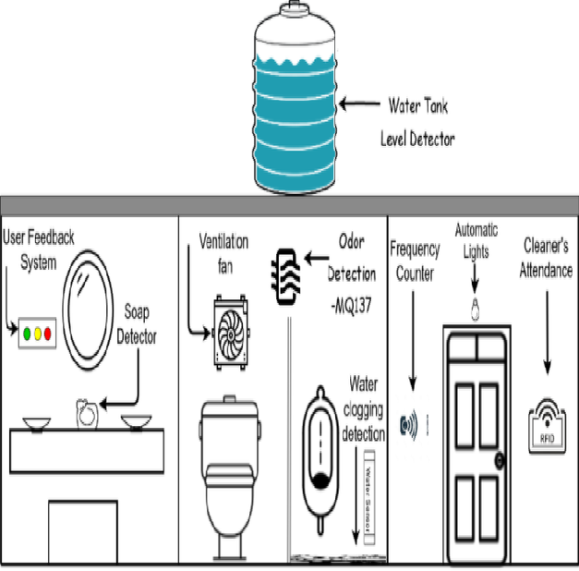
VIRTUALIZATION DIAGRAM ON IOT:
This is a representation of what would be achieved in project,
In this diagram we can see the automated clog detection system, soap detector, cleaner’s attendance, frequency counter, automated lights and all.

Slide 7
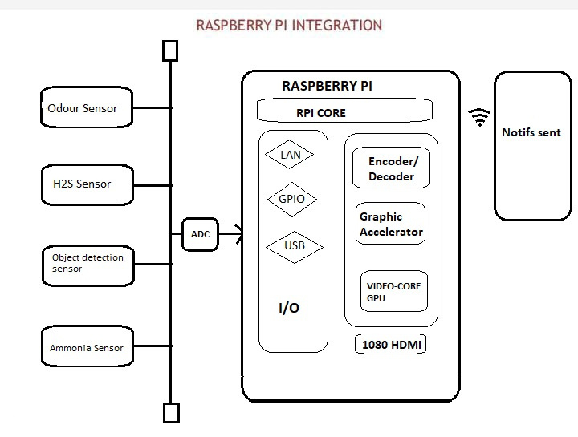
RASPBERRY PI INTEGRATION
Raspberry Pi integration refers to the process of incorporating Raspberry Pi single-board computers into various hardware and software systems to perform specific tasks or functions. Raspberry Pi boards are versatile and affordable computing devices that can be integrated into a wide range of applications across various domains.

Slide 8
CODE IMPLEMENTATION:
Odour Sensor:
import RPi.GPIO as GPIO
import time
# Set up GPIO mode and pin for the gas sensor
GPIO.setmode(GPIO.BCM)
gas_sensor_pin = 17 # Change this to the GPIO pin connected to your gas sensor
GPIO.setup(gas_sensor_pin, GPIO.IN)
def detect_unpleasant_odor():
try:
while True:
# Read the gas sensor input (0 for no gas detected, 1 for gas detected)
gas_detected = GPIO.input(gas_sensor_pin)
if gas_detected:
print("Unpleasant odor detected!")
# You can add code here to trigger an alert, such as sending an email or SMS.
# Wait for a short duration before reading the sensor again
time.sleep(2) # Adjust the sleep duration as needed
except KeyboardInterrupt:
print("Exiting...")
finally:
GPIO.cleanup()
if __name__ == "__main__": detect_unpleasant_odor()

Slide 9
CONCLUSION:
A possible conclusion for the smart public restroom project is:
The smart public restroom is a comprehensive solution that aims to improve the efficiency, cleanliness, and user experience of public restrooms It integrates various technologies, such as IoT sensors, robotics, touchless fixtures, and data analytics, to create a smart environment that can monitor and optimize restroom functions. The smart public restroom also ensures accessibility, security, and sustainability for all users. The project demonstrates the potential of applying innovation and creativity to solve everyday problems and enhance public health and hygiene.

