Slide 1

IoT PROJECT –PHASE 4:
DEPARTMENT OF COMPUTER SCIENCE AND ENGINEERING
TEAM NAME : Proj_224780_Team_3
PROJECT NAME : Smart Public Restroom
TEAM MEMBERS :
SWARNADARSINI V 113321104101
UKKISALA LAKSHMI 113321104104
VAISHALI G 113321104106
VAISHNAVI G 113321104107
VAKATI PRANAVI 113321104108

Slide 2
INNOVATION:
Smart Public Restroom is an IoT project that looks fulfilling the public’s needs, providing a good experience for the people who use them and making sure their health is not line every time they use these restrooms is the main goal.
Here are some innovative ideas for smart public restrooms:
Automatic Sanitization : Install UV-C or the other disinfection systems that automatically clean and sanitize restroom fixtures and surfaces after each use . UV-C lights can kill bacteria and viruses ,ensuring a cleaner environment.
Occupancy Tracking : Implement occupancy sensors to monitor the number of people inside the restroom . Display real-time occupancy transformation outside the restroom, so users can see if it’s crowded or available.
Touchless Fixtures : Use touchless faucets, soap dispensers, and hand dryers to minimize contact with surfaces, reducing the spread of germs.
Water Conservation: Use water-saving toilets and urinals with adjustable flush settings based on usage . Implement waterless urinals or grey water recycling systems to conserve water.
Toilet Health Sensors: Incorporate sensors to monitor toilet health and detect issues like clogs or leaks.This information can be sent to maintenance staff for proactive repairs.

Slide 3
Real-time Cleanliness Feedback: Install buttons or touchless sensors for users to provide real-time feedback on cleanliness. This data can help restroom staff prioritize cleaning tasks.
Occupancy-Linked Cleaning: Use occupancy data to schedule cleaning tasks more efficiently. For instance, if occupancy is low, cleaning staff can be alerted to perform deep cleaning.
Scent Management: Implement scent management systems that release pleasant fragrances periodically to maintain a fresh atmosphere.
Accessible Technology: Ensure that smart restroom features are accessible to all users, including those with disabilities. Incorporate braille signage and audio cues where necessary.
Smart Toilet Paper Dispensers: Install toilet paper dispensers that monitor usage and automatically order refills when supplies are low.
Energy-Efficient Lighting: Use motion-activated LED lighting to save energy when the restroom is unoccupied and provide adequate lighting when users enter.
Hygiene Stations: Offer hygiene stations with hand sanitizer dispensers and disposable face masks for users who may need them.

Slide 4
PROJECT OBJECTIVES :
Improved Hygiene: Enhance public health by providing clean and well-maintained restroom facilities with touchless fixtures to reduce the spread of germs.
Water and Energy Efficiency: Implement water-saving technologies like low-flow toilets and energy-efficient lighting to reduce resource consumption and operational costs.
Accessibility: Ensure inclusivity by designing restrooms that meet ADA (Americans with Disabilities Act) standards and are accessible to individuals with diverse needs.
Real-time Monitoring: Enable remote monitoring of restroom conditions to address maintenance issues promptly and maintain cleanliness.
Sustainability: Incorporate eco-friendly materials and sustainable building practices to minimize the environmental impact of restroom construction and operation.
User Convenience: Enhance the user experience through features like occupancy indicators, automatic flush and soap dispensers, and touchless payment systems.

Slide 5
PROJECT REQUIREMENTS :
User Counter : The requirement is that sensor that can be mount on the top of the gate to count the user , with reasonable accuracy. Also, it should be rigid enough to protect from vandalism.
Smell Sensor : A smell sensor node is a wi-fi based sensor that will detect the level of gases that causes the bad smell in the toilet.
Water Level Sensor : The Water level sensor mode is a wi-fi based device that is used to detect based on four levels i.e, 25%,50%,75%,100%.There are many water level sensors are present in the market. But, we need to use cost-effective water level sensor, so we have selected conductivity based water level sensor.
User Feedback Machine : The user feedback system is a wireless based device that takes user feedback in terms of Toilet cleaning. There are three switches for clean, average ,and Dirty feedback.
Star Light Display : Star light display is a wi-fi based service that will display a star rating of Toilet.

Slide 6
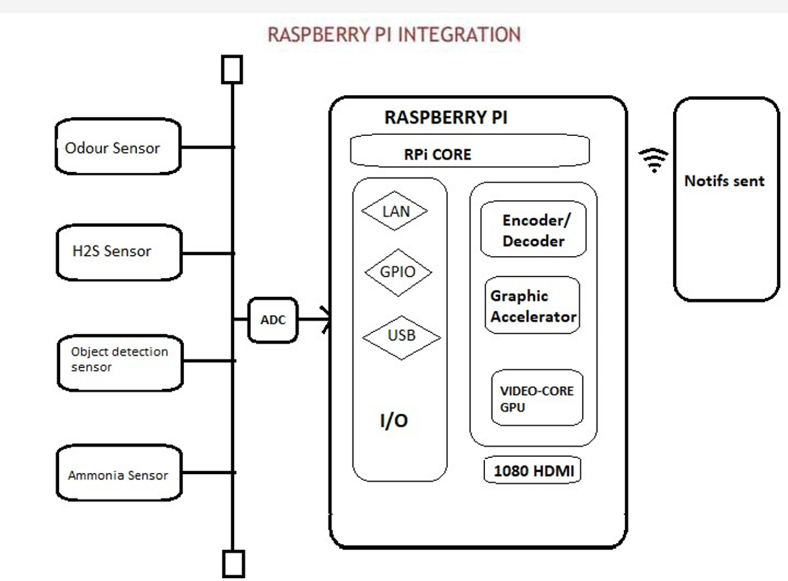
RASPBERRY PI INTEGRATION:

Slide 7
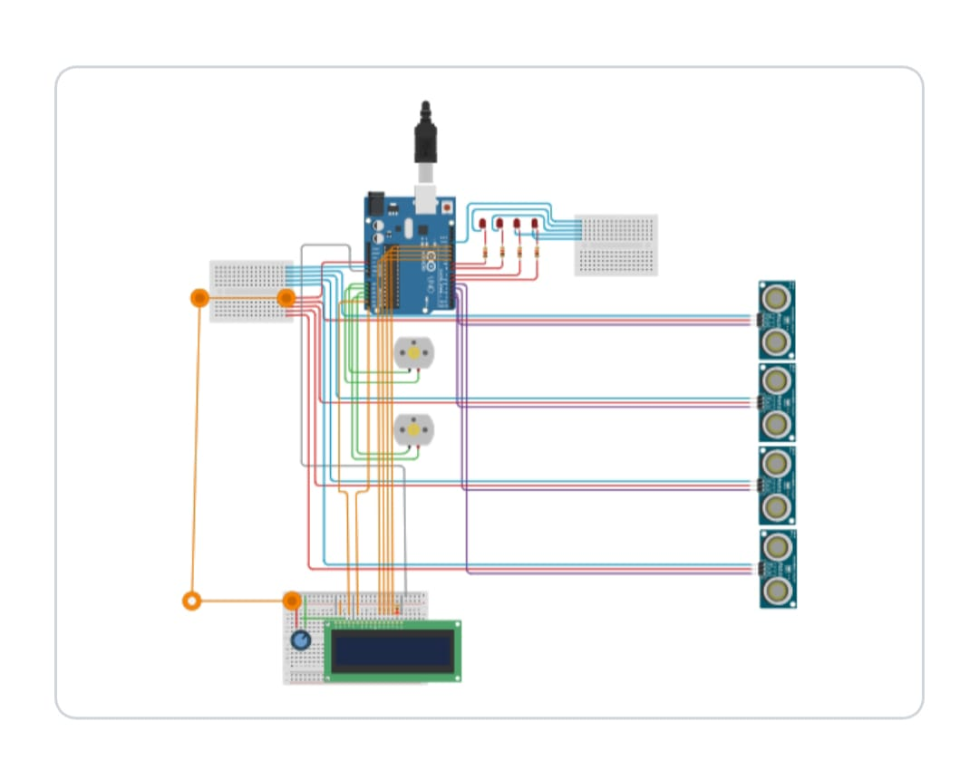
ARDUINO INTEGRATION:

Slide 8
CODE IMPLEMENTATION :
Odour Sensor :
import Rpi.GPIO as GPIO
import time
# Set up GPIO mode and pin for the gas sensor
GPIO.setmode(GPIO.BCM)
gas_sensor_pin = 17 # Change this to the GPIO pin connected to your gas sensor
GPIO.setup(gas_sensor_pin, GPIO.IN)
def detect_unpleasant_odor():
try:
while True:
# Read the gas sensor input (0 for no gas detected, 1 for gas detected)
gas_detected = GPIO.input(gas_sensor_pin)
if gas_detected:
print("Unpleasant odor detected!")

Slide 9
# You can add code here to trigger an alert, such as sending an email or SMS.
# Wait for a short duration before reading the sensor again
time.sleep(2) # Adjust the sleep duration as needed
except KeyboardInterrupt:
print("Exiting...")
finally:
GPIO.cleanup()
if __name__ == "__main__": detect_unpleasant_odor()

Slide 10
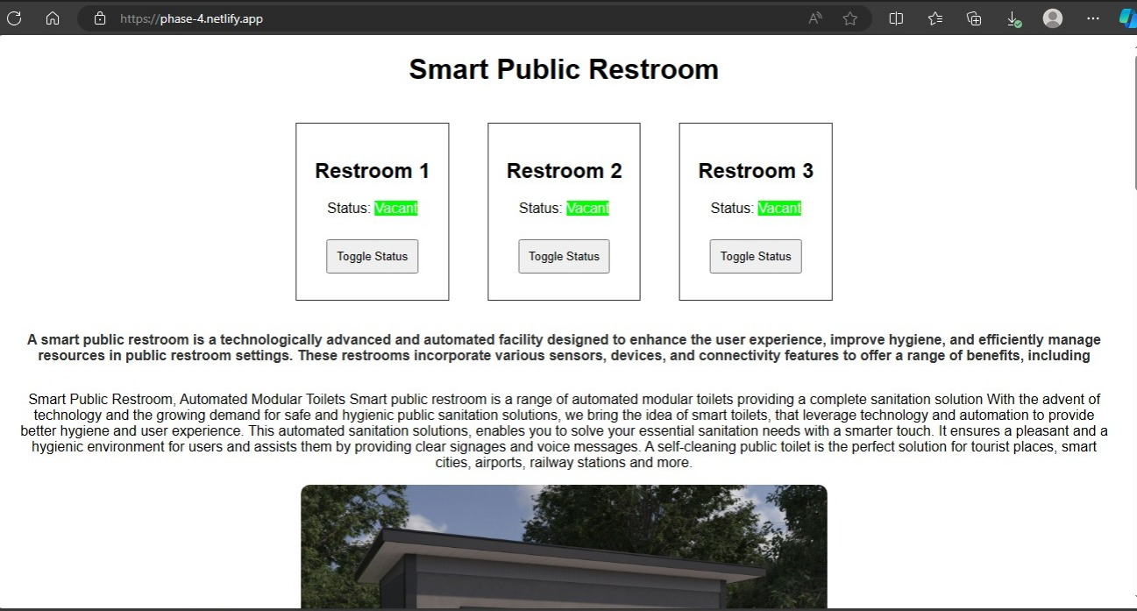
WEBSITE:
https://phase-4.netlify.app/

Slide 11
THANK YOU

