Slide 1

DEPARTMENT OF COMPUTER SCIENCE AND ENGINEERING
PROJECT NAME: SMART PUBLIC RESTROOM
TEAM NAME: proj_224780_Team_3
TEAM MEMBERS: SWARNADARSINI V 113321104101 UKKISALA LAKSHMI 113321104104 VAISHALI G 113321104106 VAISHNAVI G 113321104107 VAKATI PRANAVI 113321104108

Slide 2
PROJECT:
Our smart toilet is the only system in the markets offering concealed arms over the bowl to clean and dry the bowl and surrounding walls up to 80cm. High-pressure ejecting water is mixed with disinfectant; a floor-integrated high-pressure nozzle system ejects water and disinfectant on the floor The Goal of the system is to monitor and evaluates Toilet Condition In Real-Time, enabling city governments to improve the toilet cleaning & upkeep through:
Monitoring capabilities
Actionable intelligence
Engagement & behavior change

Slide 3
Innovation:
Smart public restrooms can greatly enhance user experience and hygiene. Here are some innovative ideas
Automated Cleaning: Incorporate sensors and robotics to automatically clean and disinfect restroom fixtures and floors, reducing the need for human intervention.
Touchless Fixtures: Use touchless faucets, soap dispensers, and flush mechanisms to minimize germ transmission.
Energy Efficiency: Utilize smart lighting and HVAC systems that adjust based on occupancy to save energy

Slide 4
Project Requirements:
The Components that are required are:
1.Raspberry Pi (or any other IoT device)
2.Sensors (e.g., occupancy sensor, door sensor, ultrasonic sensor)
3.IoT Platform (e.g., ThingSpeak for data visualization)
4.Actuators (e.g., LED lights, fans)
5.Relay module for controlling actuators
6.Internet connectivity

Slide 5
PROJECT OBJECTIVES:
❏ Building a smart public restroom using IoT
involves various components and technologies.
❏ Below, I'll provide you with a high level
Python code example for a simplified smart
Public restroom system.
❏ Keep in mind that this is a basic example, and a
real-world implementation would require
more robust hardware, sensors, and a backend
system for managing data.
❏ Now a days the smart Restroom is essential
More in Hitech city and more are comfortable with
this.

Slide 6

SAMPLE CODE:

Slide 7


Slide 8
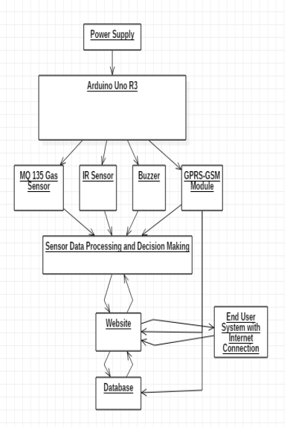
RASPBERRY PI INTEGRATION:
Our proposed system is a smart monitoring system designed to monitor the hygiene of public toilets. Unhygienic toilets can be detected by different parameters such as water levels, and various gases evolved, humidity, temperature etc. Ammonia gas is the most dominant gas that can be sensed in an unhygienic toilet. We will be using the MQ-135 gas sensor the determine the amount of ammonia present in the room

Slide 9
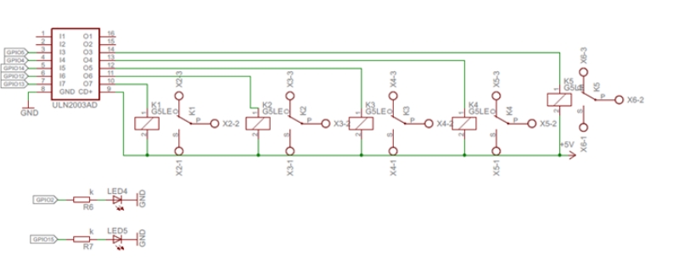
ARDUINO INTEGRATION:

Slide 10
PLATFORM REQUIRED:
Data analysis platform:
Through the data collected by smart gateways and smart controllers, a data analysis platform is established to analyze and process public toilet usage data, sanitation data, and energy consumption data, providing city managers with more scientific decision-making basis.
Intelligent management:
Through the intelligent gateway and intelligent controller, realize the intelligent management of public toilets, including real-time monitoring, remote control, real-time data analysis of public toilets, etc., to improve the management efficiency and service quality of public toilets.

Slide 11
WEB DEVELOPMENT TECHNOLOGIES:
•Front-End: You can use HTML, CSS, and JavaScript for creating a web based dashboard or user interface. Frameworks like React, Angular, or Vue.js can simplify the development process
•Back-End: You might need a server to handle data processing, user authentication, and other backend functionalities. You can use Node.js, Python, Ruby, or any other server side technology.
•Databases: Use databases (e.g., MySQL, PostgreSQL, MongoDB) to store and retrieve data.
•APIs: Create APIs to connect the front-end and back-end. RESTful or GraphQL APIs are common choices.

Slide 12
Smart Public Toilets Making Public toilet smart and hygienic:
USER COUNTER:The requirement is that sensor that can be mount on the head(top) of the door to count the user with reasonable accuracy.Also,it should be rigid enough to protect from vandalism.when a person passes beneath the PIR sensor which will be mounted on the head(top)of the Toilet it detects the motion of the person This gives a high pulse at the output.This pulse will remain High for a specific timeout and then become low for a certain time nad become ready again to detect another motion.
.

Slide 13
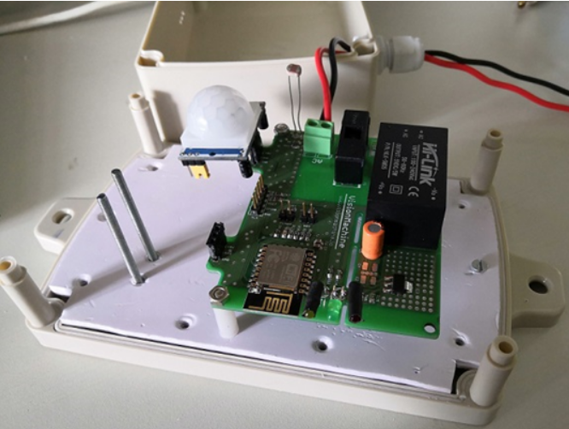
So, when motion is detected output goes HIGH for 2.7 – 2.9 seconds (approx.) and becomes LOW. Now, its output will not have LOW for the guaranteed period and will become ready to detect motion.

Slide 14
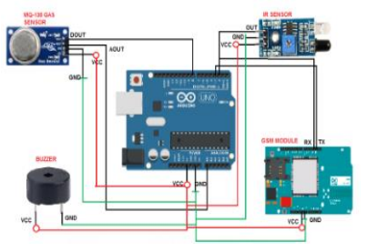

Slide 15
CONCLUSION:
Smart restroom technology is transforming the way we experience public and private restrooms. With features like occupancy sensors, odor detection, and supply level monitoring, smart restrooms enhance hygiene, efficiency, and user satisfaction. The implementation of smart restroom management systems and monitoring systems streamlines operations, optimizes resource allocation, and ensures a safe and pleasant restroom experience

Slide 16
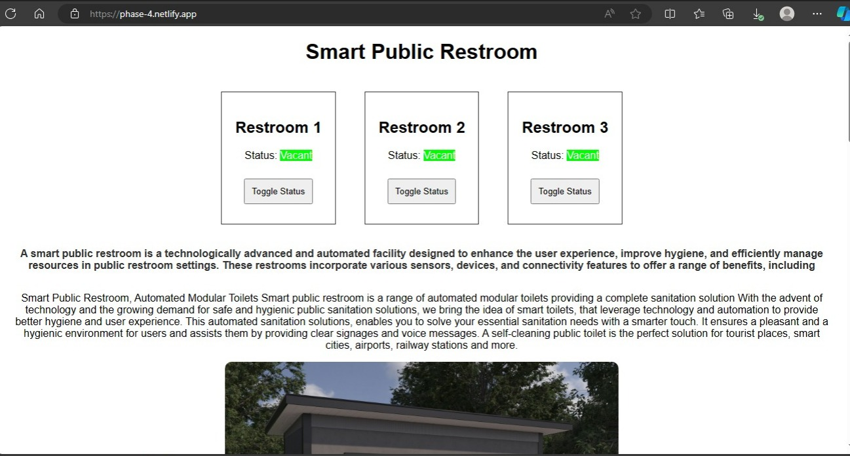
Website
netlify app

Slide 17
THANK YOU

