Slide 1
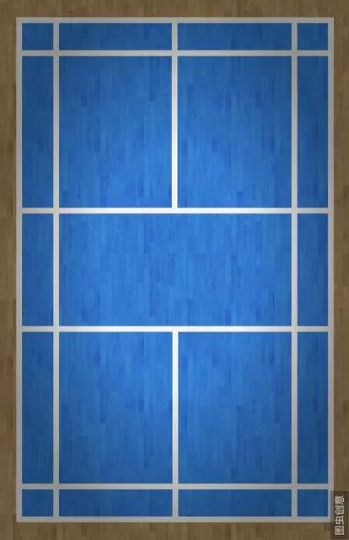
A
(180, 256)
(532, 256)
Y
Y
W
aW
A2 = (640-90) = 554
A / (644-90) = (1+a)W / aW
A = 554 * (1+a) /a
A1 = (532-180) = 352
A / (532-180) = ((1+a)W+2Y) / aW
Y = (A /352 * a –(1+a))/2 * W
Y = b * (1+a)W
= 0.28693182 * (1+a)W
b = (554/352 -1)/2
= 0.28693182
A / L = ((1+a)W+cY) / aW
L = 554 / (1+b*c), 0 ≤ c ≤ 2
L(c = 1) = 554/(1+0.28693*1)
= 430
(?, ?)
(?, ?)
(90, 468)
(644, 468)
L1
A1
A2

Slide 2
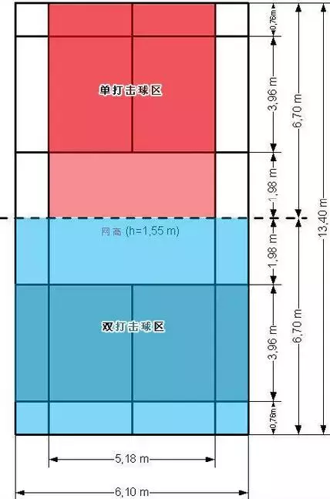
A
(180, 256)
(532, 256)
Y
Y
W
aW
(145, 338)
(575, 338)
c
(90, 468)
(644, 468)
L1
A2
y = 256, L = 352
y = 468, L = 554
y = ? L = 430
(y-256)/(468-256)=(430-352)/(554-352)
y(L) = 256 + (L-352)/(554-352)*(468-256)
= 338
x = 90, y = 468
x = 180, y = 256
x1 = ? y = 338
x1 = (y-468)/(256-468)*(180-90)+90
= 145
x = 644, y = 468
x = 532, y = 256
x2 = ? y = 338
x2 = (y-468)/(256-468)*(532-644)+644
= 575

Slide 3
A
(180, 256)
(532, 256)
Y
Y
W
aW
(145, 338)
(575, 338)
(132, 461)
(592, 461)
c
(90, 468)
(644, 468)
L2
A2
L(c = (6.7-1.98)/6.7) = L(0.7)
= 554 / (1+0.7*0.28693) = 461
y = 256, L = 352
y = 468, L = 554
y(c=0.7) = ? L = 461
(y-256)/(468-256)=(461-352)/(554-352)
y(L) = 256 + (L-352)/(554-352)*(468-256)
= 370
x = 90, y = 468
x = 180, y = 256
x1 = ? y = 370
x1 = (y -468)/(256-468)*(180-90)+90
= 132
x = 644, y = 468
x = 532, y = 256
x2 = ? y = 370
x2 = (y-468)/(256-468)*(532-644)+644
= 592

Slide 4
d
A
(180, 256)
(532, 256)
Y
Y
W
aW
(145, 338)
(575, 338)
(x1, y)
(x, y)
(x2, y)
c
(90, 468)
(644, 468)
A1
A2
已知影片中 (x, y)
A1 = (532-180) = 352
A2 = (640-90) = 554
y = 256 + (L-352)/(554-352)*(468-256)
L = (y-256)*(554-352)/(468-256)+352
L = 554/(1+ 0.28693182 *c)
c = (554/((y-256)*(554-352)/(468-256)+352)-1) / 0.28693182
x1 = (y-468)/(256-468)*(180-90)+90
x2 = (y-468)/(256-468)*(532-644)+644
x1 <= x <= x2
d = (x-x1)/(x2-x1) * A

Slide 5

d
(0, 0)
(1, 0)
(0, 1)
(1, 1)
(d, 2-c)
c
(0, 2)
(1, 2)
已知影片中 (x, y)
得到座標
(d, 2-c)
已知影片中 (x, y)
A1 = (532-180) = 352
A2 = (640-90) = 554
y = 256 + (L-352)/(554-352)*(468-256)
L = (y-256)*(554-352)/(468-256)+352
L = 554/(1+ 0.28693182 *c)
c = (554/((y-256)*(554-352)/(468-256)+352)-1) / 0.28693182
x1 = (y-468)/(256-468)*(180-90)+90
x2 = (y-468)/(256-468)*(532-644)+644
x1 <= x <= x2
d = (x-x1)/(x2-x1) * A

