Slide 1
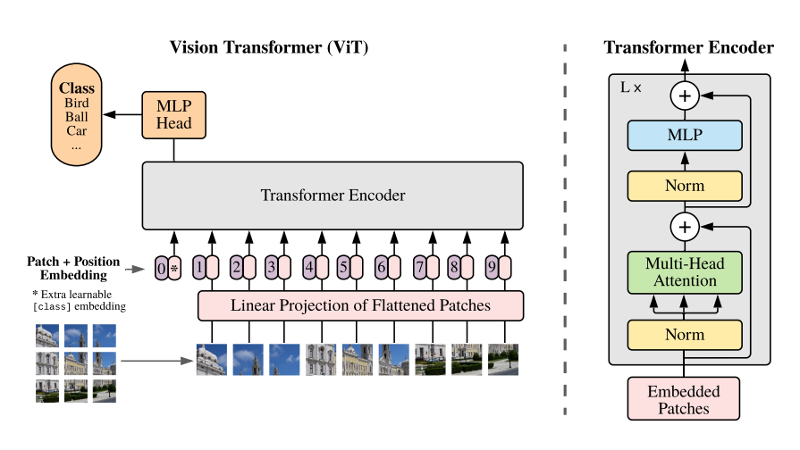
ViT Model

Slide 2
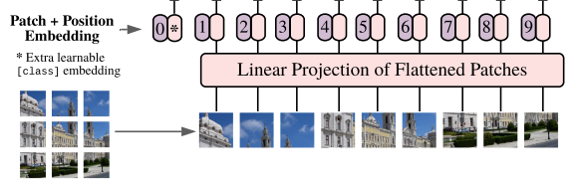
Patch Embedding Position CLS token
1 split every image into patches
2 embedding patches, linear from patch_dim to target dim
3 generate learnable CLS token, join to patches tokens
4 add position embedding

Slide 3
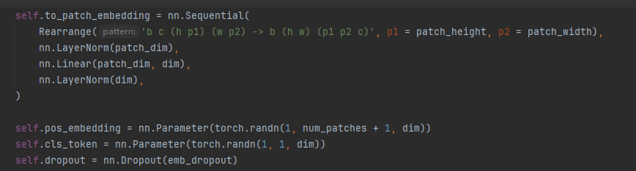
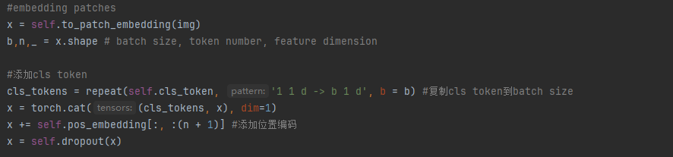
Setting
b = batch, c = channel, h =image_height, w = image_width
Last a random dropout
Forward

Slide 4
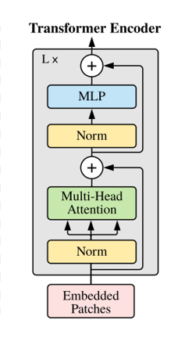
Transformer
1 define attention and mlp
2 add them to a moduleList each layer, looping depth times
3 for each layer,
run x= attention(x) + x
then x = mlp(x) + x
This is a ResNet (https://arxiv.org/abs/1512.03385)
Solve the vanishing/exploding gradient problem

Slide 5
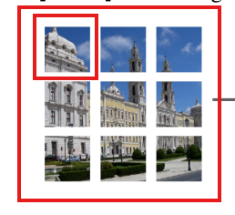


Muti-heads Self Attention
If current index = 1, we get Q from patch 1, means “queries”, what I am looking for ?
Get K, V from all patches, means “keys”,”values”
Keys: what are my options?
Values: what do they publicly reveal / broadcast to others?
Get Q,K,V by Linear from (batch,token number,dim) to (batch,token number, heads * dim * 3),then chunk to 3

Slide 6


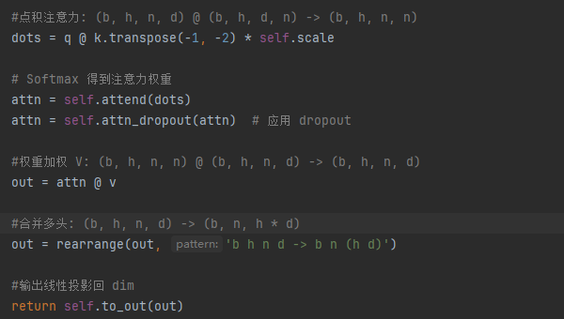
Muti-heads Self Attention
After get q,k,v, calculate for every patch the “attention tensor” to each patch
It means the relevance for each patch to other patch
Muti-heads means from different “views” to consider the relevance, for images, maybe from color, shape, outline, contrast ratio …

Slide 7
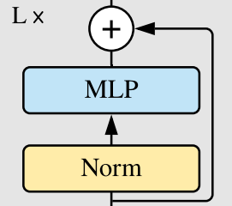
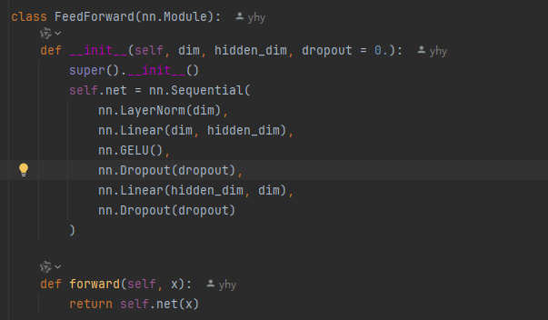
MLP/FeedForward
After attention process, each patch token contains other tokens’ information, but it is still a linear operation
MLP is a nolinear project for every single token
Using a nolinear activation function GELU
Expand dim to mlp_dim , then shrink back to dim to improve expression

Slide 8

Finally
Choose CLS token or all tokens mean stands for the final class

Slide 9
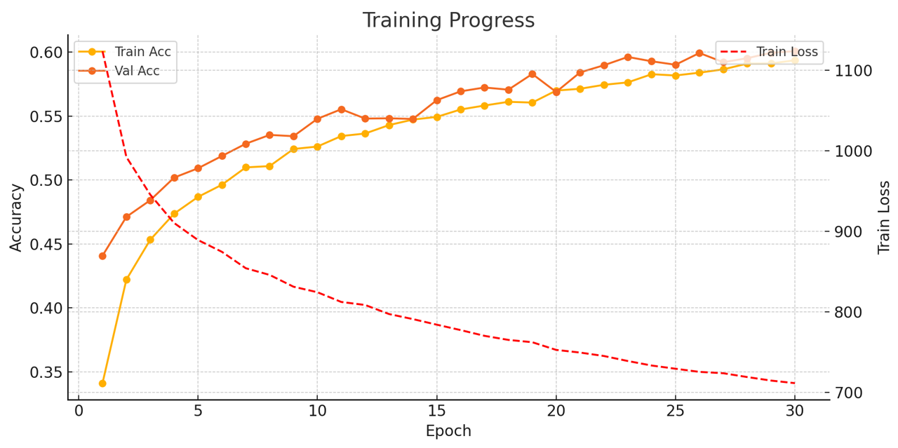
Baseline Vit
Full Cifar-10 dataset , 10 classes
Epoch = 30
Batch_size = 64
Learning_rate = 3e-5
Patch_size = 8
Dim = 128
Depth = 12
Heads = 8
Mlp_dim = 256
Test accuracy = 60.4%
Time Cost: 45min
Because of a low learn rate and not enough epoch, the accuracy is low.

Slide 10
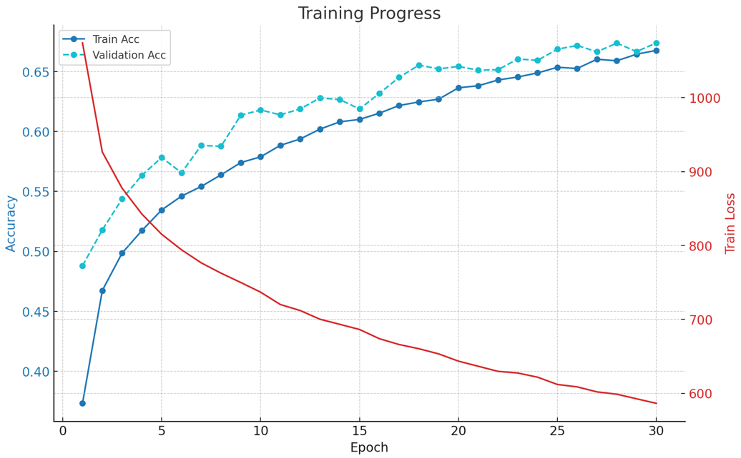

Patch Size
Model | Patch Size | Test Acc | Time Cost
Small Patch | 4 | 67.62% | 70 mins
Baseline | 8 | 60.4% | 45 mins
Large Patch | 16 | 54.87% | 40 mins*
Full Cifar-10 dataset , 10 classes
Epoch = 30
Batch_size = 64
Learning_rate = 3e-5
Patch_size = $→$
Dim = 128
Depth = 12
Heads = 8
Mlp_dim = 256
Test accuracy = 67.62%
Time Cost: 70min
Patch size has relatively large impact to the accuracy. Small patch size increases accuracy and training cost.
* using a slower runtime type

Slide 11
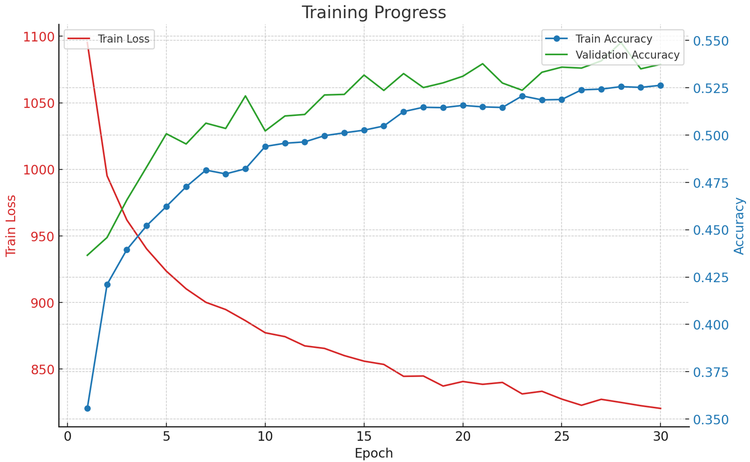

Model Size (Dim)
Model | Dim | MLP Dim | Test Acc | Time Cost
Smaller | 64 | 128 | 58.6% | 23 mins
Baseline | 128 | 256 | 60.4% | 45 mins
Larger | 256 | 512 | 53.2% | 80 mins
Full Cifar-10 dataset , 10 classes
Epoch = 30
Batch_size = 64
Learning_rate = 3e-5
Patch_size = 8
Dim = $→$
Depth = 12
Heads = 8
Mlp_dim = $→$
Test accuracy = 53.2%
Time Cost: 80min
Dimension determines capacity of each layer. Smaller dimension reduces accuracy and computational cost. Large dimension results low accuracy and high computational cost. (underfitting)

Slide 12
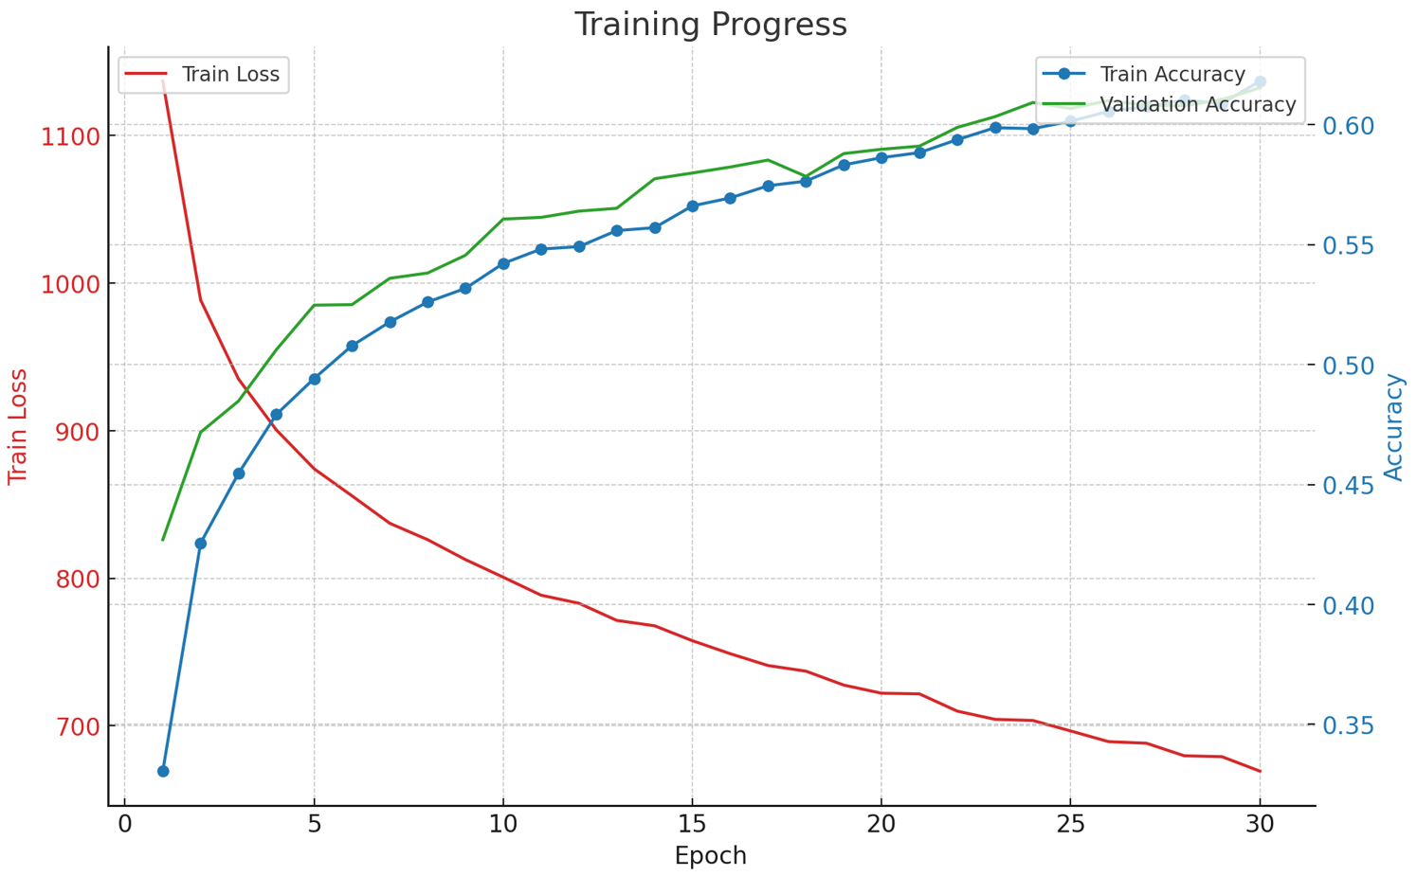

Model Size (Depth)
Model
Patch Size
Test Acc
Time Cost
Small Patch
4
67.62%
70 mins
Baseline
8
60.4%
45 mins
Large Patch
16
54.87%
40 mins*
Model | Depth | Test Acc | Time Cost
Small | 4 | 58.9% | 32 mins
Baseline | 8 | 60.4% | 45 mins
Large | 16 | 61.37% | 60 mins
Full Cifar-10 dataset , 10 classes
Epoch = 30
Batch_size = 64
Learning_rate = 3e-5
Patch_size = 8
Dim = 128
Depth = $→$
Heads = 8
Mlp_dim = 256
Test accuracy = 61.37%
Time Cost = 60min
A larger depth is helpful, but not effectively

Slide 13
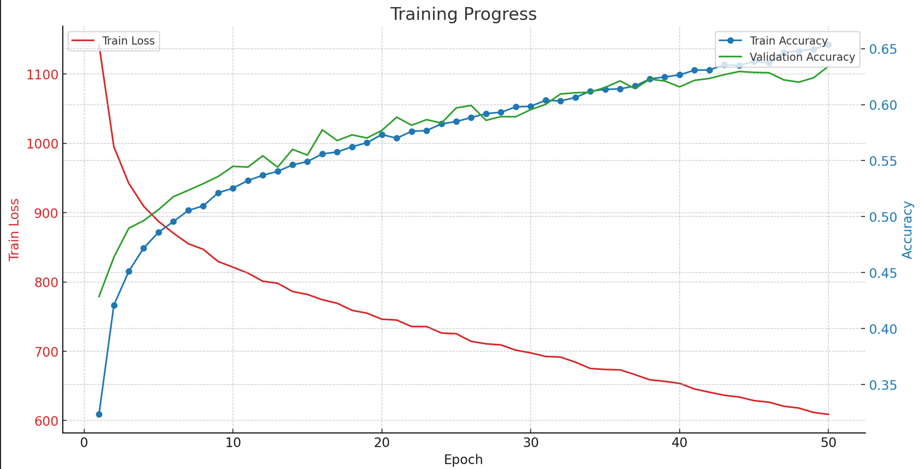

Attention Heads
Model
Patch Size
Test Acc
Time Cost
Small Patch
4
67.62%
70 mins
Baseline
8
60.4%
45 mins
Large Patch
16
54.87%
40 mins*
Model | Heads | Test Acc | Time Cost
Small | 4 | 55.7% | 60 mins*
Baseline | 8 | 60.4% | 45 mins
Large | 16 | 63.5% | 100 mins
Full Cifar-10 dataset , 10 classes
Epoch = 50
Batch_size = 64
Learning_rate = 3e-5
Patch_size = 8
Dim = 128
Depth = 12
Heads = $→$
Mlp_dim = 256
Test accuracy = 63.52%
Time Cost: 100min
Attention Head has some impact to the accuracy. Smaller heads reduce accuracy and training cost, while large attention head increase accuracy and greatly increases computational cost.
* using a slower runtime type

Slide 14
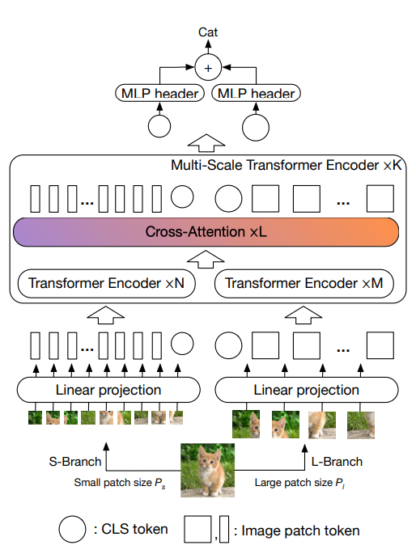
Cross ViT Model
First Step:
Split the original image into patches by different patch_size(small, large)
Embedding to target dimention tokens
Adding CLS token and position embedded
The same as baseline ViT does

Slide 15
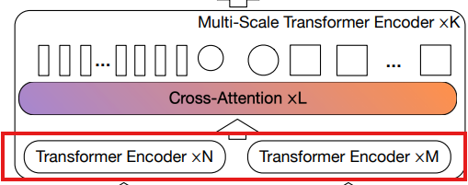
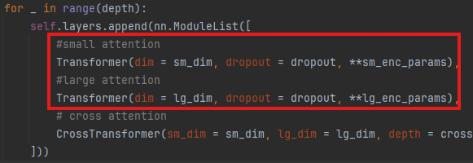
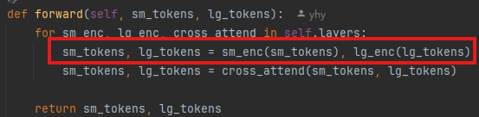
Multi-Scale Transformer
First: Muti-heads Self Attention
In every Multi-Scale Transformer layer, Firstly,
we encoder small tokens and large tokens respectively
The same as ViT does, Attention + FeedForward
ResNet Connection

Slide 16
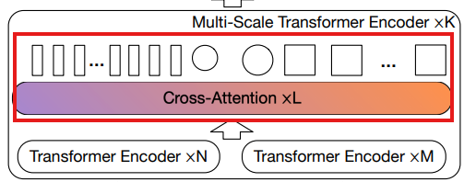
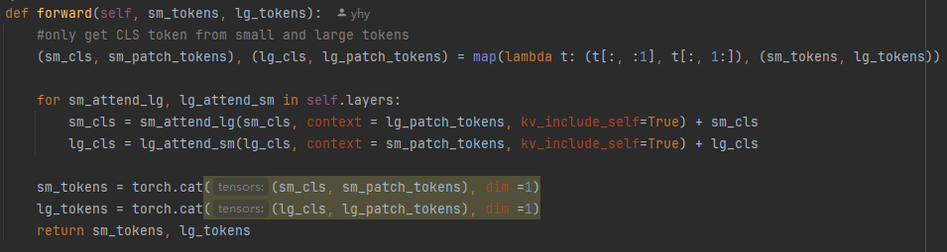
Multi-Scale Transformer Encoder – Cross-Attention
After encoding small tokens and large tokens
1 split tokens into (cls, patch_tokens) for small and large
In order to get cls token, we only use this token to cross attention
2 small cls token to study large tokens
(1) linear transform small cls to large token dimention
(e.g.: small token dim 64 -> large token dim 128)
(2) attention(small cls token, large patch tokens)
we allow small cls token to study from large patch tokens
get Q from small cls token, get K,V from large patch tokens
(3) ResNet connect studied cls token and original cls token
(4) linear transform back to small token dim, and concat back with small patch tokens, get small tokens after cross-attention
The same as large cls token to study from small patch tokens

Slide 17
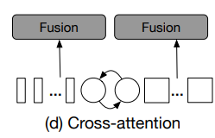
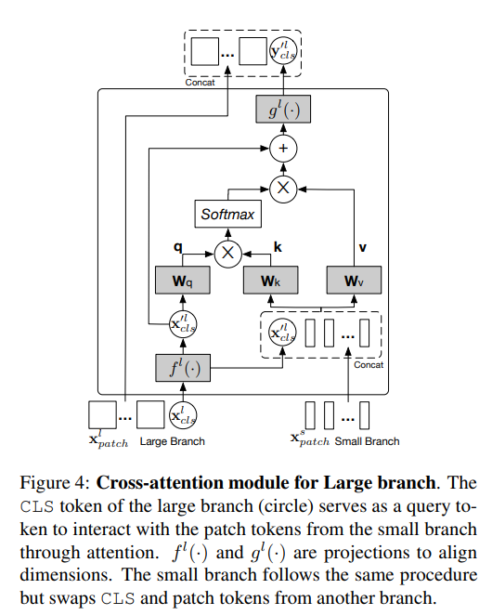
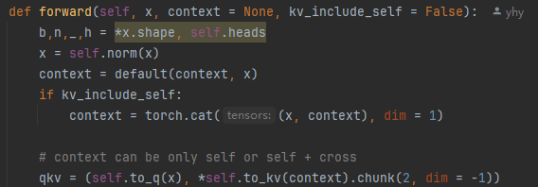
In Attention class implement
We allow q and kv from different part
In the self-attention , q,k,v are all from the same branch
In the cross-attention, q from the cls token which wants to study,
k and v from the other branch as the context
Whether context contains the studying cls is optional

Slide 18
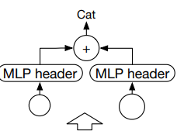
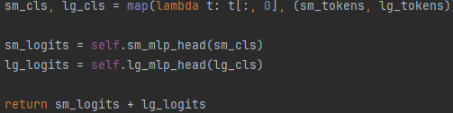
Finally, get small cls token and large cls token , mlp them, adding to get the result

Slide 19
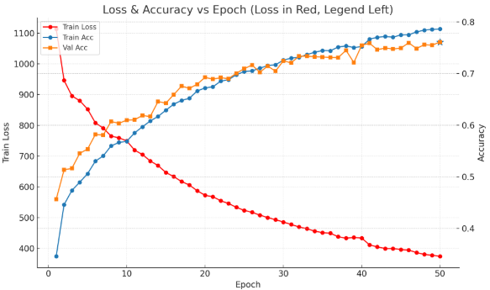
Cross Vit
Accuracy rate : 76.31%
Time Cost : 70min
image_size=32, num_classes=10,
sm_dim=192, lg_dim=384,
sm_patch_size=4, lg_patch_size=8,
depth=2,
sm_enc_depth=2, lg_enc_depth=2,
cross_attn_depth=1,
sm_enc_heads=6, sm_enc_dim_head=32,
lg_enc_heads=6, lg_enc_dim_head=64,
cross_attn_heads=4, cross_attn_dim_head=48,
sm_enc_mlp_dim=768, lg_enc_mlp_dim=1536,
dropout=0.1, emb_dropout=0.1, channels=3
Afet training by cross vit and a higher learn rate , the accuracy increases a lot, but it overfits in the last epochs
Maybe using a cooldown mechanism in the last epochs will be helpful

Slide 20




Data enhance
Original Image
Horizontal flip
X Translation
Y Translation

Slide 21
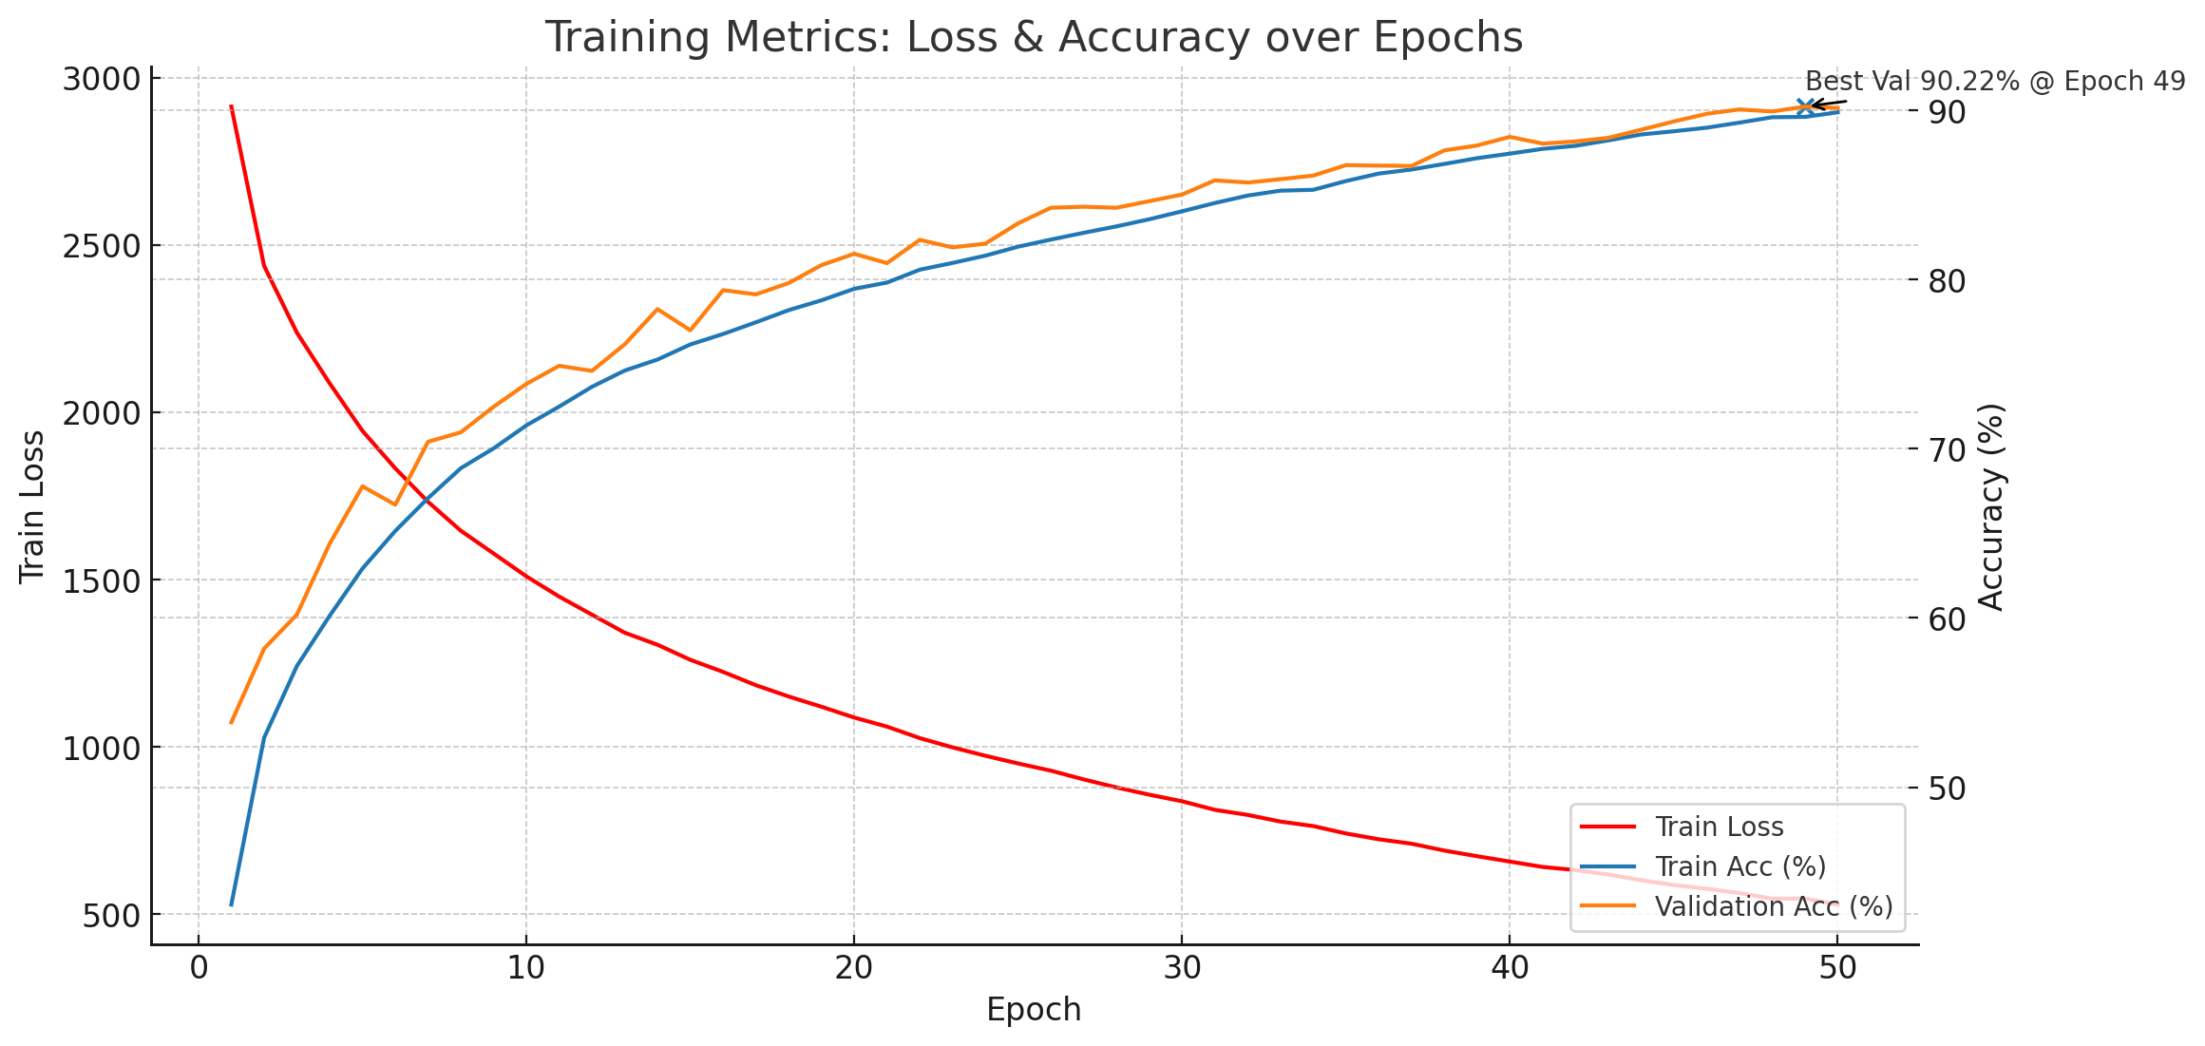
Cross Vit with enhanced dataset
Accuracy rate : 80.47%
Time Cost : 240min
The accuracy of training and validation increases so much, next to 90%,but the test accuracy rate is near 80%
We think the reason is that every image has 3 backups by different enhance function, but is split of train and validation is random, so the validation dataset is polluted, leading to a high accuracy. And the high learn rate leads to a overfitting high train accuracy.

Slide 22
Results compare
Exp | Model | Changes vs Baseline-1 | Test Acc (%)
1 | ViT | — | 60.40
2 | ViT | Patch size = 4 | 67.62
3 | ViT | Dim = 256; MLP dim = 512 | 53.20
4 | ViT | Depth = 24 | 61.37
5 | ViT | Heads = 16 | 63.52
6 | CrossViT | patch = 4 / 8; sm/ lg dim = 192 / 384; stages = 2; sm/ lg encoder depth = 2 / 2; cross-attn depth = 1; sm/ lg heads = 6 / 6; cross heads = 4; sm/ lg MLP = 768 / 1536; dropout = 0.1; emb_dropout = 0.1 | 76.31/80.47(enhanced dataset)

Slide 23
Conclusion
From the results of different parameters, we think
The patch size decides how much details we split, and how much every patch learns from each other in self attention, it affects so much.
The dimension, depth and heads have some influence to results, there is not too much information to describe for each patch, also too much transformer loops is not necessary.
The cross-vit improves the accuracy so much, every patch can learn from different size patches, to learn more detail or more integral information.
The enhance operation expands the dataset and improve the model’s generalization ability.
A suitable learn rate and epoch is also important.

