Slide 1
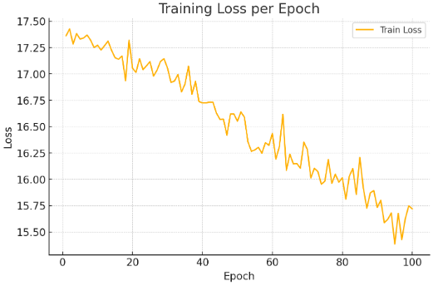
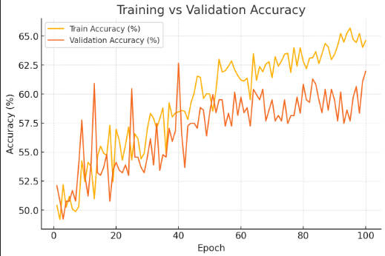
Baseline Efficient Transformer Vit
Only cat and dog 2 classes
Epoch 100
Test Accuracy 58.95%

Slide 2
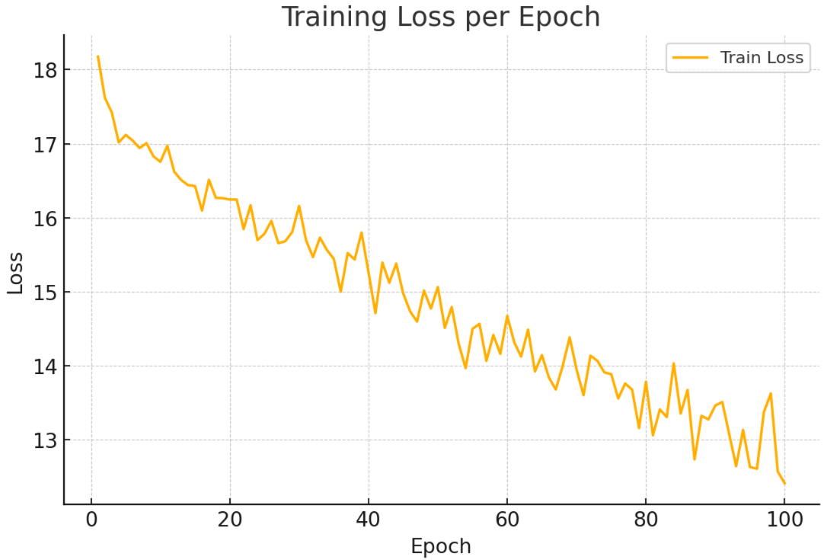
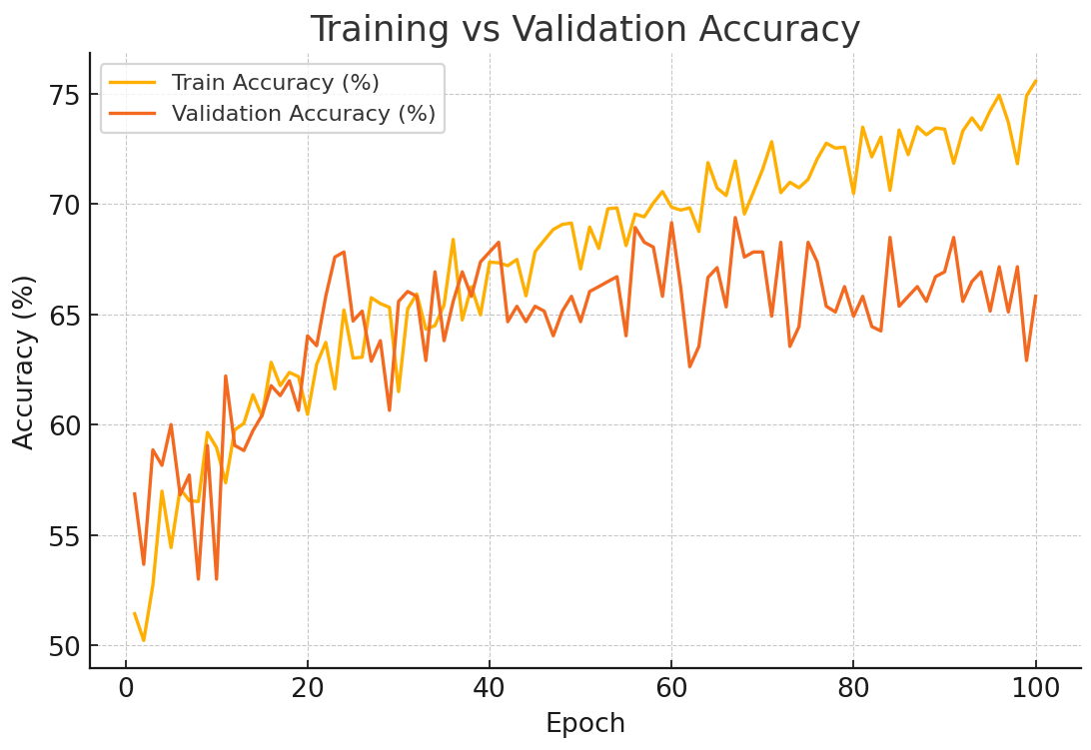
Baseline Vit
Only cat and dog 2 classes
Epoch 100
Test Accuracy 64%

