Slide 1
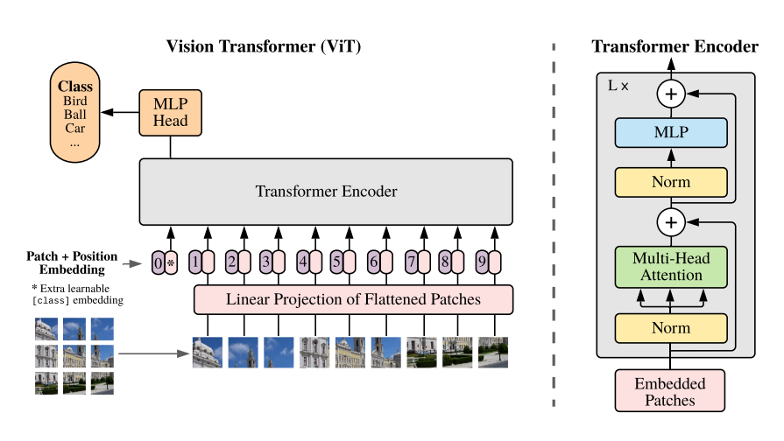
ViT Model

Slide 2
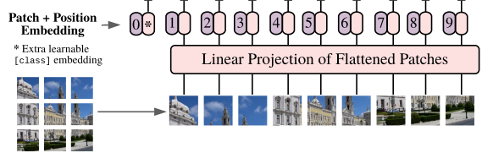
Patch Embedding Position CLS token
1 split every image into patches
2 embedding patches, linear from patch_dim to target dim
3 generate learnable CLS token, join to patches tokens
4 add position embedding

Slide 3
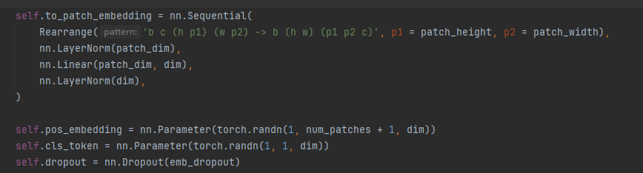
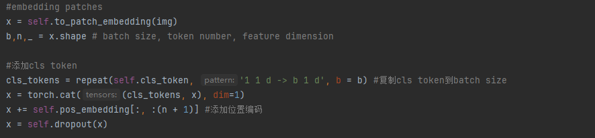
Setting
b = batch, c = channel, h =image_height, w = image_width
Last a random dropout
Forward

Slide 4
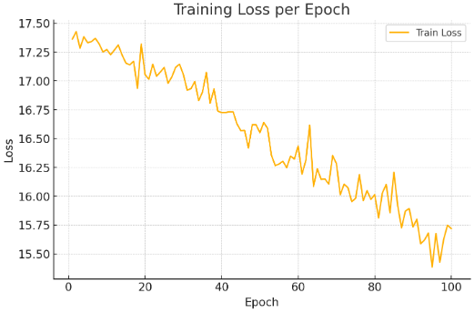
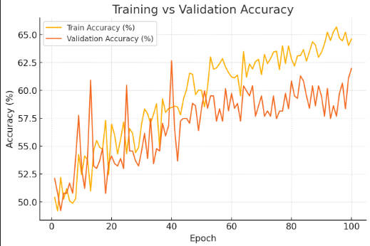
Baseline Efficient Transformer Vit
Only cat and dog 2 classes
Epoch 100
Test Accuracy 58.95%

Slide 5
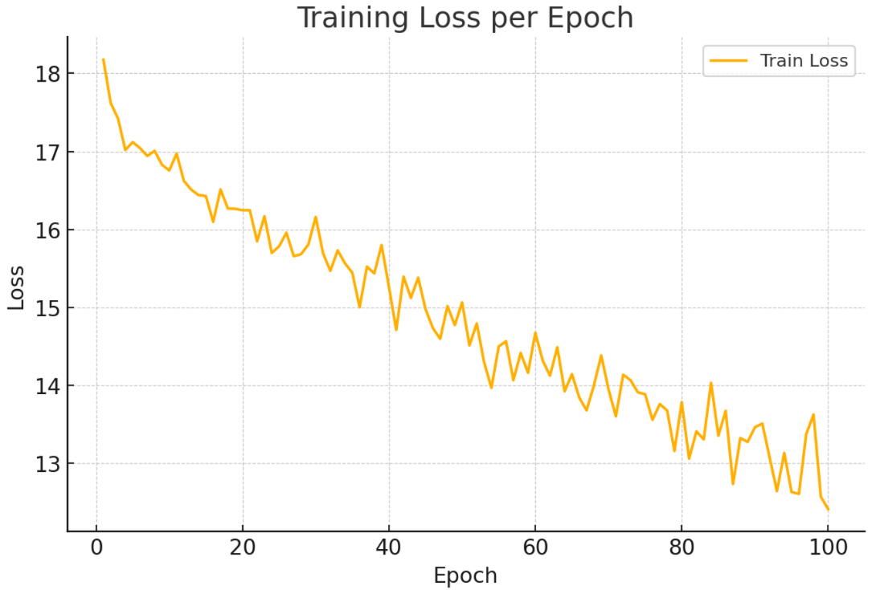
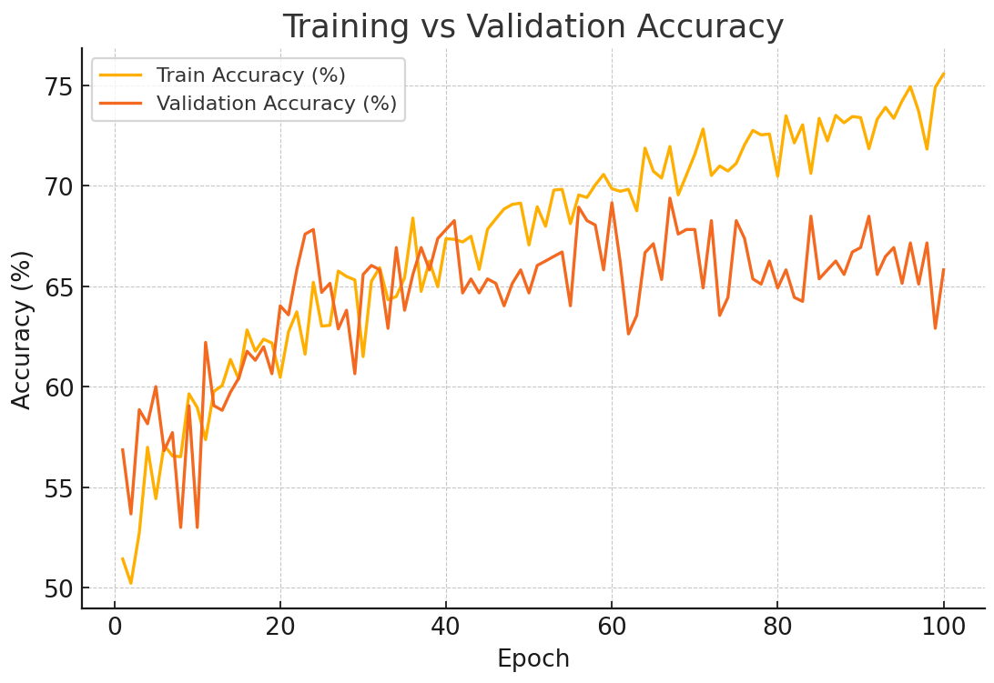
Baseline Vit
Only cat and dog 2 classes
Epoch 100
Test Accuracy 64%

