Slide 1
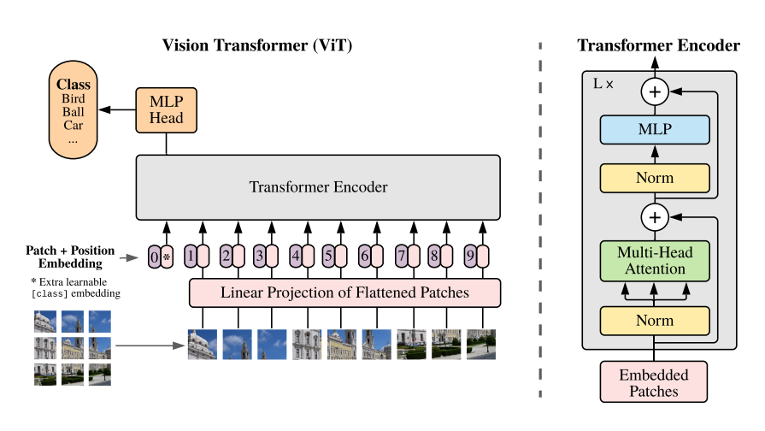
ViT Model

Slide 2
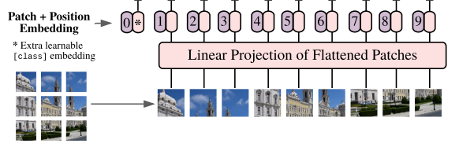
Patch Embedding Position CLS token
1 split every image into patches
2 embedding patches, linear from patch_dim to target dim
3 generate learnable CLS token, join to patches tokens
4 add position embedding

Slide 3
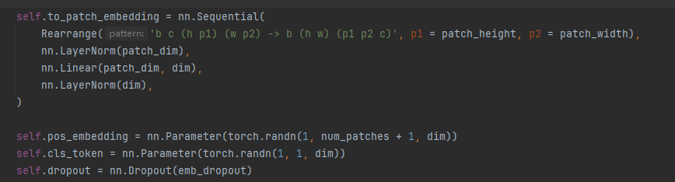
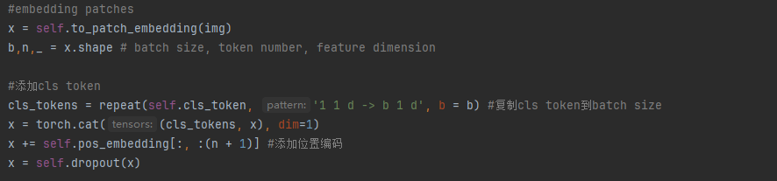
Setting
b = batch, c = channel, h =image_height, w = image_width
Last a random dropout
Forward

Slide 4
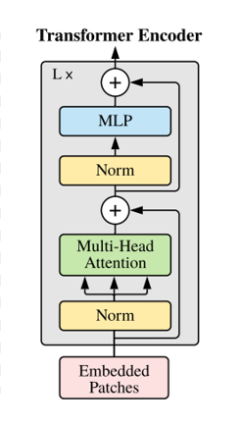
Transformer
1 define attention and mlp
2 add them to a moduleList each layer, looping depth times
3 for each layer,
run x= attention(x) + x
then x = mlp(x) + x
This is a ResNet (https://arxiv.org/abs/1512.03385)
Solve the vanishing/exploding gradient problem

Slide 5
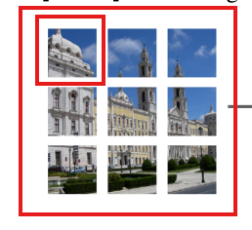


Muti-heads Self Attention
If current index = 1, we get Q from patch 1, means “queries”, what I am looking for ?
Get K, V from all patches, means “keys”,”values”
Keys: what are my options?
Values: what do they publicly reveal / broadcast to others?
Get Q,K,V by Linear from (batch,token number,dim) to (batch,token number, heads * dim * 3),then chunk to 3

Slide 6


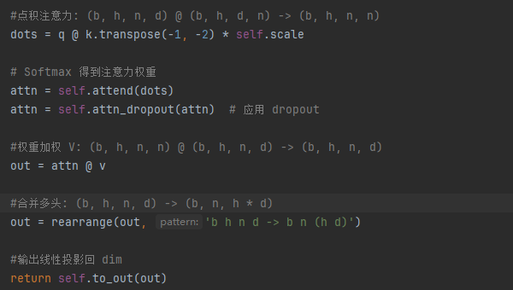
Muti-heads Self Attention
After get q,k,v, calculate for every patch the “attention tensor” to each patch
It means the relevance for each patch to other patch
Muti-heads means from different “views” to consider the relevance, for images, maybe from color, shape, outline, contrast ratio …

Slide 7
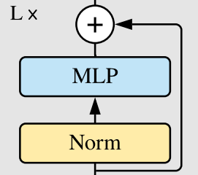
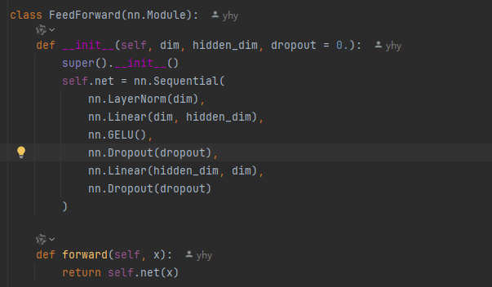
MLP/FeedForward
After attention process, each patch token contains other tokens’ information, but it is still a linear operation
MLP is a nolinear project for every single token
Using a nolinear activation function GELU
Expand dim to mlp_dim , then shrink back to dim to improve expression

Slide 8

Finally
Choose CLS token or all tokens mean stands for the final class

Slide 9
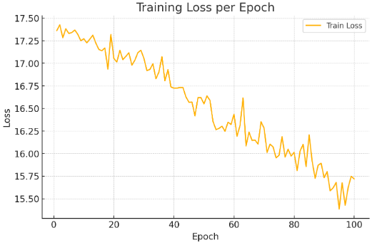
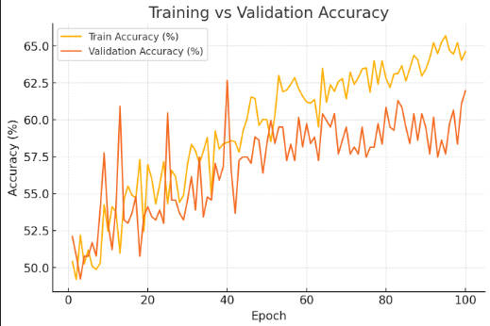
Efficient Transformer Vit
Only cat and dog 2 classes
Epoch 100
Test Accuracy 58.95%

Slide 10
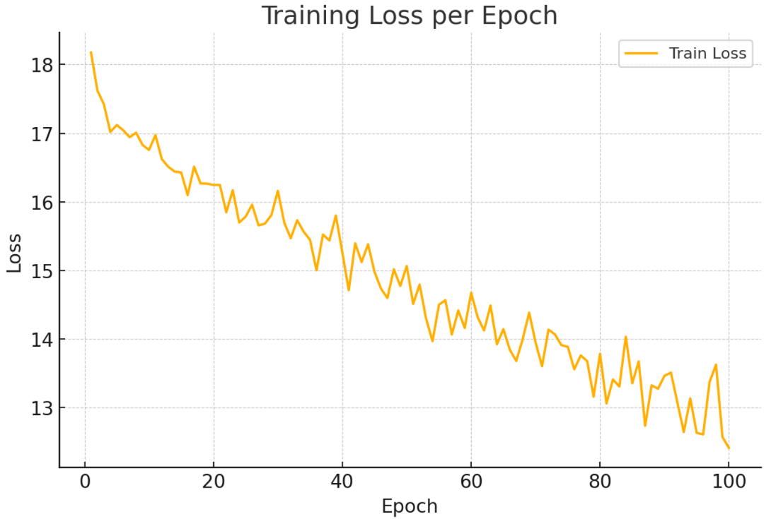
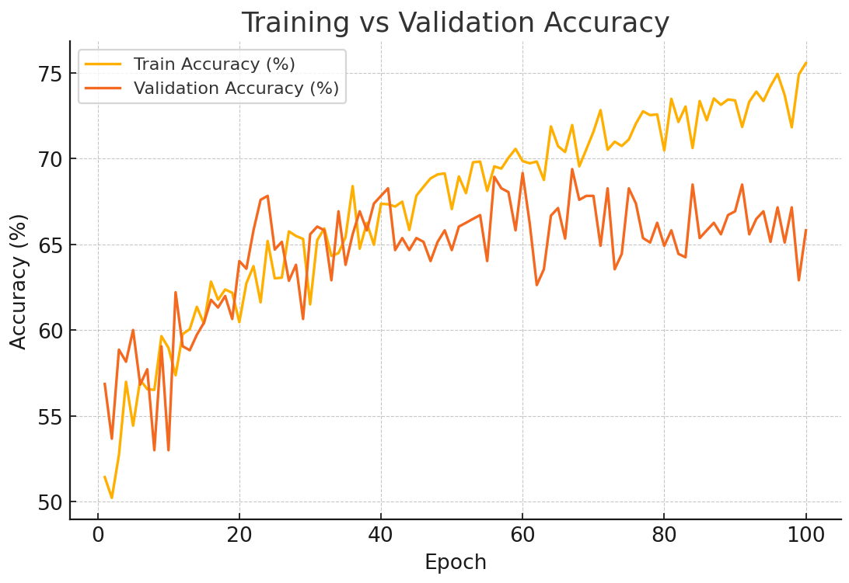
Baseline Vit
Only cat and dog 2 classes
Epoch 100
Test Accuracy 64%

Slide 11
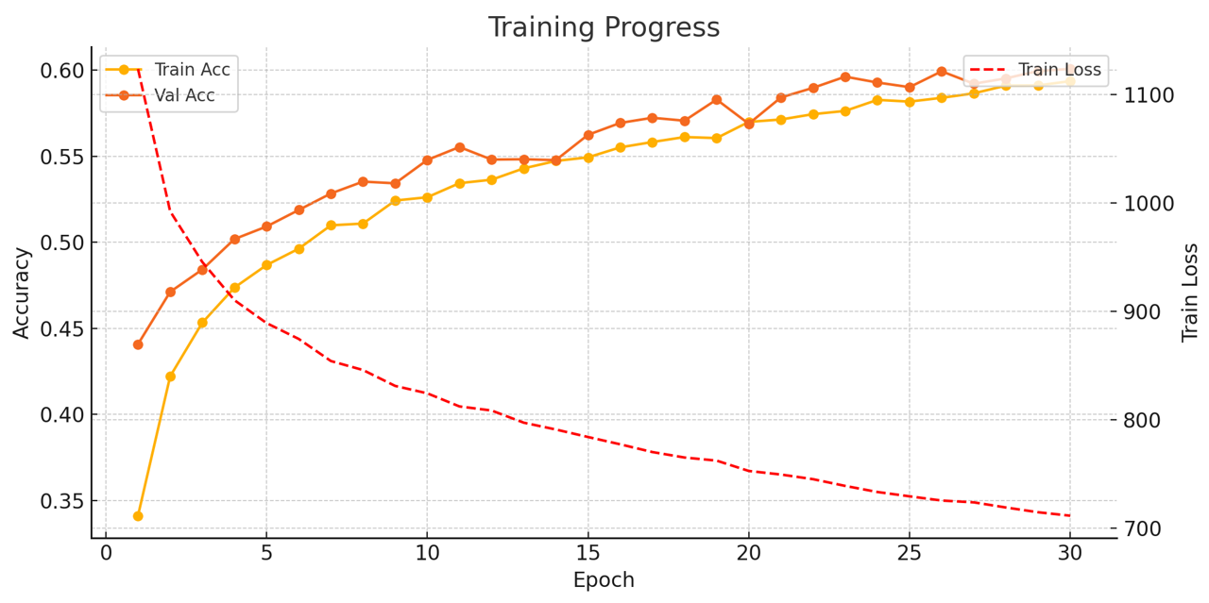
Baseline Vit
Full Cifar-10 dataset , 10 classes
Epoch = 30
Batch_size = 64
Patch_size = 8
Dim = 128
Depth = 12
Heads = 8
Mlp_dim = 256
Test accuracy = 60.4%
Time Cost: 45min

Slide 12
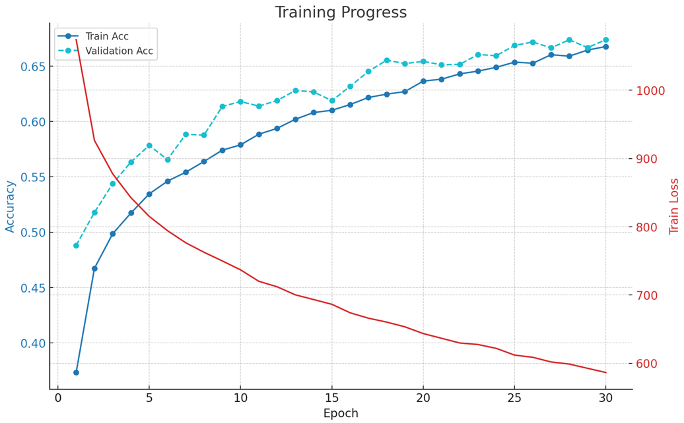
Baseline Vit
Full Cifar-10 dataset , 10 classes
Epoch = 30
Batch_size = 64
Patch_size = 4
Dim = 128
Depth = 12
Heads = 8
Mlp_dim = 256
Test accuracy = 67.62%
Time Cost: 70min
Higher accuracy than patch size = 8 !

Slide 13
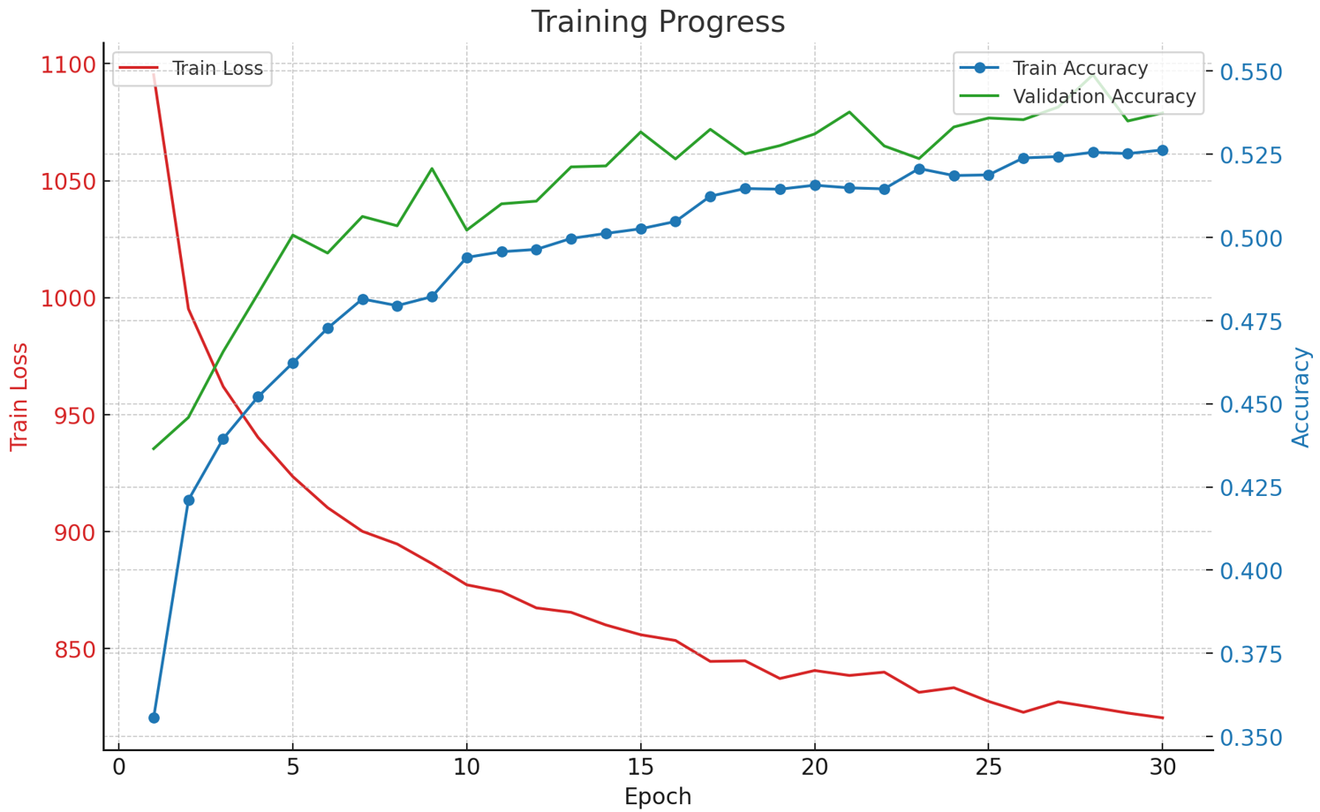
Baseline Vit
Full Cifar-10 dataset , 10 classes
Epoch = 30
Batch_size = 64
Patch_size = 8
Dim = 256
Depth = 12
Heads = 8
Mlp_dim = 512
Test accuracy = 53.2%
Time Cost: 80min

Slide 14
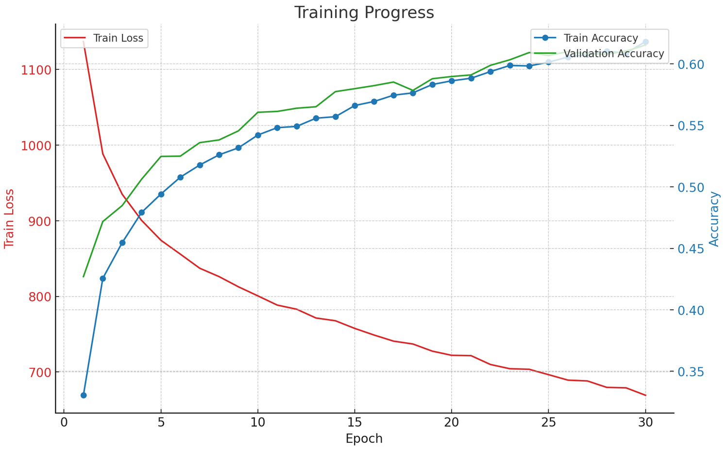
Baseline Vit
Full Cifar-10 dataset , 10 classes
Epoch = 30
Batch_size = 64
Patch_size = 8
Dim = 128
Depth = 24
Heads = 8
Mlp_dim = 256
Test accuracy = 61.37%
Time Cost = 60min

Slide 15
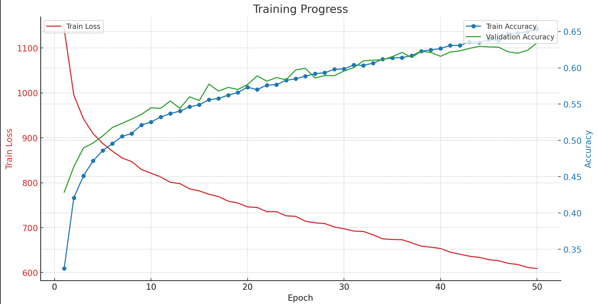
Baseline Vit
Full Cifar-10 dataset , 10 classes
Epoch = 50
Batch_size = 64
Patch_size = 8
Dim = 128
Depth = 12
Heads = 16
Mlp_dim = 256
Test accuracy = 63.52%
Time Cost: 100min

Slide 16
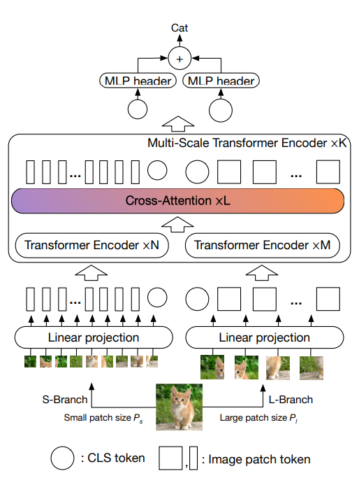
Cross ViT Model
First Step:
Split the original image into patches by different patch_size(small, large)
Embedding to target dimention tokens
Adding CLS token and position embedded
The same as baseline ViT does

Slide 17
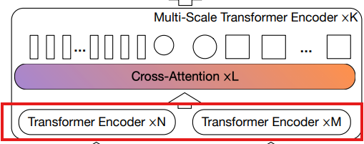
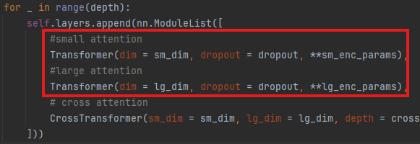
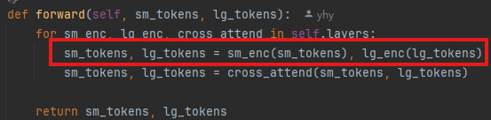
Multi-Scale Transformer
First: Muti-heads Self Attention
In every Multi-Scale Transformer layer, Firstly,
we encoder small tokens and large tokens respectively
The same as ViT does, Attention + FeedForward
ResNet Connection

Slide 18
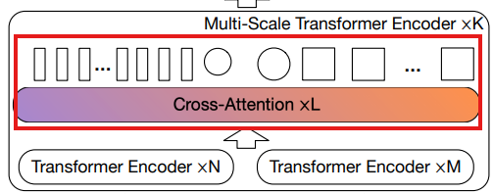
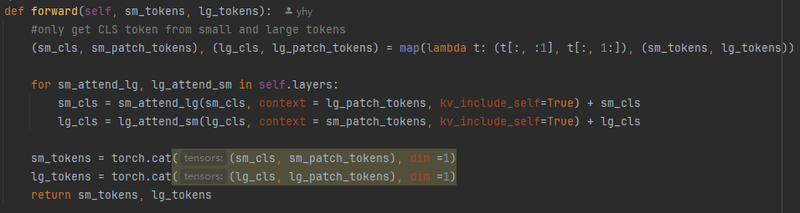
Multi-Scale Transformer Encoder – Cross-Attention
After encoding small tokens and large tokens
1 split tokens into (cls, patch_tokens) for small and large
In order to get cls token, we only use this token to cross attention
2 small cls token to study large tokens
(1) linear transform small cls to large token dimention
(e.g.: small token dim 64 -> large token dim 128)
(2) attention(small cls token, large patch tokens)
we allow small cls token to study from large patch tokens
get Q from small cls token, get K,V from large patch tokens
(3) ResNet connect studied cls token and original cls token
(4) linear transform back to small token dim, and concat back with small patch tokens, get small tokens after cross-attention
The same as large cls token to study from small patch tokens

Slide 19
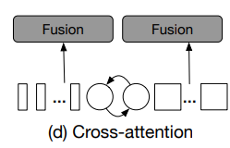
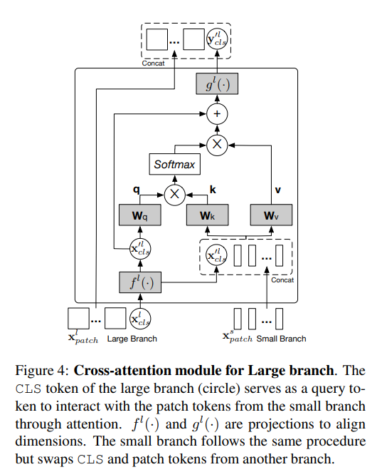
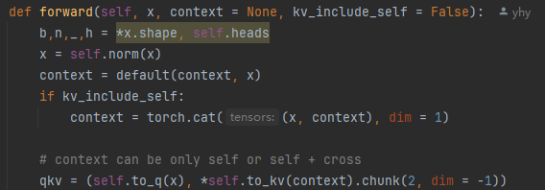
In Attention class implement
We allow q and kv from different part
In the self-attention , q,k,v are all from the same branch
In the cross-attention, q from the cls token which wants to study,
k and v from the other branch as the context
Whether context contains the studying cls is optional

Slide 20
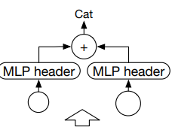
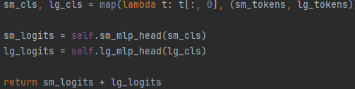
Finally, get small cls token and large cls token , mlp them, adding to get the result

Slide 21
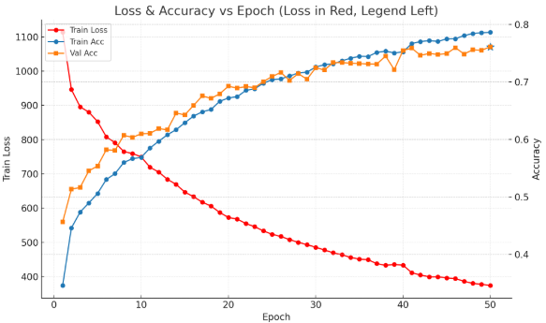
Cross Vit
Accuracy rate : 76.31%
Time Cost : 70min
image_size=32, num_classes=10,
sm_dim=192, lg_dim=384,
sm_patch_size=4, lg_patch_size=8,
depth=2,
sm_enc_depth=2, lg_enc_depth=2,
cross_attn_depth=1,
sm_enc_heads=6, sm_enc_dim_head=32,
lg_enc_heads=6, lg_enc_dim_head=64,
cross_attn_heads=4, cross_attn_dim_head=48,
sm_enc_mlp_dim=768, lg_enc_mlp_dim=1536,
dropout=0.1, emb_dropout=0.1, channels=3

Slide 22
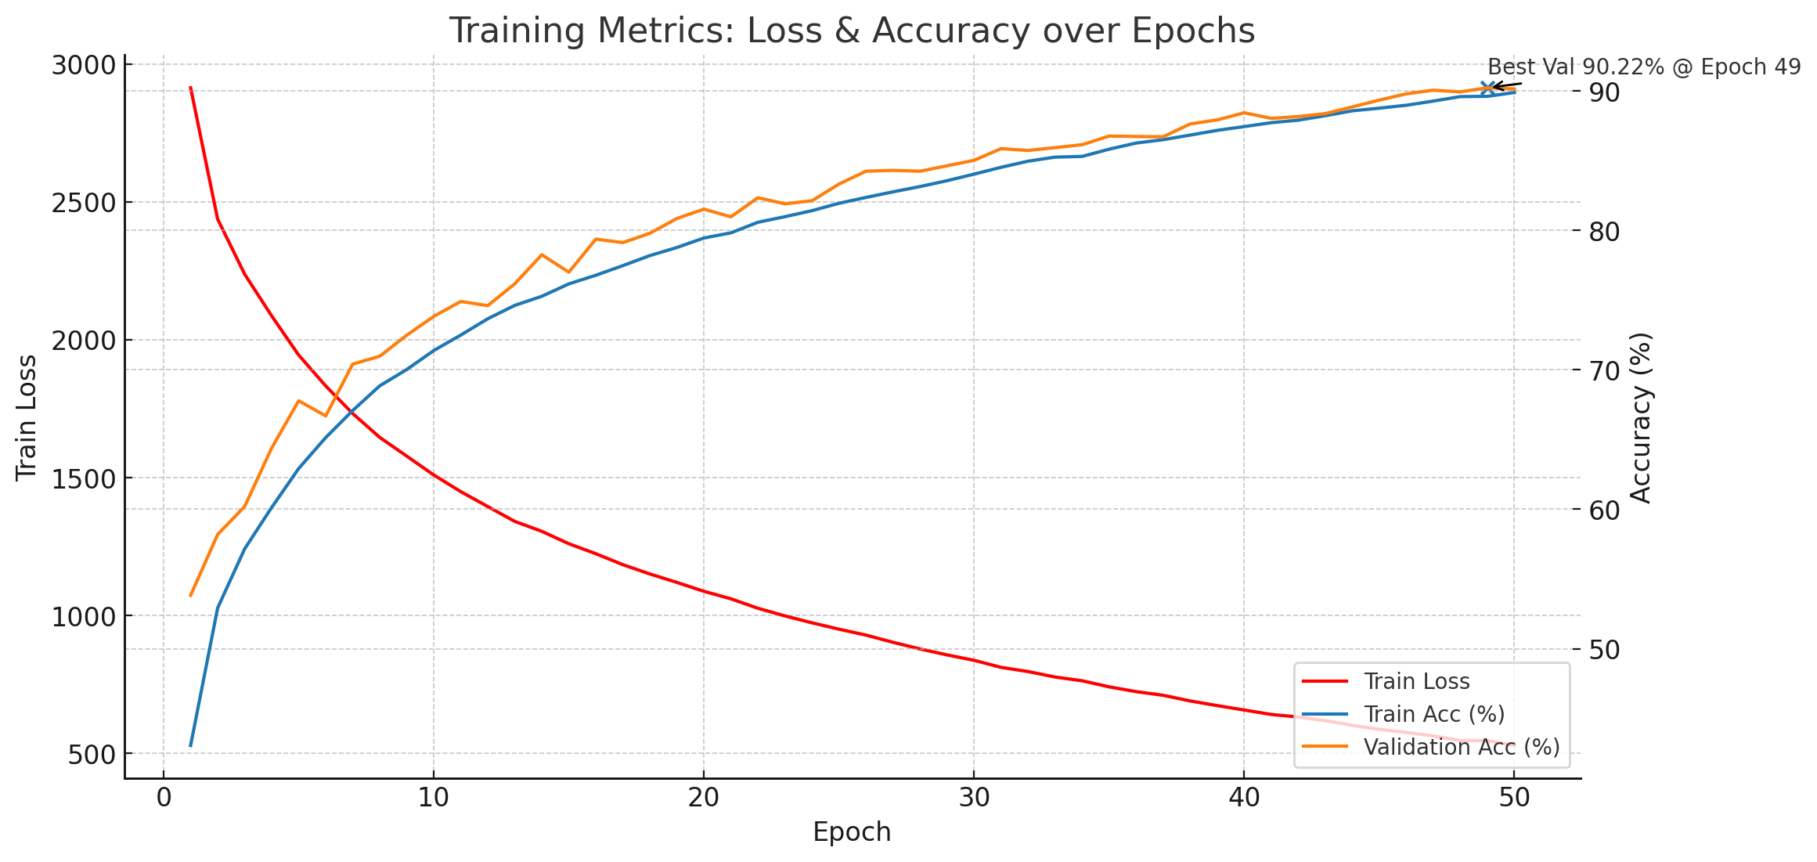
Cross Vit with enhanced dataset
Accuracy rate : 80.47%
Time Cost : 240min

Slide 23
Results compare
Exp | Model | Changes vs Baseline-1 | Test Acc (%)
1 | ViT | — | 60.40
2 | ViT | Patch size = 4 | 67.62
3 | ViT | Dim = 256; MLP dim = 512 | 53.20
4 | ViT | Depth = 24 | 61.37
5 | ViT | Heads = 16 | 63.52
6 | CrossViT | patch = 4 / 8; sm/ lg dim = 192 / 384; stages = 2; sm/ lg encoder depth = 2 / 2; cross-attn depth = 1; sm/ lg heads = 6 / 6; cross heads = 4; sm/ lg MLP = 768 / 1536; dropout = 0.1; emb_dropout = 0.1 | 76.31/80.47(enhanced dataset)

