Slide 1
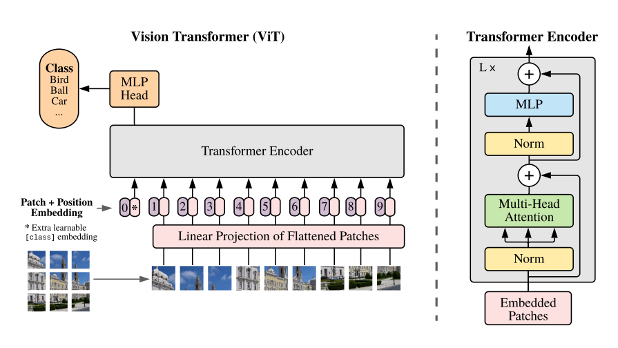
ViT Model

Slide 2
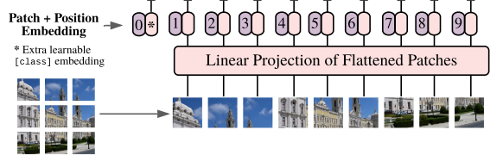
Patch Embedding Position CLS token
1 split every image into patches
2 embedding patches, linear from patch_dim to target dim
3 generate learnable CLS token, join to patches tokens
4 add position embedding

Slide 3
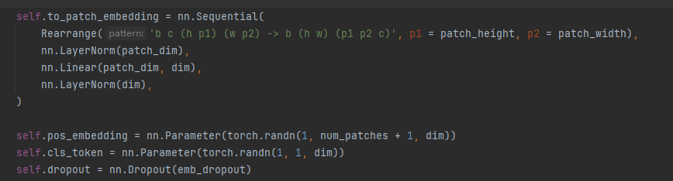
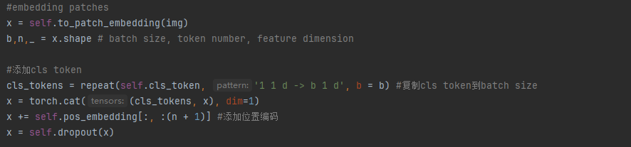
Setting
b = batch, c = channel, h =image_height, w = image_width
Last a random dropout
Forward

Slide 4
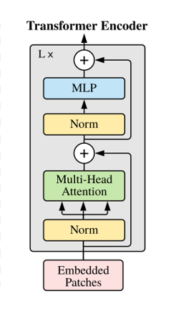
Transformer
1 define attention and mlp
2 add them to a moduleList each layer, looping depth times
3 for each layer,
run x= attention(x) + x
then x = mlp(x) + x
This is a ResNet (https://arxiv.org/abs/1512.03385)
Solve the vanishing/exploding gradient problem

Slide 5
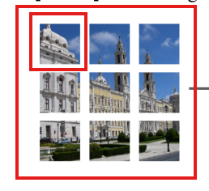


Muti-heads Self Attention
If current index = 1, we get Q from patch 1, means “queries”, what I am looking for ?
Get K, V from all patches, means “keys”,”values”
Keys: what are my options?
Values: what do they publicly reveal / broadcast to others?
Get Q,K,V by Linear from (batch,token number,dim) to (batch,token number, heads * dim * 3),then chunk to 3

Slide 6


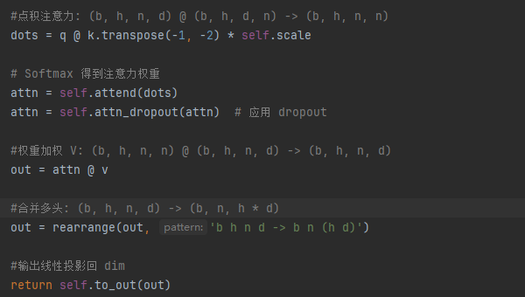
Muti-heads Self Attention
After get q,k,v, calculate for every patch the “attention tensor” to each patch
It means the relevance for each patch to other patch
Muti-heads means from different “views” to consider the relevance, for images, maybe from color, shape, outline, contrast ratio …

Slide 7
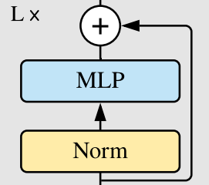
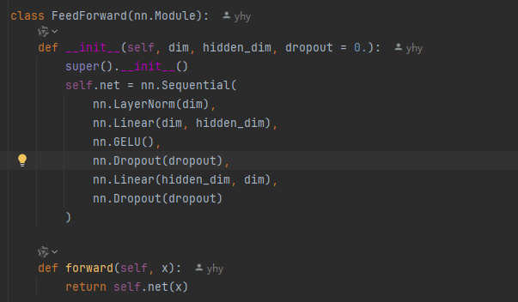
MLP/FeedForward
After attention process, each patch token contains other tokens’ information, but it is still a linear operation
MLP is a nolinear project for every single token
Using a nolinear activation function GELU
Expand dim to mlp_dim , then shrink back to dim to improve expression

Slide 8

Finally
Choose CLS token or all tokens mean stands for the final class

Slide 9
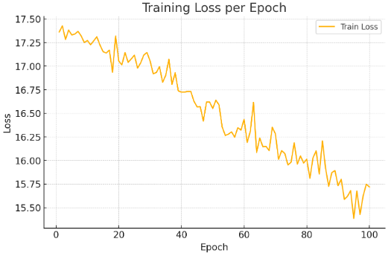
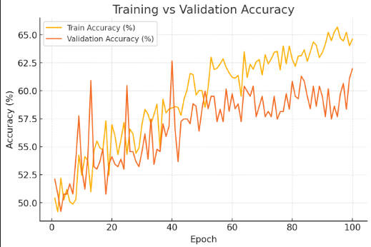
Efficient Transformer Vit
Only cat and dog 2 classes
Epoch 100
Test Accuracy 58.95%

Slide 10
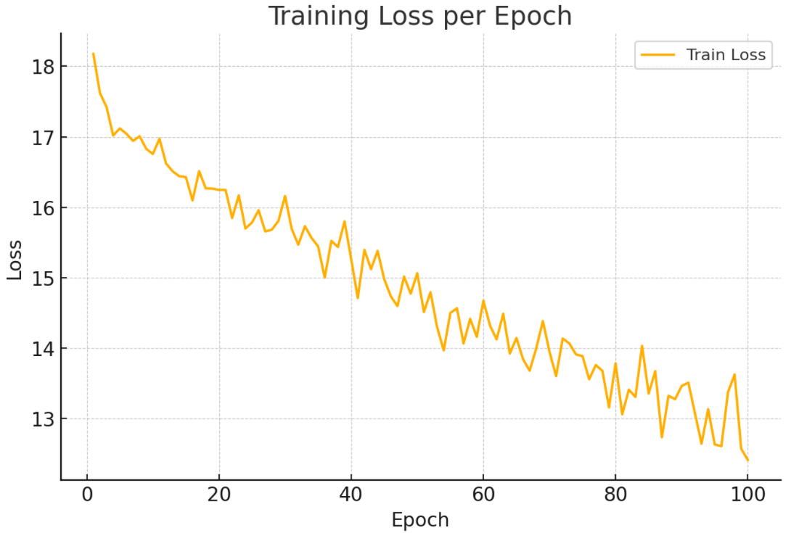
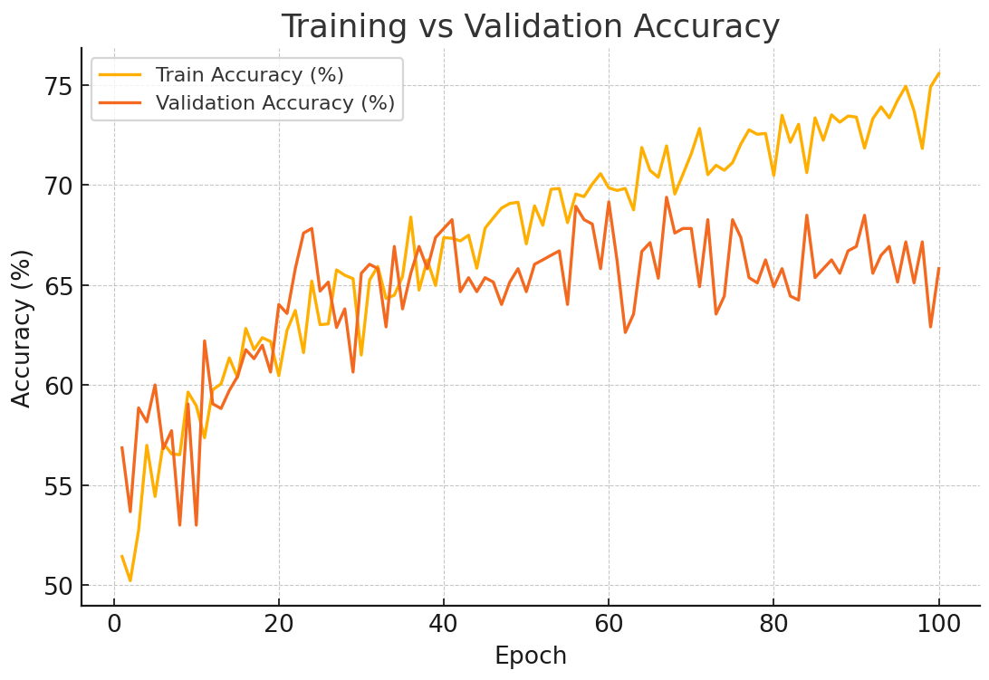
Baseline Vit
Only cat and dog 2 classes
Epoch 100
Test Accuracy 64%

Slide 11
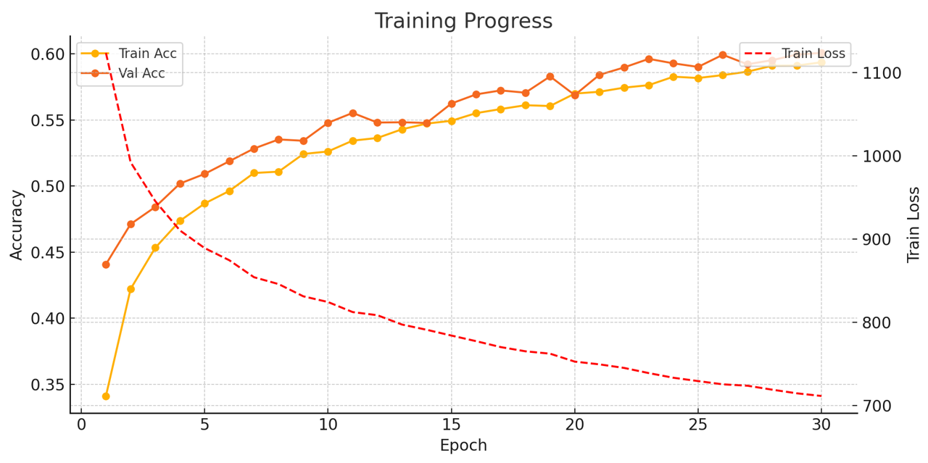
Baseline Vit
Full Cifar-10 dataset , 10 classes
Epoch = 30
Batch_size = 64
Patch_size = 8
Dim = 128
Depth = 12
Heads = 8
Mlp_dim = 256
Test accuracy = 60.4%
Time Cost: 45min

Slide 12
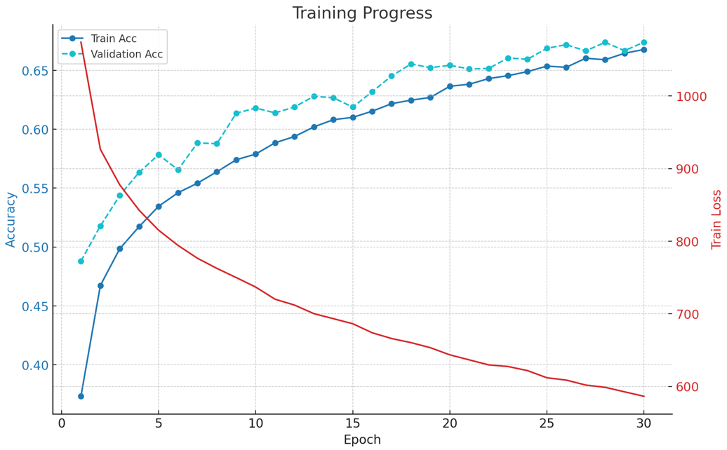
Baseline Vit
Full Cifar-10 dataset , 10 classes
Epoch = 30
Batch_size = 64
Patch_size = 4
Dim = 128
Depth = 12
Heads = 8
Mlp_dim = 256
Test accuracy = 67.62%
Time Cost: 70min
Higher accuracy than patch size = 8 !

Slide 13
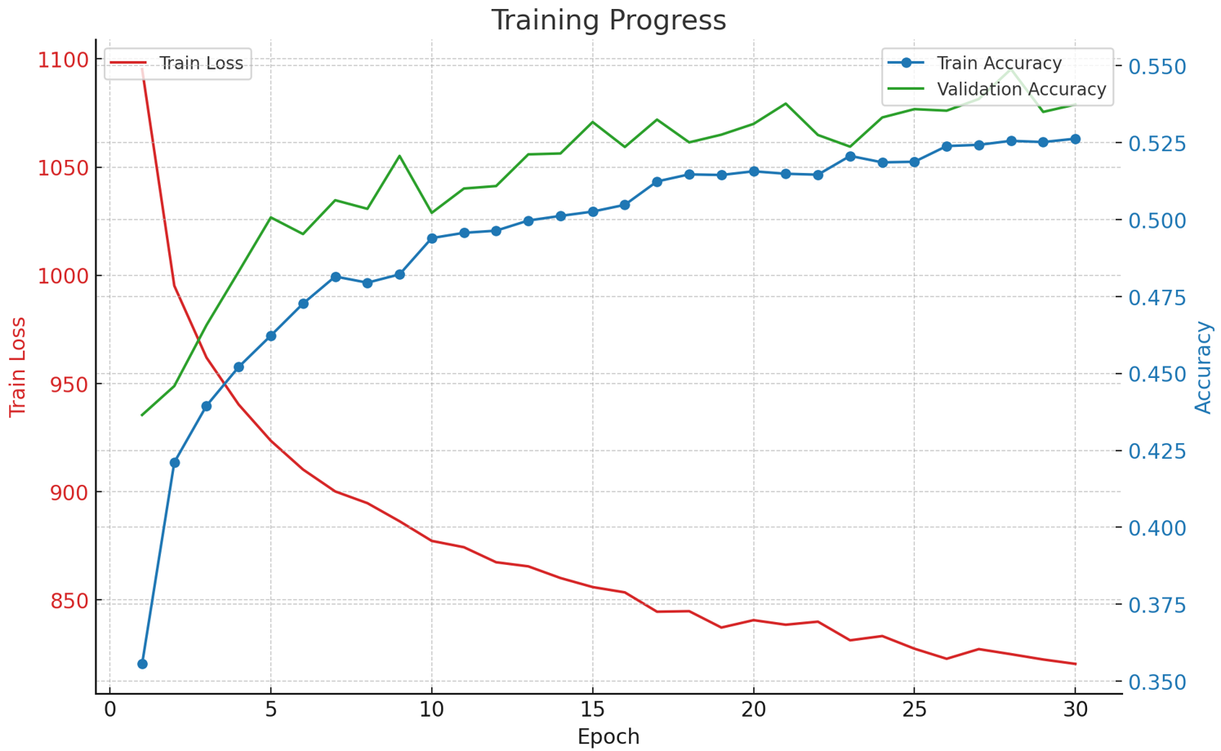
Baseline Vit
Full Cifar-10 dataset , 10 classes
Epoch = 30
Batch_size = 64
Patch_size = 8
Dim = 256
Depth = 12
Heads = 8
Mlp_dim = 512
Test accuracy = 53.2%
Time Cost: 80min

Slide 14
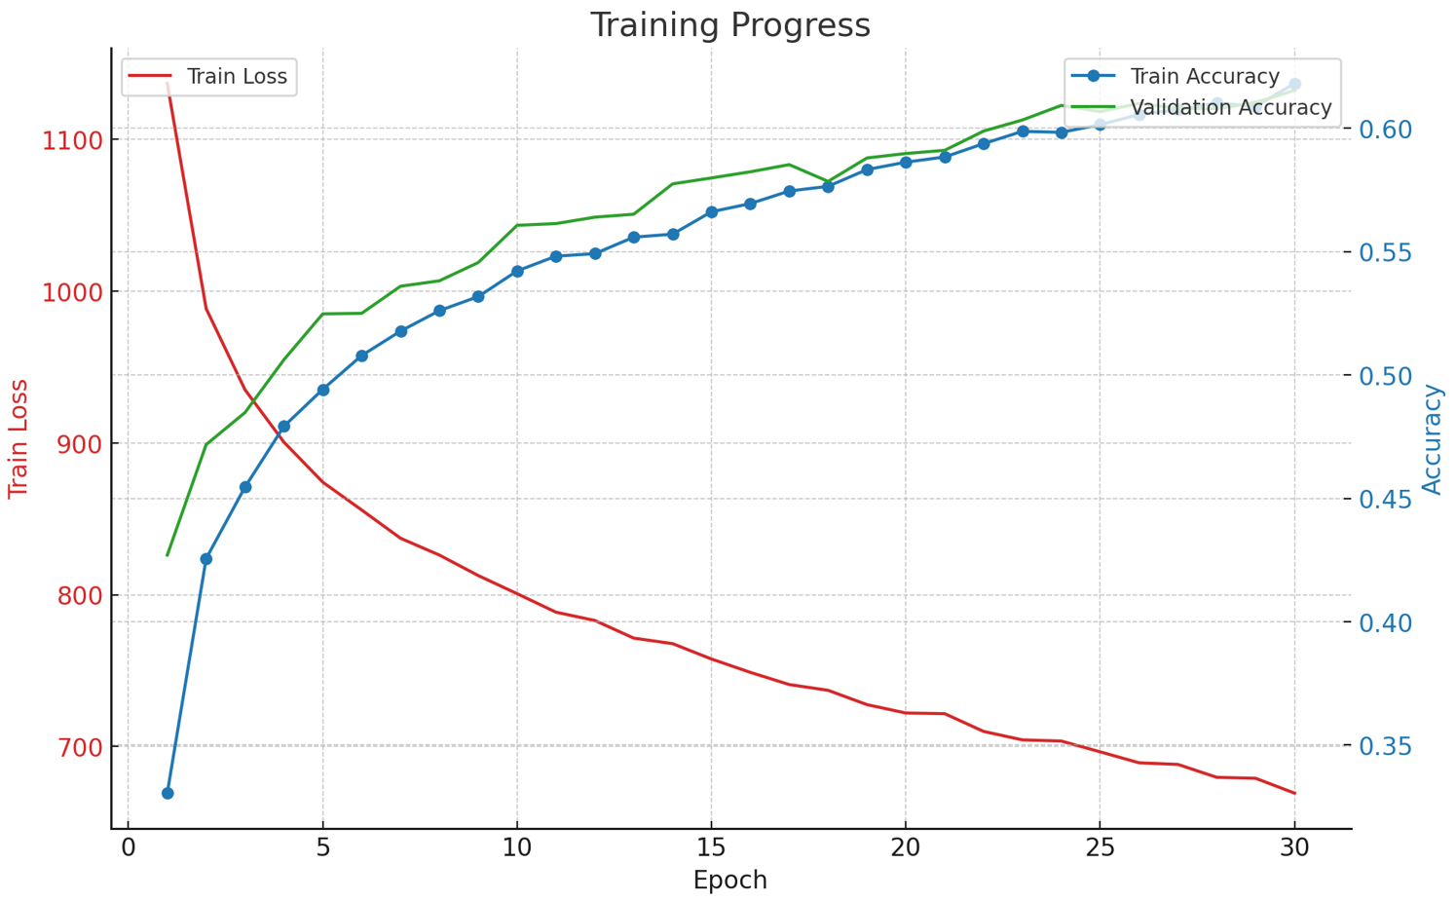
Baseline Vit
Full Cifar-10 dataset , 10 classes
Epoch = 30
Batch_size = 64
Patch_size = 8
Dim = 128
Depth = 24
Heads = 8
Mlp_dim = 256
Test accuracy = 61.37%
Time Cost = 60min

Slide 15
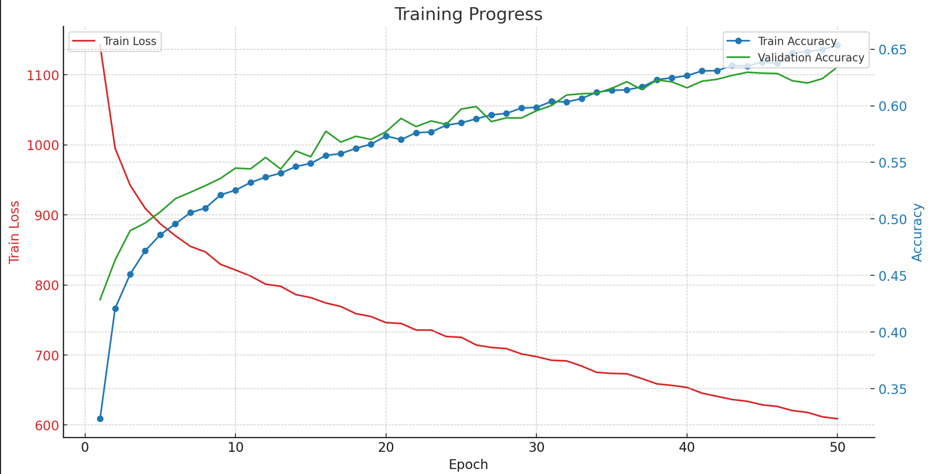
Baseline Vit
Full Cifar-10 dataset , 10 classes
Epoch = 30
Batch_size = 64
Patch_size = 8
Dim = 128
Depth = 12
Heads = 16
Mlp_dim = 256
Test accuracy = 63.52%
Time Cost: 100min

