Slide 1
OPERATION@PYTHON
4110E205
沈愛希

Slide 2
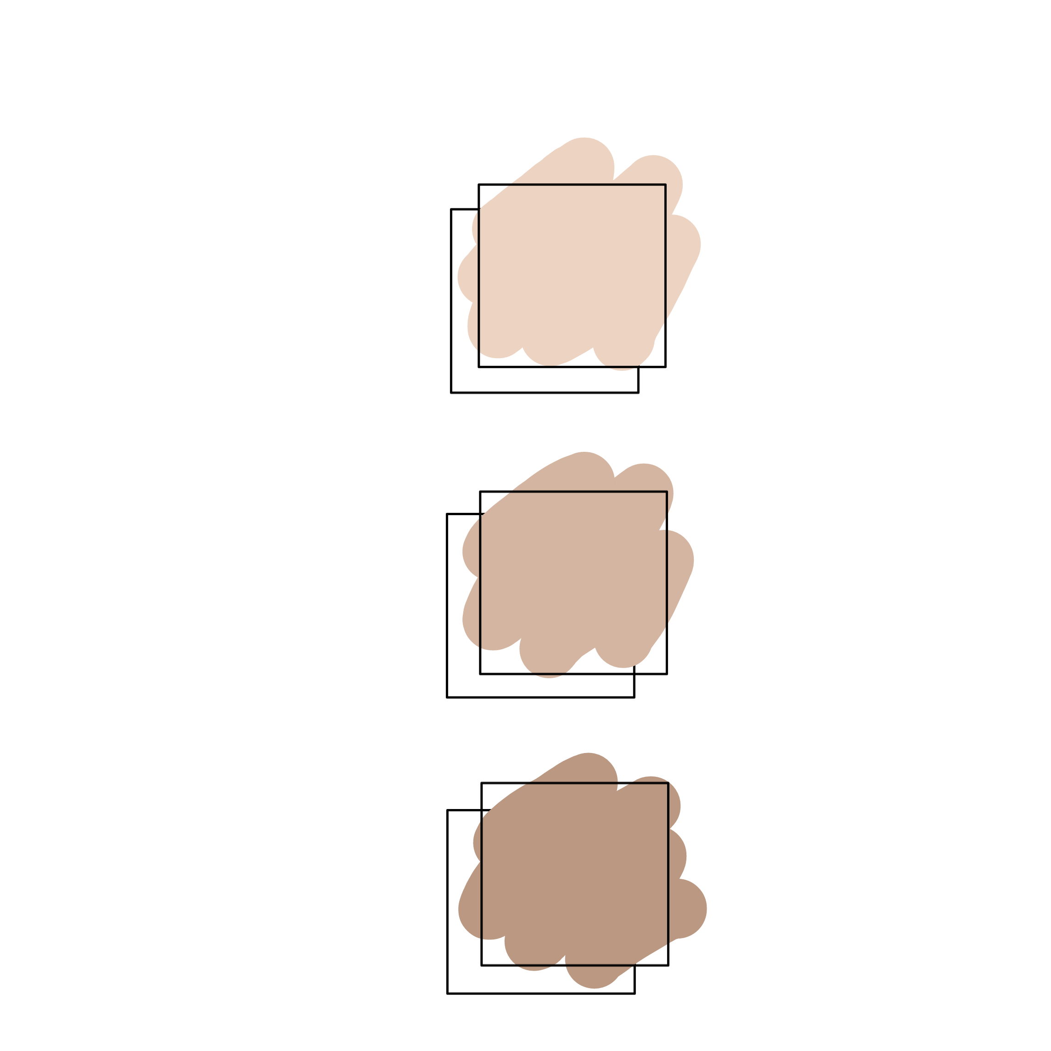
PYTHON STRINGS SLICING STRINGS MODIFY STRINGS CONCATENATE STRINGS FORMAT STRINGS METHOD STRINGS
AGENDA

Slide 3

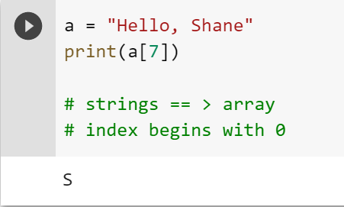
Strings in python are arrays of bytes.
Representing Unicode Characters:
01

Slide 4
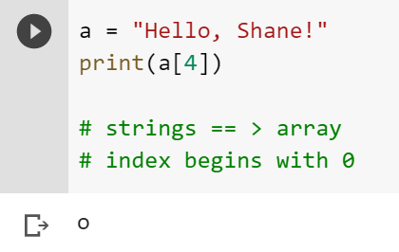
Strings are Arrays ==> access the element of array
Python does not have a character data type, a single character is simply a string with a length of 1
02

Slide 5

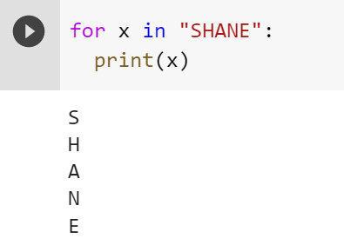
Looping through a String
03

Slide 6
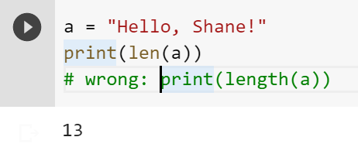
04
String Length: To get the length of a string use the len () function.

Slide 7
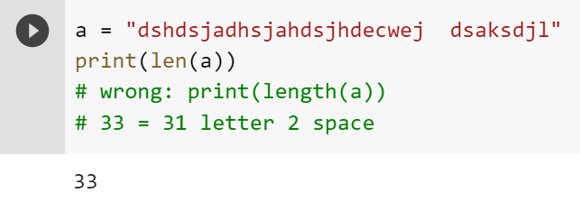
QUIZ: Tell me How many Char appear in “"dshdsjadhsjahdsjhdecwej dsaksdjl”
05

Slide 8
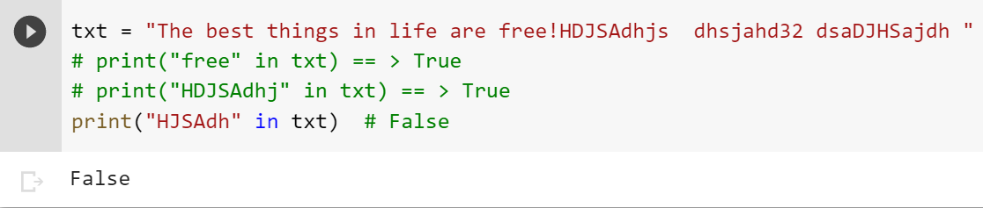
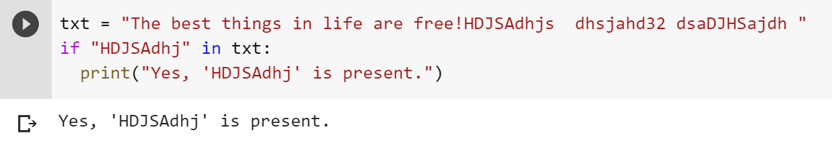
Check String:To check if a certain phrase or character is present in a string, we can use the keyword in.
Keyword in vs if
True or False
06

Slide 9
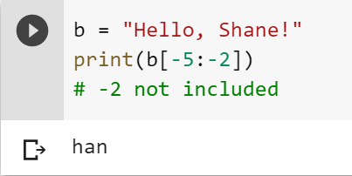
Negative Indexing
07

Slide 10
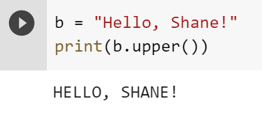

PYTHON – MODIFY STRINGS
The upper() method returns the string in upper case:
The lower() method returns the string in lower case
08

Slide 11
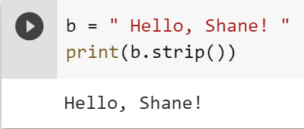
Remove Whitespace with strip() method.
The strip() method removes any whitespace from the beginning or the end
09

Slide 12
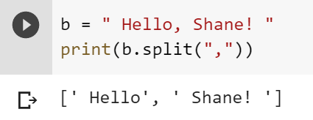
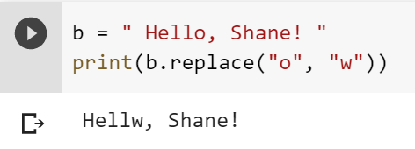
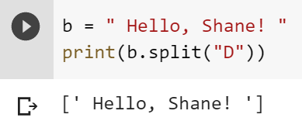
The replace()method replaces a string with another string Separator
10

Slide 13
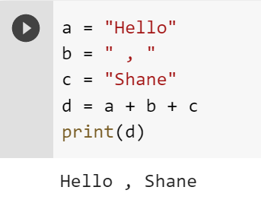
String Concatenation: To concatenate, or combine, two strings you can use the + operator.
11

Slide 14
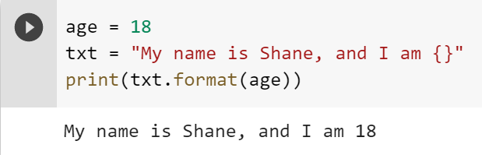
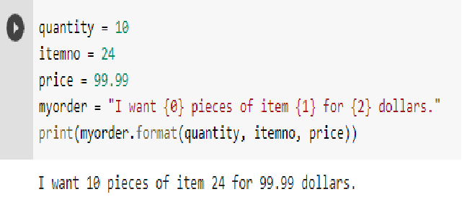
Python - Format - Strings
12

Slide 15
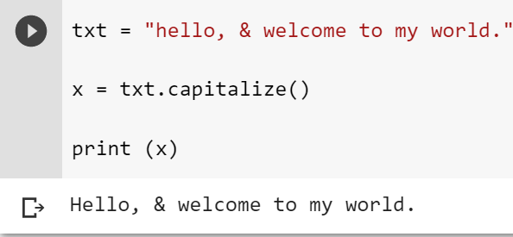
STRING METHODS
13

Slide 16
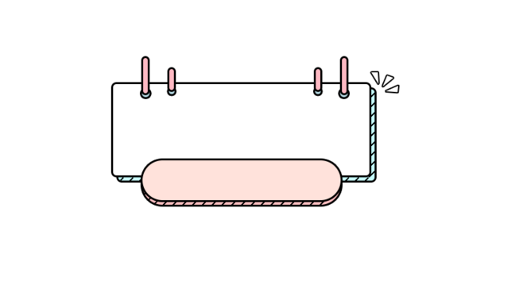
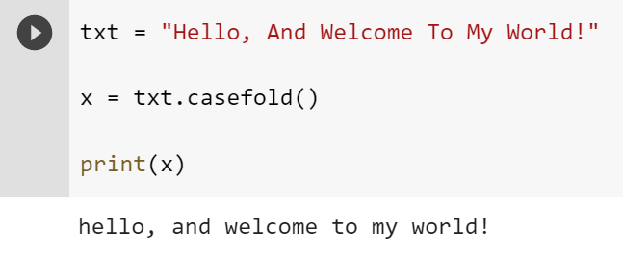
STRING
METHODS
14

Slide 17

NAME: 沈愛希 STUDENT ID: 4110E205 ENGLISH NAME: Shane Ashly G. Birad NICKNAME: Shane Email: biradshane@gmail.com GITHUB: https://github.com/4110E205/cs2022.git
Please keep this slide for attribution

