Slide 1

OPERATION@PYTHON
4110E206

Slide 2



AGENDA
PYTHON STRINGS
SLICING STRINGS
MODIFY STRINGS
CONCATENATE STRINGS
FORMAT STRINGS
METHOD STRINGS

Slide 3
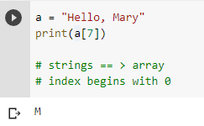
01
Strings in python are arrays of bytes. Representing Unicode Characters:

Slide 4
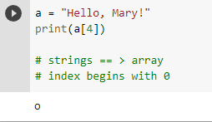
02
Strings are Arrays ==> access the element of array
Python does not have a character data type, a single character is simply a string with a length of 1

Slide 5





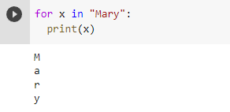
03
Looping through a String

Slide 6


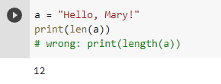
04
String Length: To get the length of a string use the len () function.

Slide 7
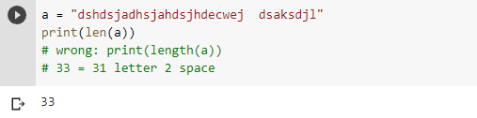

05
QUIZ: Tell me How many Char appear in “"dshdsjadhsjahdsjhdecwej dsaksdjl”

Slide 8
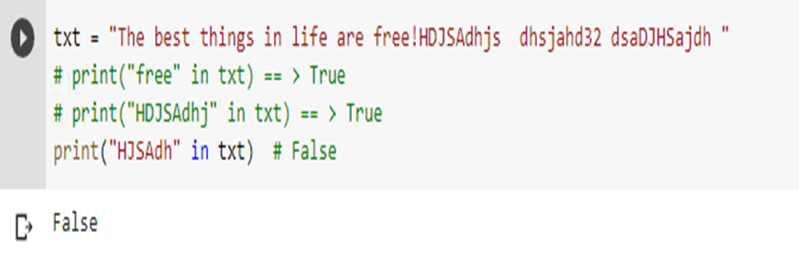
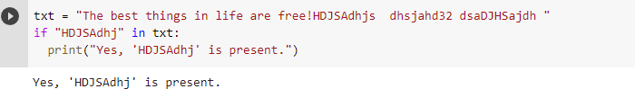

06
Check String:To check if a certain phrase or character is present in a string, we can use the keyword in.
keyword in vs if
True or False

Slide 9
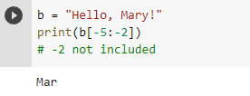

07
Negative Indexing

Slide 10

08
The upper() method returns the string in upper case:
The lower() method returns the string in lower case
PYTHON – MODIFY STRINGS

Slide 11







Remove Whitespace with strip() method.
The strip() method removes any whitespace from the beginning or the end
09

Slide 12
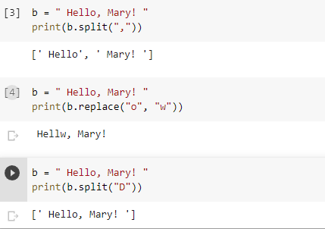

10
The replace()method replaces a string with another string
Separator

Slide 13




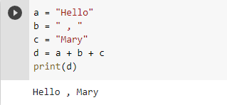

11
String Concatenation: To concatenate, or combine, two strings you can use the + operator.

Slide 14

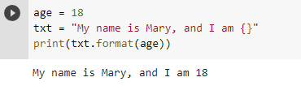

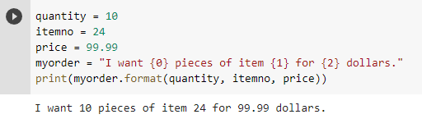


12
Python - Format - Strings

Slide 15

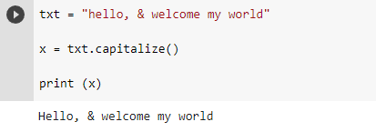
13
String Methods

Slide 16
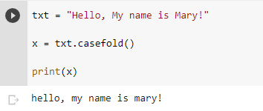


14
String Methods

Slide 17
MY NAME IS….
MA
RY
CR
IS
B.
THIS IS MY WORK

Slide 18




Mary Cris
Mal_feah

Slide 19


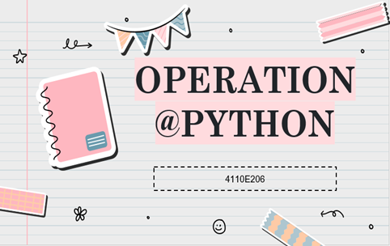
歐跟莎
“THANK YOU”
...
Chinese Name: 歐跟莎
Student Id: 4410E206
English Name: Mary Cris O. Bonode
Nickname: Mary - Feah
Email: marycrisbonode06@gmail.com
Github: https://github.com/4110E206

