Slide 1
My journal to python
VER.1
Irish d. deyto
艾芮絲
4110e214

Slide 2
Agenda: learning python
Introduction to python
Python Syntax
Python Data Types
Python Numbers
Python Casting
Python Strings
Python Booleans
Python Operators
Python Lists
Python Tuples
Python Sets
Python Dictionaries

Slide 3

What is Python?
Python is a popular programming language. It was created by Guido van Rossum, and released in 1991.
It is used for:
web development (server-side),
software development,
mathematics,
system scripting.

Slide 4
What can Python do?
Python can be used on a server to create web applications.
Python can be used alongside software to create workflows.
Python can connect to database systems. It can also read and modify files.
Python can be used to handle big data and perform complex mathematics.
Python can be used for rapid prototyping, or for production-ready software development.

Slide 5
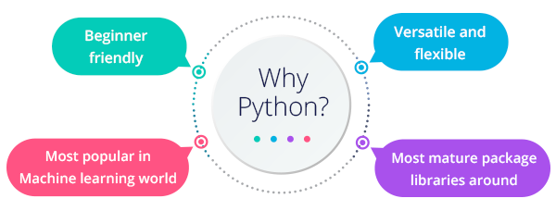
Why Python?
Python works on different platforms (Windows, Mac, Linux, Raspberry Pi, etc).
Python has a simple syntax similar to the English language.
Python has syntax that allows developers to write programs with fewer lines than some other programming languages.
Python runs on an interpreter system, meaning that code can be executed as soon as it is written. This means that prototyping can be very quick.
Python can be treated in a procedural way, an object-oriented way or a functional way.

Slide 6
Python Syntax compared to other programming languages
Python was designed for readability, and has some similarities to the English language with influence from mathematics.
Python uses new lines to complete a command, as opposed to other programming languages which often use semicolons or parentheses.
Python relies on indentation, using whitespace, to define scope; such as the scope of loops, functions and classes. Other programming languages often use curly-brackets for this purpose.

Slide 7
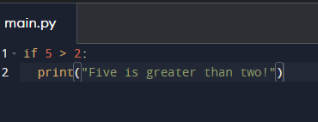

Python Indentation
Indentation refers to the spaces at the beginning of a code line.
Where in other programming languages the indentation in code is for readability only, the indentation in Python is very important.
Python uses indentation to indicate a block of code.
Example:

Slide 8
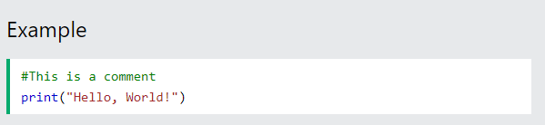
Python Comments
Comments can be used to explain Python code.
Comments can be used to make the code more readable.
Comments can be used to prevent execution when testing code.
Creating a Comment
Comments starts with a #, and Python will ignore them:

Slide 9
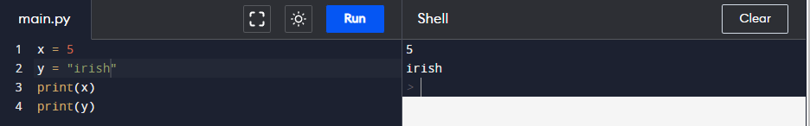
PythonVariables
Variables are containers for storing data values.
Creating Variables
Python has no command for declaring a variable.
A variable is created the moment you first assign a value to it.

Slide 10
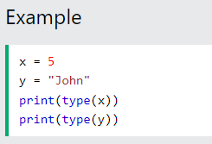
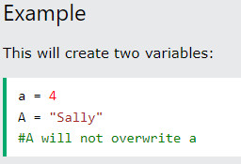
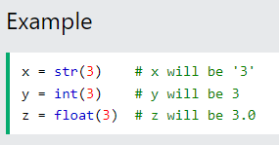
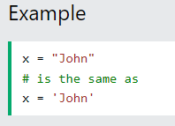
Casting
If you want to specify the data type of a variable, this can be done with casting.
Get the Type
You can get the data type of a variable with the type() function.
Case-Sensitive
Variable names are case-sensitive.
Single or Double Quotes?
String variables can be declared either by using single or double quotes:

Slide 11
Python - Variable Names
Variable Names
A variable can have a short name (like x and y) or a more descriptive name (age, carname, total_volume). Rules for Python variables:
A variable name must start with a letter or the underscore character
A variable name cannot start with a number
A variable name can only contain alpha-numeric characters and underscores (A-z, 0-9, and _ )
Variable names are case-sensitive (age, Age and AGE are three different variables)
Example
Legal variable names:
myvar = "John" my_var = "John" _my_var = "John" myVar = "John" MYVAR = "John" myvar2 = "John"
Example
Illegal variable names:
2myvar = "John" my-var = "John" my var = "John"
Remember that variable names are case-sensitive

Slide 12
Multi Words Variable Names
Variable names with more than one word can be difficult to read.
There are several techniques you can use to make them more readable:
Camel Case
Each word, except the first, starts with a capital letter:
myVariableName = “Riri“
Pascal Case
Each word starts with a capital letter:
MyVariableName = “Riri“
Snake Case
Each word is separated by an underscore character:
my_variable_name = “Riri"

Slide 13
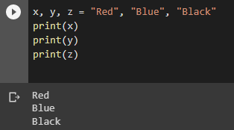
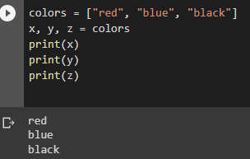
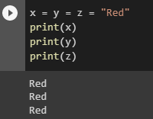
Python Variables - Assign Multiple Values
Many Values to Multiple Variables
Python allows you to assign values to multiple variables in one line:
One Value to Multiple Variables
And you can assign the same value to multiple variables in one line:
Unpack a Collection
If you have a collection of values in a list, tuple etc. Python allows you to extract the values into variables. This is called unpacking.

Slide 14

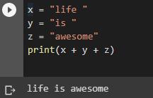
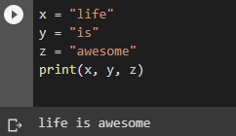
Python - Output Variables
Output Variables
The Python print() function is often used to output variables.
You can also use the + operator to output multiple variables:
Example
Example
In the print() function, you output multiple variables, separated by a comma:
Example
Notice the space character after "Python " and "is ", without them the result would be "Pythonisawesome".

Slide 15
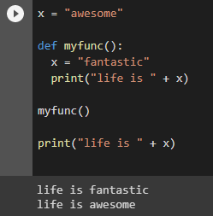
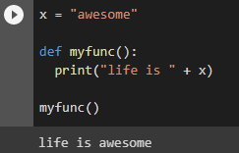
Python - Global Variables
If you create a variable with the same name inside a function, this variable will be local, and can only be used inside the function. The global variable with the same name will remain as it was, global and with the original value.
Global Variables
Variables that are created outside of a function (as in all of the examples above) are known as global variables.
Global variables can be used by everyone, both inside of functions and outside.
Example:
Create a variable inside a function, with the same name as the global variable
Example:
Create a variable outside of a function, and use it inside the function

Slide 16
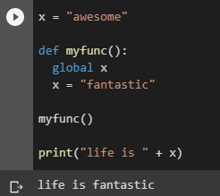
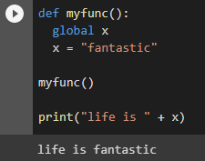
The global Keyword
Normally, when you create a variable inside a function, that variable is local, and can only be used inside that function.
To create a global variable inside a function, you can use the global keyword.
Example
If you use the global keyword, the variable belongs to the global scope:
Also, use the global keyword if you want to change a global variable inside a function.
Example
To change the value of a global variable inside a function, refer to the variable by using the global keyword:

Slide 17
Python Data Types

Slide 18
Built-in Data Types
In programming, data type is an important concept.
Variables can store data of different types, and different types can do different things.
Python has the following data types built-in by default, in these categories:
Text Type: str
Numeric Types: int, float, complex
Sequence Types: list, tuple, range
Mapping Type: dict
Set Types: set, frozenset
Boolean Type: bool
Binary Types: bytes, bytearray, memoryview
None Type: NoneType

Slide 19
Python Numbers

Slide 20
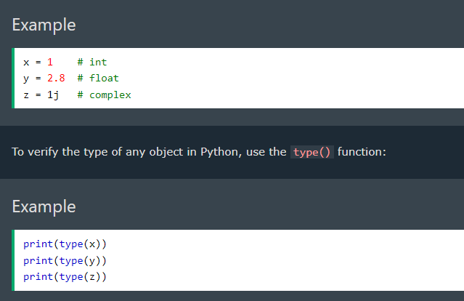
Python Numbers
There are three numeric types in Python:
int
float
Complex
Variables of numeric types are created when you assign a value to them:

Slide 21
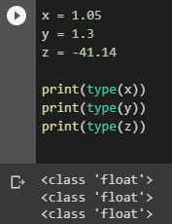
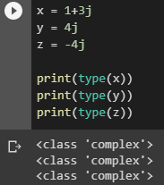
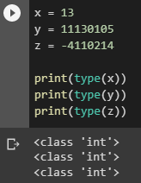
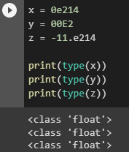
Int
Int, or integer, is a whole number, positive or negative, without decimals, of unlimited length.
Float
Float, or "floating point number" is a number, positive or negative, containing one or more decimals.
Complex
Complex numbers are written with a "j" as the imaginary part:
Float can also be scientific numbers with an "e" to indicate the power of 10.

Slide 22
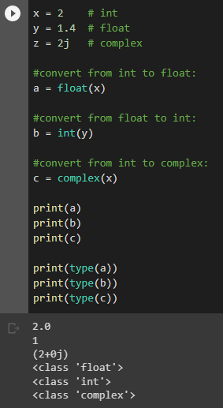
Type Conversion
You can convert from one type to another with the int(), float(), and complex() methods:
Example
Convert from one type to another:
Note: You cannot convert complex numbers into another number type
Random Number
Python does not have a random() function to make a random number, but Python has a built-in module called random that can be used to make random numbers.

Slide 23
Python Casting

Slide 24
Specify a Variable Type
There may be times when you want to specify a type on to a variable. This can be done with casting. Python is an object-orientated language, and as such it uses classes to define data types, including its primitive types.
Casting in python is therefore done using constructor functions:
int() - constructs an integer number from an integer literal, a float literal (by removing all decimals), or a string literal (providing the string represents a whole number)
float() - constructs a float number from an integer literal, a float literal or a string literal (providing the string represents a float or an integer)
str() - constructs a string from a wide variety of data types, including strings, integer literals and float literals

Slide 25
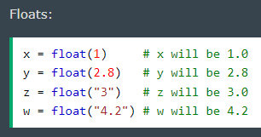
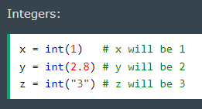
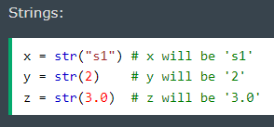
Example:

Slide 26
Python Strings

Slide 27

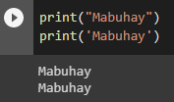
Strings
Strings in python are surrounded by either single quotation marks, or double quotation marks.
‘Mabuhay' is the same as “Mabuhay".
You can display a string literal with the print() function:
Assign String to a Variable
Assigning a string to a variable is done with the variable name followed by an equal sign and the string:

Slide 28
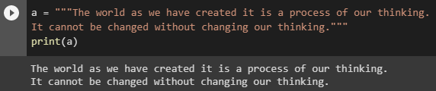
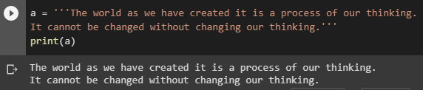
Multiline Strings
You can assign a multiline string to a variable by using three quotes:
” ” ”
’ ’ ’
Or three single quotes:
Note: in the result, the line breaks are inserted at the same position as in the code.

Slide 29

Strings are Arrays
Like many other popular programming languages, strings in Python are arrays of bytes representing unicode characters.
However, Python does not have a character data type, a single character is simply a string with a length of 1.
Square brackets can be used to access elements of the string.
Example:
Get the character at position 1 (remember that the first character has the position 0):

Slide 30

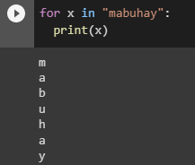
Looping Through a String
Since strings are arrays, we can loop through the characters in a string, with a for loop.
Example
Loop through the letters in the word “mabuhay":
String Length
To get the length of a string, use the len() function.
Example
The len() function returns the length of a string:

Slide 31

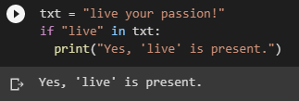
Check String
To check if a certain phrase or character is present in a string, we can use the keyword in.
Example
Check if “live" is present in the following text:
Use it in an if statement:
Example
Print only if “live" is present:

Slide 32

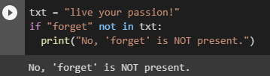
Check if NOT
To check if a certain phrase or character is NOT present in a string, we can use the keyword not in.
Example
Check if "expensive" is NOT present in the following text:
Use it in an if statement:
Example
print only if "expensive" is NOT present:

Slide 33

Python - Slicing Strings
Slicing
You can return a range of characters by using the slice syntax.
Specify the start index and the end index, separated by a colon, to return a part of the string.
Example:
Get the characters from position 2 to position 5 (not included):

Slide 34


Slice To the End
By leaving out the end index, the range will go to the end:
Example:
Get the characters from position 2, and all the way to the end:
Negative Indexing
Use negative indexes to start the slice from the end of the string:
Example
Get the characters:
From: "o" in "World!" (position -5)
To, but not included: "d" in "World!" (position -2):

Slide 35



Python - Modify Strings
Python has a set of built-in methods that you can use on strings.
Upper Case
Example:
The upper() method returns the string in upper case:
Lower Case
Example
The lower() method returns the string in lower case
Remove Whitespace
Whitespace is the space before and/or after the actual text, and very often you want to remove this space.
Example
The strip() method removes any whitespace from the beginning or the end:

Slide 36


Replace String
Example:
The replace() method replaces a string with another string:
Split String
The split() method returns a list where the text between the specified separator becomes the list items.
Example:
The split() method splits the string into substrings if it finds instances of the separator:

Slide 37
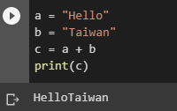
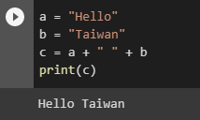
Python - String Concatenation
String Concatenation
To concatenate, or combine, two strings you can use the + operator.
Example
Merge variable a with variable b into variable c:
Example:
To add a space between them, add a " ":

Slide 38
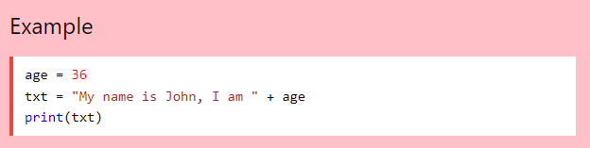
Python - Format - Strings
String Format
As we learned in the Python Variables chapter, we cannot combine strings and numbers like this:
But we can combine strings and numbers by using the format() method!
The format() method takes the passed arguments, formats them, and places them in the string where the placeholders {} are:

Slide 39
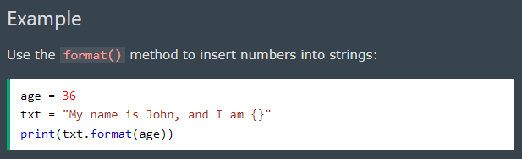
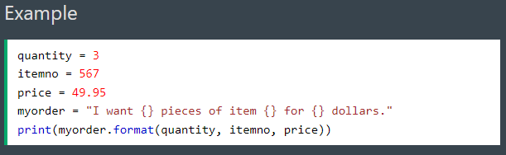
The format() method takes unlimited number of arguments, and are placed into the respective placeholders:

Slide 40
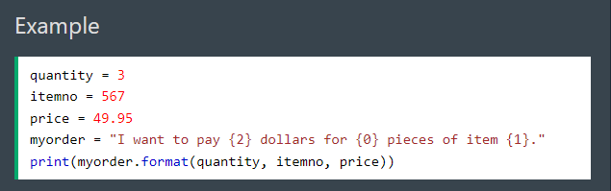
You can use index numbers {0} to be sure the arguments are placed in the correct placeholders:

Slide 41
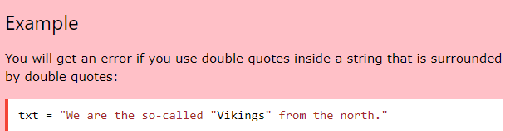
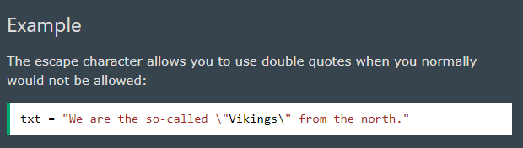
Python - Escape Characters
Escape Character
To insert characters that are illegal in a string, use an escape character.
An escape character is a backslash \ followed by the character you want to insert.
An example of an illegal character is a double quote inside a string that is surrounded by double quotes:
To fix this problem, use the escape character \":

Slide 42
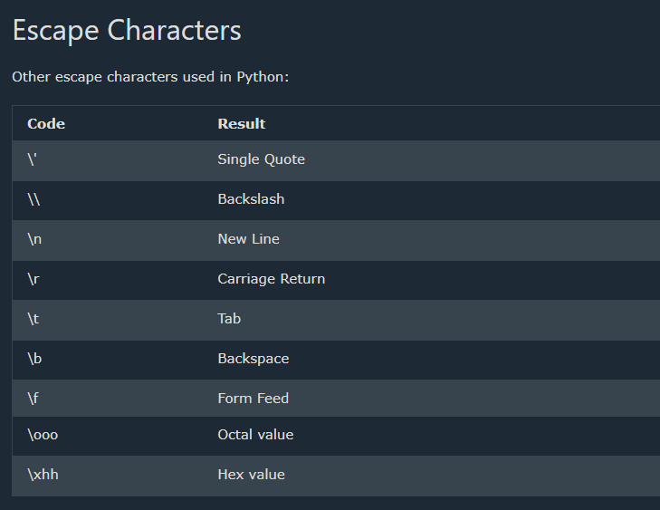

Slide 43

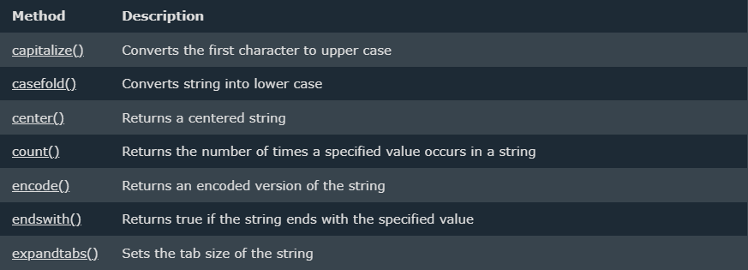
Python - String Methods
String Methods
Python has a set of built-in methods that you can use on strings.

Slide 44
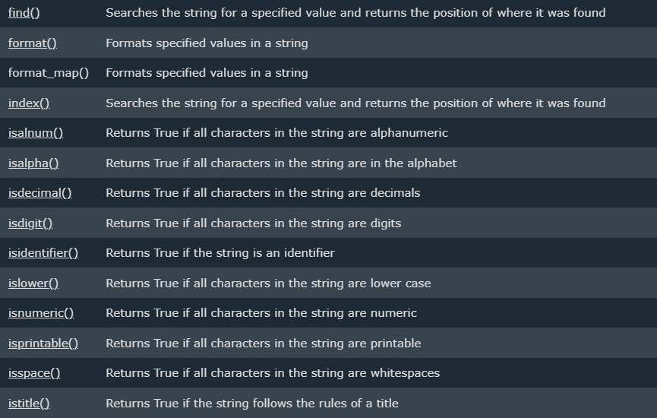

Slide 45
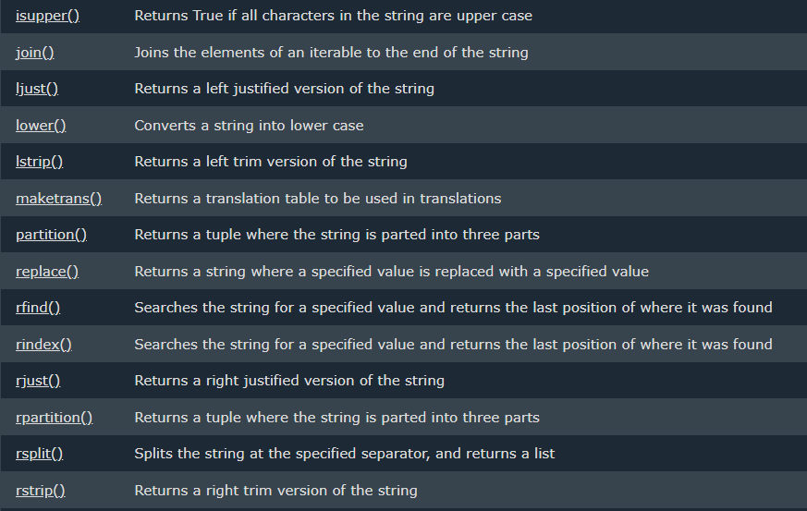

Slide 46
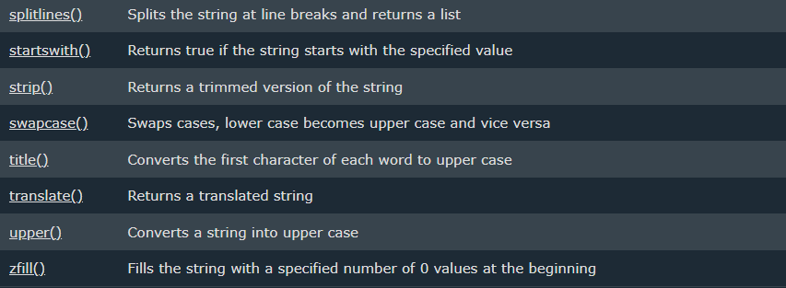

Slide 47
Python Booleans
Booleans represent one of two values: True or False.

Slide 48
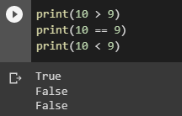
Boolean Values
In programming you often need to know if an expression is True or False.
You can evaluate any expression in Python, and get one of two answers, True or False.
When you compare two values, the expression is evaluated and Python returns the Boolean answer:
Example:

Slide 49
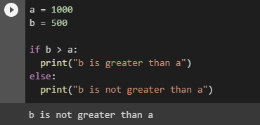
When you run a condition in an if statement, Python returns True or False:
Example
Print a message based on whether the condition is True or False:

Slide 50
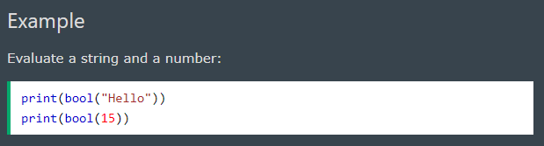
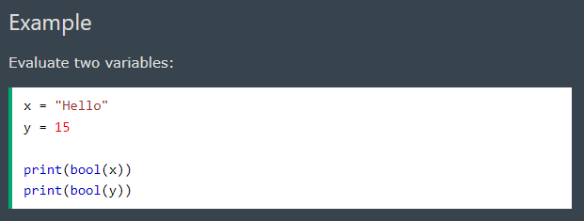
Evaluate Values and Variables
The bool() function allows you to evaluate any value, and give you True or False in return,

Slide 51
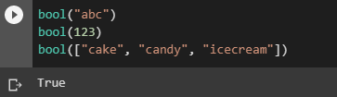
Most Values are True
Almost any value is evaluated to True if it has some sort of content.
Any string is True, except empty strings.
Any number is True, except 0.
Any list, tuple, set, and dictionary are True, except empty ones.
Example
The following will return True:

Slide 52

Some Values are False
In fact, there are not many values that evaluate to False, except empty values, such as (), [], {}, "", the number 0, and the value None. And of course the value False evaluates to False.
Example
The following will return False:

Slide 53

One more value, or object in this case, evaluates to False, and that is if you have an object that is made from a class with a __len__ function that returns 0 or False:
Example

Slide 54

Functions can Return a Boolean
You can create functions that returns a Boolean Value:
Example
Print the answer of a function:

Slide 55

You can execute code based on the Boolean answer of a function:
Example
Print "YES!" if the function returns True, otherwise print "NO!":

Slide 56

Python also has many built-in functions that return a boolean value, like the isinstance() function, which can be used to determine if an object is of a certain data type:
Example
Check if an object is an integer or not:

Slide 57
Python Operators

Slide 58

Python Operators
Operators are used to perform operations on variables and values.
In the example below, we use the + operator to add together two values:
Python divides the operators in the following groups:
Arithmetic operators
Assignment operators
Comparison operators
Logical operators
Identity operators
Membership operators
Bitwise operators

Slide 59

Python Arithmetic Operators
Arithmetic operators are used with numeric values to perform common mathematical operations:

Slide 60


Python Assignment Operators
Assignment operators are used to assign values to variables:

Slide 61

Python Comparison Operators
Comparison operators are used to compare two values:

Slide 62

Python Logical Operators
Logical operators are used to combine conditional statements:

Slide 63

Python Identity Operators
Identity operators are used to compare the objects, not if they are equal, but if they are actually the same object, with the same memory location:

Slide 64

Python Membership Operators
Membership operators are used to test if a sequence is presented in an object:

Slide 65

Python Bitwise Operators
Bitwise operators are used to compare (binary) numbers:

Slide 66
Python Lists

Slide 67

List
Lists are used to store multiple items in a single variable.
Lists are one of 4 built-in data types in Python used to store collections of data, the other 3 are Tuple, Set, and Dictionary, all with different qualities and usage.
Lists are created using square brackets:
Example
Create a List:

Slide 68
List Items
List items are ordered, changeable, and allow duplicate values.
List items are indexed, the first item has index [0], the second item has index [1] etc.
Ordered
When we say that lists are ordered, it means that the items have a defined order, and that order will not change.
If you add new items to a list, the new items will be placed at the end of the list.

Slide 69

Changeable
The list is changeable, meaning that we can change, add, and remove items in a list after it has been created.
Allow Duplicates
Since lists are indexed, lists can have items with the same value:
Example
Lists allow duplicate values:

Slide 70

Python - Access List Items
Access Items
List items are indexed and you can access them by referring to the index number:
Example
Print the second item of the list:

Slide 71

Negative Indexing
Negative indexing means start from the end
-1 refers to the last item, -2 refers to the second last item etc.
Example
Print the last item of the list:

Slide 72

Range of Indexes
You can specify a range of indexes by specifying where to start and where to end the range.
When specifying a range, the return value will be a new list with the specified items.
Example
Return the third, fourth, and fifth item:
Note: The search will start at index 2 (included) and end at index 5 (not included).
Remember that the first item has index 0.

Slide 73


By leaving out the start value, the range will start at the first item:
Example
This example returns the items from the beginning to, but NOT including, “rose":
By leaving out the end value, the range will go on to the end of the list:
Example
This example returns the items from “daisy" to the end:

Slide 74

Python - Change List Item
Change Item Value
To change the value of a specific item, refer to the index number:
Example
Change the second item:

Slide 75

Change a Range of Item Values
To change the value of items within a specific range, define a list with the new values, and refer to the range of index numbers where you want to insert the new values:
Example
Change the values “lily" and “sunflower" with the values “carnations" and “marigold":

Slide 76


If you insert more items than you replace, the new items will be inserted where you specified, and the remaining items will move accordingly:
Example
Change the second value by replacing it with two new values:
If you insert less items than you replace, the new items will be inserted where you specified, and the remaining items will move accordingly:
Example
Change the second and third value by replacing it with one value:

Slide 77

Insert Items
To insert a new list item, without replacing any of the existing values, we can use the insert() method.
The insert() method inserts an item at the specified index:
Example
Insert "watermelon" as the third item:

Slide 78

Python - Add List Items
Append Items
To add an item to the end of the list, use the append() method:
Example
Using the append() method to append an item:

Slide 79

Insert Items
To insert a list item at a specified index, use the insert() method.
The insert() method inserts an item at the specified index:
Example
Insert an item as the second position:

Slide 80

Extend List
To append elements from another list to the current list, use the extend() method.
Example
Add the elements of tropical to thislist:
The elements will be added to the end of the list.

Slide 81

Add Any Iterable
The extend() method does not have to append lists, you can add any iterable object (tuples, sets, dictionaries etc.).
Example
Add elements of a tuple to a list:

Slide 82

Python - Remove List Items
Remove Specified Item
The remove() method removes the specified item.
Example
Remove “lily":

Slide 83


Remove Specified Index
The pop() method removes the specified index.
Example
Remove the second item:
If you do not specify the index, the pop() method removes the last item.
Example
Remove the last item:

Slide 84


DELETE
The del keyword also removes the specified index:
Example
Remove the first item:
The del keyword can also delete the list completely.
Example
Delete the entire list:

Slide 85

Clear the List
The clear() method empties the list.
The list still remains, but it has no content.
Example
Clear the list content:

Slide 86

Python - Loop Lists
Loop Through a List
You can loop through the list items by using a for loop:
Example
Print all items in the list, one by one:

Slide 87

Loop Through the Index Numbers
You can also loop through the list items by referring to their index number.
Use the range() and len() functions to create a suitable iterable.
Example
Print all items by referring to their index number:
The iterable created in the example above is [0, 1, 2].

Slide 88

Using a While Loop
You can loop through the list items by using a while loop.
Use the len() function to determine the length of the list, then start at 0 and loop your way through the list items by referring to their indexes.
Remember to increase the index by 1 after each iteration.
Example
Print all items, using a while loop to go through all the index numbers

Slide 89

Looping Using List Comprehension
List Comprehension offers the shortest syntax for looping through lists:
Example
A short hand for loop that will print all items in a list:

Slide 90
Python - List Comprehension
List Comprehension
List comprehension offers a shorter syntax when you want to create a new list based on the values of an existing list.
Example:
Based on a list of fruits, you want a new list, containing only the fruits with the letter "a" in the name.
Without list comprehension you will have to write a for statement with a conditional test inside:

Slide 91


Example
With list comprehension you can do all that with only one line of code:
Example

Slide 92

The Syntax
The return value is a new list, leaving the old list unchanged.
Condition
The condition is like a filter that only accepts the items that valuate to True.
Example
Only accept items that are not “rose":

Slide 93

The condition if x != "apple" will return True for all elements other than “rose", making the new list contain all fruits except “rose".
The condition is optional and can be omitted:
Example
With no if statement:

Slide 94


Iterable
The iterable can be any iterable object, like a list, tuple, set etc.
Example
You can use the range() function to create an iterable:
Same example, but with a condition:
Example
Accept only numbers lower than 3:

Slide 95

Expression
The expression is the current item in the iteration, but it is also the outcome, which you can manipulate before it ends up like a list item in the new list:
You can set the outcome to whatever you like:

Slide 96


The expression can also contain conditions, not like a filter, but as a way to manipulate the outcome:
The expression in the example above says:
"Return the item if it is not banana, if it is banana return orange".

Slide 97


Python - Sort Lists
Sort List Alphanumerically
List objects have a sort() method that will sort the list alphanumerically, ascending, by default:

Slide 98


Sort Descending
To sort descending, use the keyword argument reverse = True:

Slide 99

Customize Sort Function
You can also customize your own function by using the keyword argument key = function.
The function will return a number that will be used to sort the list (the lowest number first):

Slide 100


Case Insensitive Sort
By default the sort() method is case sensitive, resulting in all capital letters being sorted before lower case letters:
Luckily we can use built-in functions as key functions when sorting a list.
So if you want a case-insensitive sort function, use str.lower as a key function:

Slide 101

Reverse Order
What if you want to reverse the order of a list, regardless of the alphabet?
The reverse() method reverses the current sorting order of the elements.

Slide 102
END OF VERSION 1

Slide 103
My journal to python VER.2
Irish d. deyto
艾芮絲
4110e214

Slide 104
AGENDA
Python Lists
Python Tuples
Python Sets
Python Dictionaries
Python If ... Else
Python while loops
Python For Loops
Python Functions
Python lambda
Python arrays

Slide 105
Python Lists

Slide 106

Python - Copy Lists
Copy a List
You cannot copy a list simply by typing list2 = list1, because: list2 will only be a reference to list1, and changes made in list1 will automatically also be made in list2.
There are ways to make a copy, one way is to use the built-in List method copy().
Example
Make a copy of a list with the copy() method:

Slide 107

Example
Make a copy of a list with the list() method:

Slide 108

Python - Join Lists
Join Two Lists
There are several ways to join, or concatenate, two or more lists in Python.
One of the easiest ways are by using the + operator.
Example
Join two list:

Slide 109
Python - Join Lists
Join Two Lists
There are several ways to join, or concatenate, two or more lists in Python.
One of the easiest ways are by using the + operator.
Example
Join two list:

Slide 110

Python - List Methods
List Methods
Python has a set of built-in methods that you can use on lists.

Slide 111
Python Tuples

Slide 112

Tuple
Tuples are used to store multiple items in a single variable.
Tuple is one of 4 built-in data types in Python used to store collections of data, the other 3 are List, Set, and Dictionary, all with different qualities and usage.
A tuple is a collection which is ordered and unchangeable.
Tuples are written with round brackets.
Example
Create a Tuple:

Slide 113
Tuple Items
Tuple items are ordered, unchangeable, and allow duplicate values.
Tuple items are indexed, the first item has index [0], the second item has index [1] etc.
Ordered
When we say that tuples are ordered, it means that the items have a defined order, and that order will not change.

Slide 114

Unchangeable
Tuples are unchangeable, meaning that we cannot change, add or remove items after the tuple has been created.
Allow Duplicates
Since tuples are indexed, they can have items with the same value:
Example
Tuples allow duplicate values:

Slide 115

Tuple Length
To determine how many items a tuple has, use the len() function:
Example
Print the number of items in the tuple:

Slide 116

Create Tuple With One Item
To create a tuple with only one item, you have to add a comma after the item, otherwise Python will not recognize it as a tuple.
Example
One item tuple, remember the comma:

Slide 117

Tuple Items - Data Types
Tuple items can be of any data type:
Example
String, int and boolean data types:
A tuple can contain different data types:
Example
A tuple with strings, integers and boolean values:

Slide 118

type()
From Python's perspective, tuples are defined as objects with the data type 'tuple':
<class 'tuple’>
Example
What is the data type of a tuple?

Slide 119
Python Collections (Arrays)
There are four collection data types in the Python programming language:
List is a collection which is ordered and changeable. Allows duplicate members.
Tuple is a collection which is ordered and unchangeable. Allows duplicate members.
Set is a collection which is unordered, unchangeable*, and unindexed. No duplicate members.
Dictionary is a collection which is ordered** and changeable. No duplicate members.
*Set items are unchangeable, but you can remove and/or add items whenever you like.
**As of Python version 3.7, dictionaries are ordered. In Python 3.6 and earlier, dictionaries are unordered.
When choosing a collection type, it is useful to understand the properties of that type. Choosing the right type for a particular data set could mean retention of meaning, and, it could mean an increase in efficiency or security.

Slide 120

Python - Access Tuple Items
Access Tuple Items
You can access tuple items by referring to the index number, inside square brackets:
Example
Print the second item in the tuple:
Note: The first item has index 0.

Slide 121

Negative Indexing
Negative indexing means start from the end.
-1 refers to the last item, -2 refers to the second last item etc.
Example
Print the last item of the tuple:
end

Slide 122

Range of Indexes
You can specify a range of indexes by specifying where to start and where to end the range.
When specifying a range, the return value will be a new tuple with the specified items.
Example
Return the third, fourth, and fifth item:
Note: The search will start at index 2 (included) and end at index 5 (not included).
Remember that the first item has index 0.

Slide 123


By leaving out the start value, the range will start at the first item:
Example
This example returns the items from the beginning to, but NOT included, “dog":
By leaving out the end value, the range will go on to the end of the list:
Example
This example returns the items from "cherry" and to the end:

Slide 124

Range of Negative Indexes
Specify negative indexes if you want to start the search from the end of the tuple:
Example
This example returns the items from index -4 (included) to index -1 (excluded)

Slide 125

Check if Item Exists
To determine if a specified item is present in a tuple use the in keyword:
Example
Check if “tiger" is present in the tuple:

Slide 126
Python - Update Tuples
Tuples are unchangeable, meaning that you cannot change, add, or remove items once the tuple is created.
But there are some workarounds.

Slide 127

Change Tuple Values
Once a tuple is created, you cannot change its values. Tuples are unchangeable, or immutable as it also is called.
But there is a workaround. You can convert the tuple into a list, change the list, and convert the list back into a tuple.
Example
Convert the tuple into a list to be able to change it:

Slide 128

Add Items
Since tuples are immutable, they do not have a build-in append() method, but there are other ways to add items to a tuple.
1. Convert into a list: Just like the workaround for changing a tuple, you can convert it into a list, add your item(s), and convert it back into a tuple.
Example
Convert the tuple into a list, add “cat", and convert it back into a tuple:

Slide 129

2. Add tuple to a tuple. You are allowed to add tuples to tuples, so if you want to add one item, (or many), create a new tuple with the item(s), and add it to the existing tuple:
Example
Create a new tuple with the value "orange", and add that tuple:
Note: When creating a tuple with only one item, remember to include a comma after the item, otherwise it will not be identified as a tuple.

Slide 130

Remove Items
Note: You cannot remove items in a tuple.
Tuples are unchangeable, so you cannot remove items from it, but you can use the same workaround as we used for changing and adding tuple items:
Example
Convert the tuple into a list, remove "apple", and convert it back into a tuple:

Slide 131
Or you can delete the tuple completely:
Example
The del keyword can delete the tuple completely:
thistuple = ("apple", "banana", "cherry")
del thistuple
print(thistuple) #this will raise an error because the tuple no longer exists

Slide 132

Python - Unpack Tuples
Unpacking a Tuple
When we create a tuple, we normally assign values to it. This is called "packing" a tuple:
Example
Packing a tuple:

Slide 133

But, in Python, we are also allowed to extract the values back into variables. This is called "unpacking":
Example
Unpacking a tuple:
Note: The number of variables must match the number of values in the tuple, if not, you must use an asterisk to collect the remaining values as a list.

Slide 134

Using Asterisk*
If the number of variables is less than the number of values, you can add an * to the variable name and the values will be assigned to the variable as a list:
Example
Assign the rest of the values as a list called "red":

Slide 135

If the asterisk is added to another variable name than the last, Python will assign values to the variable until the number of values left matches the number of variables left.
Example
Add a list of values the "tropic" variable:

Slide 136

Python - Loop Tuples
Loop Through a Tuple
You can loop through the tuple items by using a for loop.
Example
Iterate through the items and print the values:

Slide 137

Loop Through the Index Numbers
You can also loop through the tuple items by referring to their index number.
Use the range() and len() functions to create a suitable iterable.
Example
Print all items by referring to their index number:

Slide 138

Using a While Loop
You can loop through the list items by using a while loop.
Use the len() function to determine the length of the tuple, then start at 0 and loop your way through the tuple items by refering to their indexes.
Remember to increase the index by 1 after each iteration.
Example
Print all items, using a while loop to go through all the index numbers:

Slide 139

Python - Join Tuples
Join Two Tuples
To join two or more tuples you can use the + operator:
Example
Join two tuples:

Slide 140

Multiply Tuples
If you want to multiply the content of a tuple a given number of times, you can use the * operator:
Example
Multiply the fruits tuple by 2:

Slide 141

Python - Tuple Methods
Tuple Methods
Python has two built-in methods that you can use on tuples.

Slide 142
Python Sets

Slide 143

Set
Sets are used to store multiple items in a single variable.
Set is one of 4 built-in data types in Python used to store collections of data, the other 3 are List, Tuple, and Dictionary, all with different qualities and usage.
A set is a collection which is unordered, unchangeable*, and unindexed.
* Note: Set items are unchangeable, but you can remove items and add new items.
Sets are written with curly brackets.
Example
Create a Set:
Note: Sets are unordered, so you cannot be sure in which order the items will appear.

Slide 144
Set Items
Set items are unordered, unchangeable, and do not allow duplicate values.
Unordered
Unordered means that the items in a set do not have a defined order.
Set items can appear in a different order every time you use them, and cannot be referred to by index or key.
Unchangeable
Set items are unchangeable, meaning that we cannot change the items after the set has been created.
Once a set is created, you cannot change its items, but you can remove items and add new items.

Slide 145

Duplicates Not Allowed
Sets cannot have two items with the same value.
Example
Duplicate values will be ignored:

Slide 146

Get the Length of a Set
To determine how many items a set has, use the len() function.
Example
Get the number of items in a set:

Slide 147


Set Items - Data Types
Set items can be of any data type:
Example
String, int and boolean data types:
A set can contain different data types:
Example
A set with strings, integers and boolean values:

Slide 148

type()
From Python's perspective, sets are defined as objects with the data type 'set':
<class 'set’>
Example
What is the data type of a set?

Slide 149

The set() Constructor
It is also possible to use the set() constructor to make a set.
Example
Using the set() constructor to make a set:

Slide 150
Python Collections (Arrays)
There are four collection data types in the Python programming language:
List is a collection which is ordered and changeable. Allows duplicate members.
Tuple is a collection which is ordered and unchangeable. Allows duplicate members.
Set is a collection which is unordered, unchangeable*, and unindexed. No duplicate members.
Dictionary is a collection which is ordered** and changeable. No duplicate members.
*Set items are unchangeable, but you can remove items and add new items.
**As of Python version 3.7, dictionaries are ordered. In Python 3.6 and earlier, dictionaries are unordered.
When choosing a collection type, it is useful to understand the properties of that type. Choosing the right type for a particular data set could mean retention of meaning, and, it could mean an increase in efficiency or security.

Slide 151
Python Dictionaries

Slide 152
Python Collections (Arrays)
There are four collection data types in the Python programming language:
List is a collection which is ordered and changeable. Allows duplicate members.
Tuple is a collection which is ordered and unchangeable. Allows duplicate members.
Set is a collection which is unordered, unchangeable*, and unindexed. No duplicate members.
Dictionary is a collection which is ordered** and changeable. No duplicate members.
*Set items are unchangeable, but you can remove items and add new items.
**As of Python version 3.7, dictionaries are ordered. In Python 3.6 and earlier, dictionaries are unordered.
When choosing a collection type, it is useful to understand the properties of that type. Choosing the right type for a particular data set could mean retention of meaning, and, it could mean an increase in efficiency or security.

Slide 153
Dictionary
Dictionaries are used to store data values in key:value pairs.
A dictionary is a collection which is ordered*, changeable and do not allow duplicates.
As of Python version 3.7, dictionaries are ordered. In Python 3.6 and earlier, dictionaries are unordered.
Dictionaries are written with curly brackets, and have keys and values:

Slide 154

Example
Create and print a dictionary:

Slide 155

Dictionary Items
Dictionary items are ordered, changeable, and does not allow duplicates.
Dictionary items are presented in key:value pairs, and can be referred to by using the key name.
Example
Print the "brand" value of the dictionary:

Slide 156
Ordered or Unordered?
As of Python version 3.7, dictionaries are ordered. In Python 3.6 and earlier, dictionaries are unordered.
When we say that dictionaries are ordered, it means that the items have a defined order, and that order will not change.
Unordered means that the items does not have a defined order, you cannot refer to an item by using an index.
Changeable
Dictionaries are changeable, meaning that we can change, add or remove items after the dictionary has been created.

Slide 157

Duplicates Not Allowed
Dictionaries cannot have two items with the same key:
Example
Duplicate values will overwrite existing values:

Slide 158


Dictionary Length
To determine how many items a dictionary has, use the len() function:
Dictionary Items - Data Types
The values in dictionary items can be of any data type:

Slide 159

type()
From Python's perspective, dictionaries are defined as objects with the data type 'dict':
<class 'dict’>
Example
Print the data type of a dictionary:

Slide 160

The dict() Constructor
It is also possible to use the dict() constructor to make a dictionary.
Example
Using the dict() method to make a dictionary:

Slide 161


Python - Access Dictionary Items
Accessing Items
You can access the items of a dictionary by referring to its key name, inside square brackets:
There is also a method called get() that will give you the same result:

Slide 162


Get Keys
The keys() method will return a list of all the keys in the dictionary.
The list of the keys is a view of the dictionary, meaning that any changes done to the dictionary will be reflected in the keys list.

Slide 163


Get Values
The values() method will return a list of all the values in the dictionary.
The list of the values is a view of the dictionary, meaning that any changes done to the dictionary will be reflected in the values list.

Slide 164



Get Items
The items() method will return each item in a dictionary, as tuples in a list.
The returned list is a view of the items of the dictionary, meaning that any changes done to the dictionary will be reflected in the items list.

Slide 165


Slide 166


Python - Change Dictionary Items

Slide 167


Python - Add Dictionary Items

Slide 168





Python - Loop Dictionaries
Loop Through a Dictionary
You can loop through a dictionary by using a for loop.
When looping through a dictionary, the return value are the keys of the dictionary, but there are methods to return the values as well.

Slide 169
Python If ... Else

Slide 170

Python Conditions and If statements
Python supports the usual logical conditions from mathematics:
Equals: a == b
Not Equals: a != b
Less than: a < b
Less than or equal to: a <= b
Greater than: a > b
Greater than or equal to: a >= b
These conditions can be used in several ways, most commonly in "if statements" and loops.
An "if statement" is written by using the if keyword.

Slide 171

Elif
The elif keyword is pythons way of saying "if the previous conditions were not true, then try this condition".
In this example a is equal to b, so the first condition is not true, but the elif condition is true, so we print to screen that "a and b are equal".

Slide 172


Else
The else keyword catches anything which isn't caught by the preceding conditions.
In this example a is greater than b, so the first condition is not true, also the elif condition is not true, so we go to the else condition and print to screen that "a is greater than b".
You can also have an else without the elif:

Slide 173


Short Hand If
If you have only one statement to execute, you can put it on the same line as the if statement.
Short Hand If ... Else
If you have only one statement to execute, one for if, and one for else, you can put it all on the same line:
This technique is known as Ternary Operators, or Conditional Expressions.

Slide 174


You can also have multiple else statements on the same line:
And
The and keyword is a logical operator, and is used to combine conditional statements:

Slide 175


Or
The or keyword is a logical operator, and is used to combine conditional statements:
Nested If
You can have if statements inside if statements, this is called nested if statements.

Slide 176

The pass Statement
if statements cannot be empty, but if you for some reason have an if statement with no content, put in the pass statement to avoid getting an error.

Slide 177
Python While Loops

Slide 178
Python Loops
Python has two primitive loop commands:
while loops
for loops
The while Loop
With the while loop we can execute a set of statements as long as a condition is true.

Slide 179

Note: remember to increment i, or else the loop will continue forever.
The while loop requires relevant variables to be ready, in this example we need to define an indexing variable, i, which we set to 1.

Slide 180



The break Statement
With the break statement we can stop the loop even if the while condition is true:
The continue Statement
With the continue statement we can stop the current iteration, and continue with the next:
The else Statement
With the else statement we can run a block of code once when the condition no longer is true:

Slide 181

Python For Loops
Python For Loops
A for loop is used for iterating over a sequence (that is either a list, a tuple, a dictionary, a set, or a string).
This is less like the for keyword in other programming languages, and works more like an iterator method as found in other object-orientated programming languages.
With the for loop we can execute a set of statements, once for each item in a list, tuple, set etc.
The for loop does not require an indexing variable to set beforehand.

Slide 182

Looping Through a String
Even strings are iterable objects, they contain a sequence of characters:
Example
Loop through the letters in the word "banana":
The break Statement
With the break statement we can stop the loop before it has looped through all the items:
Example
Exit the loop when x is "banana":

Slide 183


The continue Statement
With the continue statement we can stop the current iteration of the loop, and continue with the next:
Else in For Loop
The else keyword in a for loop specifies a block of code to be executed when the loop is finished:

Slide 184


Nested Loops
A nested loop is a loop inside a loop.
The "inner loop" will be executed one time for each iteration of the "outer loop":
Example
Print each adjective for every fruit:
The pass Statement
for loops cannot be empty, but if you for some reason have a for loop with no content, put in the pass statement to avoid getting an error.

Slide 185
Python Functions
A function is a block of code which only runs when it is called.
You can pass data, known as parameters, into a function.
A function can return data as a result.

Slide 186


Creating a Function
In Python a function is defined using the def keyword:
Calling a Function
To call a function, use the function name followed by parenthesis:

Slide 187

Arguments
Information can be passed into functions as arguments.
Arguments are specified after the function name, inside the parentheses. You can add as many arguments as you want, just separate them with a comma.
The following example has a function with one argument (fname). When the function is called, we pass along a first name, which is used inside the function to print the full name:
Example
Arguments are often shortened to args in Python documentations.

Slide 188

Parameters or Arguments?
The terms parameter and argument can be used for the same thing: information that are passed into a function.
From a function's perspective:
A parameter is the variable listed inside the parentheses in the function definition.
An argument is the value that is sent to the function when it is called.
Number of Arguments
By default, a function must be called with the correct number of arguments. Meaning that if your function expects 2 arguments, you have to call the function with 2 arguments, not more, and not less.
If you try to call the function with 1 or 3 arguments, you will get an error

Slide 189

Arbitrary Arguments, *args
If you do not know how many arguments that will be passed into your function, add a * before the parameter name in the function definition.
This way the function will receive a tuple of arguments, and can access the items accordingly:
Example
If the number of arguments is unknown, add a * before the parameter name:
Arbitrary Arguments are often shortened to *args in Python documentations.

Slide 190

Recursion
Python also accepts function recursion, which means a defined function can call itself.
Recursion is a common mathematical and programming concept. It means that a function calls itself. This has the benefit of meaning that you can loop through data to reach a result.
The developer should be very careful with recursion as it can be quite easy to slip into writing a function which never terminates, or one that uses excess amounts of memory or processor power. However, when written correctly recursion can be a very efficient and mathematically-elegant approach to programming.
In this example, tri_recursion() is a function that we have defined to call itself ("recurse"). We use the k variable as the data, which decrements (-1) every time we recurse. The recursion ends when the condition is not greater than 0 (i.e. when it is 0).
To a new developer it can take some time to work out how exactly this works, best way to find out is by testing and modifying it.

Slide 191
Python Lambda
A lambda function is a small anonymous function.
A lambda function can take any number of arguments, but can only have one expression.

Slide 192


Syntax
lambda arguments : expression
The expression is executed and the result is returned:
Example
Add 5 to argument a, and return the result:
Lambda functions can take any number of arguments:
Example
Multiply argument a with argument b and return the result:

Slide 193

Why Use Lambda Functions?
The power of lambda is better shown when you use them as an anonymous function inside another function.
Say you have a function definition that takes one argument, and that argument will be multiplied with an unknown number:
def myfunc(n):
return lambda a : a * n
Use that function definition to make a function that always doubles the number you send in:

Slide 194


Or, use the same function definition to make a function that always triples the number you send in:
Or, use the same function definition to make both functions, in the same program:
Use lambda functions when an anonymous function is required for a short period of time.

Slide 195
Python Arrays
Note: Python does not have built-in support for Arrays, but Python Lists can be used instead.

Slide 196

What is an Array?
An array is a special variable, which can hold more than one value at a time.
If you have a list of items (a list of car names, for example), storing the cars in single variables could look like this:
car1 = "Ford"
car2 = "Volvo"
car3 = "BMW“
However, what if you want to loop through the cars and find a specific one? And what if you had not 3 cars, but 300?
The solution is an array!
An array can hold many values under a single name, and you can access the values by referring to an index number.
Arrays
Note: This page shows you how to use LISTS as ARRAYS, however, to work with arrays in Python you will have to import a library, like the NumPy library.
Arrays are used to store multiple values in one single variable:
Example
Create an array containing car names:

Slide 197


Access the Elements of an Array
You refer to an array element by referring to the index number.
Example
Get the value of the first array item:
Example
Modify the value of the first array item:

Slide 198

The Length of an Array
Use the len() method to return the length of an array (the number of elements in an array).
Example
Return the number of elements in the cars array:
Note: The length of an array is always one more than the highest array index.

Slide 199


Looping Array Elements
You can use the for in loop to loop through all the elements of an array.
Example
Print each item in the flowers array:
Adding Array Elements
You can use the append() method to add an element to an array.
Example
Add one more element to the cars array:

Slide 200


Removing Array Elements
You can use the pop() method to remove an element from the array.
Example
Delete the second element of the flowers array:
You can also use the remove() method to remove an element from the array.
Example
Delete the element that has the value "Volvo":
Note: The list's remove() method only removes the first occurrence of the specified value.

Slide 201

Array Methods
Python has a set of built-in methods that you can use on lists/arrays.
Note: Python does not have built-in support for Arrays, but Python Lists can be used instead.

Slide 202
MY JOURNAL TO PYTHON
-END-

