Slide 1
Learning python
20220928
艾芮絲 IRISH DEYTO - 4110E214

Slide 2
What is python?
Python is a very popular general-purpose interpreted, interactive, object-oriented, and high-level programming language. It was created by Guido van Rossum, and released in 1991.
Python is a computer programming language often used to build websites and software, automate tasks, and conduct data analysis. Since it is a general-purpose language, it can be used to create a variety of different programs and isn't specialized for any specific problems.
Python supports multiple programming paradigms, including Procedural, Object Oriented and Functional programming language.

Slide 3
Python works on different platforms (Windows, Mac, Linux, Raspberry Pi, etc).
It is used for:
•web development (server-side),
•software development,
•mathematics,
•system scripting.
What can Python do?
Python can be used on a server to create web applications.
Python can be used alongside software to create workflows.
Python can connect to database systems. It can also read and modify files.
Python can be used to handle big data and perform complex mathematics.
Python can be used for rapid prototyping, or for production-ready software development.

Slide 4
Python Jobs
Python is very high in demand and all the major companies are looking for great Python Programmers to develop websites, software components, and applications or to work with Data Science, AI, and ML technologies.
PYTHON DEVELOPER
SOFTWARE ENGINEER
PYTHON PROGRAMMER
PYTHON PROGRAMMER

Slide 5
Why learn python?
Python is an immensely popular and one of the most highly-demanded programming languages in the world. Why?
Simply because of its universal appeal. Whether it is Data Science or Big Data, or be it for coding and app development, Python finds applications everywhere. That’s how versatile it is. The language has become so popular in recent times that aspirants are flocking to learn the language and acquire Python programming skills.
Python is a good choice for rapid development of web applications. With many frameworks like Django, Pyramid, and Flask, Python allows you to build web apps with great speed.

Slide 6
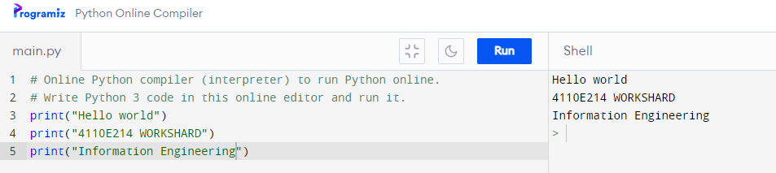
Interpreter 1

Slide 7
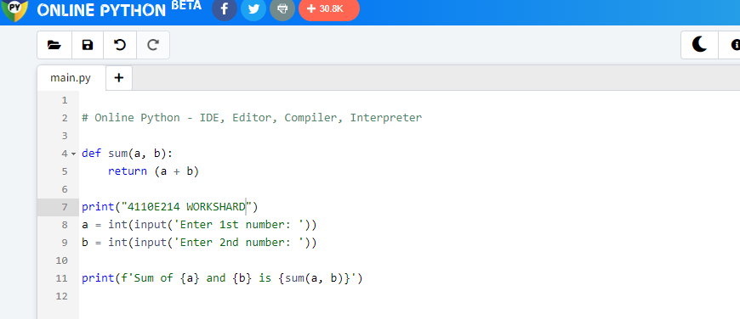
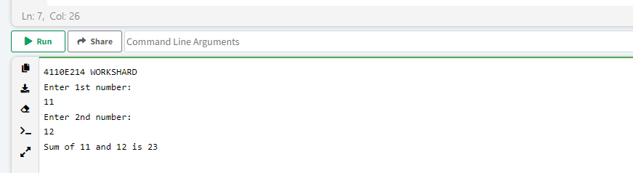
Interpreter 2

Slide 8
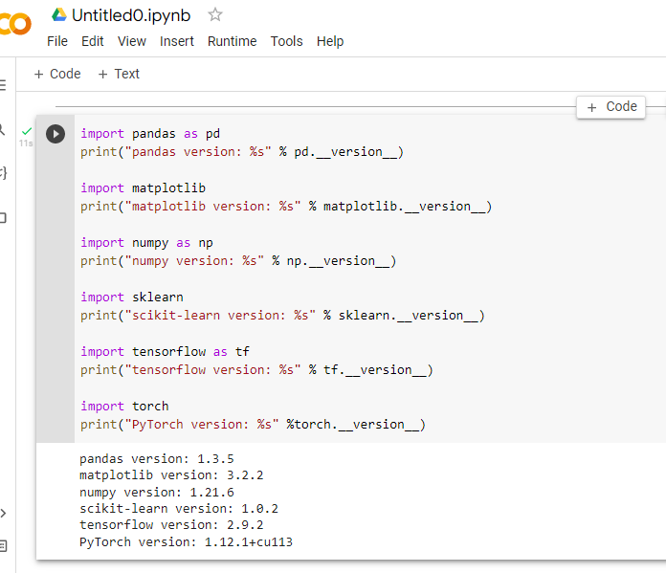
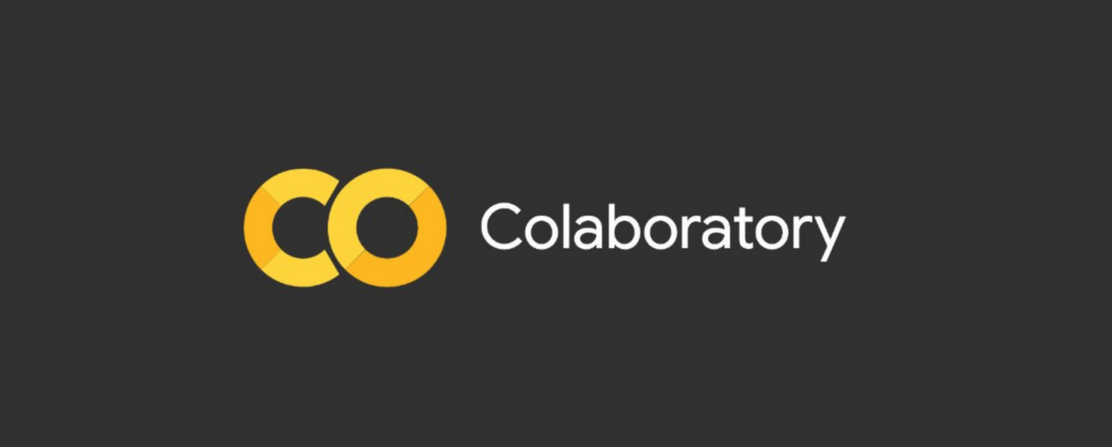

Python code

Slide 9
END

