Slide 1
My journal to python
VER.1
Irish d. deyto
艾芮絲
4110e214

Slide 2
Agenda: learning python
Introduction to python
Python Syntax
Python Data Types
Python Numbers
Python Casting
Python Strings
Python Booleans
Python Operators
Python Lists
Python Tuples
Python Sets
Python Dictionaries

Slide 3

What is Python?
Python is a popular programming language. It was created by Guido van Rossum, and released in 1991.
It is used for:
web development (server-side),
software development,
mathematics,
system scripting.

Slide 4
What can Python do?
Python can be used on a server to create web applications.
Python can be used alongside software to create workflows.
Python can connect to database systems. It can also read and modify files.
Python can be used to handle big data and perform complex mathematics.
Python can be used for rapid prototyping, or for production-ready software development.

Slide 5
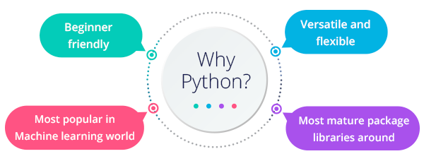
Why Python?
Python works on different platforms (Windows, Mac, Linux, Raspberry Pi, etc).
Python has a simple syntax similar to the English language.
Python has syntax that allows developers to write programs with fewer lines than some other programming languages.
Python runs on an interpreter system, meaning that code can be executed as soon as it is written. This means that prototyping can be very quick.
Python can be treated in a procedural way, an object-oriented way or a functional way.

Slide 6
Python Syntax compared to other programming languages
Python was designed for readability, and has some similarities to the English language with influence from mathematics.
Python uses new lines to complete a command, as opposed to other programming languages which often use semicolons or parentheses.
Python relies on indentation, using whitespace, to define scope; such as the scope of loops, functions and classes. Other programming languages often use curly-brackets for this purpose.

Slide 7
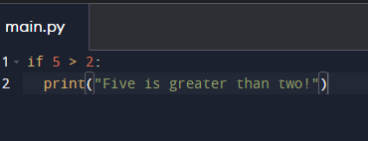

Python Indentation
Indentation refers to the spaces at the beginning of a code line.
Where in other programming languages the indentation in code is for readability only, the indentation in Python is very important.
Python uses indentation to indicate a block of code.
Example:

Slide 8
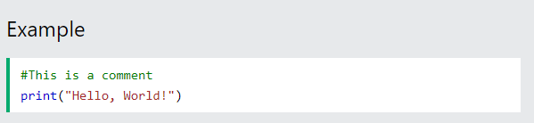
Python Comments
Comments can be used to explain Python code.
Comments can be used to make the code more readable.
Comments can be used to prevent execution when testing code.
Creating a Comment
Comments starts with a #, and Python will ignore them:

Slide 9
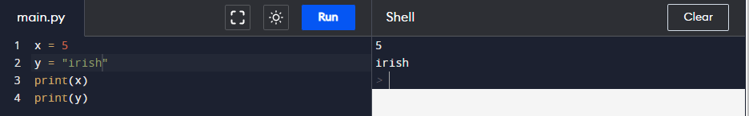
PythonVariables
Variables are containers for storing data values.
Creating Variables
Python has no command for declaring a variable.
A variable is created the moment you first assign a value to it.

Slide 10
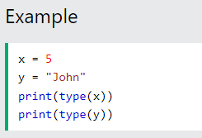
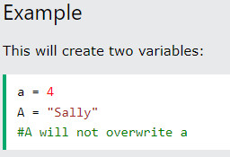
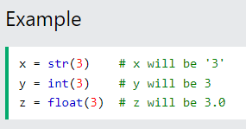
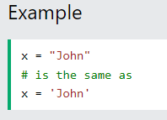
Casting
If you want to specify the data type of a variable, this can be done with casting.
Get the Type
You can get the data type of a variable with the type() function.
Case-Sensitive
Variable names are case-sensitive.
Single or Double Quotes?
String variables can be declared either by using single or double quotes:

Slide 11
Python - Variable Names
Variable Names
A variable can have a short name (like x and y) or a more descriptive name (age, carname, total_volume). Rules for Python variables:
A variable name must start with a letter or the underscore character
A variable name cannot start with a number
A variable name can only contain alpha-numeric characters and underscores (A-z, 0-9, and _ )
Variable names are case-sensitive (age, Age and AGE are three different variables)
Example
Legal variable names:
myvar = "John" my_var = "John" _my_var = "John" myVar = "John" MYVAR = "John" myvar2 = "John"
Example
Illegal variable names:
2myvar = "John" my-var = "John" my var = "John"
Remember that variable names are case-sensitive

Slide 12
Multi Words Variable Names
Variable names with more than one word can be difficult to read.
There are several techniques you can use to make them more readable:
Camel Case
Each word, except the first, starts with a capital letter:
myVariableName = “Riri“
Pascal Case
Each word starts with a capital letter:
MyVariableName = “Riri“
Snake Case
Each word is separated by an underscore character:
my_variable_name = “Riri"

Slide 13
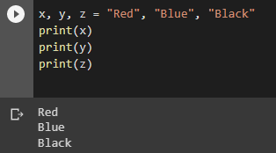
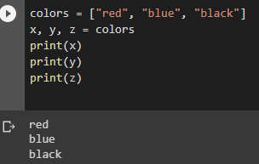
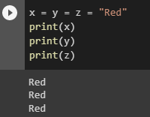
Python Variables - Assign Multiple Values
Many Values to Multiple Variables
Python allows you to assign values to multiple variables in one line:
One Value to Multiple Variables
And you can assign the same value to multiple variables in one line:
Unpack a Collection
If you have a collection of values in a list, tuple etc. Python allows you to extract the values into variables. This is called unpacking.

Slide 14

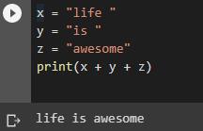
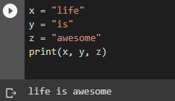
Python - Output Variables
Output Variables
The Python print() function is often used to output variables.
You can also use the + operator to output multiple variables:
Example
Example
In the print() function, you output multiple variables, separated by a comma:
Example
Notice the space character after "Python " and "is ", without them the result would be "Pythonisawesome".

Slide 15
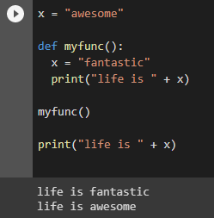
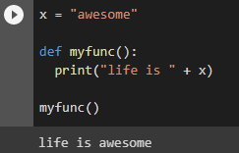
Python - Global Variables
If you create a variable with the same name inside a function, this variable will be local, and can only be used inside the function. The global variable with the same name will remain as it was, global and with the original value.
Global Variables
Variables that are created outside of a function (as in all of the examples above) are known as global variables.
Global variables can be used by everyone, both inside of functions and outside.
Example:
Create a variable inside a function, with the same name as the global variable
Example:
Create a variable outside of a function, and use it inside the function

Slide 16
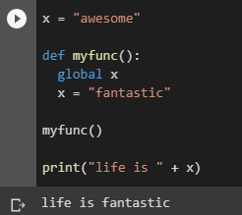
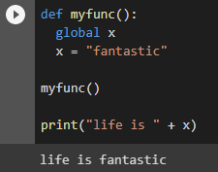
The global Keyword
Normally, when you create a variable inside a function, that variable is local, and can only be used inside that function.
To create a global variable inside a function, you can use the global keyword.
Example
If you use the global keyword, the variable belongs to the global scope:
Also, use the global keyword if you want to change a global variable inside a function.
Example
To change the value of a global variable inside a function, refer to the variable by using the global keyword:

Slide 17
Python Data Types

Slide 18
Built-in Data Types
In programming, data type is an important concept.
Variables can store data of different types, and different types can do different things.
Python has the following data types built-in by default, in these categories:
Text Type: str
Numeric Types: int, float, complex
Sequence Types: list, tuple, range
Mapping Type: dict
Set Types: set, frozenset
Boolean Type: bool
Binary Types: bytes, bytearray, memoryview
None Type: NoneType

Slide 19
Python Numbers

Slide 20
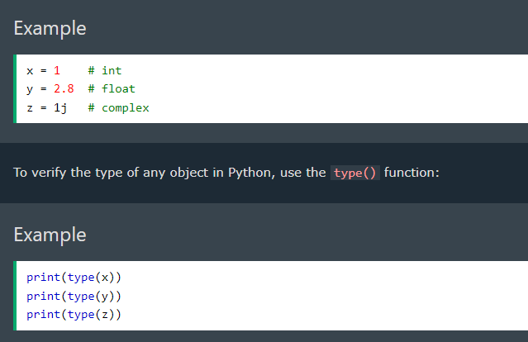
Python Numbers
There are three numeric types in Python:
int
float
Complex
Variables of numeric types are created when you assign a value to them:

Slide 21
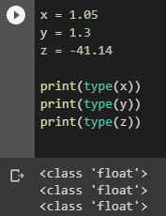
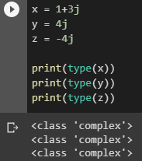
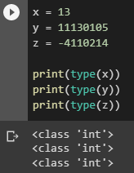
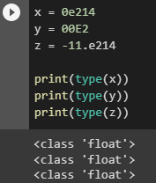
Int
Int, or integer, is a whole number, positive or negative, without decimals, of unlimited length.
Float
Float, or "floating point number" is a number, positive or negative, containing one or more decimals.
Complex
Complex numbers are written with a "j" as the imaginary part:
Float can also be scientific numbers with an "e" to indicate the power of 10.

Slide 22
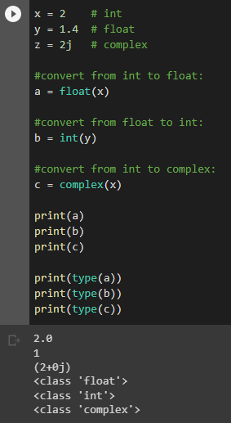
Type Conversion
You can convert from one type to another with the int(), float(), and complex() methods:
Example
Convert from one type to another:
Note: You cannot convert complex numbers into another number type
Random Number
Python does not have a random() function to make a random number, but Python has a built-in module called random that can be used to make random numbers.

Slide 23
Python Casting

Slide 24
Specify a Variable Type
There may be times when you want to specify a type on to a variable. This can be done with casting. Python is an object-orientated language, and as such it uses classes to define data types, including its primitive types.
Casting in python is therefore done using constructor functions:
int() - constructs an integer number from an integer literal, a float literal (by removing all decimals), or a string literal (providing the string represents a whole number)
float() - constructs a float number from an integer literal, a float literal or a string literal (providing the string represents a float or an integer)
str() - constructs a string from a wide variety of data types, including strings, integer literals and float literals

Slide 25
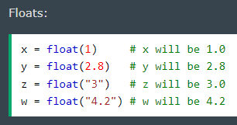
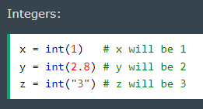
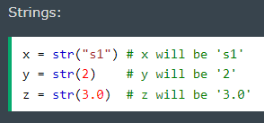
Example:

Slide 26
Python Strings

Slide 27

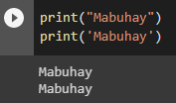
Strings
Strings in python are surrounded by either single quotation marks, or double quotation marks.
‘Mabuhay' is the same as “Mabuhay".
You can display a string literal with the print() function:
Assign String to a Variable
Assigning a string to a variable is done with the variable name followed by an equal sign and the string:

Slide 28
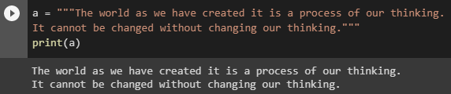
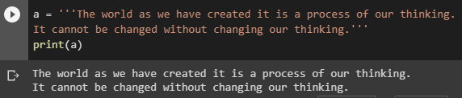
Multiline Strings
You can assign a multiline string to a variable by using three quotes:
” ” ”
’ ’ ’
Or three single quotes:
Note: in the result, the line breaks are inserted at the same position as in the code.

Slide 29

Strings are Arrays
Like many other popular programming languages, strings in Python are arrays of bytes representing unicode characters.
However, Python does not have a character data type, a single character is simply a string with a length of 1.
Square brackets can be used to access elements of the string.
Example:
Get the character at position 1 (remember that the first character has the position 0):

Slide 30

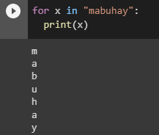
Looping Through a String
Since strings are arrays, we can loop through the characters in a string, with a for loop.
Example
Loop through the letters in the word “mabuhay":
String Length
To get the length of a string, use the len() function.
Example
The len() function returns the length of a string:

Slide 31

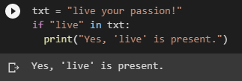
Check String
To check if a certain phrase or character is present in a string, we can use the keyword in.
Example
Check if “live" is present in the following text:
Use it in an if statement:
Example
Print only if “live" is present:

Slide 32

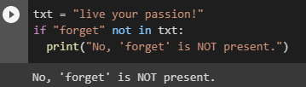
Check if NOT
To check if a certain phrase or character is NOT present in a string, we can use the keyword not in.
Example
Check if "expensive" is NOT present in the following text:
Use it in an if statement:
Example
print only if "expensive" is NOT present:

Slide 33

Python - Slicing Strings
Slicing
You can return a range of characters by using the slice syntax.
Specify the start index and the end index, separated by a colon, to return a part of the string.
Example:
Get the characters from position 2 to position 5 (not included):

Slide 34


Slice To the End
By leaving out the end index, the range will go to the end:
Example:
Get the characters from position 2, and all the way to the end:
Negative Indexing
Use negative indexes to start the slice from the end of the string:
Example
Get the characters:
From: "o" in "World!" (position -5)
To, but not included: "d" in "World!" (position -2):

Slide 35



Python - Modify Strings
Python has a set of built-in methods that you can use on strings.
Upper Case
Example:
The upper() method returns the string in upper case:
Lower Case
Example
The lower() method returns the string in lower case
Remove Whitespace
Whitespace is the space before and/or after the actual text, and very often you want to remove this space.
Example
The strip() method removes any whitespace from the beginning or the end:

Slide 36


Replace String
Example:
The replace() method replaces a string with another string:
Split String
The split() method returns a list where the text between the specified separator becomes the list items.
Example:
The split() method splits the string into substrings if it finds instances of the separator:

Slide 37
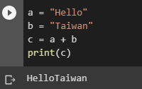
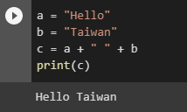
Python - String Concatenation
String Concatenation
To concatenate, or combine, two strings you can use the + operator.
Example
Merge variable a with variable b into variable c:
Example:
To add a space between them, add a " ":

Slide 38
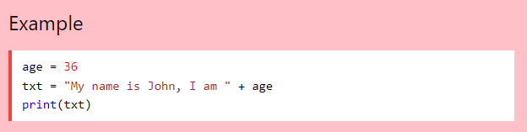
Python - Format - Strings
String Format
As we learned in the Python Variables chapter, we cannot combine strings and numbers like this:
But we can combine strings and numbers by using the format() method!
The format() method takes the passed arguments, formats them, and places them in the string where the placeholders {} are:

Slide 39
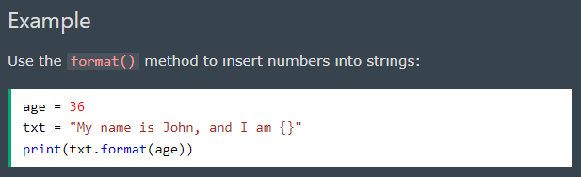
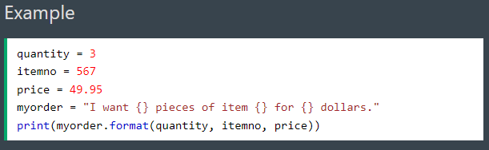
The format() method takes unlimited number of arguments, and are placed into the respective placeholders:

Slide 40
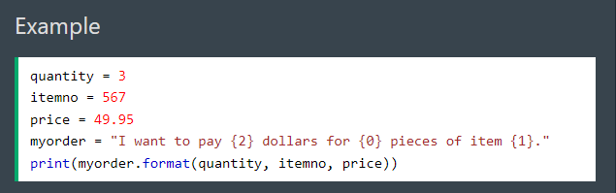
You can use index numbers {0} to be sure the arguments are placed in the correct placeholders:

Slide 41
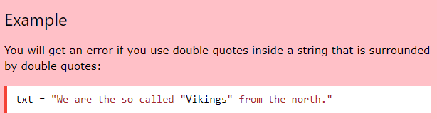
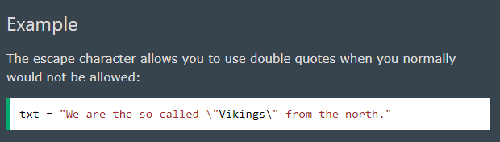
Python - Escape Characters
Escape Character
To insert characters that are illegal in a string, use an escape character.
An escape character is a backslash \ followed by the character you want to insert.
An example of an illegal character is a double quote inside a string that is surrounded by double quotes:
To fix this problem, use the escape character \":

Slide 42
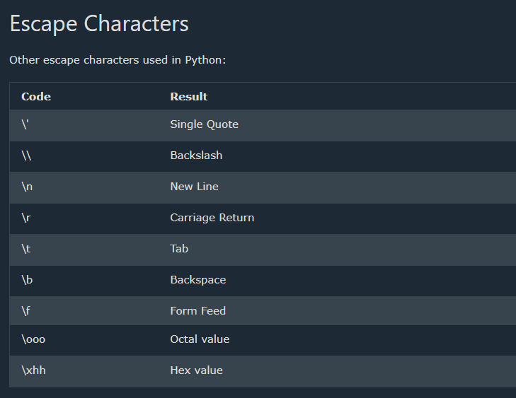

Slide 43

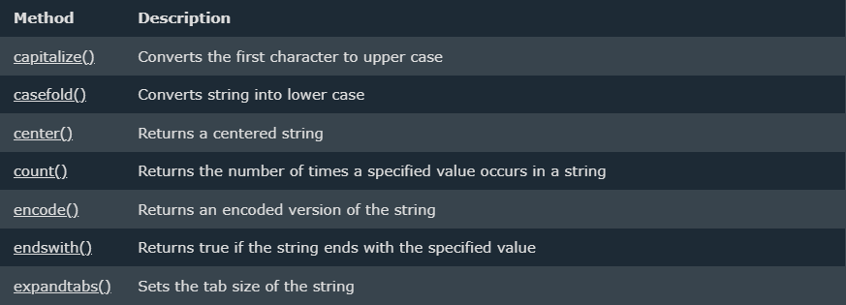
Python - String Methods
String Methods
Python has a set of built-in methods that you can use on strings.

Slide 44
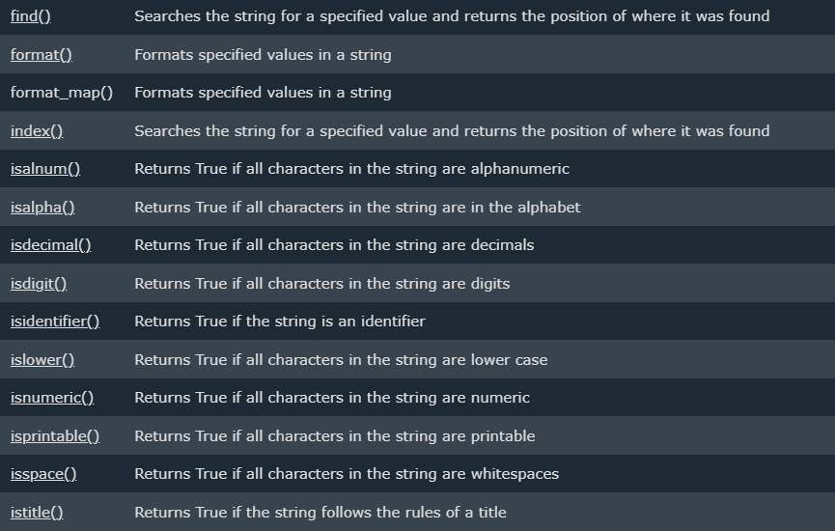

Slide 45
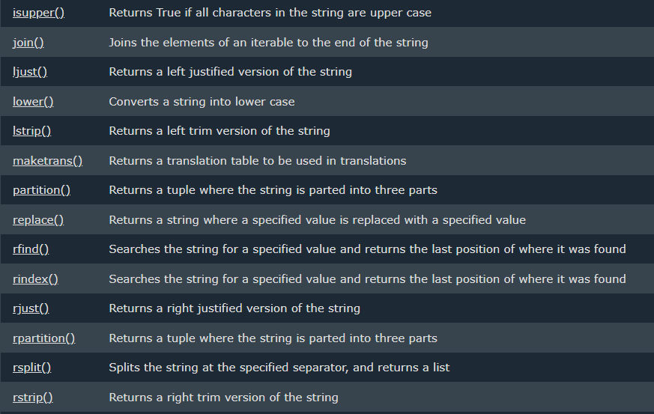

Slide 46
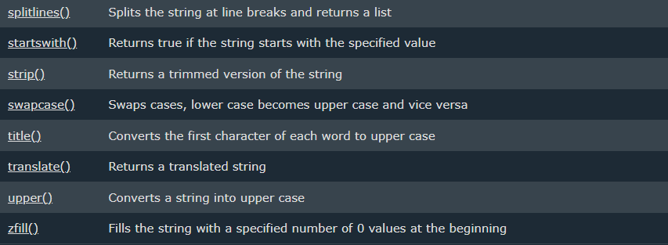

Slide 47
Python Booleans
Booleans represent one of two values: True or False.

Slide 48
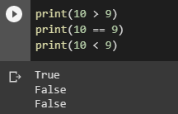
Boolean Values
In programming you often need to know if an expression is True or False.
You can evaluate any expression in Python, and get one of two answers, True or False.
When you compare two values, the expression is evaluated and Python returns the Boolean answer:
Example:

Slide 49
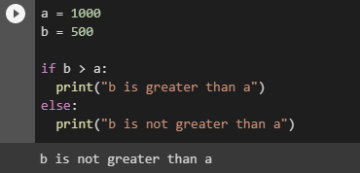
When you run a condition in an if statement, Python returns True or False:
Example
Print a message based on whether the condition is True or False:

Slide 50
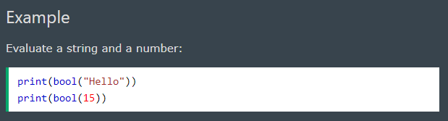
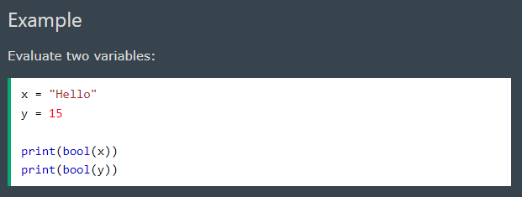
Evaluate Values and Variables
The bool() function allows you to evaluate any value, and give you True or False in return,

Slide 51
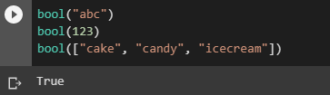
Most Values are True
Almost any value is evaluated to True if it has some sort of content.
Any string is True, except empty strings.
Any number is True, except 0.
Any list, tuple, set, and dictionary are True, except empty ones.
Example
The following will return True:

Slide 52

Some Values are False
In fact, there are not many values that evaluate to False, except empty values, such as (), [], {}, "", the number 0, and the value None. And of course the value False evaluates to False.
Example
The following will return False:

Slide 53

One more value, or object in this case, evaluates to False, and that is if you have an object that is made from a class with a __len__ function that returns 0 or False:
Example

Slide 54

Functions can Return a Boolean
You can create functions that returns a Boolean Value:
Example
Print the answer of a function:

Slide 55

You can execute code based on the Boolean answer of a function:
Example
Print "YES!" if the function returns True, otherwise print "NO!":

Slide 56

Python also has many built-in functions that return a boolean value, like the isinstance() function, which can be used to determine if an object is of a certain data type:
Example
Check if an object is an integer or not:

Slide 57
Python Operators

Slide 58

Python Operators
Operators are used to perform operations on variables and values.
In the example below, we use the + operator to add together two values:
Python divides the operators in the following groups:
Arithmetic operators
Assignment operators
Comparison operators
Logical operators
Identity operators
Membership operators
Bitwise operators

Slide 59

Python Arithmetic Operators
Arithmetic operators are used with numeric values to perform common mathematical operations:

Slide 60


Python Assignment Operators
Assignment operators are used to assign values to variables:

Slide 61

Python Comparison Operators
Comparison operators are used to compare two values:

Slide 62

Python Logical Operators
Logical operators are used to combine conditional statements:

Slide 63

Python Identity Operators
Identity operators are used to compare the objects, not if they are equal, but if they are actually the same object, with the same memory location:

Slide 64

Python Membership Operators
Membership operators are used to test if a sequence is presented in an object:

Slide 65

Python Bitwise Operators
Bitwise operators are used to compare (binary) numbers:

Slide 66
Python Lists

Slide 67

List
Lists are used to store multiple items in a single variable.
Lists are one of 4 built-in data types in Python used to store collections of data, the other 3 are Tuple, Set, and Dictionary, all with different qualities and usage.
Lists are created using square brackets:
Example
Create a List:

Slide 68
List Items
List items are ordered, changeable, and allow duplicate values.
List items are indexed, the first item has index [0], the second item has index [1] etc.
Ordered
When we say that lists are ordered, it means that the items have a defined order, and that order will not change.
If you add new items to a list, the new items will be placed at the end of the list.

Slide 69

Changeable
The list is changeable, meaning that we can change, add, and remove items in a list after it has been created.
Allow Duplicates
Since lists are indexed, lists can have items with the same value:
Example
Lists allow duplicate values:

Slide 70

Python - Access List Items
Access Items
List items are indexed and you can access them by referring to the index number:
Example
Print the second item of the list:

Slide 71

Negative Indexing
Negative indexing means start from the end
-1 refers to the last item, -2 refers to the second last item etc.
Example
Print the last item of the list:

Slide 72

Range of Indexes
You can specify a range of indexes by specifying where to start and where to end the range.
When specifying a range, the return value will be a new list with the specified items.
Example
Return the third, fourth, and fifth item:
Note: The search will start at index 2 (included) and end at index 5 (not included).
Remember that the first item has index 0.

Slide 73


By leaving out the start value, the range will start at the first item:
Example
This example returns the items from the beginning to, but NOT including, “rose":
By leaving out the end value, the range will go on to the end of the list:
Example
This example returns the items from “daisy" to the end:

Slide 74

Python - Change List Item
Change Item Value
To change the value of a specific item, refer to the index number:
Example
Change the second item:

Slide 75

Change a Range of Item Values
To change the value of items within a specific range, define a list with the new values, and refer to the range of index numbers where you want to insert the new values:
Example
Change the values “lily" and “sunflower" with the values “carnations" and “marigold":

Slide 76


If you insert more items than you replace, the new items will be inserted where you specified, and the remaining items will move accordingly:
Example
Change the second value by replacing it with two new values:
If you insert less items than you replace, the new items will be inserted where you specified, and the remaining items will move accordingly:
Example
Change the second and third value by replacing it with one value:

Slide 77

Insert Items
To insert a new list item, without replacing any of the existing values, we can use the insert() method.
The insert() method inserts an item at the specified index:
Example
Insert "watermelon" as the third item:

Slide 78

Python - Add List Items
Append Items
To add an item to the end of the list, use the append() method:
Example
Using the append() method to append an item:

Slide 79

Insert Items
To insert a list item at a specified index, use the insert() method.
The insert() method inserts an item at the specified index:
Example
Insert an item as the second position:

Slide 80

Extend List
To append elements from another list to the current list, use the extend() method.
Example
Add the elements of tropical to thislist:
The elements will be added to the end of the list.

Slide 81

Add Any Iterable
The extend() method does not have to append lists, you can add any iterable object (tuples, sets, dictionaries etc.).
Example
Add elements of a tuple to a list:

Slide 82

Python - Remove List Items
Remove Specified Item
The remove() method removes the specified item.
Example
Remove “lily":

Slide 83


Remove Specified Index
The pop() method removes the specified index.
Example
Remove the second item:
If you do not specify the index, the pop() method removes the last item.
Example
Remove the last item:

Slide 84


DELETE
The del keyword also removes the specified index:
Example
Remove the first item:
The del keyword can also delete the list completely.
Example
Delete the entire list:

Slide 85

Clear the List
The clear() method empties the list.
The list still remains, but it has no content.
Example
Clear the list content:

Slide 86

Python - Loop Lists
Loop Through a List
You can loop through the list items by using a for loop:
Example
Print all items in the list, one by one:

Slide 87

Loop Through the Index Numbers
You can also loop through the list items by referring to their index number.
Use the range() and len() functions to create a suitable iterable.
Example
Print all items by referring to their index number:
The iterable created in the example above is [0, 1, 2].

Slide 88

Using a While Loop
You can loop through the list items by using a while loop.
Use the len() function to determine the length of the list, then start at 0 and loop your way through the list items by referring to their indexes.
Remember to increase the index by 1 after each iteration.
Example
Print all items, using a while loop to go through all the index numbers

Slide 89

Looping Using List Comprehension
List Comprehension offers the shortest syntax for looping through lists:
Example
A short hand for loop that will print all items in a list:

Slide 90
Python - List Comprehension
List Comprehension
List comprehension offers a shorter syntax when you want to create a new list based on the values of an existing list.
Example:
Based on a list of fruits, you want a new list, containing only the fruits with the letter "a" in the name.
Without list comprehension you will have to write a for statement with a conditional test inside:

Slide 91


Example
With list comprehension you can do all that with only one line of code:
Example

Slide 92

The Syntax
The return value is a new list, leaving the old list unchanged.
Condition
The condition is like a filter that only accepts the items that valuate to True.
Example
Only accept items that are not “rose":

Slide 93

The condition if x != "apple" will return True for all elements other than “rose", making the new list contain all fruits except “rose".
The condition is optional and can be omitted:
Example
With no if statement:

Slide 94


Iterable
The iterable can be any iterable object, like a list, tuple, set etc.
Example
You can use the range() function to create an iterable:
Same example, but with a condition:
Example
Accept only numbers lower than 3:

Slide 95

Expression
The expression is the current item in the iteration, but it is also the outcome, which you can manipulate before it ends up like a list item in the new list:
You can set the outcome to whatever you like:

Slide 96


The expression can also contain conditions, not like a filter, but as a way to manipulate the outcome:
The expression in the example above says:
"Return the item if it is not banana, if it is banana return orange".

Slide 97


Python - Sort Lists
Sort List Alphanumerically
List objects have a sort() method that will sort the list alphanumerically, ascending, by default:

Slide 98


Sort Descending
To sort descending, use the keyword argument reverse = True:

Slide 99

Customize Sort Function
You can also customize your own function by using the keyword argument key = function.
The function will return a number that will be used to sort the list (the lowest number first):

Slide 100


Case Insensitive Sort
By default the sort() method is case sensitive, resulting in all capital letters being sorted before lower case letters:
Luckily we can use built-in functions as key functions when sorting a list.
So if you want a case-insensitive sort function, use str.lower as a key function:

Slide 101

Reverse Order
What if you want to reverse the order of a list, regardless of the alphabet?
The reverse() method reverses the current sorting order of the elements.

Slide 102
END OF VERSION 1

