Slide 1
My journal to python VER.2
Irish d. deyto
艾芮絲
4110e214

Slide 2
AGENDA
Python Lists
Python Tuples
Python Sets
Python Dictionaries
Python If ... Else
Python while loops
Python For Loops
Python Functions
Python lambda
Python arrays

Slide 3
Python Lists

Slide 4
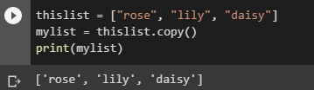
Python - Copy Lists
Copy a List
You cannot copy a list simply by typing list2 = list1, because: list2 will only be a reference to list1, and changes made in list1 will automatically also be made in list2.
There are ways to make a copy, one way is to use the built-in List method copy().
Example
Make a copy of a list with the copy() method:

Slide 5
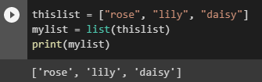
Example
Make a copy of a list with the list() method:

Slide 6
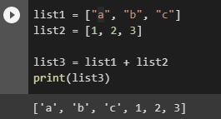
Python - Join Lists
Join Two Lists
There are several ways to join, or concatenate, two or more lists in Python.
One of the easiest ways are by using the + operator.
Example
Join two list:

Slide 7
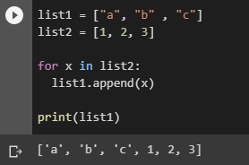
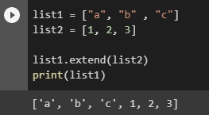
Another way to join two lists is by appending all the items from list2 into list1, one by one:
Example
Append list2 into list1:
Or you can use the extend() method, which purpose is to add elements from one list to another list:
Example
Use the extend() method to add list2 at the end of list1:

Slide 8
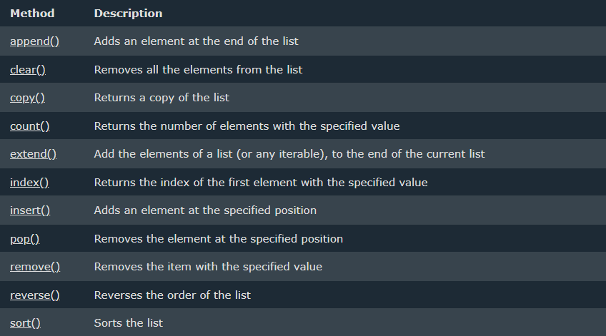
Python - List Methods
List Methods
Python has a set of built-in methods that you can use on lists.

Slide 9
Python Tuples

Slide 10

Tuple
Tuples are used to store multiple items in a single variable.
Tuple is one of 4 built-in data types in Python used to store collections of data, the other 3 are List, Set, and Dictionary, all with different qualities and usage.
A tuple is a collection which is ordered and unchangeable.
Tuples are written with round brackets.
Example
Create a Tuple:

Slide 11
Tuple Items
Tuple items are ordered, unchangeable, and allow duplicate values.
Tuple items are indexed, the first item has index [0], the second item has index [1] etc.
Ordered
When we say that tuples are ordered, it means that the items have a defined order, and that order will not change.

Slide 12

Unchangeable
Tuples are unchangeable, meaning that we cannot change, add or remove items after the tuple has been created.
Allow Duplicates
Since tuples are indexed, they can have items with the same value:
Example
Tuples allow duplicate values:

Slide 13

Tuple Length
To determine how many items a tuple has, use the len() function:
Example
Print the number of items in the tuple:

Slide 14
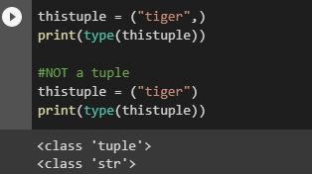
Create Tuple With One Item
To create a tuple with only one item, you have to add a comma after the item, otherwise Python will not recognize it as a tuple.
Example
One item tuple, remember the comma:

Slide 15

Tuple Items - Data Types
Tuple items can be of any data type:
Example
String, int and boolean data types:
A tuple can contain different data types:
Example
A tuple with strings, integers and boolean values:

Slide 16

type()
From Python's perspective, tuples are defined as objects with the data type 'tuple':
<class 'tuple’>
Example
What is the data type of a tuple?

Slide 17

The tuple() Constructor
It is also possible to use the tuple() constructor to make a tuple.
Example
Using the tuple() method to make a tuple:

Slide 18
Python Collections (Arrays)
There are four collection data types in the Python programming language:
List is a collection which is ordered and changeable. Allows duplicate members.
Tuple is a collection which is ordered and unchangeable. Allows duplicate members.
Set is a collection which is unordered, unchangeable*, and unindexed. No duplicate members.
Dictionary is a collection which is ordered** and changeable. No duplicate members.
*Set items are unchangeable, but you can remove and/or add items whenever you like.
**As of Python version 3.7, dictionaries are ordered. In Python 3.6 and earlier, dictionaries are unordered.
When choosing a collection type, it is useful to understand the properties of that type. Choosing the right type for a particular data set could mean retention of meaning, and, it could mean an increase in efficiency or security.

Slide 19

Python - Access Tuple Items
Access Tuple Items
You can access tuple items by referring to the index number, inside square brackets:
Example
Print the second item in the tuple:
Note: The first item has index 0.

Slide 20

Negative Indexing
Negative indexing means start from the end.
-1 refers to the last item, -2 refers to the second last item etc.
Example
Print the last item of the tuple:
end

Slide 21

Range of Indexes
You can specify a range of indexes by specifying where to start and where to end the range.
When specifying a range, the return value will be a new tuple with the specified items.
Example
Return the third, fourth, and fifth item:
Note: The search will start at index 2 (included) and end at index 5 (not included).
Remember that the first item has index 0.

Slide 22


By leaving out the start value, the range will start at the first item:
Example
This example returns the items from the beginning to, but NOT included, “dog":
By leaving out the end value, the range will go on to the end of the list:
Example
This example returns the items from "cherry" and to the end:

Slide 23

Range of Negative Indexes
Specify negative indexes if you want to start the search from the end of the tuple:
Example
This example returns the items from index -4 (included) to index -1 (excluded)

Slide 24
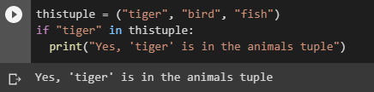
Check if Item Exists
To determine if a specified item is present in a tuple use the in keyword:
Example
Check if “tiger" is present in the tuple:

Slide 25
Python - Update Tuples
Tuples are unchangeable, meaning that you cannot change, add, or remove items once the tuple is created.
But there are some workarounds.

Slide 26
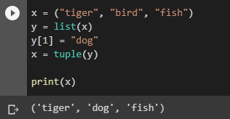
Change Tuple Values
Once a tuple is created, you cannot change its values. Tuples are unchangeable, or immutable as it also is called.
But there is a workaround. You can convert the tuple into a list, change the list, and convert the list back into a tuple.
Example
Convert the tuple into a list to be able to change it:

Slide 27
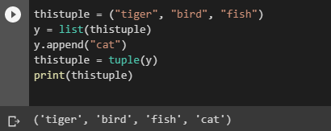
Add Items
Since tuples are immutable, they do not have a build-in append() method, but there are other ways to add items to a tuple.
1. Convert into a list: Just like the workaround for changing a tuple, you can convert it into a list, add your item(s), and convert it back into a tuple.
Example
Convert the tuple into a list, add “cat", and convert it back into a tuple:

Slide 28
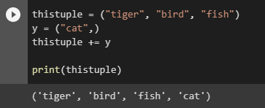
2. Add tuple to a tuple. You are allowed to add tuples to tuples, so if you want to add one item, (or many), create a new tuple with the item(s), and add it to the existing tuple:
Example
Create a new tuple with the value "orange", and add that tuple:
Note: When creating a tuple with only one item, remember to include a comma after the item, otherwise it will not be identified as a tuple.

Slide 29
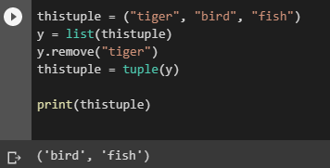
Remove Items
Note: You cannot remove items in a tuple.
Tuples are unchangeable, so you cannot remove items from it, but you can use the same workaround as we used for changing and adding tuple items:
Example
Convert the tuple into a list, remove "apple", and convert it back into a tuple:

Slide 30
Or you can delete the tuple completely:
Example
The del keyword can delete the tuple completely:
thistuple = ("apple", "banana", "cherry")
del thistuple
print(thistuple) #this will raise an error because the tuple no longer exists

Slide 31
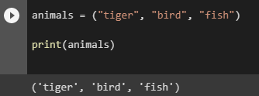
Python - Unpack Tuples
Unpacking a Tuple
When we create a tuple, we normally assign values to it. This is called "packing" a tuple:
Example
Packing a tuple:

Slide 32
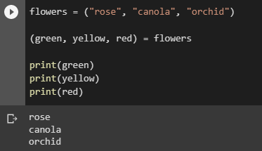
But, in Python, we are also allowed to extract the values back into variables. This is called "unpacking":
Example
Unpacking a tuple:
Note: The number of variables must match the number of values in the tuple, if not, you must use an asterisk to collect the remaining values as a list.

Slide 33
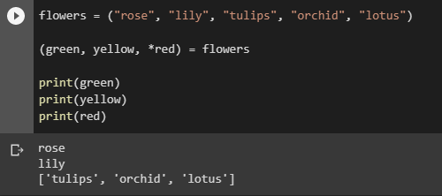
Using Asterisk*
If the number of variables is less than the number of values, you can add an * to the variable name and the values will be assigned to the variable as a list:
Example
Assign the rest of the values as a list called "red":

Slide 34
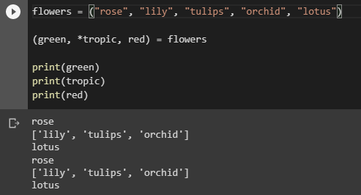
If the asterisk is added to another variable name than the last, Python will assign values to the variable until the number of values left matches the number of variables left.
Example
Add a list of values the "tropic" variable:

Slide 35
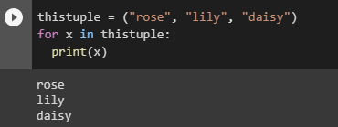
Python - Loop Tuples
Loop Through a Tuple
You can loop through the tuple items by using a for loop.
Example
Iterate through the items and print the values:

Slide 36
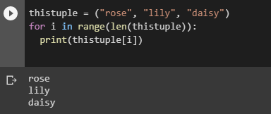
Loop Through the Index Numbers
You can also loop through the tuple items by referring to their index number.
Use the range() and len() functions to create a suitable iterable.
Example
Print all items by referring to their index number:

Slide 37
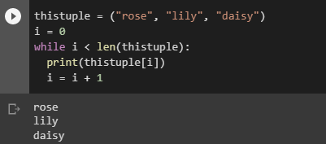
Using a While Loop
You can loop through the list items by using a while loop.
Use the len() function to determine the length of the tuple, then start at 0 and loop your way through the tuple items by refering to their indexes.
Remember to increase the index by 1 after each iteration.
Example
Print all items, using a while loop to go through all the index numbers:

Slide 38
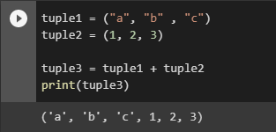
Python - Join Tuples
Join Two Tuples
To join two or more tuples you can use the + operator:
Example
Join two tuples:

Slide 39
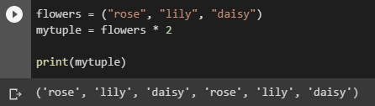
Multiply Tuples
If you want to multiply the content of a tuple a given number of times, you can use the * operator:
Example
Multiply the fruits tuple by 2:

Slide 40
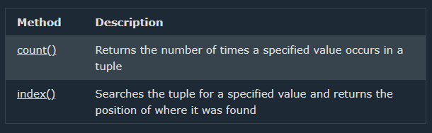
Python - Tuple Methods
Tuple Methods
Python has two built-in methods that you can use on tuples.

Slide 41
Python Sets

Slide 42

Set
Sets are used to store multiple items in a single variable.
Set is one of 4 built-in data types in Python used to store collections of data, the other 3 are List, Tuple, and Dictionary, all with different qualities and usage.
A set is a collection which is unordered, unchangeable*, and unindexed.
* Note: Set items are unchangeable, but you can remove items and add new items.
Sets are written with curly brackets.
Example
Create a Set:
Note: Sets are unordered, so you cannot be sure in which order the items will appear.

Slide 43
Set Items
Set items are unordered, unchangeable, and do not allow duplicate values.
Unordered
Unordered means that the items in a set do not have a defined order.
Set items can appear in a different order every time you use them, and cannot be referred to by index or key.
Unchangeable
Set items are unchangeable, meaning that we cannot change the items after the set has been created.
Once a set is created, you cannot change its items, but you can remove items and add new items.

Slide 44
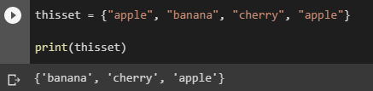
Duplicates Not Allowed
Sets cannot have two items with the same value.
Example
Duplicate values will be ignored:

Slide 45
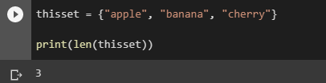
Get the Length of a Set
To determine how many items a set has, use the len() function.
Example
Get the number of items in a set:

Slide 46
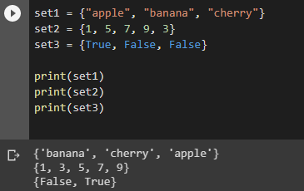
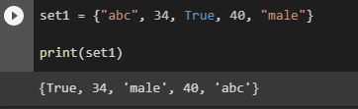
Set Items - Data Types
Set items can be of any data type:
Example
String, int and boolean data types:
A set can contain different data types:
Example
A set with strings, integers and boolean values:

Slide 47

type()
From Python's perspective, sets are defined as objects with the data type 'set':
<class 'set’>
Example
What is the data type of a set?

Slide 48
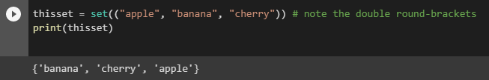
The set() Constructor
It is also possible to use the set() constructor to make a set.
Example
Using the set() constructor to make a set:

Slide 49
Python Collections (Arrays)
There are four collection data types in the Python programming language:
List is a collection which is ordered and changeable. Allows duplicate members.
Tuple is a collection which is ordered and unchangeable. Allows duplicate members.
Set is a collection which is unordered, unchangeable*, and unindexed. No duplicate members.
Dictionary is a collection which is ordered** and changeable. No duplicate members.
*Set items are unchangeable, but you can remove items and add new items.
**As of Python version 3.7, dictionaries are ordered. In Python 3.6 and earlier, dictionaries are unordered.
When choosing a collection type, it is useful to understand the properties of that type. Choosing the right type for a particular data set could mean retention of meaning, and, it could mean an increase in efficiency or security.

Slide 50
Python Dictionaries

Slide 51
Dictionary
Dictionaries are used to store data values in key:value pairs.
A dictionary is a collection which is ordered*, changeable and do not allow duplicates.
As of Python version 3.7, dictionaries are ordered. In Python 3.6 and earlier, dictionaries are unordered.
Dictionaries are written with curly brackets, and have keys and values:

Slide 52
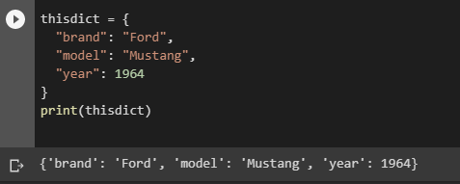
Example
Create and print a dictionary:

Slide 53
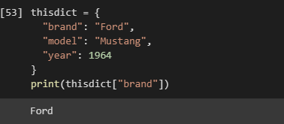
Dictionary Items
Dictionary items are ordered, changeable, and does not allow duplicates.
Dictionary items are presented in key:value pairs, and can be referred to by using the key name.
Example
Print the "brand" value of the dictionary:

Slide 54
Ordered or Unordered?
As of Python version 3.7, dictionaries are ordered. In Python 3.6 and earlier, dictionaries are unordered.
When we say that dictionaries are ordered, it means that the items have a defined order, and that order will not change.
Unordered means that the items does not have a defined order, you cannot refer to an item by using an index.
Changeable
Dictionaries are changeable, meaning that we can change, add or remove items after the dictionary has been created.

Slide 55
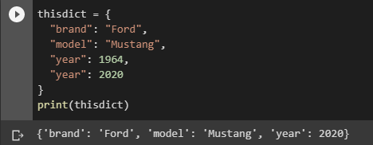
Duplicates Not Allowed
Dictionaries cannot have two items with the same key:
Example
Duplicate values will overwrite existing values:

Slide 56
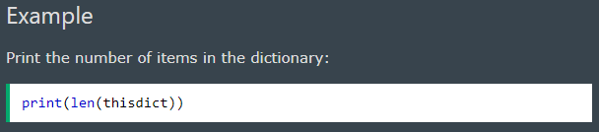
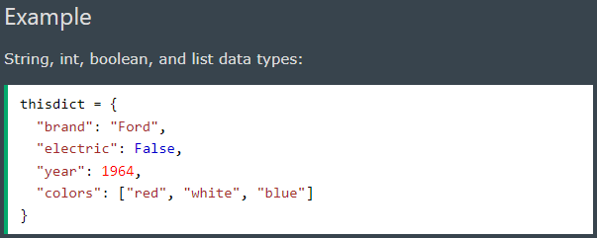
Dictionary Length
To determine how many items a dictionary has, use the len() function:
Dictionary Items - Data Types
The values in dictionary items can be of any data type:

Slide 57
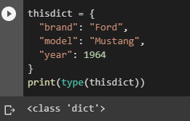
type()
From Python's perspective, dictionaries are defined as objects with the data type 'dict':
<class 'dict’>
Example
Print the data type of a dictionary:

Slide 58
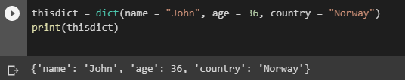
The dict() Constructor
It is also possible to use the dict() constructor to make a dictionary.
Example
Using the dict() method to make a dictionary:

Slide 59
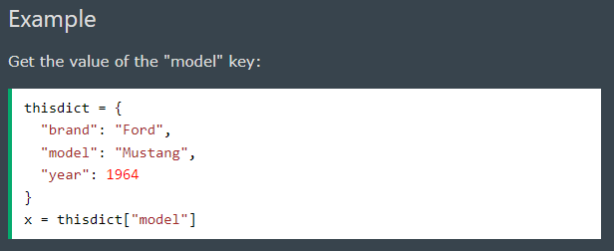
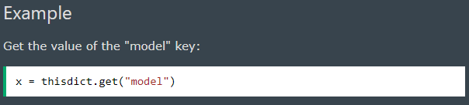
Python - Access Dictionary Items
Accessing Items
You can access the items of a dictionary by referring to its key name, inside square brackets:
There is also a method called get() that will give you the same result:

Slide 60
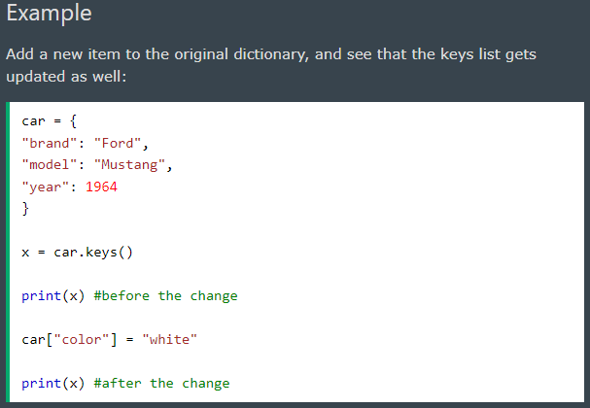
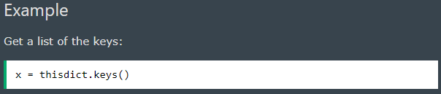
Get Keys
The keys() method will return a list of all the keys in the dictionary.
The list of the keys is a view of the dictionary, meaning that any changes done to the dictionary will be reflected in the keys list.

Slide 61
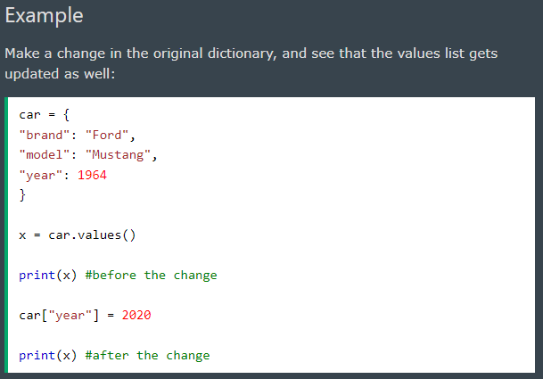
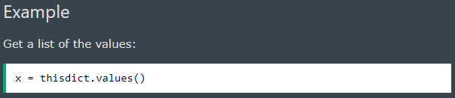
Get Values
The values() method will return a list of all the values in the dictionary.
The list of the values is a view of the dictionary, meaning that any changes done to the dictionary will be reflected in the values list.

Slide 62
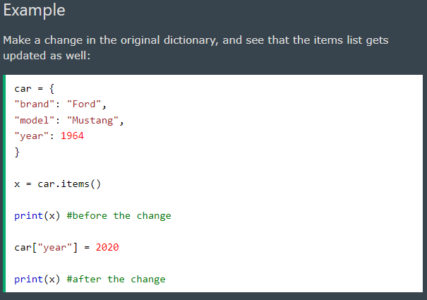
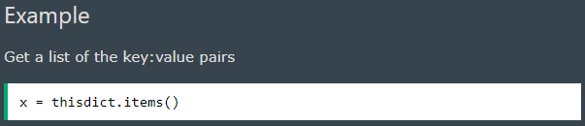
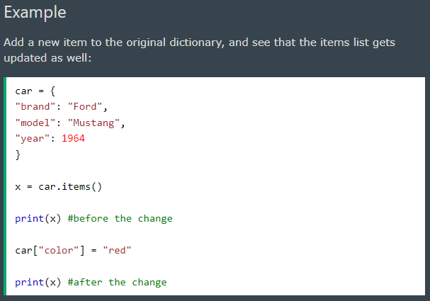
Get Items
The items() method will return each item in a dictionary, as tuples in a list.
The returned list is a view of the items of the dictionary, meaning that any changes done to the dictionary will be reflected in the items list.

Slide 63
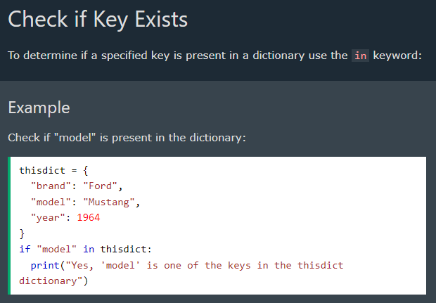

Slide 64
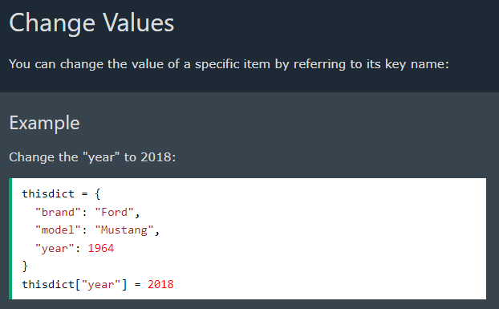
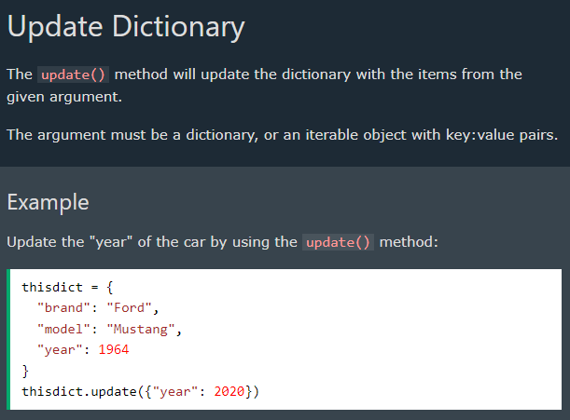
Python - Change Dictionary Items

Slide 65
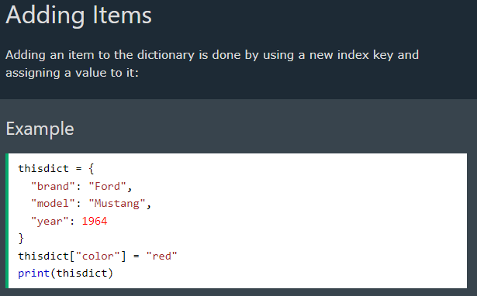
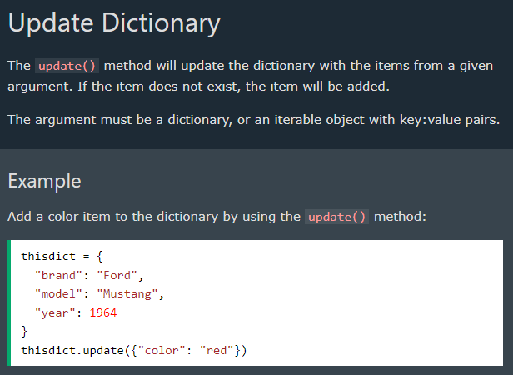
Python - Add Dictionary Items

Slide 66
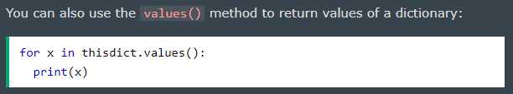
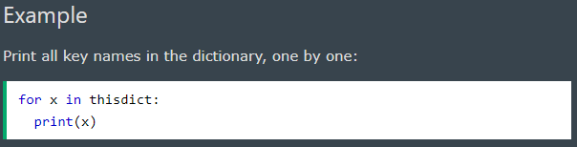



Python - Loop Dictionaries
Loop Through a Dictionary
You can loop through a dictionary by using a for loop.
When looping through a dictionary, the return value are the keys of the dictionary, but there are methods to return the values as well.

Slide 67
Python If ... Else

Slide 68

Python Conditions and If statements
Python supports the usual logical conditions from mathematics:
Equals: a == b
Not Equals: a != b
Less than: a < b
Less than or equal to: a <= b
Greater than: a > b
Greater than or equal to: a >= b
These conditions can be used in several ways, most commonly in "if statements" and loops.
An "if statement" is written by using the if keyword.

Slide 69

Elif
The elif keyword is pythons way of saying "if the previous conditions were not true, then try this condition".
In this example a is equal to b, so the first condition is not true, but the elif condition is true, so we print to screen that "a and b are equal".

Slide 70


Else
The else keyword catches anything which isn't caught by the preceding conditions.
In this example a is greater than b, so the first condition is not true, also the elif condition is not true, so we go to the else condition and print to screen that "a is greater than b".
You can also have an else without the elif:

Slide 71


Short Hand If
If you have only one statement to execute, you can put it on the same line as the if statement.
Short Hand If ... Else
If you have only one statement to execute, one for if, and one for else, you can put it all on the same line:
This technique is known as Ternary Operators, or Conditional Expressions.

Slide 72


You can also have multiple else statements on the same line:
And
The and keyword is a logical operator, and is used to combine conditional statements:

Slide 73


Or
The or keyword is a logical operator, and is used to combine conditional statements:
Nested If
You can have if statements inside if statements, this is called nested if statements.

Slide 74

The pass Statement
if statements cannot be empty, but if you for some reason have an if statement with no content, put in the pass statement to avoid getting an error.

Slide 75
Python While Loops

Slide 76
Python Loops
Python has two primitive loop commands:
while loops
for loops
The while Loop
With the while loop we can execute a set of statements as long as a condition is true.

Slide 77

Note: remember to increment i, or else the loop will continue forever.
The while loop requires relevant variables to be ready, in this example we need to define an indexing variable, i, which we set to 1.

Slide 78



The break Statement
With the break statement we can stop the loop even if the while condition is true:
The continue Statement
With the continue statement we can stop the current iteration, and continue with the next:
The else Statement
With the else statement we can run a block of code once when the condition no longer is true:

Slide 79

Python For Loops
Python For Loops
A for loop is used for iterating over a sequence (that is either a list, a tuple, a dictionary, a set, or a string).
This is less like the for keyword in other programming languages, and works more like an iterator method as found in other object-orientated programming languages.
With the for loop we can execute a set of statements, once for each item in a list, tuple, set etc.
The for loop does not require an indexing variable to set beforehand.

Slide 80

Looping Through a String
Even strings are iterable objects, they contain a sequence of characters:
Example
Loop through the letters in the word "banana":
The break Statement
With the break statement we can stop the loop before it has looped through all the items:
Example
Exit the loop when x is "banana":

Slide 81


The continue Statement
With the continue statement we can stop the current iteration of the loop, and continue with the next:
Else in For Loop
The else keyword in a for loop specifies a block of code to be executed when the loop is finished:

Slide 82


Nested Loops
A nested loop is a loop inside a loop.
The "inner loop" will be executed one time for each iteration of the "outer loop":
Example
Print each adjective for every fruit:
The pass Statement
for loops cannot be empty, but if you for some reason have a for loop with no content, put in the pass statement to avoid getting an error.

Slide 83
Python Functions
A function is a block of code which only runs when it is called.
You can pass data, known as parameters, into a function.
A function can return data as a result.

Slide 84


Creating a Function
In Python a function is defined using the def keyword:
Calling a Function
To call a function, use the function name followed by parenthesis:

Slide 85

Arguments
Information can be passed into functions as arguments.
Arguments are specified after the function name, inside the parentheses. You can add as many arguments as you want, just separate them with a comma.
The following example has a function with one argument (fname). When the function is called, we pass along a first name, which is used inside the function to print the full name:
Example
Arguments are often shortened to args in Python documentations.

Slide 86

Parameters or Arguments?
The terms parameter and argument can be used for the same thing: information that are passed into a function.
From a function's perspective:
A parameter is the variable listed inside the parentheses in the function definition.
An argument is the value that is sent to the function when it is called.
Number of Arguments
By default, a function must be called with the correct number of arguments. Meaning that if your function expects 2 arguments, you have to call the function with 2 arguments, not more, and not less.
If you try to call the function with 1 or 3 arguments, you will get an error

Slide 87

Arbitrary Arguments, *args
If you do not know how many arguments that will be passed into your function, add a * before the parameter name in the function definition.
This way the function will receive a tuple of arguments, and can access the items accordingly:
Example
If the number of arguments is unknown, add a * before the parameter name:
Arbitrary Arguments are often shortened to *args in Python documentations.

Slide 88

Recursion
Python also accepts function recursion, which means a defined function can call itself.
Recursion is a common mathematical and programming concept. It means that a function calls itself. This has the benefit of meaning that you can loop through data to reach a result.
The developer should be very careful with recursion as it can be quite easy to slip into writing a function which never terminates, or one that uses excess amounts of memory or processor power. However, when written correctly recursion can be a very efficient and mathematically-elegant approach to programming.
In this example, tri_recursion() is a function that we have defined to call itself ("recurse"). We use the k variable as the data, which decrements (-1) every time we recurse. The recursion ends when the condition is not greater than 0 (i.e. when it is 0).
To a new developer it can take some time to work out how exactly this works, best way to find out is by testing and modifying it.

Slide 89
Python Lambda
A lambda function is a small anonymous function.
A lambda function can take any number of arguments, but can only have one expression.

Slide 90


Syntax
lambda arguments : expression
The expression is executed and the result is returned:
Example
Add 5 to argument a, and return the result:
Lambda functions can take any number of arguments:
Example
Multiply argument a with argument b and return the result:

Slide 91

Why Use Lambda Functions?
The power of lambda is better shown when you use them as an anonymous function inside another function.
Say you have a function definition that takes one argument, and that argument will be multiplied with an unknown number:
def myfunc(n):
return lambda a : a * n
Use that function definition to make a function that always doubles the number you send in:

Slide 92


Or, use the same function definition to make a function that always triples the number you send in:
Or, use the same function definition to make both functions, in the same program:
Use lambda functions when an anonymous function is required for a short period of time.

Slide 93
Python Arrays
Note: Python does not have built-in support for Arrays, but Python Lists can be used instead.

Slide 94

What is an Array?
An array is a special variable, which can hold more than one value at a time.
If you have a list of items (a list of car names, for example), storing the cars in single variables could look like this:
car1 = "Ford"
car2 = "Volvo"
car3 = "BMW“
However, what if you want to loop through the cars and find a specific one? And what if you had not 3 cars, but 300?
The solution is an array!
An array can hold many values under a single name, and you can access the values by referring to an index number.
Arrays
Note: This page shows you how to use LISTS as ARRAYS, however, to work with arrays in Python you will have to import a library, like the NumPy library.
Arrays are used to store multiple values in one single variable:
Example
Create an array containing car names:

Slide 95


Access the Elements of an Array
You refer to an array element by referring to the index number.
Example
Get the value of the first array item:
Example
Modify the value of the first array item:

Slide 96

The Length of an Array
Use the len() method to return the length of an array (the number of elements in an array).
Example
Return the number of elements in the cars array:
Note: The length of an array is always one more than the highest array index.

Slide 97


Looping Array Elements
You can use the for in loop to loop through all the elements of an array.
Example
Print each item in the flowers array:
Adding Array Elements
You can use the append() method to add an element to an array.
Example
Add one more element to the cars array:

Slide 98


Removing Array Elements
You can use the pop() method to remove an element from the array.
Example
Delete the second element of the flowers array:
You can also use the remove() method to remove an element from the array.
Example
Delete the element that has the value "Volvo":
Note: The list's remove() method only removes the first occurrence of the specified value.

Slide 99

Array Methods
Python has a set of built-in methods that you can use on lists/arrays.
Note: Python does not have built-in support for Arrays, but Python Lists can be used instead.

Slide 100
MY JOURNAL TO PYTHON
-END-

