Slide 1
HTTP

Slide 2
AGENDA

Slide 3
<!DOCTYPE html>\n <html lang="en">\n <head>\n <meta charset="utf-8">\n <meta http-equiv="X-UA-Compatible" content="IE=edge">\n <meta name="viewport" content="width=device-width, initial-scale=1">\n <!-- The above 3 meta tags *must* come first in the head; any other head content must come *after* these tags -->\n <meta name="description" content="">\n <meta name="author" content="">\n \n <title>Pycone 松果城市</title>\n\n <!-- Bootstrap core CSS -->\n <link href="bootstrap.min.css" rel="stylesheet">\n\n <!-- IE10 viewport hack for Surface/desktop Windows 8 bug -->\n <link href="https://getbootstrap.com/assets/css/ie10-viewport-bug-workaround.css" rel="stylesheet">\n\n <!-- Custom styles for this template -->\n <link href="https://getbootstrap.com/examples/sticky-footer/sticky-footer.css" rel="stylesheet">\n\n <!-- Just for debugging purposes. Don\'t actually copy these 2 lines! -->\n <!--[if lt IE 9]><script src="../../assets/js/ie8-responsive

Slide 4
HTTP request methods HTTP 1.1
HTTP defines a set of request methods to indicate the desired action to be performed for a given resource. Although they can also be nouns, these request methods are sometimes referred to as HTTP verbs. Each of them implements a different semantic, but some common features are shared by a group of them: e.g. a request method can be safe, idempotent, or cacheable.

Slide 5
GET
The GET method requests a representation of the specified resource. Requests using GET should only retrieve data.
HEAD
The HEAD method asks for a response identical to a GET request, but without the response body.
POST

Slide 6
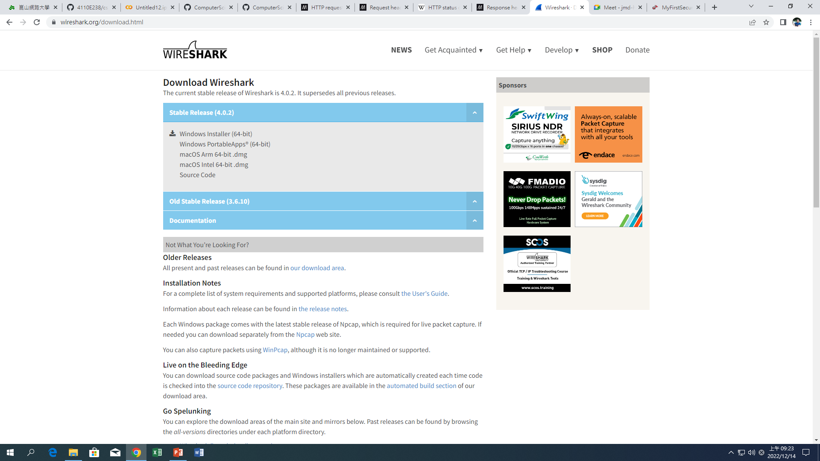

Slide 7
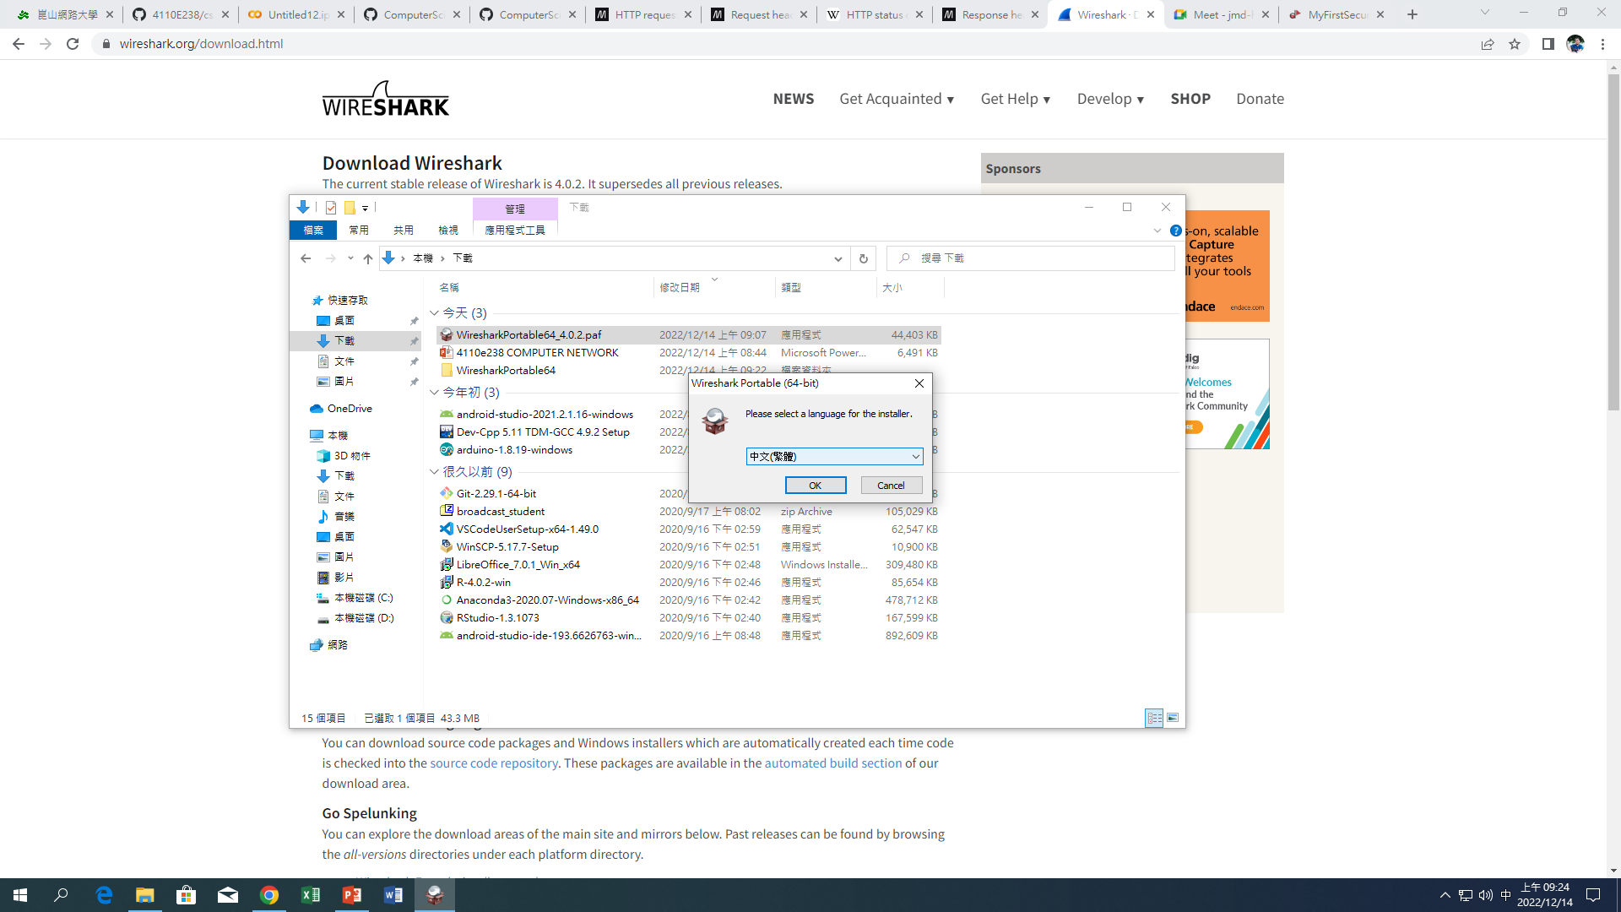

Slide 8
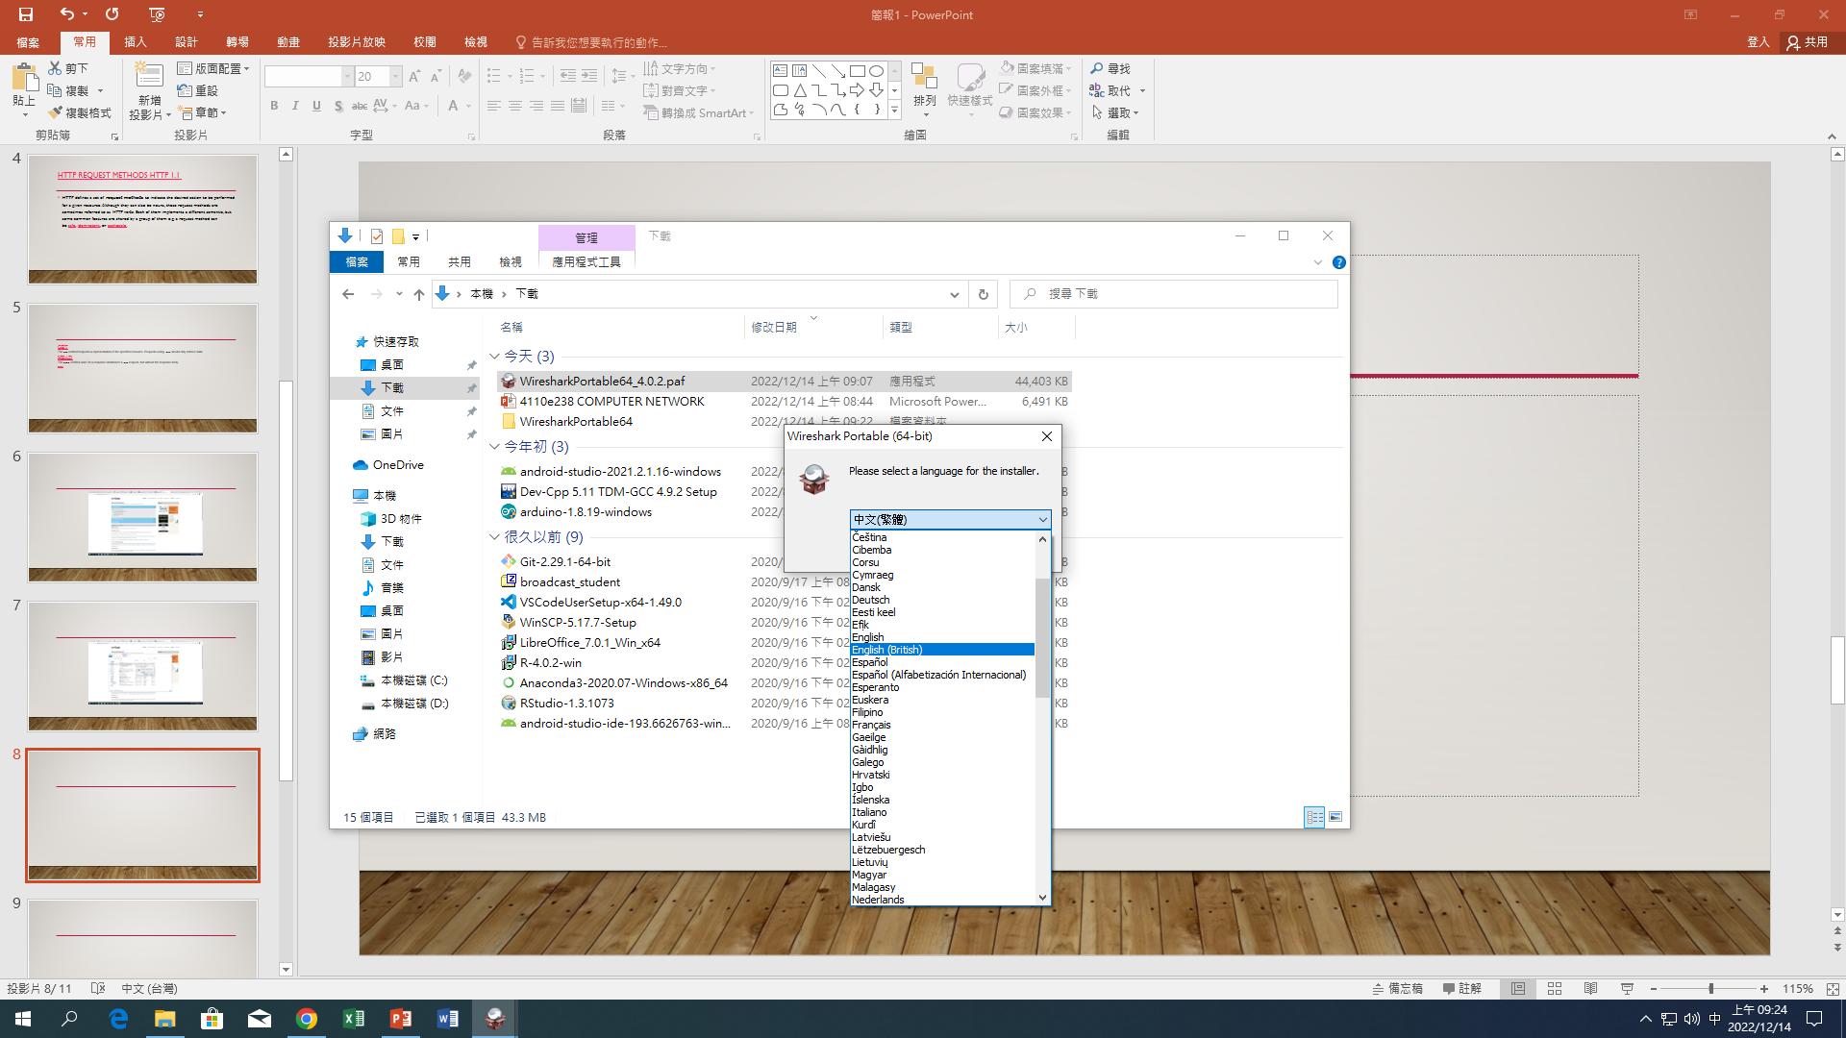

Slide 9
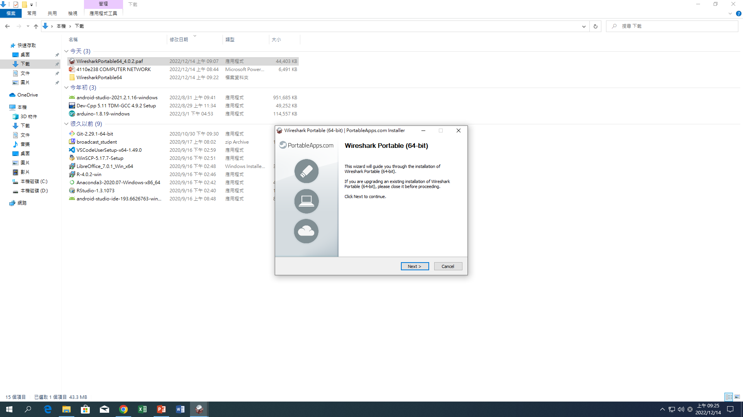

Slide 10
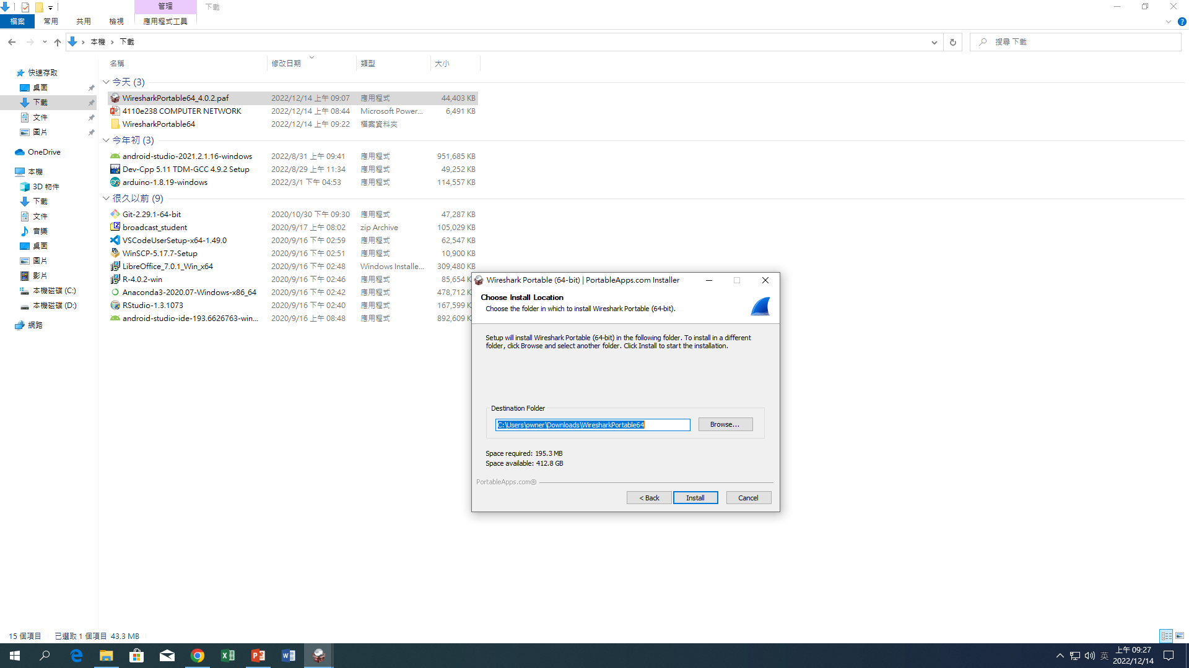

Slide 11
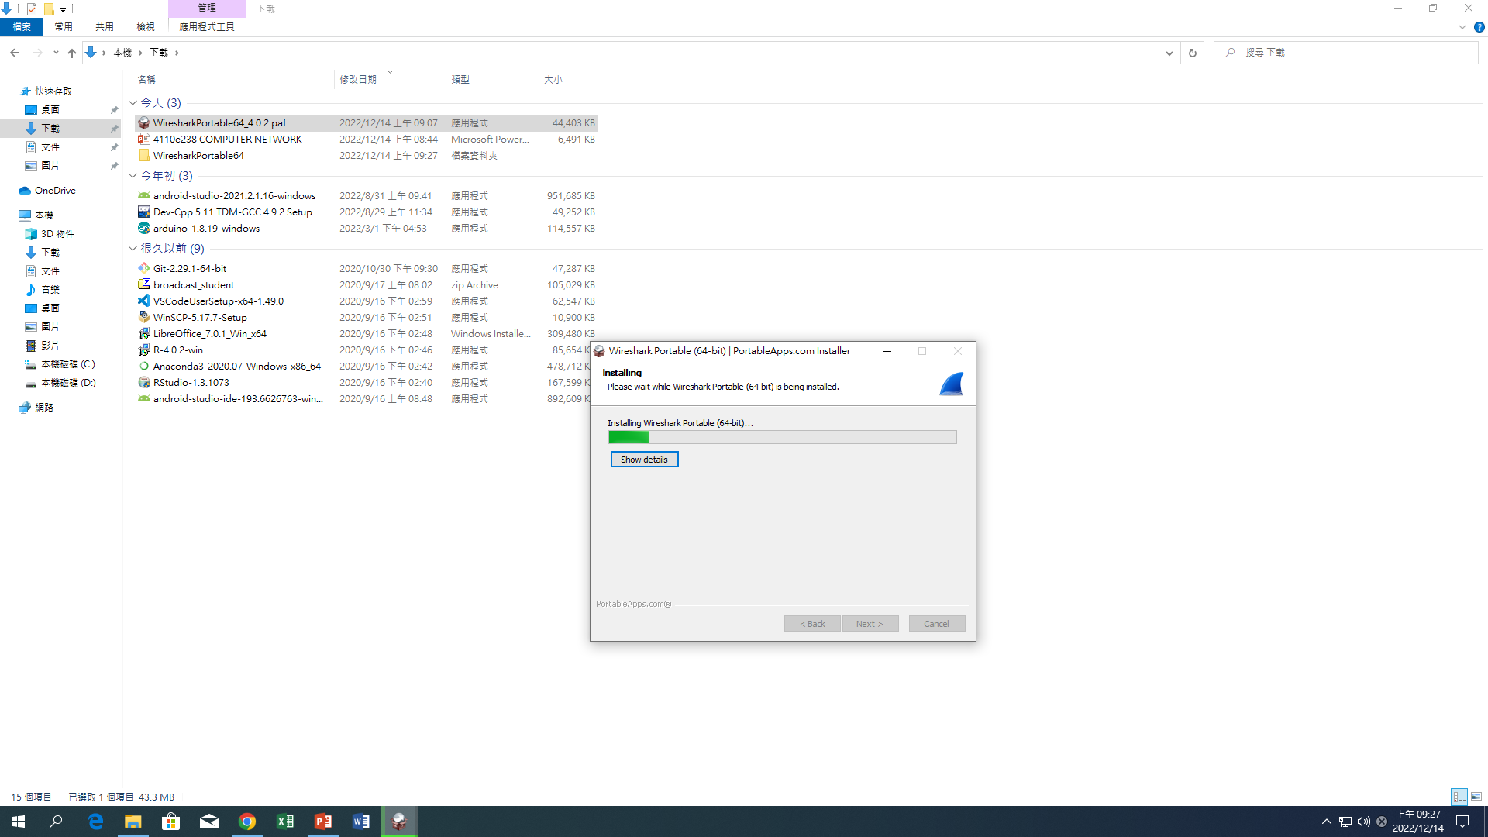

Slide 12
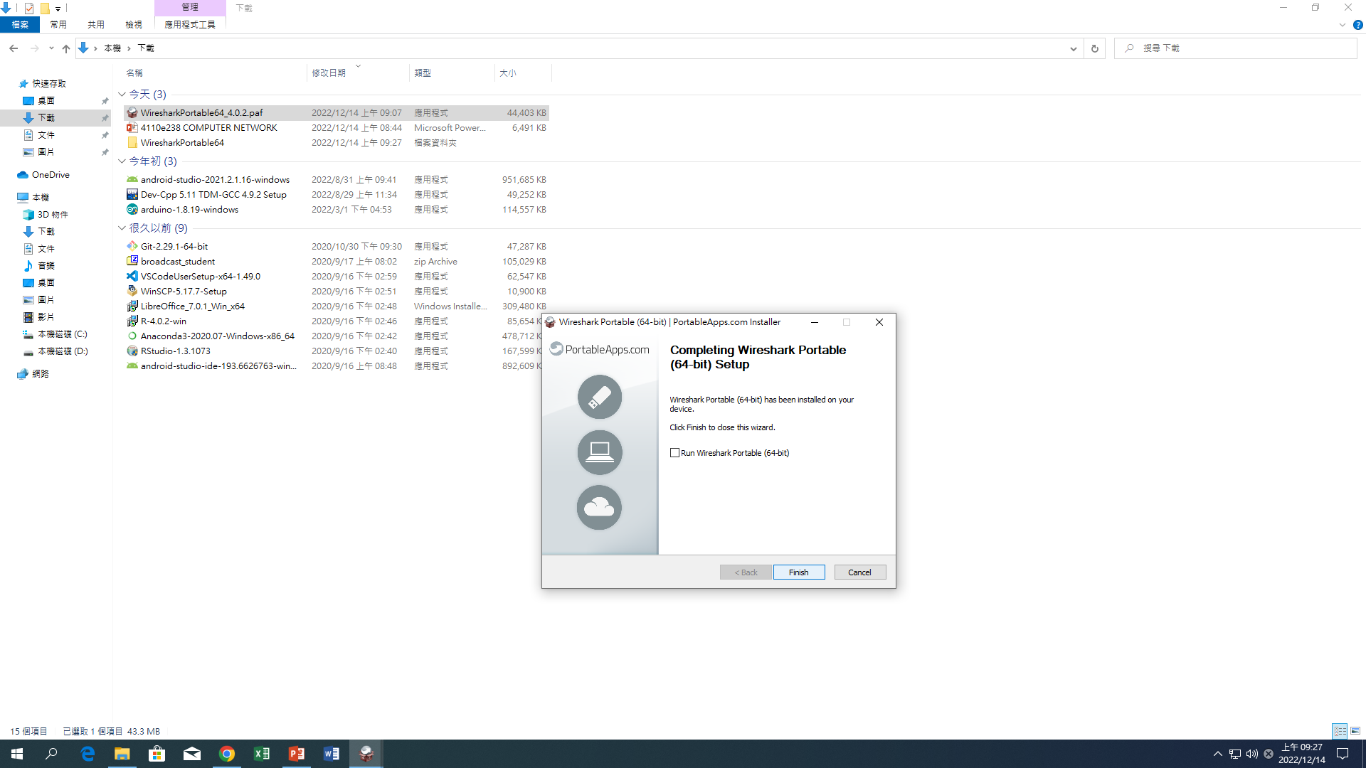

Slide 13
