Slide 1
LEARNING PYTHON
20220928

Slide 2
AGENDA
LEARNING PYTHON
INPUT AND OUTPUT
DATA TYPE
OPERATIONS

Slide 3
Learning Python

Slide 4
CONTENT
WHAT IS PYTHON ?
PYTHON JOBS ?
WHY TO LEARN PYTHON ?
PYTHON INTERPRETER ?
ONE
TWO
GOOGLE COLAB
PYTHON CODE

Slide 5
WHAT IS PYTHON ?
Python is a very popular general-purpose interpreted, interactive, object-oriented, and high-level programming language. Python is dynamically-typed and garbage-collected programming language. It was created by Guido van Rossum during 1985- 1990.

Slide 6
PYTHON JOBS
Today, Python is very high in demand and all the major companies are looking for great Python Programmers to develop websites, software components, and applications or to work with Data Science, AI, and ML technologies. When we are developing this tutorial in 2022, there is a high shortage of Python Programmers where as market demands more number of Python Programmers due to it's application in Machine Learning, Artificial Intelligence etc.

Slide 7
WHY TO LEARN PYTHON
Python is consistently rated as one of the world's most popular programming languages. Python is fairly easy to learn, so if you are starting to learn any programming language then Python could be your great choice. Today various Schools, Colleges and Universities are teaching Python as their primary programming language. There are many other good reasons which makes Python as the top choice of any programmer:
Python is simple and so easy to learn
Python is versatile and can be used to create many different things.
Python has powerful development libraries include AI, ML etc.
Python is much in demand and ensures high salary

Slide 8
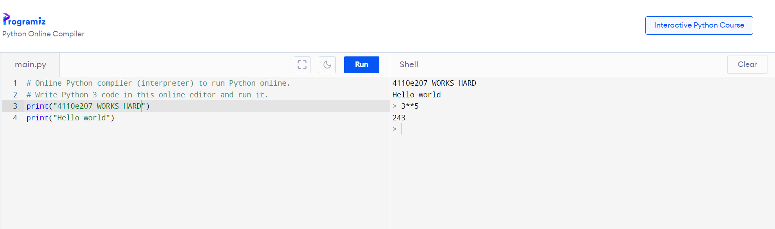
PYTHON ONLINE INTERPRETER : ONE

Slide 9
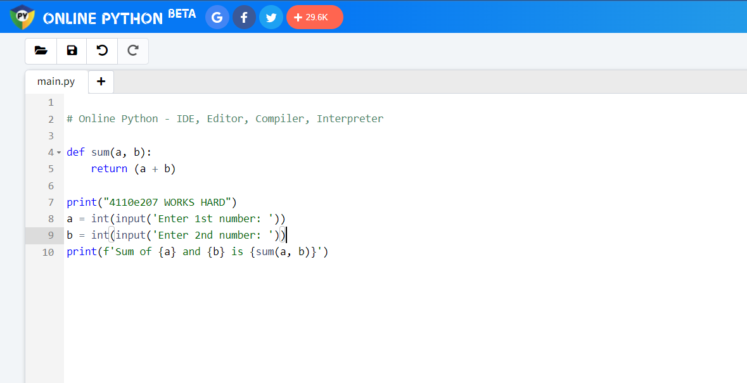
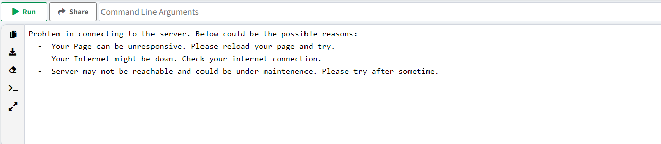
PYTHON ONLINE INTERPRETER : TWO

Slide 10
INPUT AND OUTPUT
20220928

Slide 11
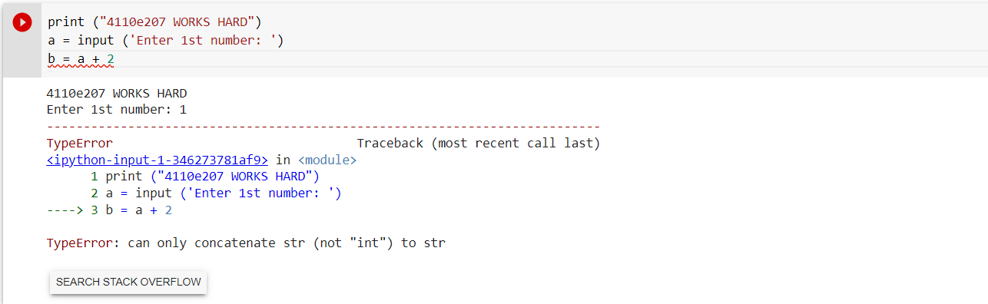
Question:
Data type :

Slide 12
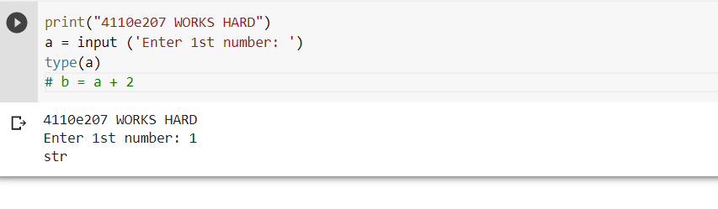

Slide 13
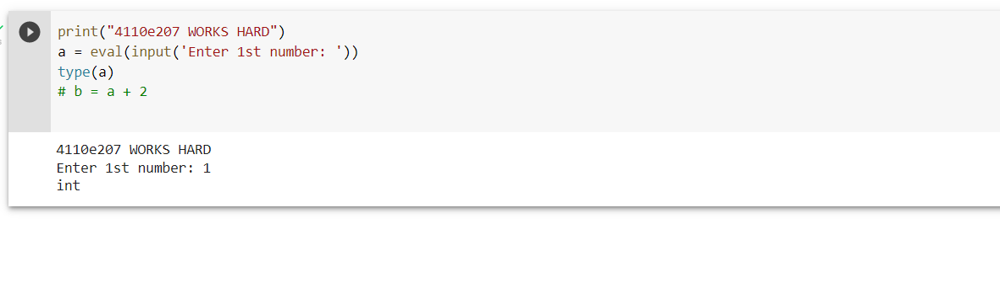

Slide 14
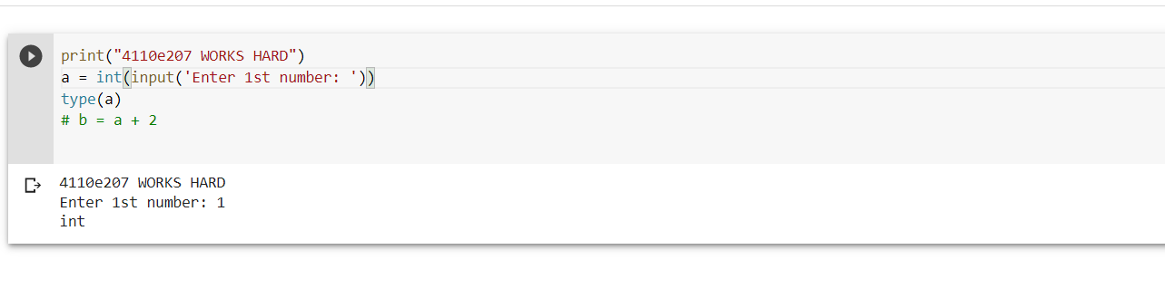

Slide 15
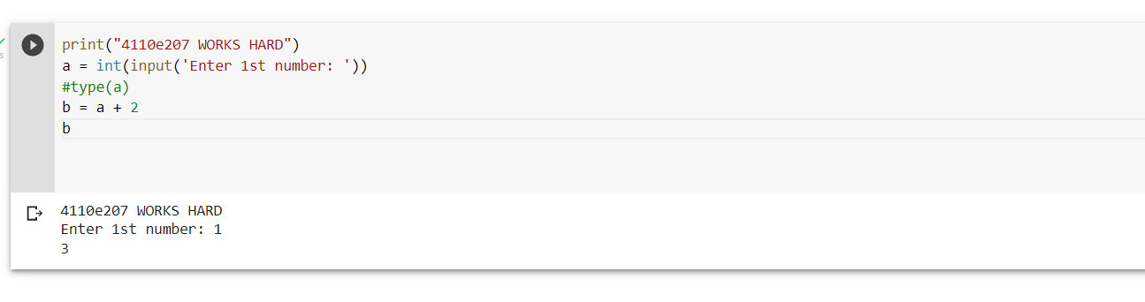
Answer: 1

Slide 16
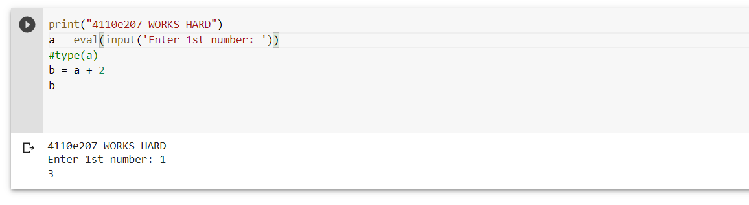
Answer: 2

Slide 17
PYTHON DATA TYPES
20220928

Slide 18
Data Types
Text Type: str
Numeric Types: int, float, complex
Sequence Types: list, tuple, range
Mapping Type: dict
Set Types: set, frozenset
Boolean Type: bool
Binary Types: bytes, bytearray, memoryview
None Type: NoneType

Slide 19
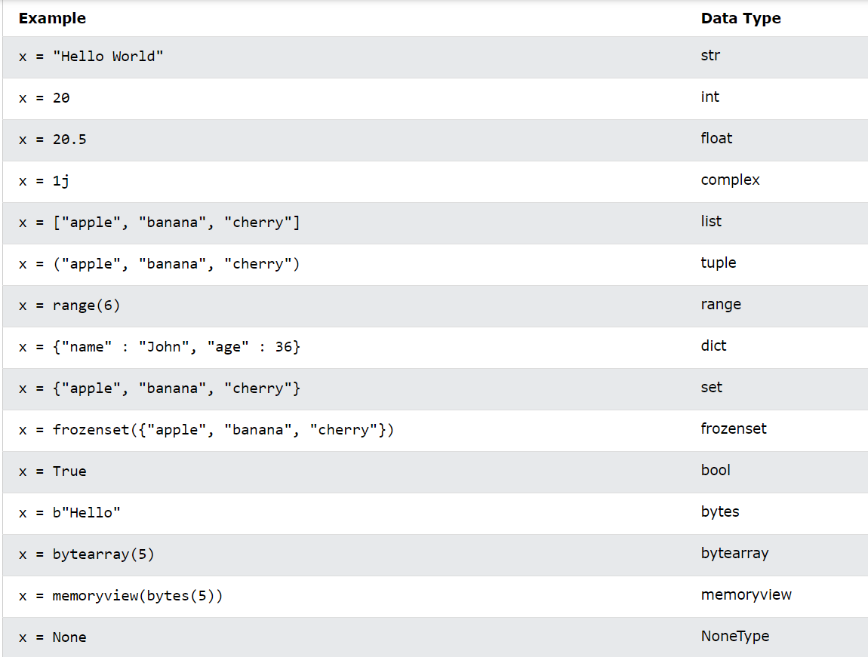

Slide 20
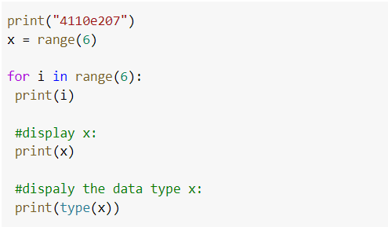
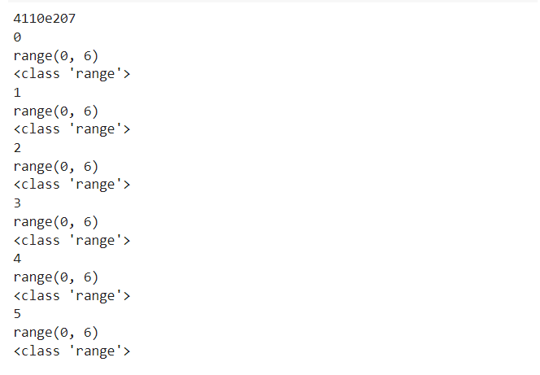

Slide 21
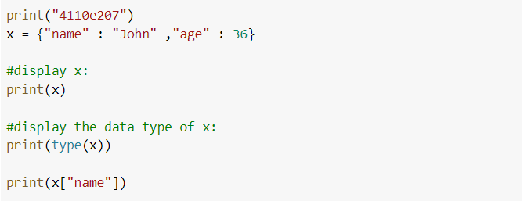
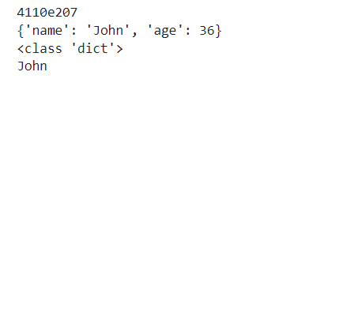
Dict: key- value pair

Slide 22
PYTHON OPERATIONS
20220928

Slide 23
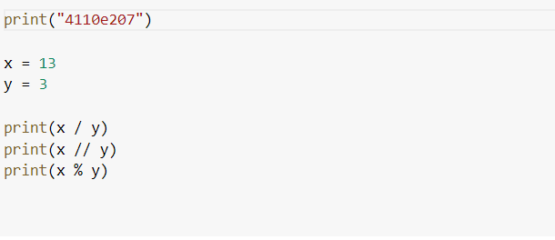
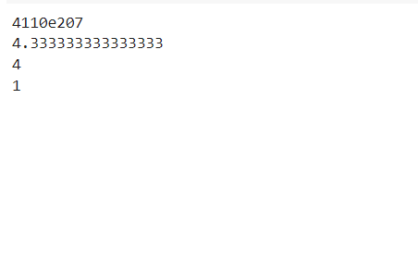
Python Arithmetic Operators

Slide 24
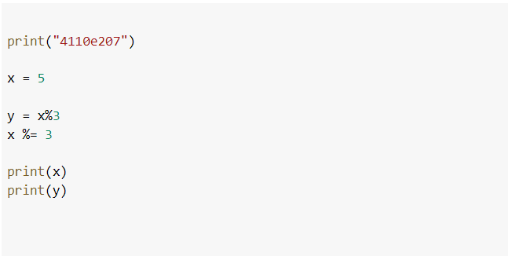
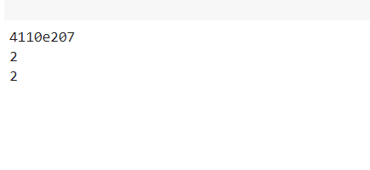
Python assingnment operators

Slide 25
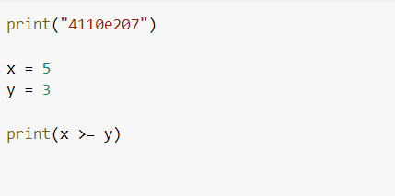
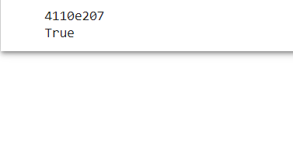
Python comparison operators

Slide 26
Python comparison operations
Z
["apple", "banana"]
["apple", "banana"]
z = x
x
y
x is y == > False
x == y == > True

Slide 27
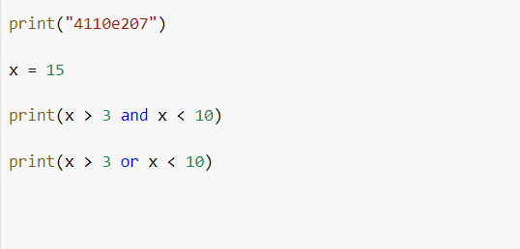
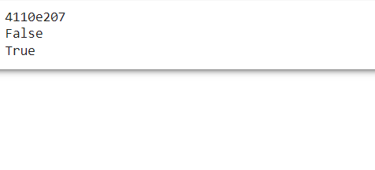
Python logical operators

Slide 28

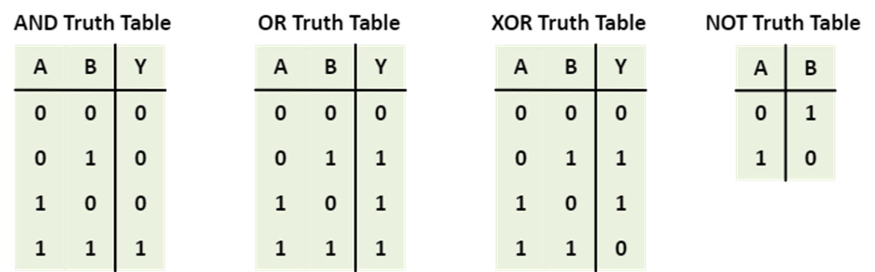

PYTHON BITWISE OPERATORS
1 ==> TRUE
0 ==> FALSE

Slide 29
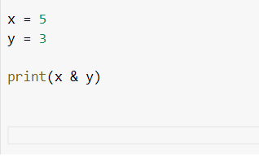
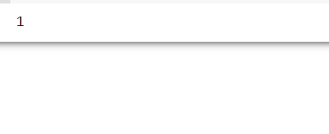
PYTHON BITWISE OPERATIONS
binary
1*2²+0*2¹+1*2⁰
x = 5
y = 3
print(x & y)
(101)₂
(011)₂
(001)₂

Slide 30
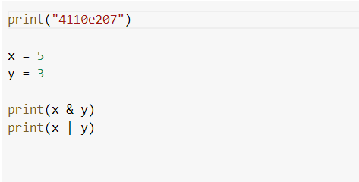
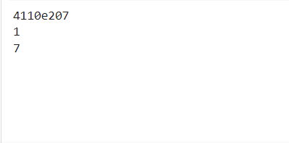
Python bitwise operators

Slide 31
Thank you

