Slide 1
MY JOURNEY TO PYTHON
NAME: 4110E207
TEACHER: MY DEAR GREAT TEACHERS

Slide 2
AGENDA
PYTHON
Input and output: input() and print()
Data types: numbers, strings, list, dictionaries
Operators on data type:
CONTROLS IF|IF-ELSIF|IF-ELSE
LOOP: FOR WHILE |RANGE |()|BREAK | CONTINUE
FUNCTION
PARAMETERS (ARGUMENTS)
RECURSIVE FUNCTION
LAMBA FUNCTION

Slide 3
python
Python is a popular programming language. It was created by Guido van Rossum, and released in 1991.
It is used for:
*web development (server-side),
*software development,
*mathematics,
*system scripting.
What can Python do?
*Python can be used on a server to create web applications.
*Python can be used alongside software to create workflows.
*Python can connect to database systems. It can also read and modify files.
*Python can be used to handle big data and perform complex mathematics.
*Python can be used for rapid prototyping, or for production-ready software development.

Slide 4
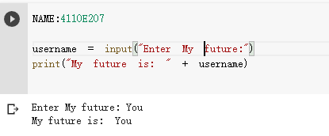
Input and output:
Python allows for user input.
That means we are able to ask the user for input.
The method is a bit different in Python 3.6 than Python 2.7.
Python 3.6 uses the input() method.
Python 2.7 uses the raw_input() method.
The following example asks for the username, and when you entered the username, it gets printed on the screen:

Slide 5
Data types: numbers

