Slide 1
OperATION@PYTHON

Slide 2
AGENDA
Python String
Slicing Strings
Modify Strings
Concatenate Strings
Format Strings
String Methods

Slide 3
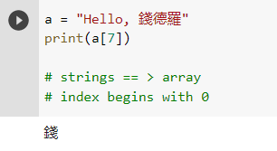
Strings are python are arrays of bytes representing Unicode characters.

Slide 4
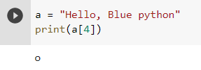
Strings are Arrays ==> acces the elemet of arrays
Python does not have a character data type, a single character is simply a string with a length of 1

Slide 5
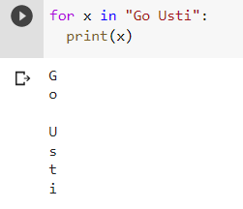
Looping Through a String

Slide 6
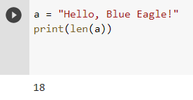
String Length:
To get the length of a string, use the len ()function.

Slide 7
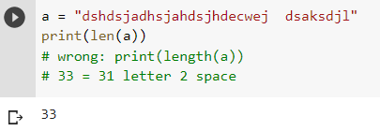
QUIZ: tell me how many char appear in "dshdsjadhsjahdsjhdecwej dsaksdjl“

Slide 8
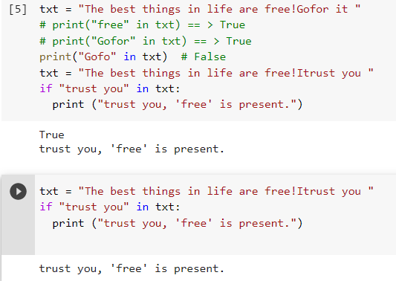
Check String:
To check if a certain phrase or character is present in a string,
we can use the keyword in .
keyword in vs if
True or False

Slide 9
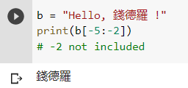
Negative Indexing

Slide 10
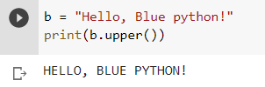
Python - Modify Strings
The upper() method returns the string in upper case:
The lower() method returns the string in lower case

Slide 11
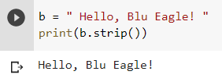
Remove Whitespace with strip() method
The strip() method removes any whitespace from the beginning or the end

Slide 12
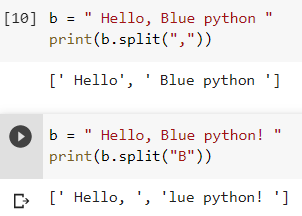
The replace()method replaces a string with another string
seperator

Slide 13
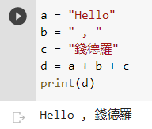
String Concatenation: To concatenate, or combine, two strings you can use the `+` operator.

Slide 14
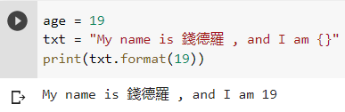
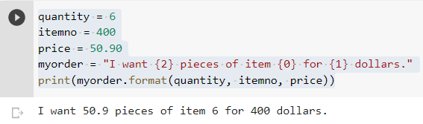
Python - Format - Strings

Slide 15
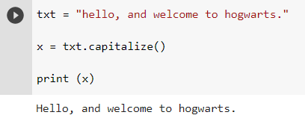
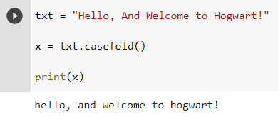
String Methods

Slide 16
THANK YOU
CHINESE NAME:錢德羅
STUDENT ID: 4110E216
Email: chandroermitanio95@gmail.com
Github: https://github.com/4110e216/cs2022.git

