Slide 1
LEARNING PYTHON Prepared by: 喬安蒂

Slide 2
AGENDA :
LEARNING PYTHON
INPUT AND OUTPUT
DATA TYPE
OPERATORS

Slide 3
What is Python?
Python is a very popular general-purpose interpreted, interactive, object-oriented, and high-level programming language. Python is a dynamically-typed and garbage-collected programming language. It was created by Guido van Rossum during 1985- 1990. Like Perl, Python source code is also available under the GNU General Public License (GPL).
Python supports multiple programming paradigms, including Procedural, Object Oriented, and Functional programming languages. Python’s design philosophy emphasizes code readability with the use of significant indentation.

Slide 4
Python Jobs
Today, Python is very high in demand and all the major companies are looking for great Python Programmers to develop websites, software components, and applications or to work with Data Science, AI, and ML technologies. When we are developing this tutorial in 2022, there is a high shortage of Python Programmers whereas the market demands more Python Programmers due to its application in Machine Learning, Artificial Intelligence, etc.

Slide 5
Why to Learn Python?
Python is consistently rated as one of the world's most popular programming languages. Python is fairly easy to learn, so if you are starting to learn any programming language then Python could be your great choice. Today various Schools, Colleges, and Universities are teaching Python as their primary programming language. There are many other good reasons which make Python the top choice of any programmer:
Python is Open Source which means it’s available free of cost.
Python is simple and so easy to learn
Python is versatile and can be used to create many different things.
Python has powerful development libraries including AI, ML, etc.
Python is much in demand and ensures a high salary

Slide 6
Python is a MUST for students and working professionals to become great Software Engineers especially when they are working in Web Development Domain. I will list down some of the key advantages of learning Python:
Python is Interpreted − Python is processed at runtime by the interpreter. You do not need to compile your program before executing it. This is similar to PERL and PHP.
Python is Interactive − You can actually sit at a Python prompt and interact with the interpreter directly to write your programs.
Python is Object-Oriented − Python supports an Object-Oriented style or technique of programming that encapsulates code within objects.
Python is a Beginner's Language − Python is a great language for beginner-level programmers and supports the development of a wide range of applications from simple text processing to WWW browsers to games.

Slide 7
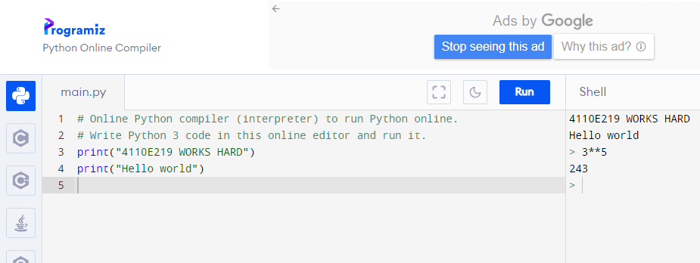
Python Online Interpreter: 1
INTERACTIVE

Slide 8
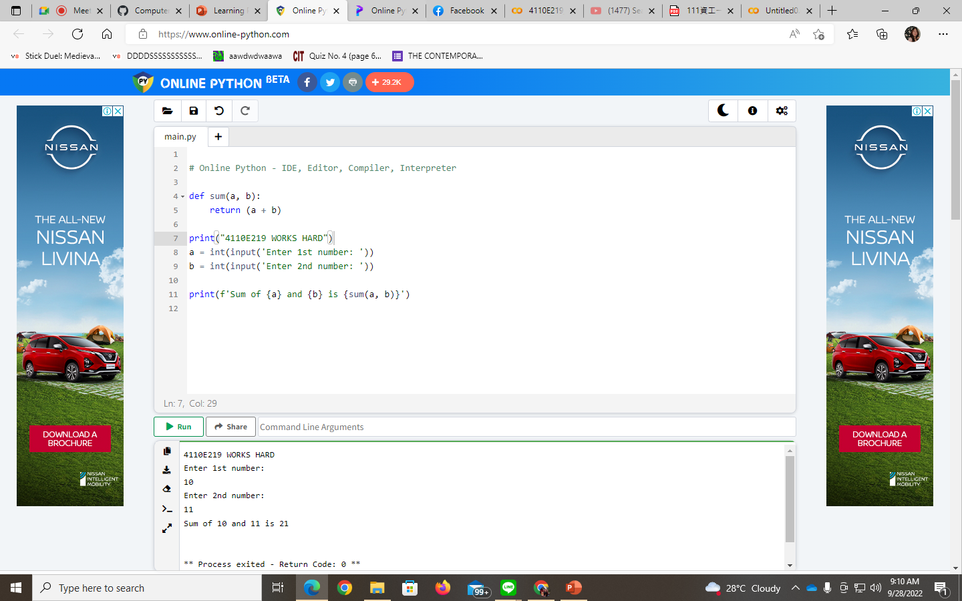
Python Online Interpreter: 2

Slide 9
Input and Output

Slide 10
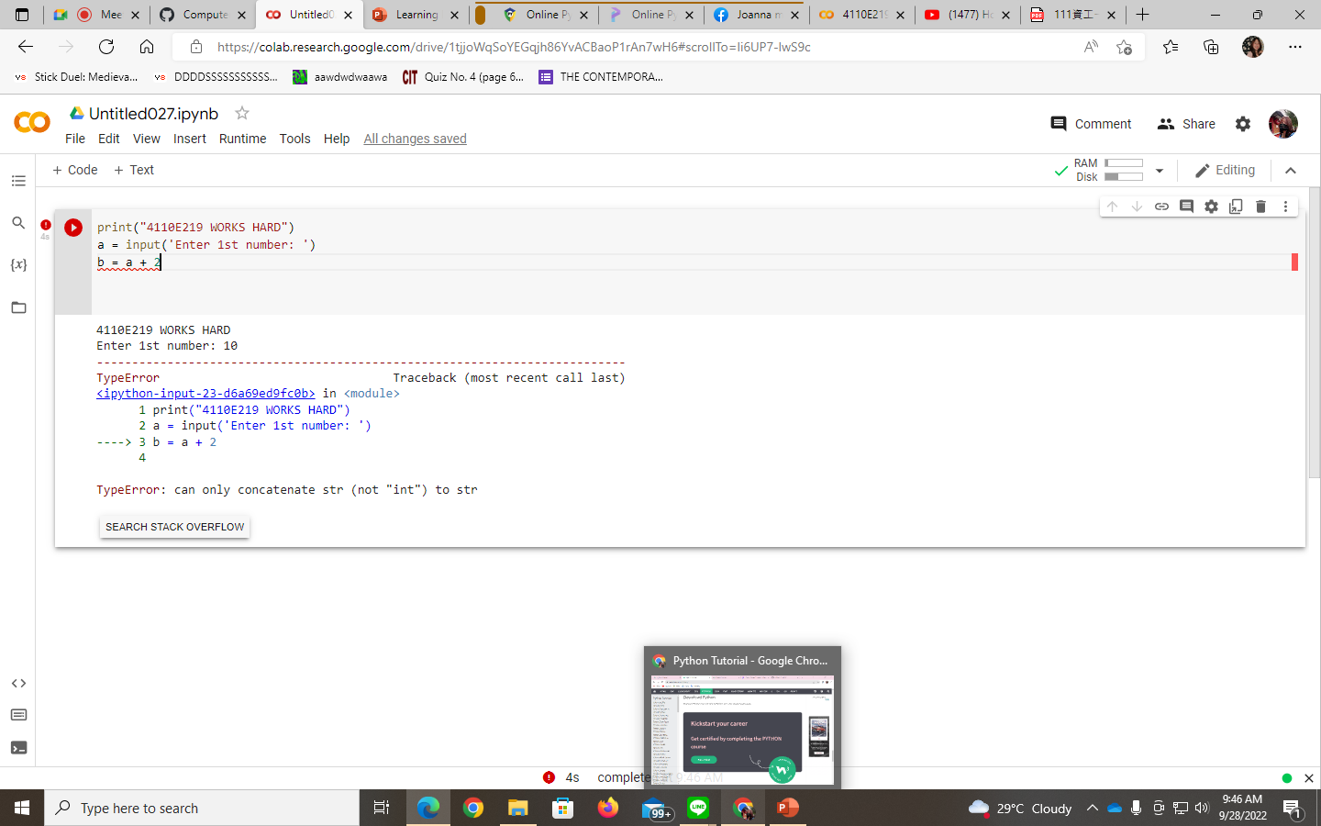
DATA TYPE

Slide 11
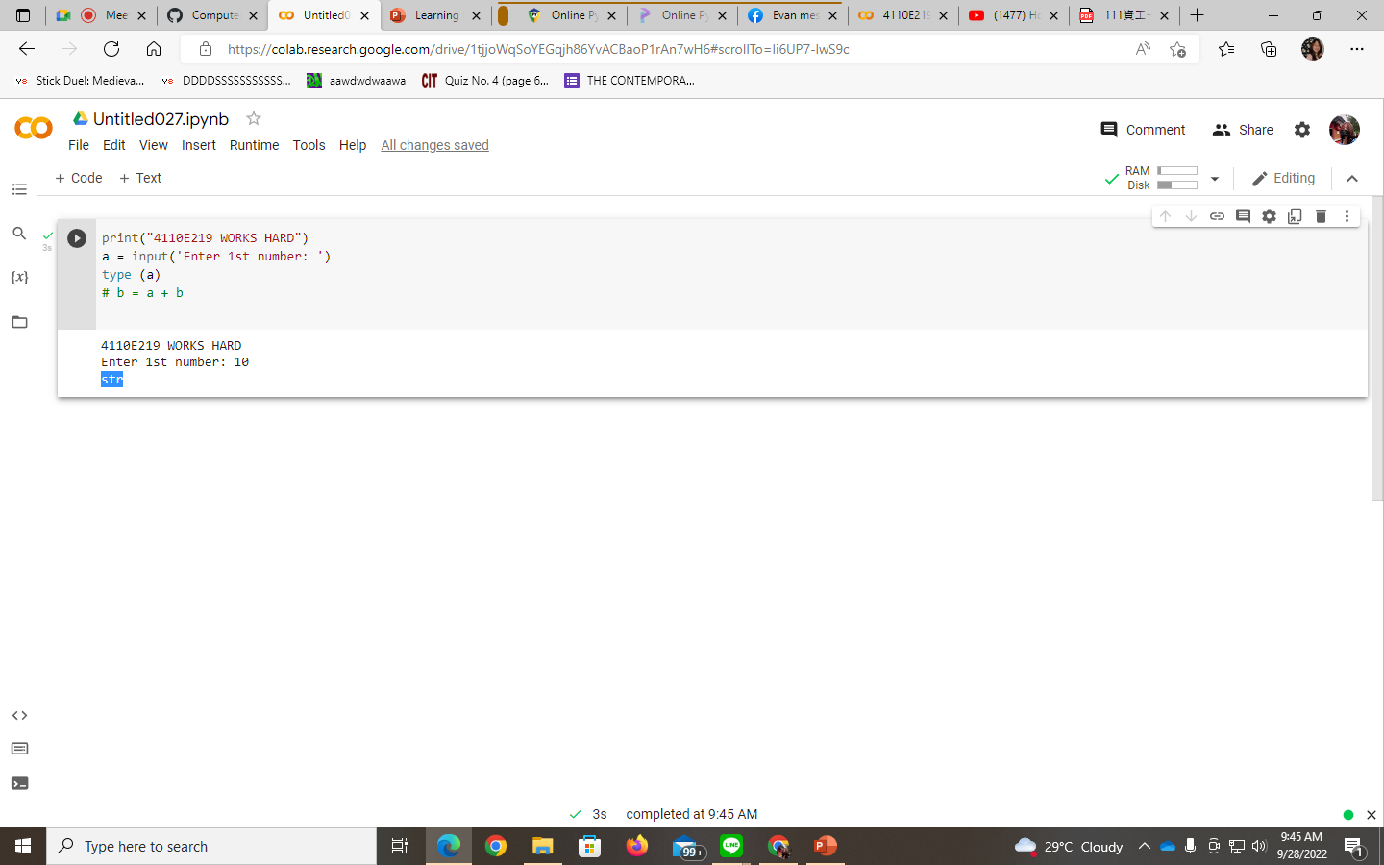

Slide 12


Slide 13
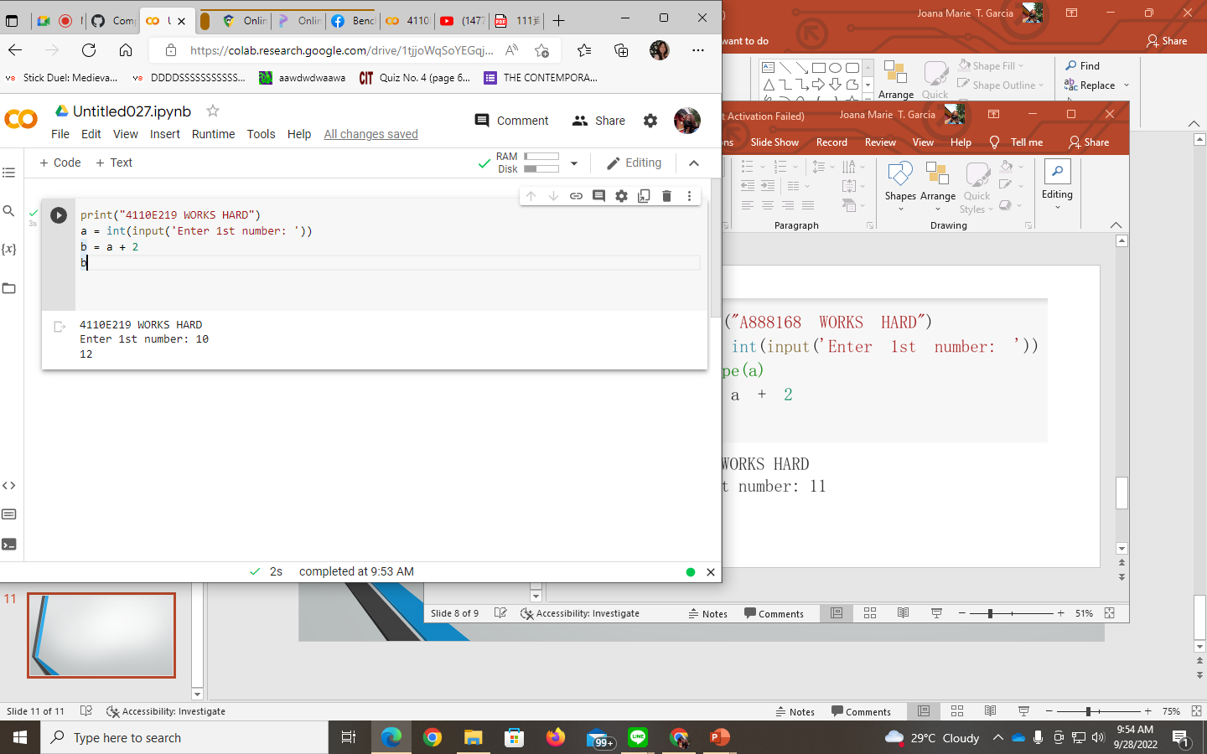

Slide 14
DATA TYPE

Slide 15
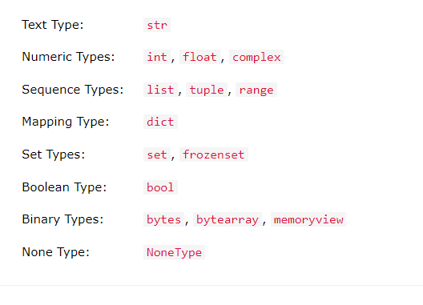
Data Type

Slide 16
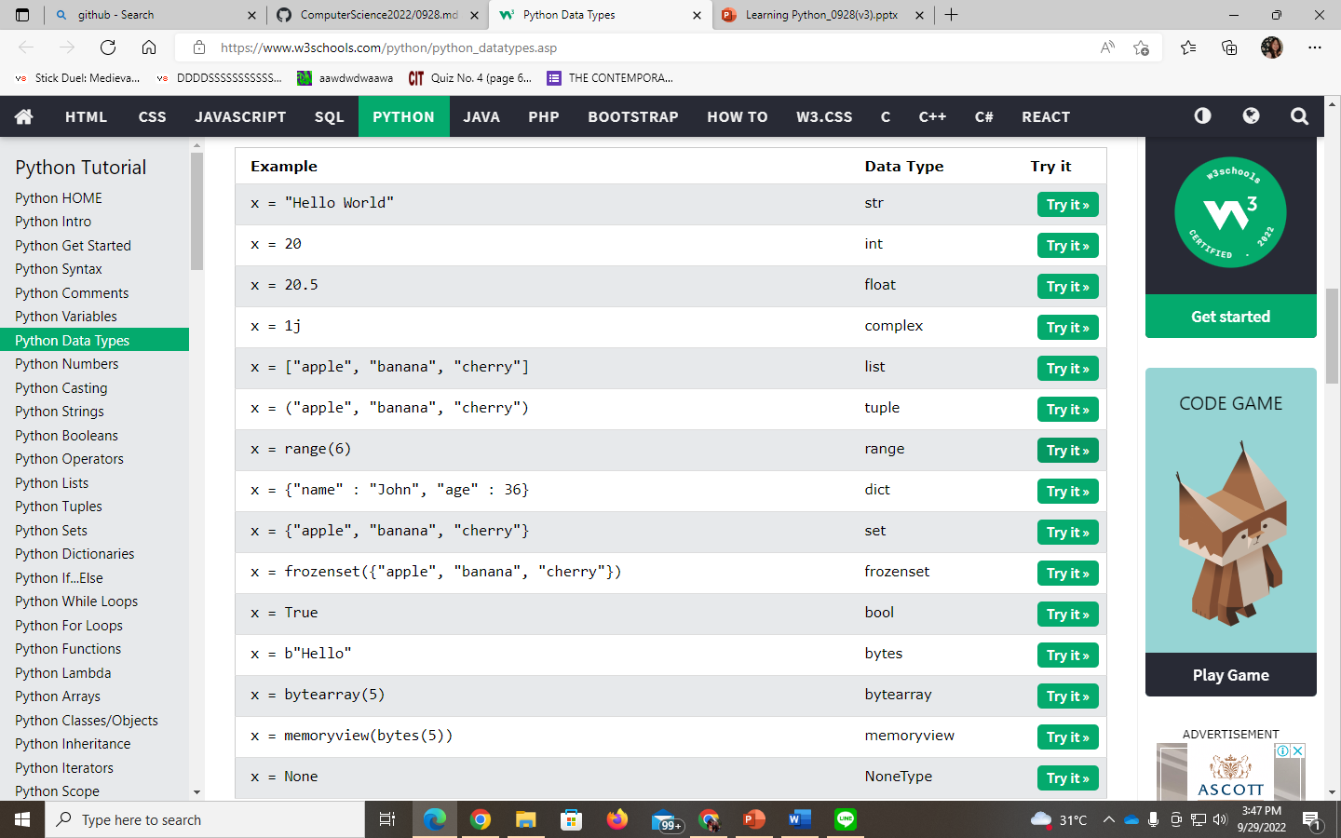

Slide 17
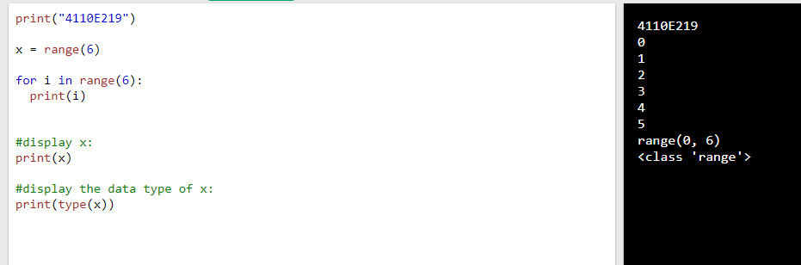

Slide 18
Operator @

Slide 19
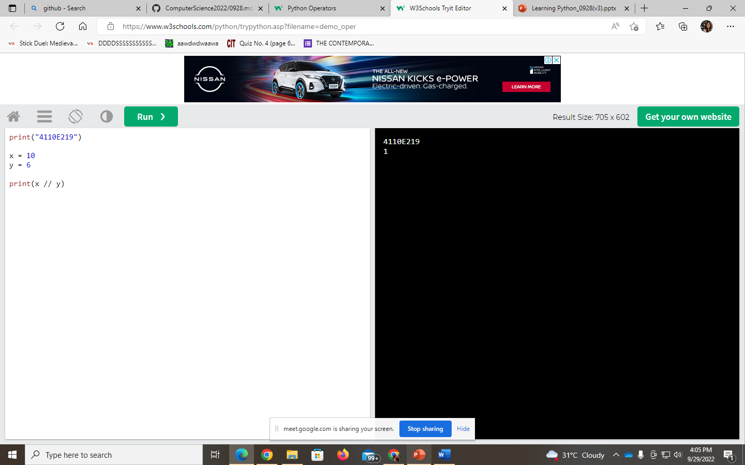


Slide 20
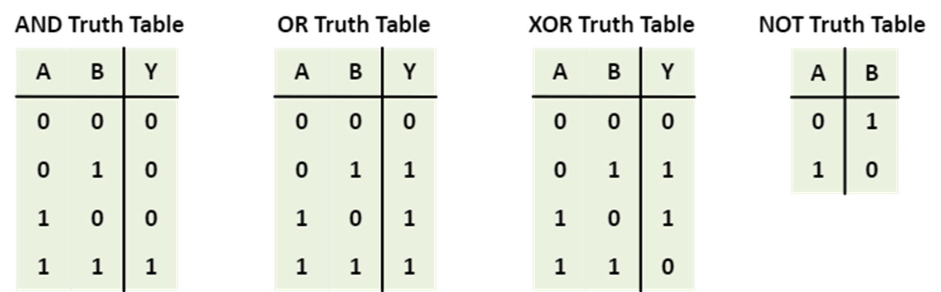
1 == > TRUE 0 == > FALSE

Slide 21
[“apple”, “banana”]
[“apple”, “banana”]
z = x
z
x
y
x is y ==> False
x == y ==> True

Slide 22
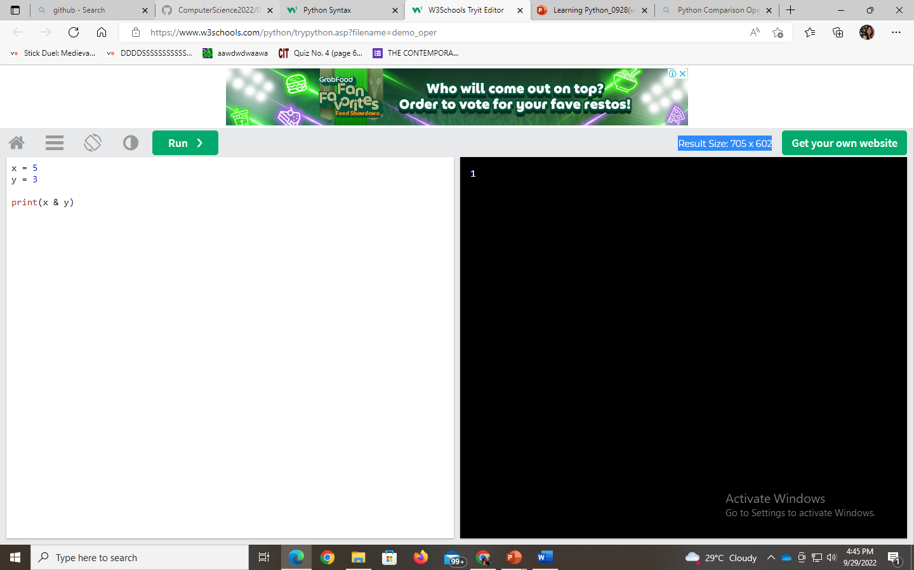
Binary
1*2²+0*2¹+1*2⁰
x = 5
y = 3
print(x & y)
(101)₂
(011)₂
(001)₂

Slide 23
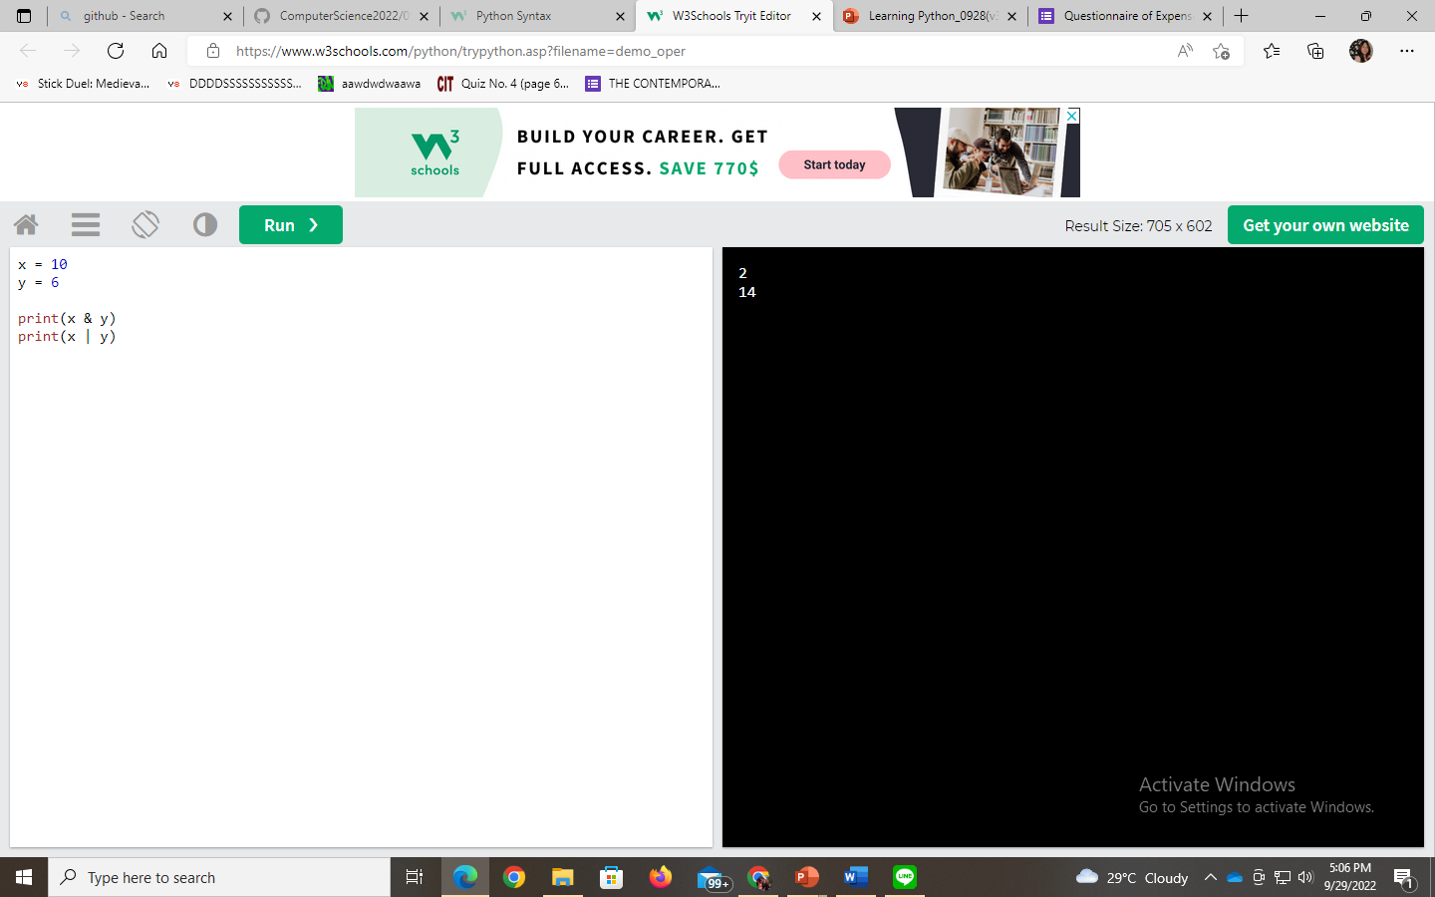
Exercise: how to get a 7 in bitwise-or

Slide 24
THANK YOU!

