Slide 1
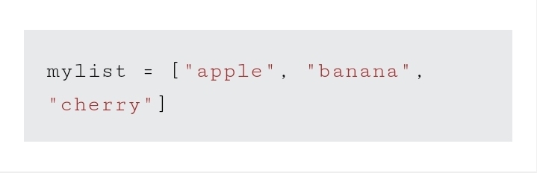
Python list
Example :

Slide 2
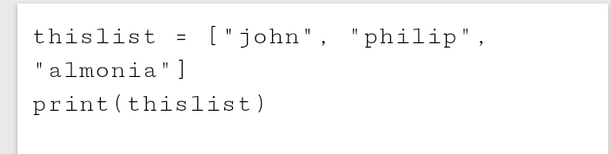
LIST
Lists are used to store multiple items in a single variable. Lists are one of 4 built-in data types in Python used to store collections of data, the other 3 are Tuple, Set, and Dictionary, all with different qualities and usage. Lists are created using square brackets:

Slide 3
List items:
ORDERED:
List items are ordered, changeable, and allow duplicate values. List items are indexed, the first item has index [0], the second item has index [1] etc.
When we say that lists are ordered, it means that the items have a defined order, and that order will not change. If you add new items to a list, the new items will be placed at the end of the list.

Slide 4
Changeable:
The list is changeable, meaning that we can change, add, and remove items in a list after it has been created.

Slide 5
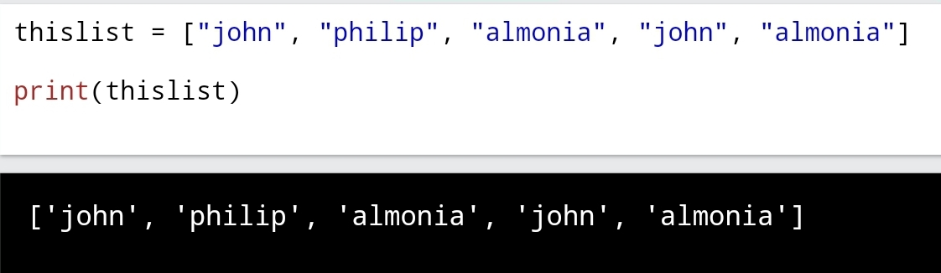
ALLOW DUPLICATE:
Since lists are indexed, lists can have items with the same value: EXAMPLE
Lists allow duplicate values:

Slide 6
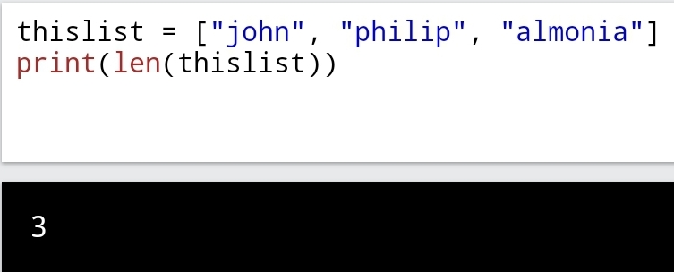
LIST LENGTH:
To determine how many items a list has, use the len() function:
EXAMPLE
Print the number of items in the list:

Slide 7
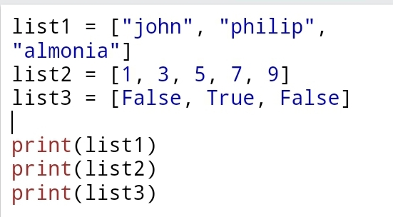
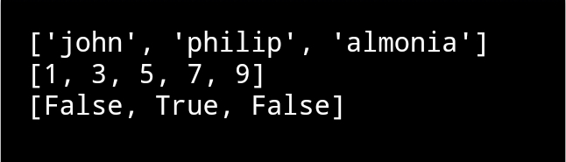
LIST ITEMS – data types
List items can be of any data type:
EXAMPLE:
String, int and boolean data types:

Slide 8
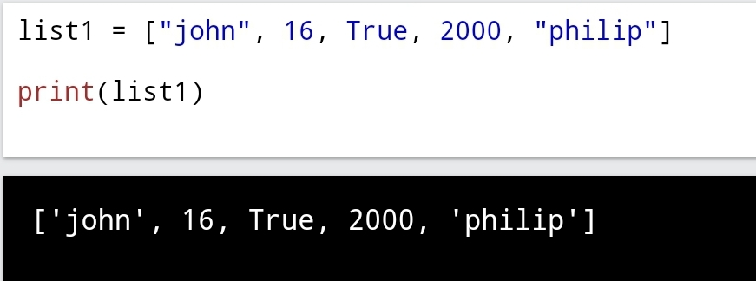
A list can contain can contain different data types
EXAMPLE
A list with strings, integers and boolean values:

Slide 9
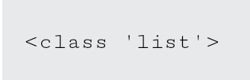
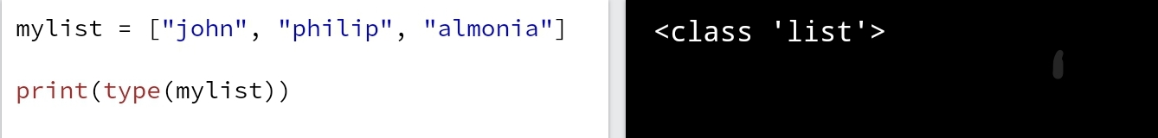
Type ()
From Python's perspective, lists are defined as objects with the data type 'list':
EXAMPLE
What is the data type of a list?

Slide 10
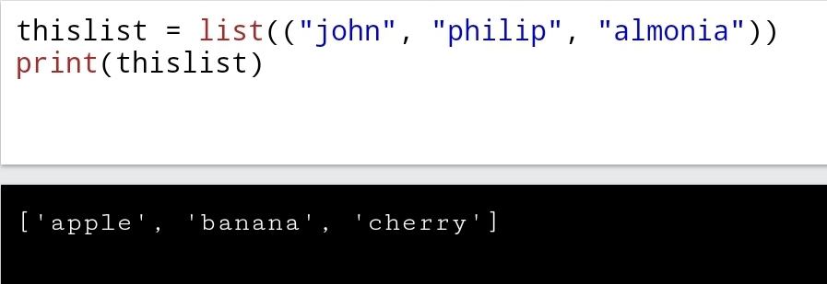
The list () constructor
It is also possible to use the list() constructor when creating a new list.

Slide 11
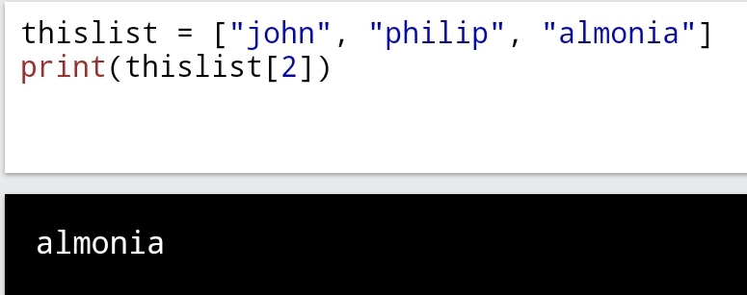
PYTHON – access list items
Access Items:
List items are indexed and you can access them by referring to the index number:
Example
Print the second item of the list:

Slide 12
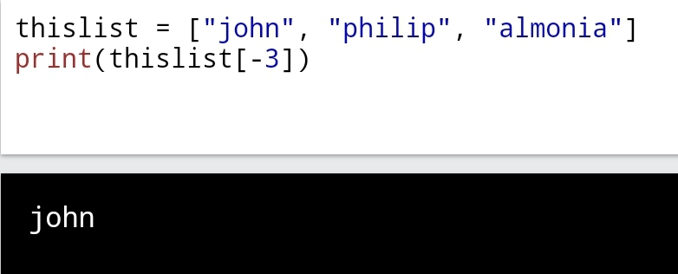
NEGATIVE INDEXING
Negative indexing means start from the end
-1 refers to the last item, -2 refers to the second last item etc.
Example Print the last item of the list:

Slide 13
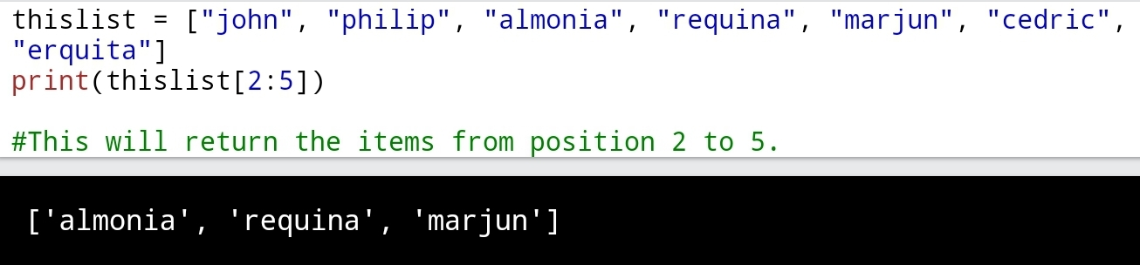
RANGE OF INDEXES
Example Return the third, fourth, and fifth item:
You can specify a range of indexes by specifying where to start and where to end the range.
When specifying a range, the return value will be a new list with the specified items.

Slide 14
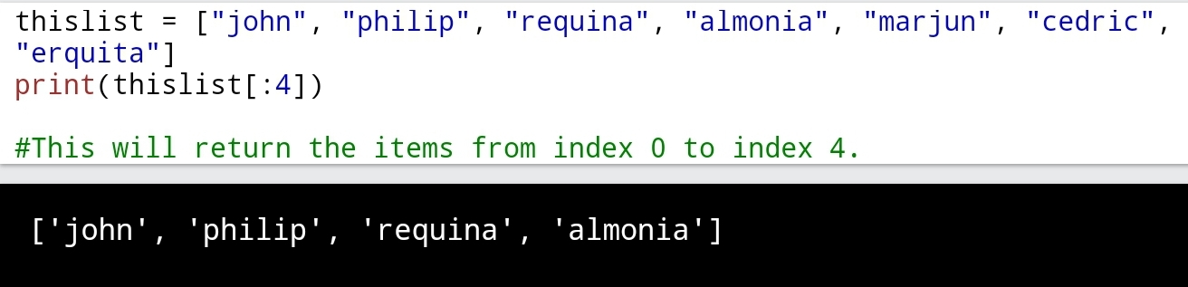
By leaving out the start value, the range will start at the first item:
Example
This example returns the items from the beginning to, but NOT including, “marjun":

Slide 15
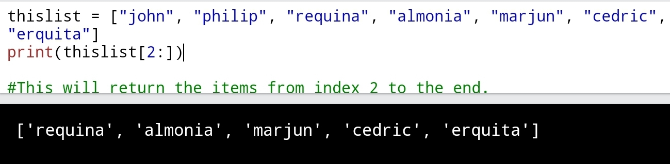
By leaving out the end value, the range will go on to the end of the list:
Example This example returns the items from “requina” to the end:

Slide 16
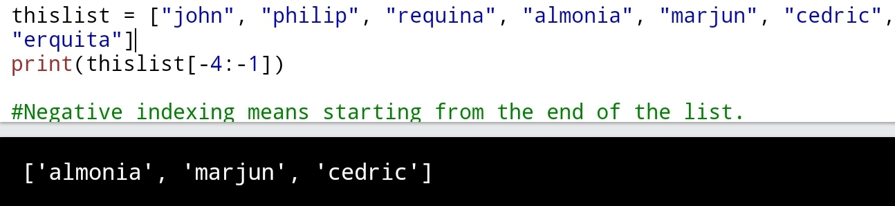
Range of Negative Indexes
Specify negative indexes if you want to start the search from the end of the list:
Example This example returns the items from “almonia” (-4) to, but NOT including “erquita” (-1):

Slide 17
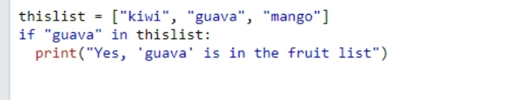
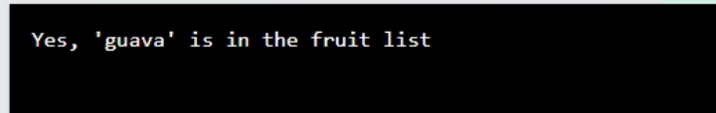
Check if Item Exists
To determine if a specified item is present in a list use the in keyword:
Example
Check if “guava" is present in the list:

Slide 18
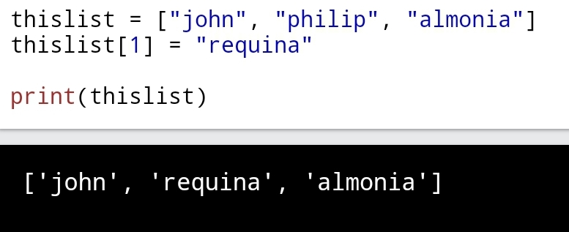
Python – change list names
Change Item Value
To change the value of a specific item, refer to the index number:
Example:
Change the second item:

Slide 19
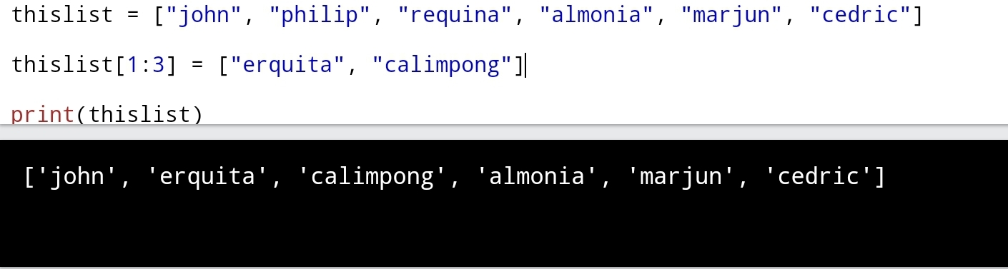
Change a Range of Item Values
To change the value of items within a specific range, define a list with the new values, and refer to the range of index numbers where you want to insert the new values:
Example Change the values “philip” and “requina” with the values “erquita” and “calimpong”:

Slide 20
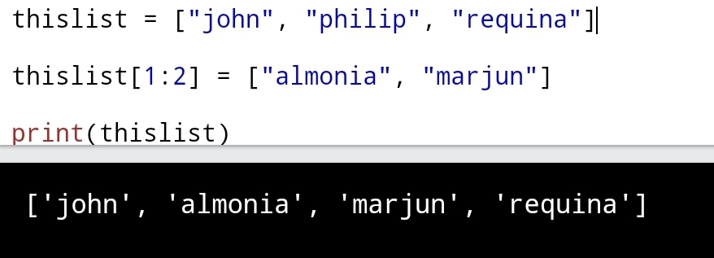
If you insert more items than you replace, the new items will be inserted where you specified, and the remaining items will move accordingly:
Example
Change the second value by replacing it with two new values:

Slide 21
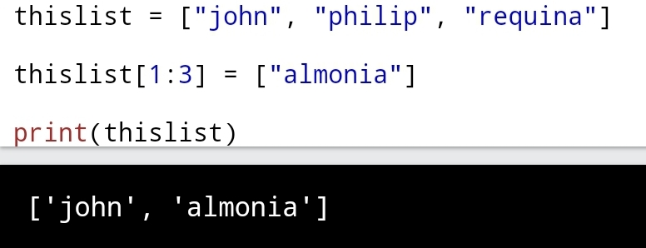
If you insert less items than you replace, the new items will be inserted where you specified, and the remaining items will move accordingly:
Example Change the second and third value by replacing it with one value:

Slide 22
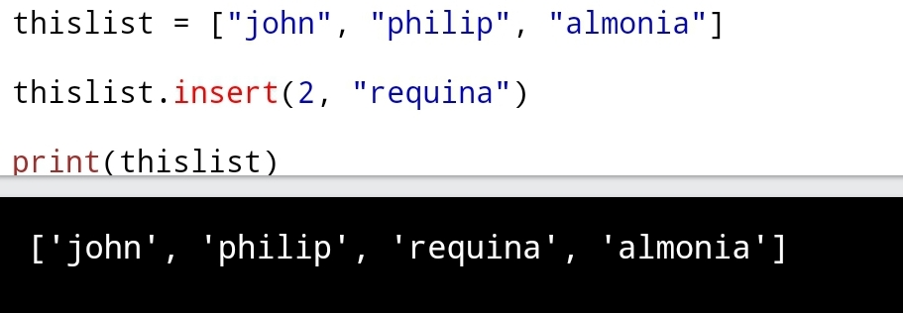
Insert items:
Example Insert “requina" as the third item:
To insert a new list item, without replacing any of the existing values, we can use the insert() method. The insert() method inserts an item at the specified index:

Slide 23
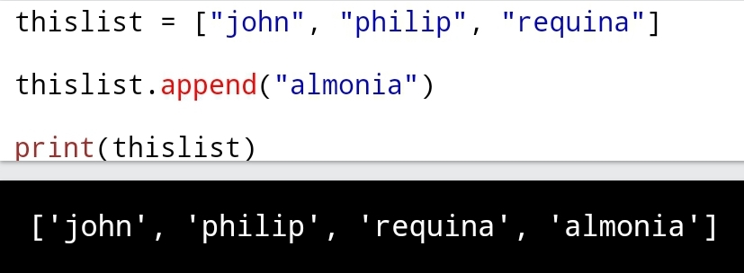
Python - Add List Items
Append Items To add an item to the end of the list, use the append() method:
Example Using the append() method to append an item:

Slide 24
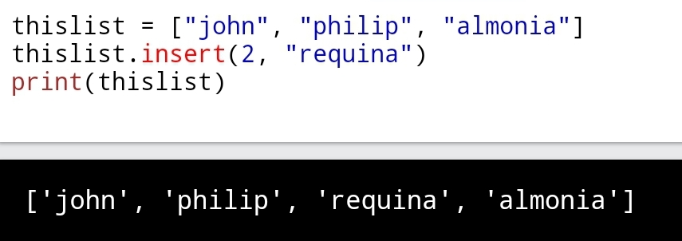
Insert Items To insert a list item at a specified index, use the insert() method. The insert() method inserts an item at the specified index:
Example Insert an item as the second position:

Slide 25
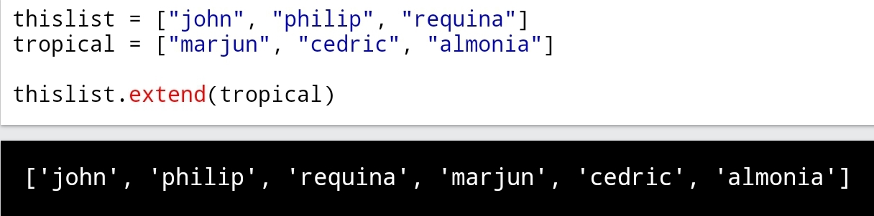
EXTEND LIST
To append elements from another list to the current list, use the extend() method.
Example Add the elements of tropical to thislist:

Slide 26
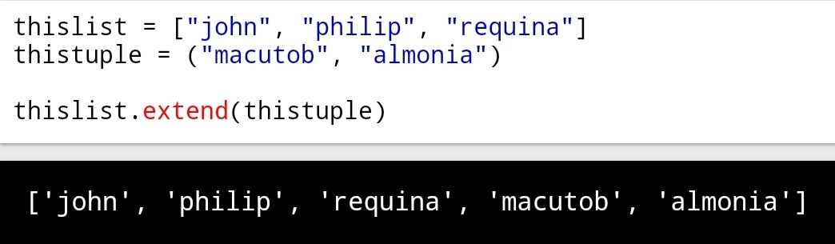
Add Any Iterable
The extend() method does not have to append lists, you can add any iterable object (tuples, sets, dictionaries etc.).
Example
Add elements of a tuple to a list:

