Slide 1

DESIGN AND SIMULATION OF A TVAR-BASED PACKET LOSS PREDICTION MODEL FOR WIRELESS MESH NETWORKS
BY:
Kelvin Gyesi Konah - 4111231007
Stephans Neris Kwei Kuku – 4121230007
Supervisor:
Dr. Francis Oduro-Gyimah
GHANA COMMUNICATION TECHNOLOGY UNIVERSITY

Slide 2



BACKGROUND OF STUDY
Evolution of WMNs
Market Projection
Telecommunication has undergone a major shift. A key focus is the adoption of Wireless Mesh Networks (WMNs), known for their:
The global wireless mesh network market size is expanding rapidly:
Market Value (2022):
Dynamic & self-organized routing
•
USD 8.29B
Self-configured capabilities
•
Self-healing autonomy
Projected Value (2030):
•
USD 15.95B
Page 2
Notes:
Grand View Research growing at a compound annual growth rate (CAGR) of 8.6% from 2023 to 2030

Slide 3



PROBLEM STATEMENT
Inherent Challenge
Existing Limitations
Research Focus
Current mitigation measures are static in highly dynamic, non-stationary WMN environments [6].
This study designs a model to predict network packet loss before it degrades performance.
Packet loss is an inherent bottleneck in WMNs due to their multi-hop architecture.
Alternative reactive or proactive approaches introduce high overhead or computational complexity [7], straining limited hardware [5].
We propose, a non-stationary, lightweight time-series model optimized for resource-constrained mesh hardware.
When data packets fail to reach their destination, critical transmission failures occur.
Page 3

Slide 4








RESEARCH OBJECTIVES
General Objective
To develop and validate a TVAR model for packet loss prediction in WMNs.
Specific Objectives
Network Design
Traffic Simulation
Model Dev
Evaluating
To design a 10 node WMN in NS-3 network simulator.
To simulate the designed WMN to generate traffic.
To develop TVAR model using generated traffic.
To apply TVAR model to predict packet loss in designed WMN.
Page 4

Slide 5


SCOPE & LIMITATIONS
Scope
Limitations
Focused on WMNs, evaluating TVAR as the packet-loss prediction model.
■
Simulated only — not yet tested on a real-world WMN deployment.
■
Network design: 3×4 grid, 10 nodes (top row incomplete), simulated in NS-3.
■
■
Bounded to 10 nodes — larger networks introduce different challenges.
Training, testing, and validation of the TVAR model conducted in Jupyter Notebooks.
■
Page 6

Slide 6
SUMMARY OF RELATED WORKS
Author(s) & Year | Research Topic | Limitation | Methodology
X. Wu, C. Wu, and P. Deng (2023) | Prediction of Packet Loss Rate in Non-Stationary Networks Based on Time-Varying Autoregressive Sequences | • Requires current packet loss rate to update parameters. • Error-prone during sudden, drastic fluctuations. | 1. Developed an improved Gilbert-Elliot model to generate time series data. 2. Generated non-stationary data via an added medium state with Gaussian packet loss rates.
Z. Jia and C. Zhang (2025) | Time-Varying Autoregressive Models: A Novel Approach Using Physics-Informed Neural Networks | • Unresolved DNN challenges cause lower prediction accuracy. • Higher computational demands than compared models. • Relies on physical priors that may be unavailable. | 1. Defined individual models. 2. Combined PINN with TVAR and TV-VAR. 3. Compared simulations across three scenarios.
Page 8

Slide 7
SUMMARY OF RELATED WORKS CONT...
Author(s) & Year | Research Topic | Limitation | Methodology
J. M. B. Haslbeck, L. F. Bringmann, and L. J. Waldorp (2020) | A Tutorial on Estimating Time-Varying Vector Autoregressive Model | • High dependence on Signal-to-Noise ratio. • Limited to strictly monotone parameters. • Restricted to VAR models with p = 10 variables and single lag. | 1. Generalized Additive Models (GAM) 2. Kernel-Smoothing (KS)
R. Abduljabbar, H. Dia, P.-W. Tsai, and S. Liyanage (2021) | Forecasting the Traffic Flow by Using ARIMA and LSTM Models: Case of Muhima Junction | • Mixed traffic data (mostly non-stationary). • Ignores environmental factors due to data limits. | 1. ARIMA filters noise to predict linear trends. 2. LSTM captures complex, non-linear traffic patterns.
Page 9

Slide 8
SUMMARY OF RELATED WORKS CONT...
Author(s) & Year | Research Topic | Limitation | Methodology
E. Owoeye, T. Komolafe, I. Oke, S. Adegbola, I. Adeyemo, and A. Saka (2025) | Adaptive Hybrid Routing for Wireless Mesh Networks in Smart Grid | • High computational overhead on resource-constrained routers. • ML model performance is highly dependent on training data quality and quantity. | 1. Modeled Smart Grid mesh. 2. Combined RPL and GPSR protocols. 3. Integrated Random Forest classifier as dynamic decision engine.
D. Thakre and S. Awaya (2024) | Performance Study of AODV, OLSR, and DSDV Routing Protocols in Mobile AD HOC Networks | • Did not perform original simulations (relied on findings of others). | 1. Simulated MANET using MATLAB. 2. Compared standard OLSR with hybrid OLSR+LEACH. 3. Evaluated Throughput and PDR under varying node counts and areas.
Page 10

Slide 9
METHODOLOGY
Methodology used to model, simulate and evaluate TVAR model for packet loss prediction in WMNs was done in three phases:
PHASE 01
Network Simulation
Using NS-3 to model, and simulate the network.
PHASE 02
Model Training
Training with TVAR.
PHASE 03
Performance Evaluation
Evaluating the model performance.
Page 11

Slide 10
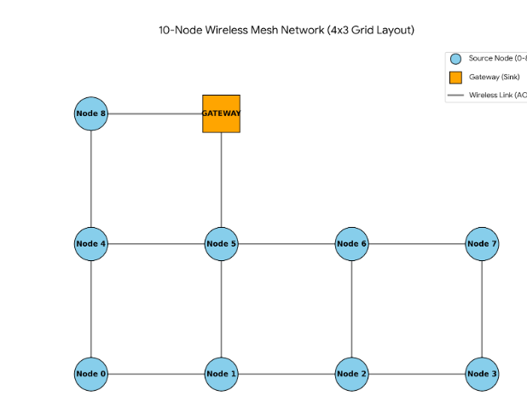
NETWORK MODELING & SIMULATION
NETWORK CONFIGURATION
Simple 10-node grid topology layout.
100-meter node spacing.
The last node is designated as the gateway node.
GRID TOPOLOGY DIAGRAM
SIMULATION PARAMETERS
Configured with 802.11a wireless standard.
Log Distance path loss model (exponent 2.3).
Each node requires 1 to 4 hops to reach source.
Figure 1
Page 12
Notes:
A 100 meter node spacing was introduced, this was chosen to give the model relatively good connectivity and better reach for the packets while also keeping the packet loss realistic.
with 4 columns and 3 rows with the top row being incomplete

Slide 11
NETWORK MODELING & SIMULATION CONT...
Three network traffic flows were configured for simulation and evaluation:
FLOW 01
Baseline
Structured intervals were used with periodic traffic rate changes. For every twenty time windows, the network traffic was set to a given amount.
FLOW 02
Regime Switching
Traffic was alternated at random intervals with highs and lows.
FLOW 03
Random Walk
A continuous drift was used via a random step algorithm. With a step size of plus or minus 150 kbps for each window.
Page 13
Notes:
Regime switching: between 40 second and 90 second intervals

Slide 12
DATA COLLECTION
MEASUREMENT
5-Second Windows
Data was collected using 5-second measurement windows via the NS-3 FlowMonitor module.
DATA POINTS
3,240 Samples
Interval set at 360 windows (30 mins) across 9 routes, producing 3,240 observations.
TRAFFIC & SIZE
UDP
UDP traffic with exponential on/off times. Packet size configured to 1024 bytes.
PREPARATION
150s Warm-Up
A 150-second warm-up period allowed complete route discovery prior to data collection.
Page 14

Slide 13
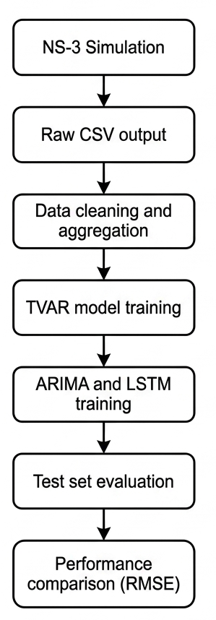
DATA COLLECTION CONT...
Dataset Structure
3,240 Samples & 8 Columns
The CSV generated from the simulation had 3,240 rows of data samples and 8 columns.
Quality Checks
Data Validation
Checks were made on loss rates.
Checks were made to ensure no columns contained null or undefined values.
Figure 2
Page 15

Slide 14
TVAR MODEL ARCHITECTURE
Optimal Order Selection
Akaike Information Criterion (AIC) was used to select the optimal order p, testing from the lowest 1 through to 15 on each route.
Selected Model Orders
• Baseline & Regime Switching: Order of 2 was used
• Random Walk: Order of 4 was used
1) YULE WALKER (BASELINE)
2) REGIME SWITCHING
3) RANDOM WALK
This method was used because it requires some sort of stationarity in the data.
Window Size: It used a window size of 30 observations.
Two separate linear regression models were trained on low and high regime changes respectively.
Prediction Time: The model selects regimes dynamically based on the traffic rate.
It works by estimating the AR coefficients continuously updating at every single time step.
Page 16

Slide 15
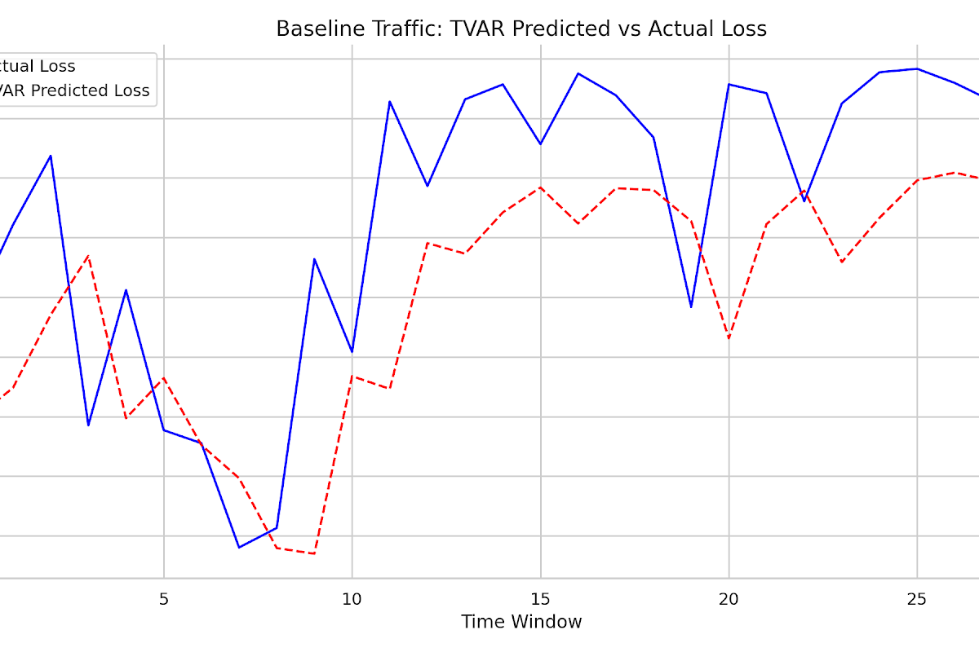
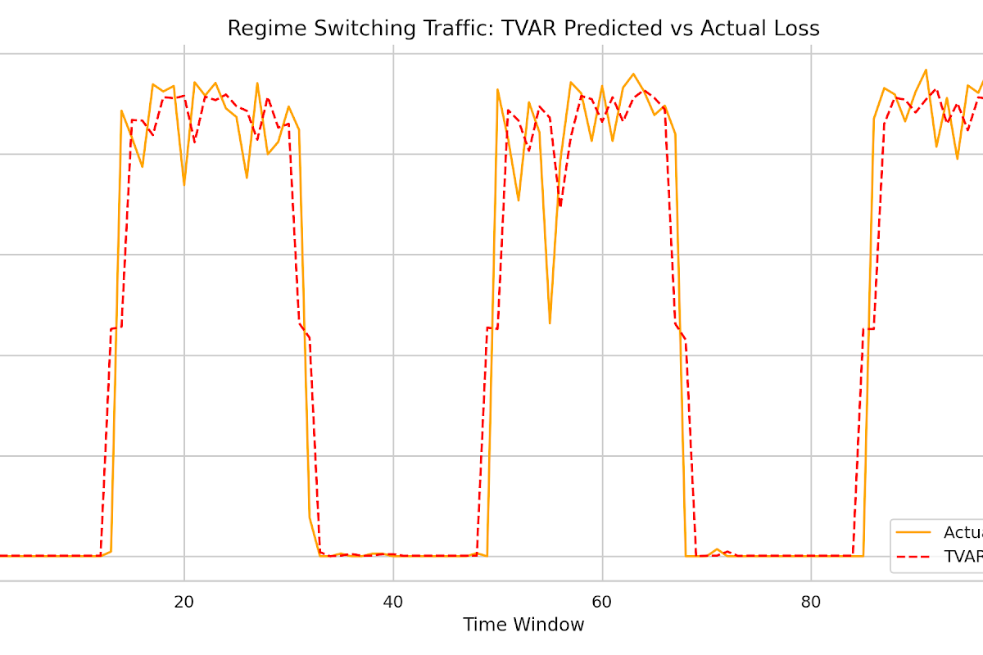
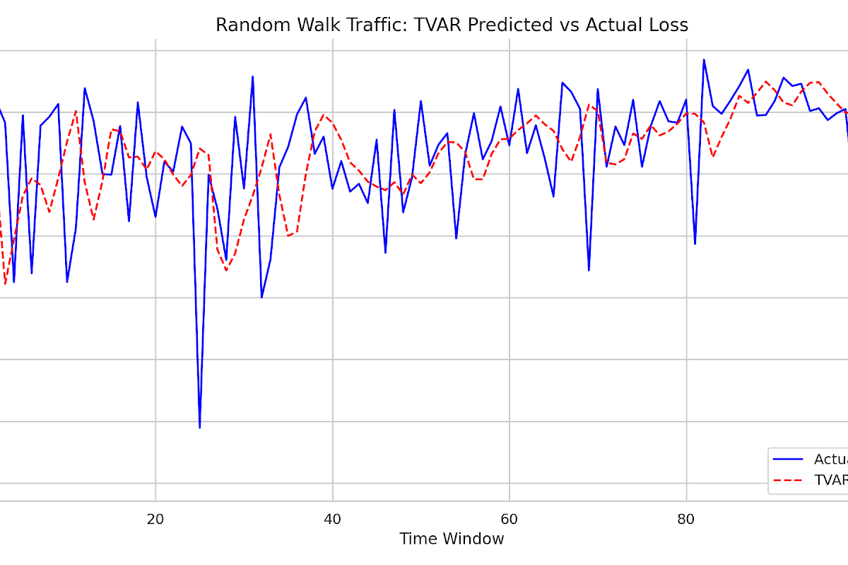
PERFORMANCE OF TVAR MODEL IN TRAFFIC FLOWS
1) BASELINE FLOW
2) REGIME SWITCHING
3) RANDOM WALK
Metric Performance
Mean RMSE: 0.1710
Stable traffic flow model serving as the reference baseline for packet loss prediction.
Metric Performance
Mean RMSE: 0.1444
Adapts dynamically to high and low traffic rates, successfully modeling sudden shifts.
Metric Performance
Mean RMSE: 0.1388
Estimates AR coefficients continuously to track drifts and highly volatile environments.
Figure 3.1
Figure 3.2
Figure 3.3
Page 17

Slide 16
CONCLUSION
This research set out to address the challenge of packet loss in WMNs by designing and simulating a TVAR model for packet loss prediction. Simulation results confirmed that in highly volatile environments, the model successfully tracked the trends of the network and adapted to sudden regime shifts with minimal lag. By shifting the network management paradigm from reactive to proactive, this research contributes to the development of more resilient, cost-effective, and reliable wireless infrastructure, paving the way for improved QoS in future smart grid and mesh deployments.
Page 18

Slide 17
REFERENCES
1] A. Albuero, Wireless Mesh Networks. Arcler Press, 2021.
[2] Grand View Research, "Wireless Mesh Network Market Size, Share & Trends Analysis Report By Radio Frequency (2.4 GHz, 5 GHz), By Application (Video Surveillance, Home Networking), By End-use (Oil & Gas, Mining), And Segment Forecasts, 2023 - 2030," Grand View Research, San Francisco, CA, Feb. 27, 2023. [Online]. Available: https://www.grandviewresearch.com/industry-analysis/wireless-mesh-network-wmn-market
[3] L. Davoli and G. Ferrari, Wireless Mesh Networks for IoT and Smart Cities. 2022.
[4] P. Shinde, Y. Kathane, E. Varpe, T. Jagtap, and P. Thakkar, “Performance Analysis of MANET Protocols: A Comparative Study of DSR, AODV, DSDV, and OLSR Based on Packet Delivery Ratio, Average Throughput, and Average Delay ,” vol. 11, no. 5, pp. 194–197, May 2024, doi: https://doi.org/10.17148/IARJSET.2024.11527.
[5] D. Thakre and S. Awaya, “Performance Study of AODV, OLSR, and DSDV Routing Protocols in Mobile AD HOC Networks,” vol. 10, no. 2, pp. 38–58, 2024, doi: https://doi.org/10.37628/IJMET.
[6] V. N. Katambire, R. Musabe, A. Uwitonze, and D. Mukanyiligira, “Forecasting the Traffic Flow by Using ARIMA and LSTM Models: Case of Muhima Junction,” Forecasting, vol. 5, no. 4, pp. 616–628, Dec. 2023, doi: https://doi.org/10.3390/forecast5040034.
Page 19

Slide 18
REFERENCES
[7] S. Bonthu, “Hybrid Traditional and Deep Learning Approaches for Network Traffic Forecasting with Real-Time Anomaly Detection,” A Comparative Study of ARIMA, LSTM, and ARIMA-LSTM Hybrid Model, May 2025.
[8] X. Wu, C. Wu, and P. Deng, “Prediction of Packet Loss Rate in Non-Stationary Networks Based on Time-Varying Autoregressive Sequences,” Electronics, vol. 12, no. 5, pp. 1103–1103, Feb. 2023, doi: https://doi.org/10.3390/electronics12051103.
[9] M. Najim Abdulleh and S. Yussof, “Performance Analysis of AODV, OLSR and GPSR MANET Routing Protocols with Respect to Network Size and Density,” Research Journal of Applied Sciences, Engineering and Technology, vol. 11, no. 4, pp. 400–406, Oct. 2015, doi: https://doi.org/10.19026/rjaset.11.1794.
[10] E. Owoeye, T. Komolafe, I. Oke, S. Adegbola, I. Adeyemo, and A. Saka, “Adaptive Hybrid Routing for Wireless Mesh Networks in Smart Grid,” 2025, doi: https://doi.org/10.2139/ssrn.5752382.
[11] Z. Jia and C. Zhang, “Time-Varying Autoregressive Models: A Novel Approach Using Physics-Informed Neural Networks,” Entropy, vol. 27, no. 9, p. 934, Sep. 2025, doi: https://doi.org/10.3390/e27090934.
[12] GeeksforGeeks, "Introduction of Mobile Ad hoc Network (MANET)," GeeksforGeeks, 2024.[Online].Available: https://www.geeksforgeeks.org/computer-networks/introduction-of-mobile-ad-hoc-network-manet/. [Accessed: June 14, 2026].
Page 20

Slide 19
REFERENCES
[13] J. M. B. Haslbeck, L. F. Bringmann, and L. J. Waldorp, “A tutorial on Estimating Time-Varying Vector Autoregressive Models,” Multivariate Behavioral Research, vol. 56, no. 1, pp. 120–149, Apr. 2020, doi: 10.1080/00273171.2020.1743630.
[14] R. Abduljabbar, H. Dia, P.-W. Tsai, and S. Liyanage, “Short-Term Traffic Forecasting: An LSTM Network for Spatial-Temporal Speed Prediction,” Future Transportation, vol. 1, no. 1, pp. 21–37, Mar. 2021, doi: 10.3390/futuretransp1010003.
[15] “Comparative Study of Routing Protocols,” vol. 13, no. 10, Oct. 2024.
[16] H. Yu, K. Zeng and P. Mohapatra, (2011). Measurement-Based Short-Term Performance Prediction in Wireless Mesh Networks. 2011 Proceedings of 20th International Conference on Computer Communications and Networks (ICCCN), pp.1–6. doi:https://doi.org/10.1109/icccn.2011.6005763.
[17] A. Mozo, B. Ordozgoiti, and S. Gómez-Canaval, “Forecasting short-term data center network traffic load with convolutional neural networks,” PLOS ONE, vol. 13, no. 2, p. e0191939, Feb. 2018, doi: https://doi.org/10.1371/journal.pone.0191939.
[18] J. Brownlee, Introduction to Time Series Forecasting With Python. Machine Learning Mastery, edition 1.9, 2020.
Page 21

Slide 20
REFERENCES
[19] D. A. Dugaev and E. Siemens, “A Wireless Mesh Network NS-3 Simulation Model: Implementation and Performance Comparison With a Real Test-Bed,” International Conference on Applied Innovation in IT, vol. 2, no. 1, Feb. 2019, doi: 10.13142/kt10002.01.
Page 22

Slide 21
THANK YOU

