Slide 1
RainGuage: Sprint 1
COS 101
Uwais Cornelius
4121659

Slide 2

Project Initiation
Vision
Stakeholders
Scrum Team
The vision for this project is to create a rainfall tracker app.
The app will be for users to input rainfall each day and it will keep track of it and provide analytics such as average and total rainfall.
The stakeholders include environmental enthusiasts, meteorologists, and farmers.
They could find this app useful to track patterns in the weather and monitor rainfall for research purposes or for practical use on a farm.
There are three parts to this team. The product owner is the founder of RainGuage. The scrum master is an experienced agile coach. The development team consists of app developers, to ensure that it is running smoothly, and UI designers so that it can be pleasing to the eye.

Slide 3
Product Backlog
User
Analytics
The user will be able to input their measurements for daily rainfall. This is an essential part of the app since it is the main purpose of the app.
These measurements should be displayed on a calendar to make the app easy to use and monitor.
The measurements of rainfall will be used to create a statistical analysis which will be displayed on the app. This can include charts showing the average rainfall for each week, month, or year. Another feature would be to display the total rainfall counter for the week, month, or year, as well as the number of days rained.

Slide 4
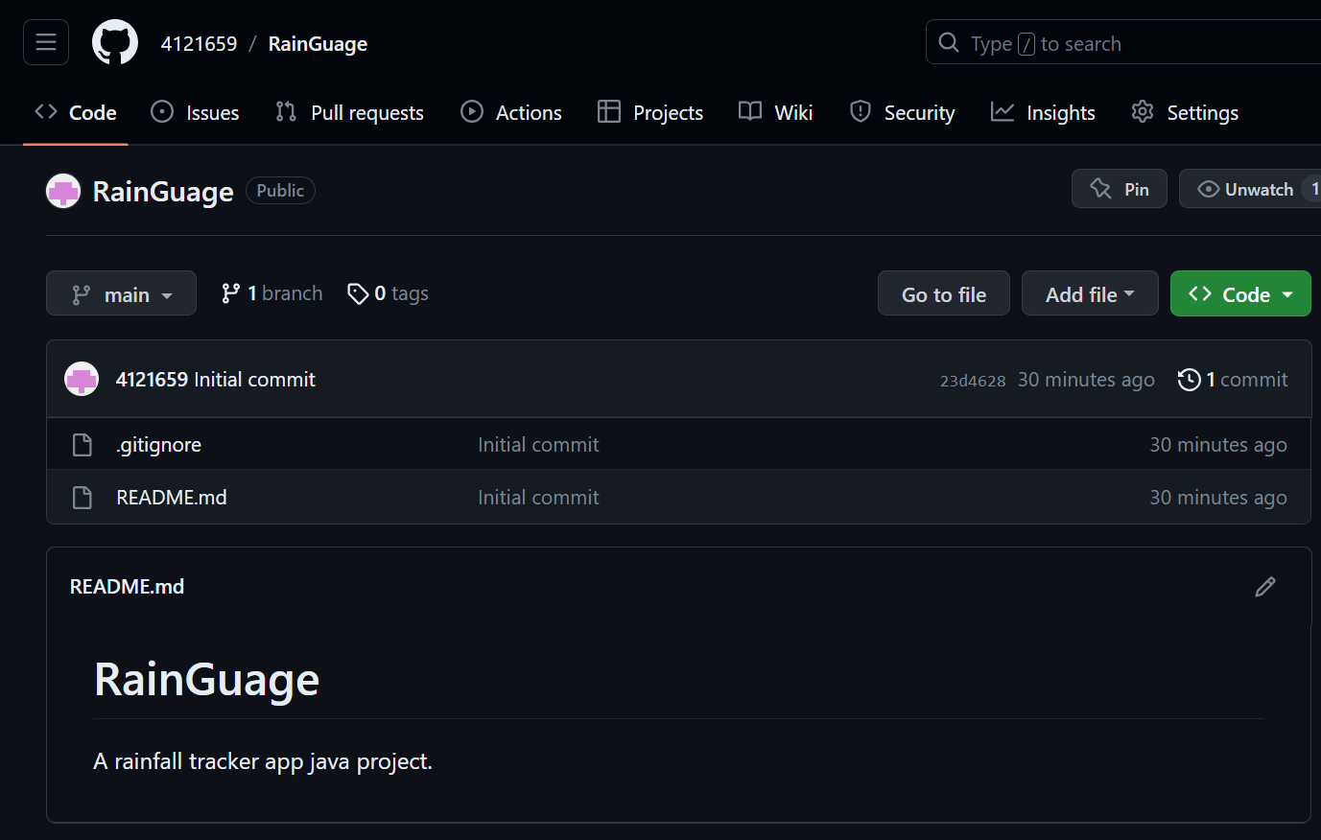
GitHub Repository
A GitHub repository was created to act as a host for the RainGuage rainfall tracker project.

Slide 5
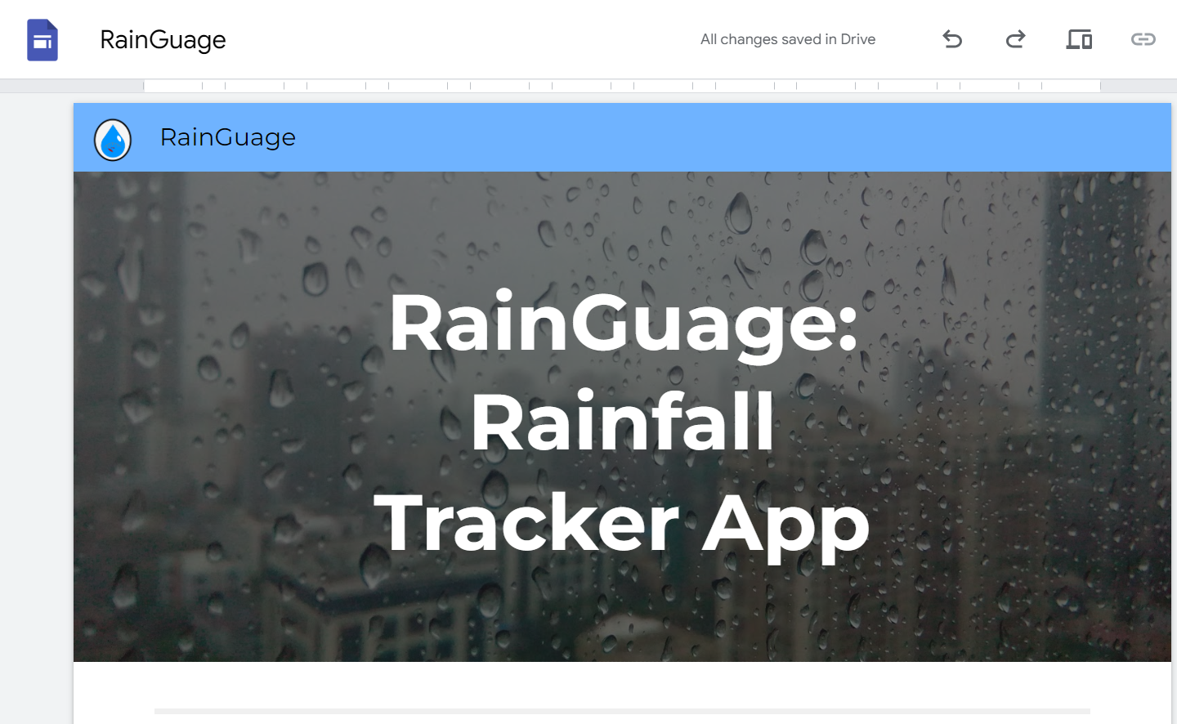
Google Site
A Google site was created to act as a medium with the purpose of informing the public about the app. Paint.net was used to create a logo for RainGuage.

