Slide 1
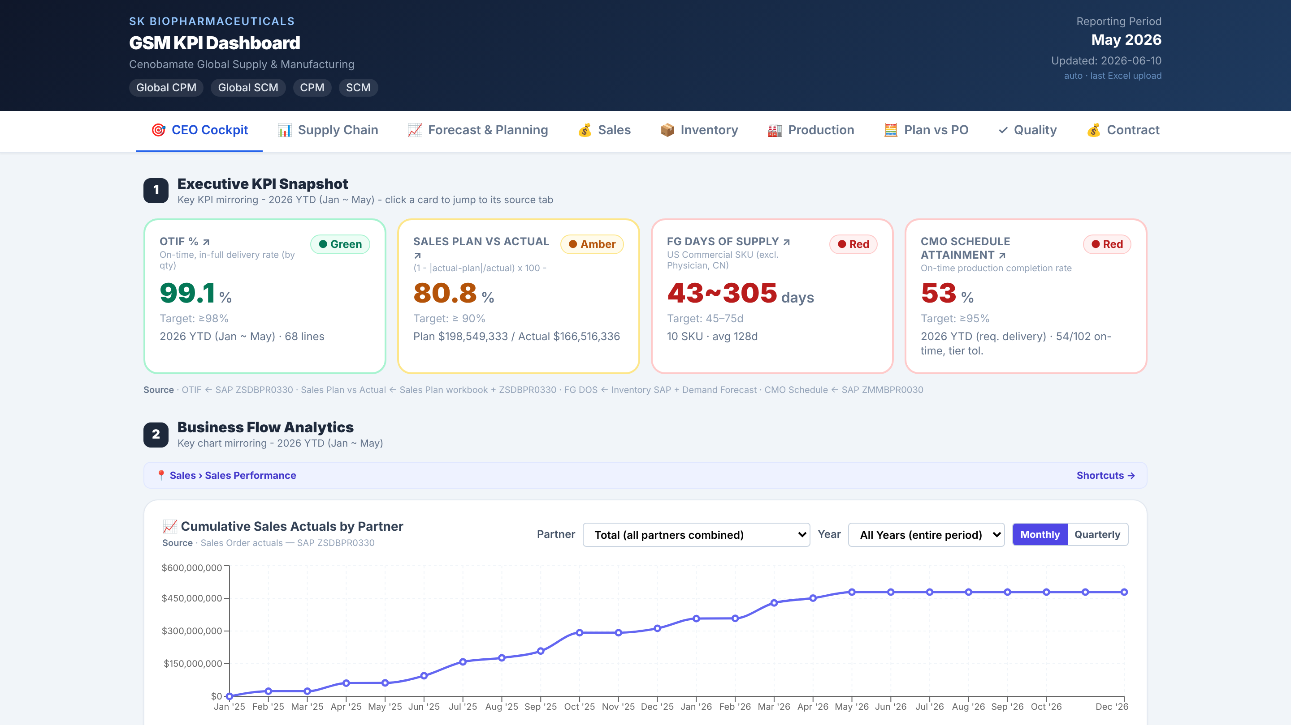
Notes:
CEO Cockpit

Slide 2
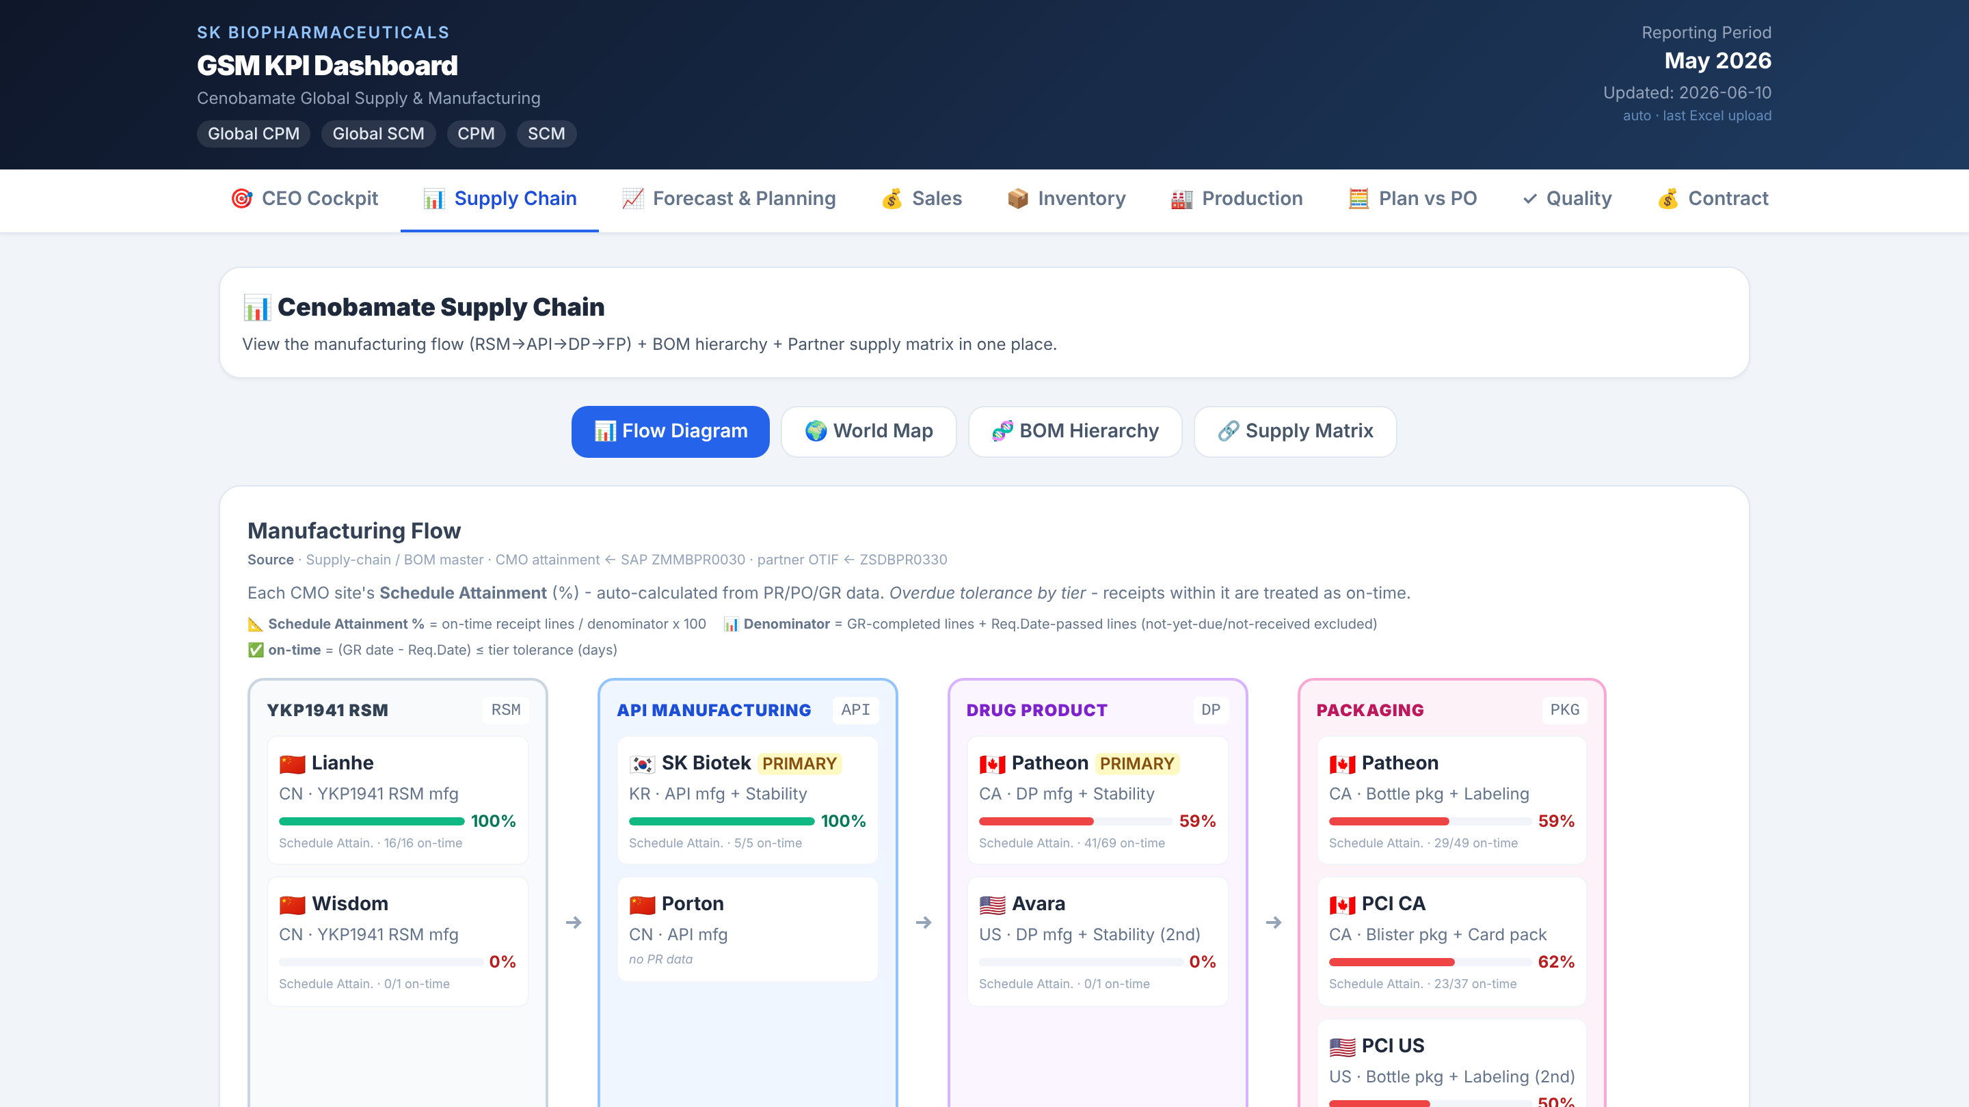
Notes:
Supply Chain

Slide 3
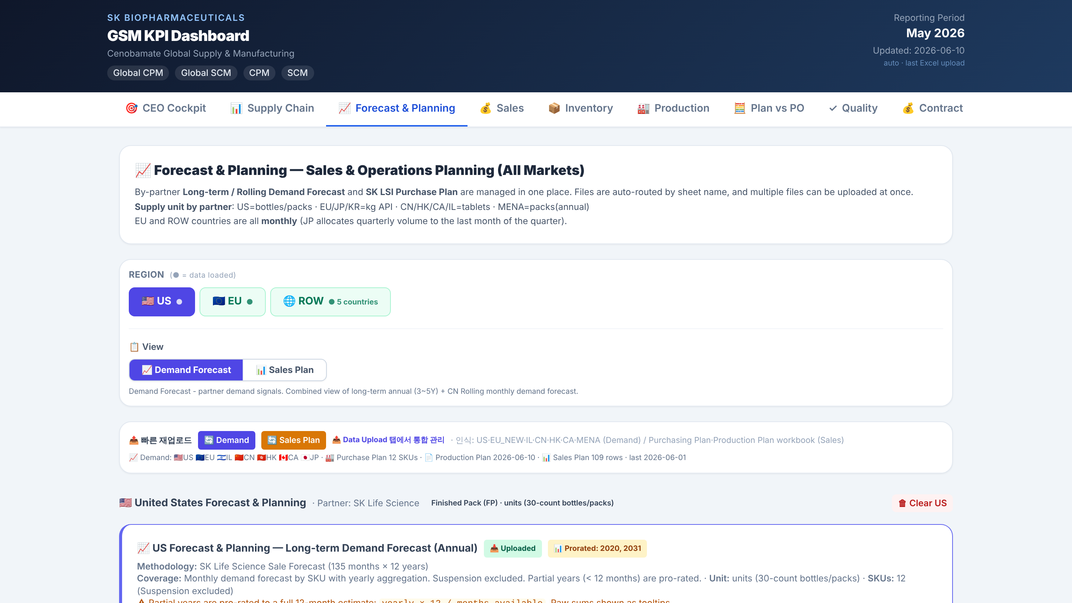
Notes:
Forecast & Planning

Slide 4
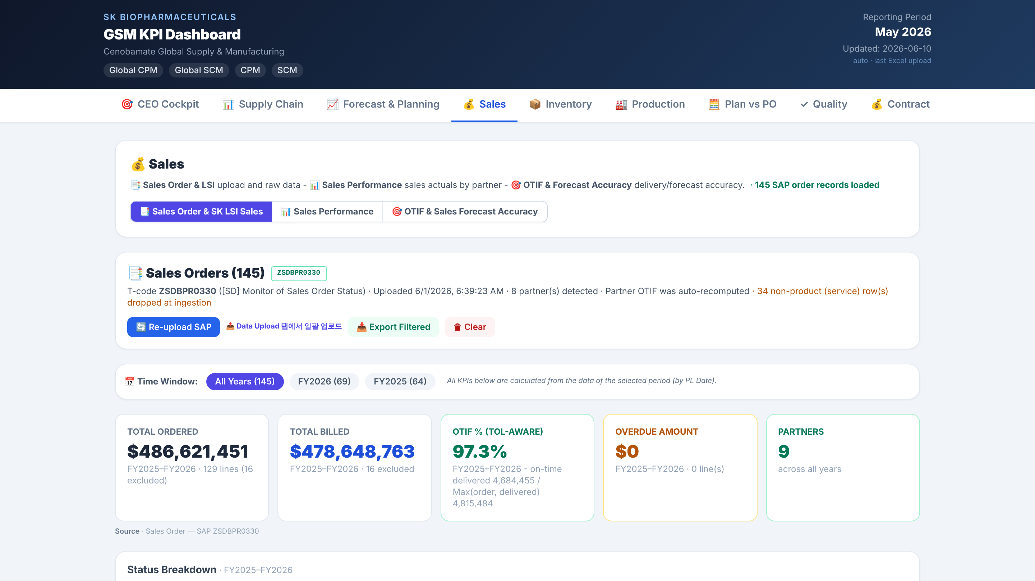
Notes:
Sales

Slide 5
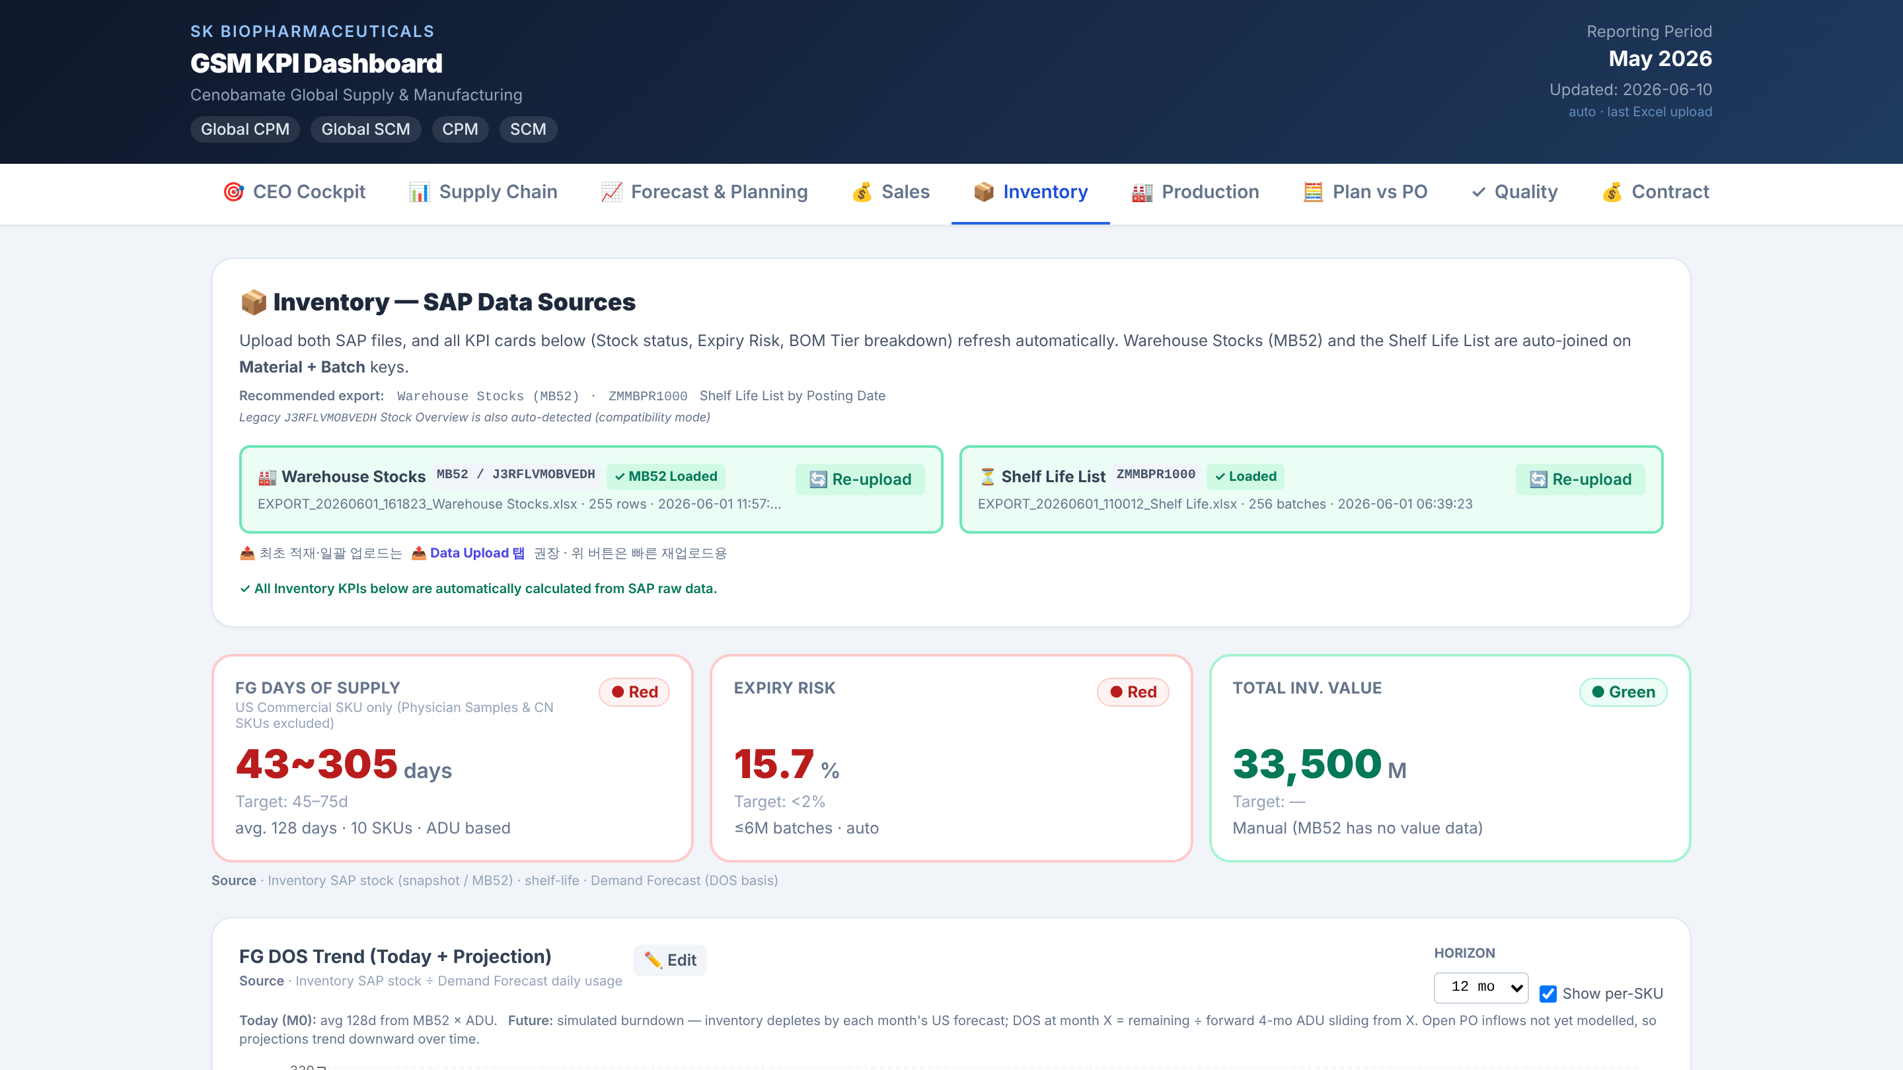
Notes:
Inventory

Slide 6
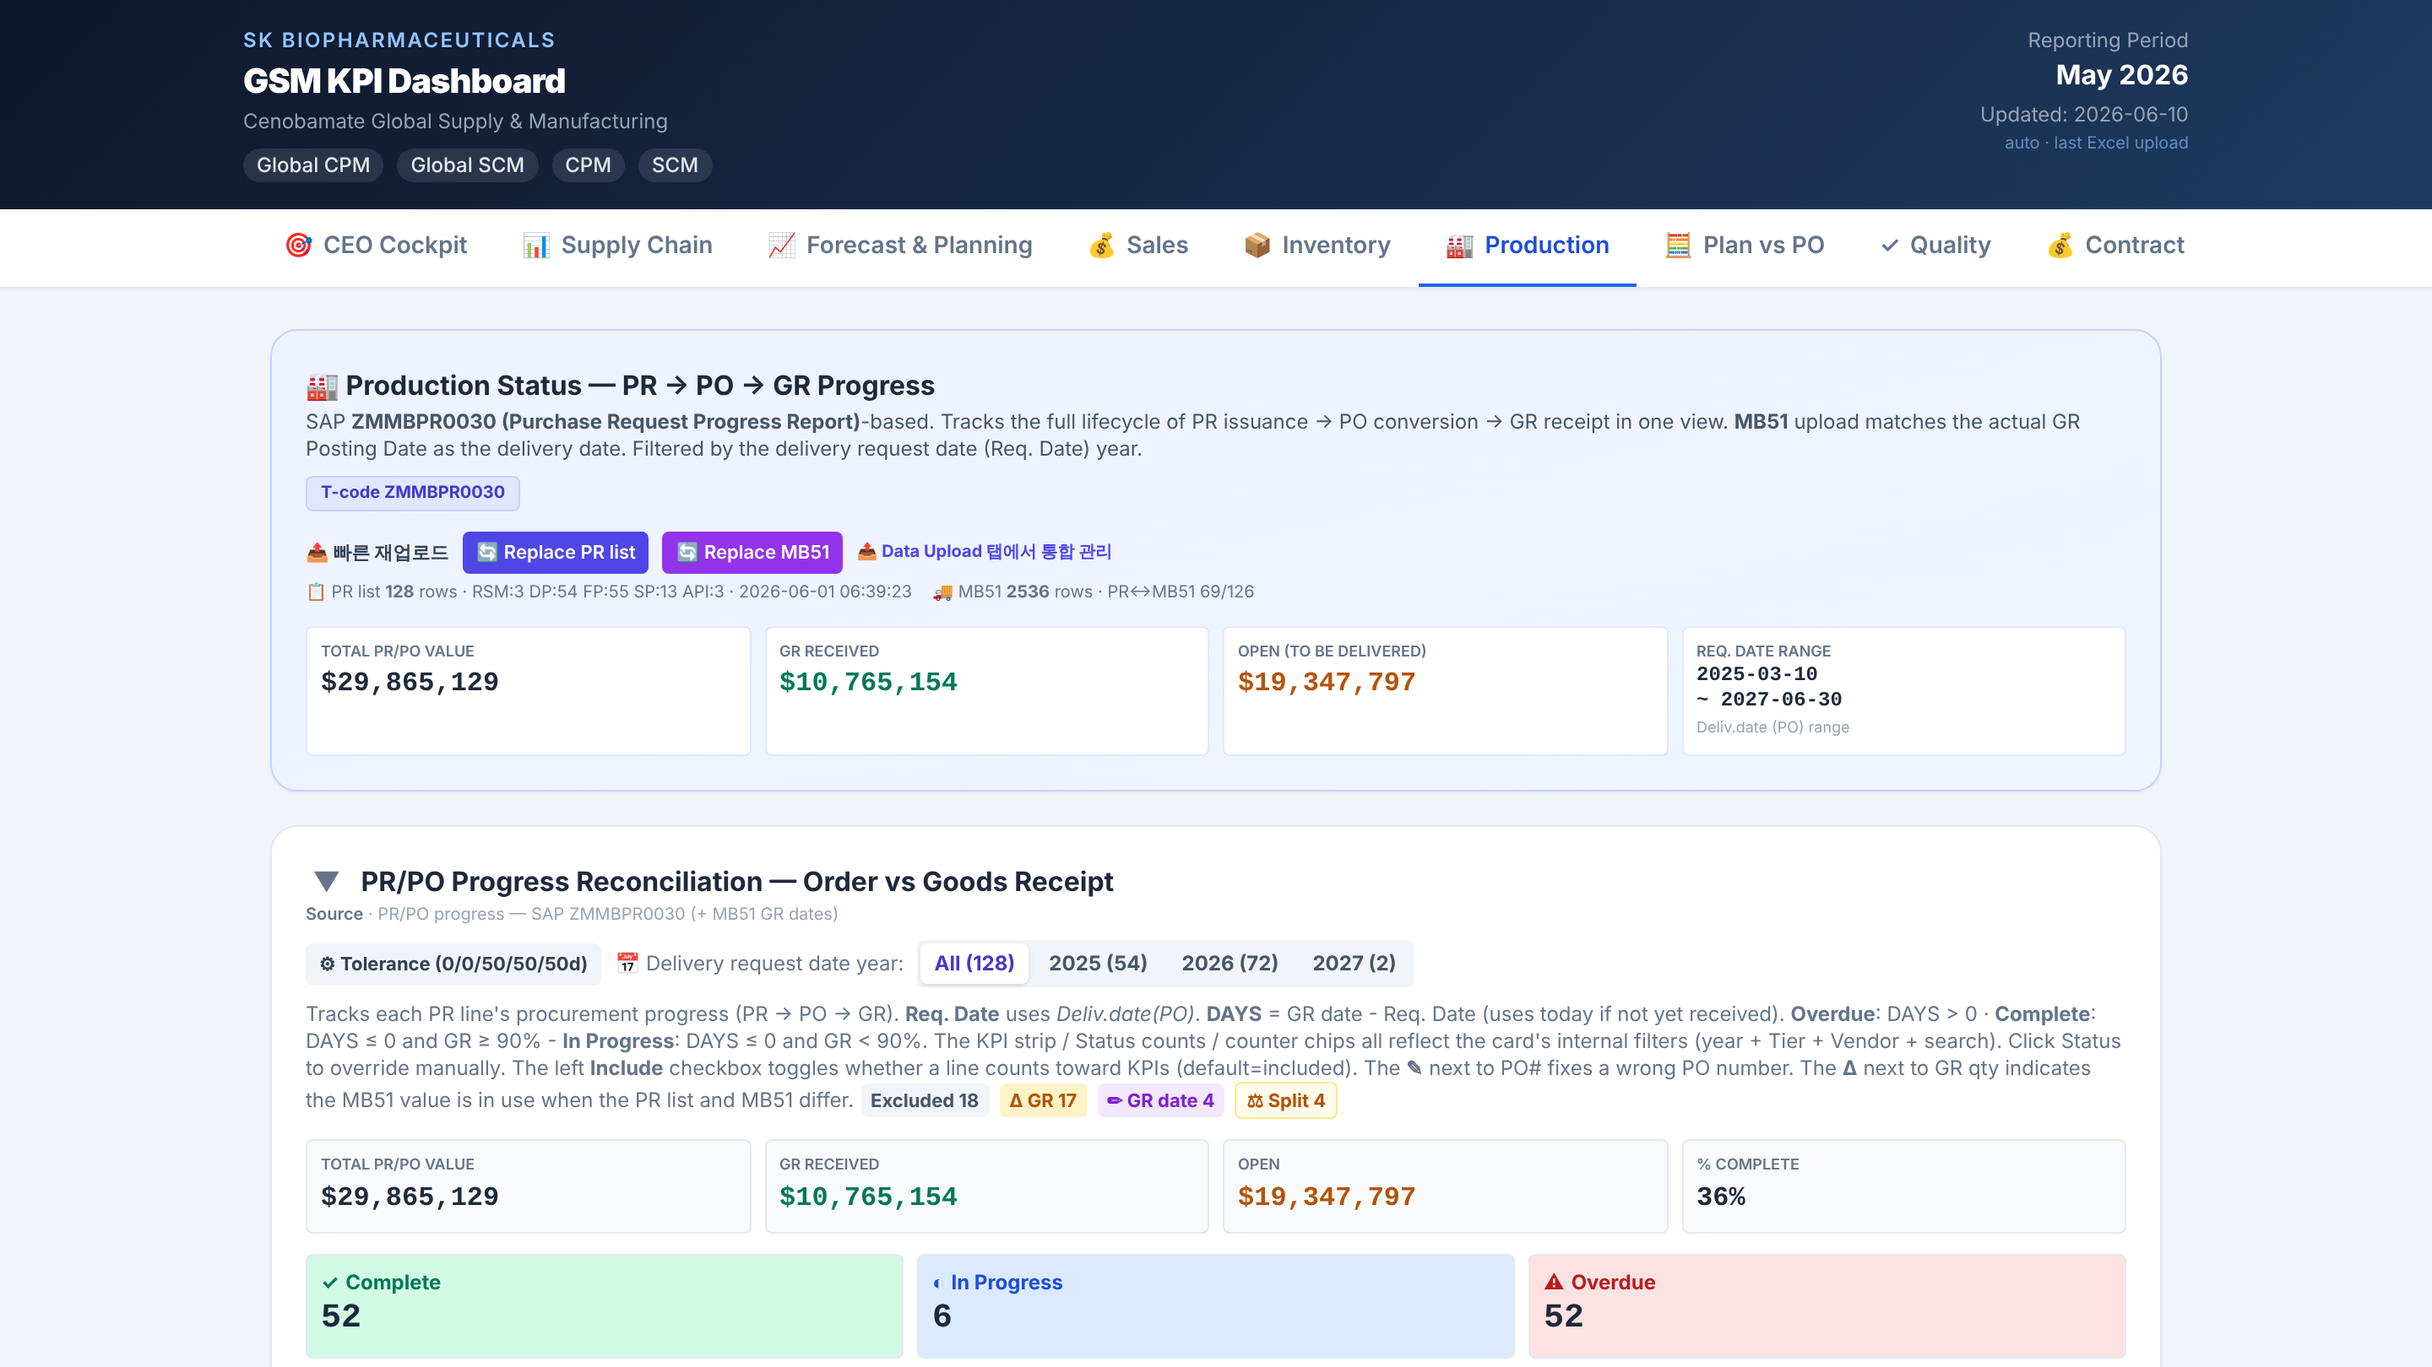
Notes:
Production

Slide 7
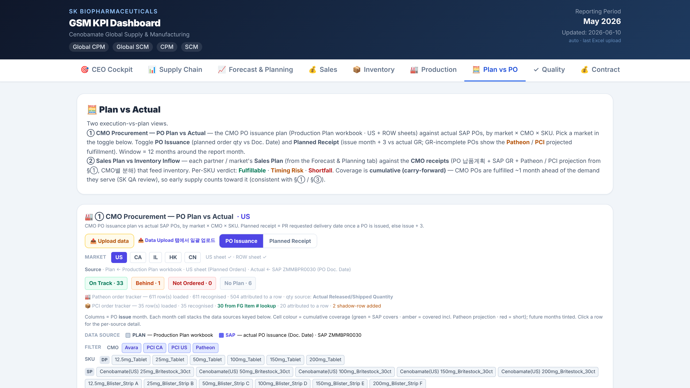
Notes:
Plan vs PO

Slide 8
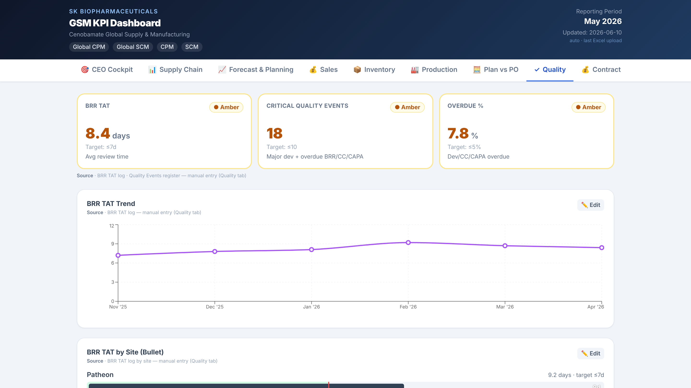
Notes:
Quality

Slide 9
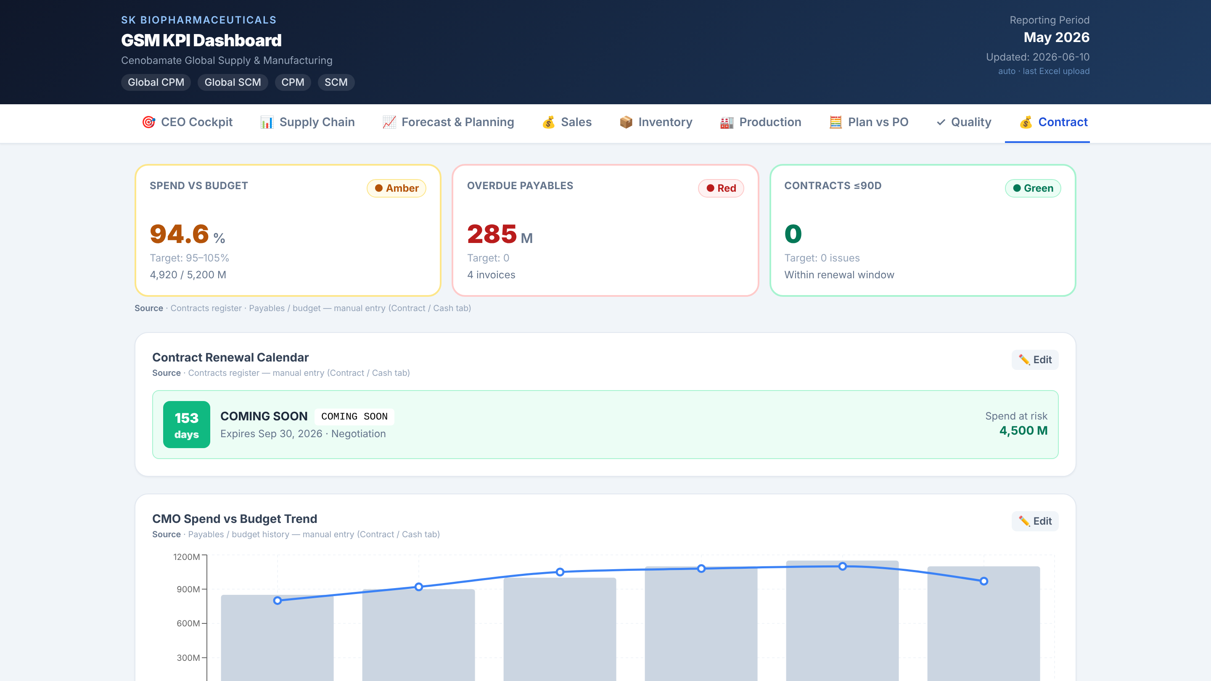
Notes:
Contract

Slide 10
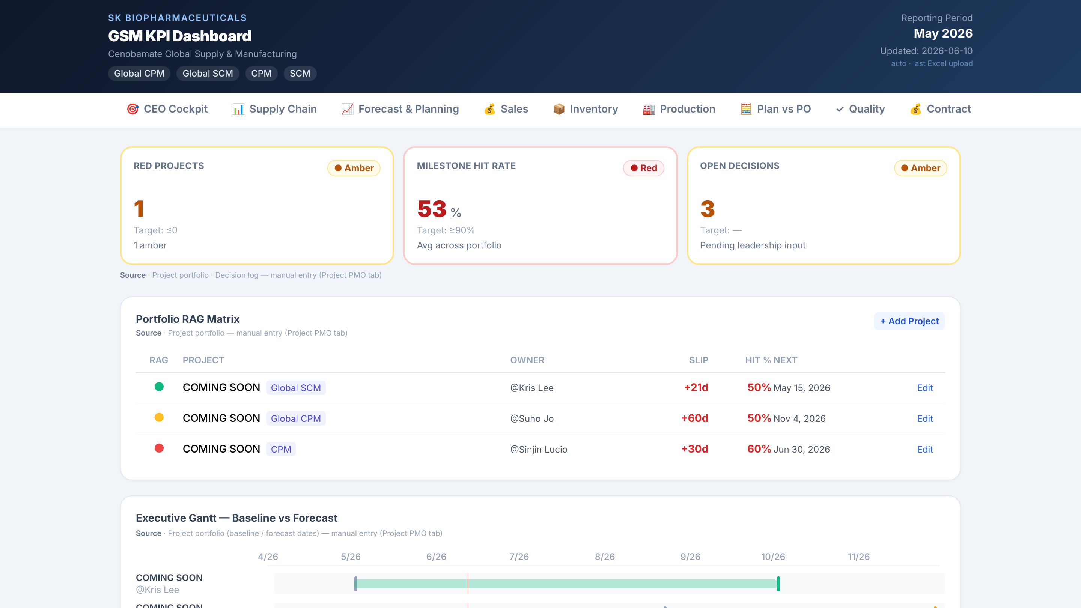
Notes:
Project PMO

Slide 11
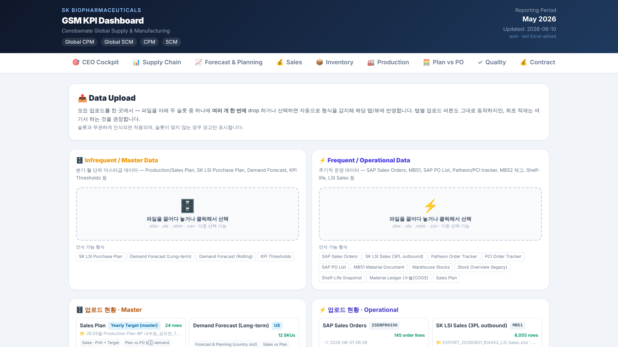
Notes:
Data Upload

Slide 12
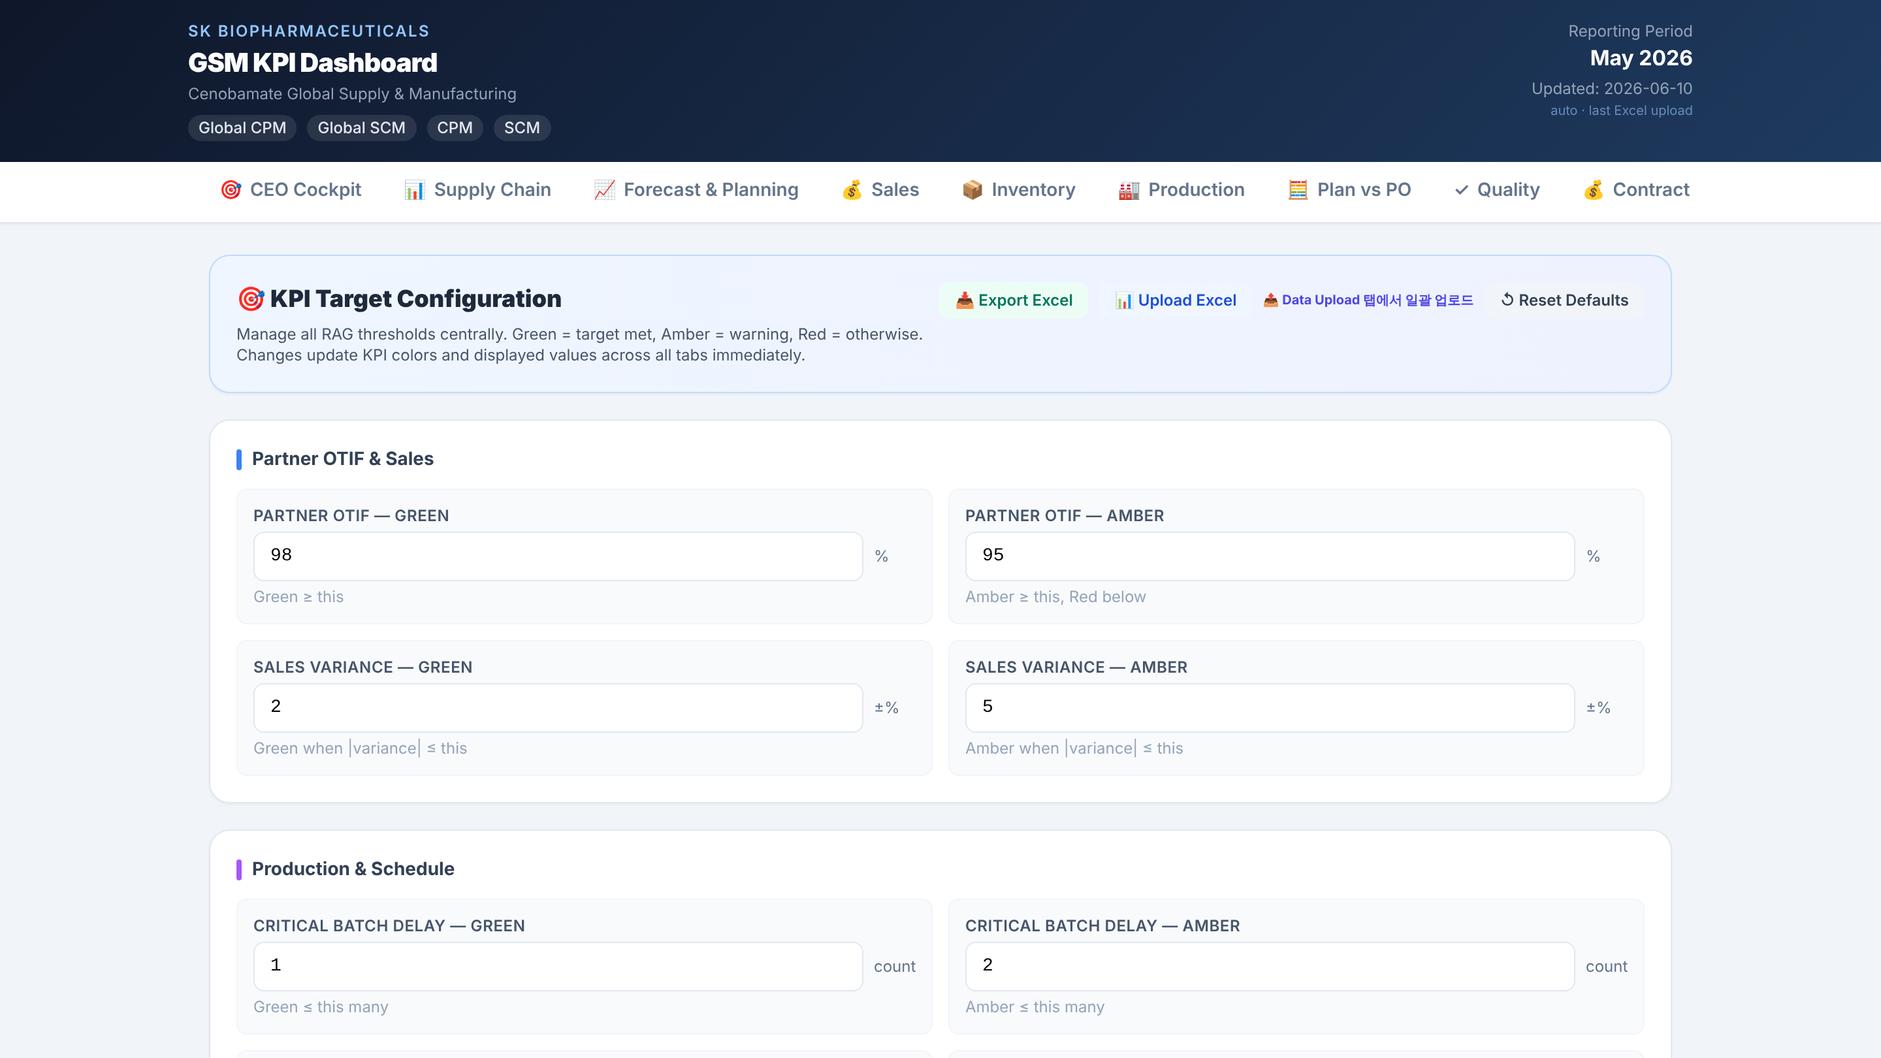
Notes:
KPI Targets

Slide 13
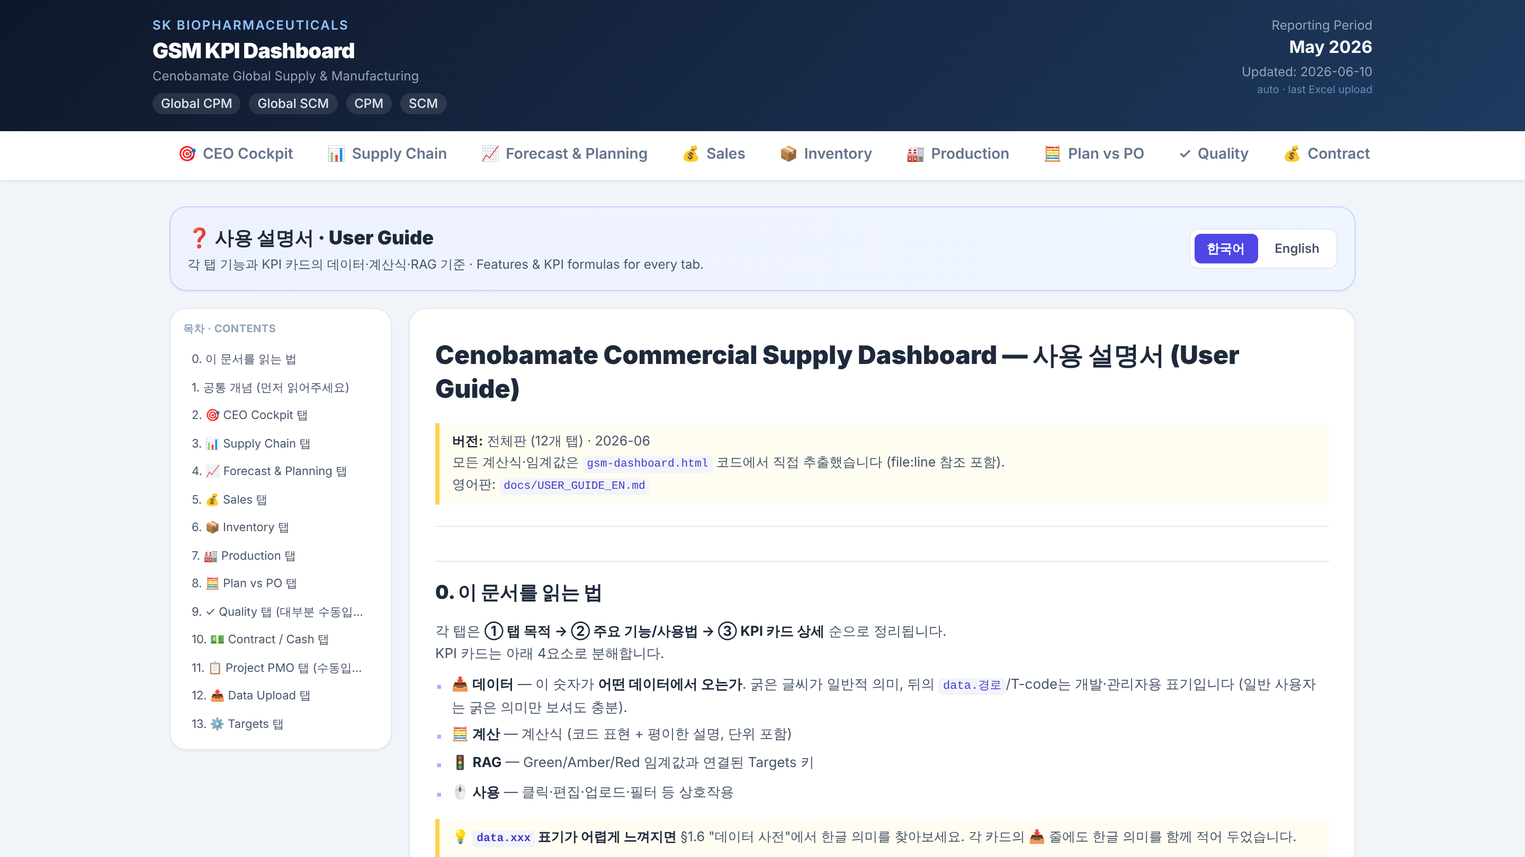
Notes:
User Guide

