Slide 1
邊緣人工智慧
Edge AI
Quantization
吳凱強
Kai-Chang Wu

Slide 2
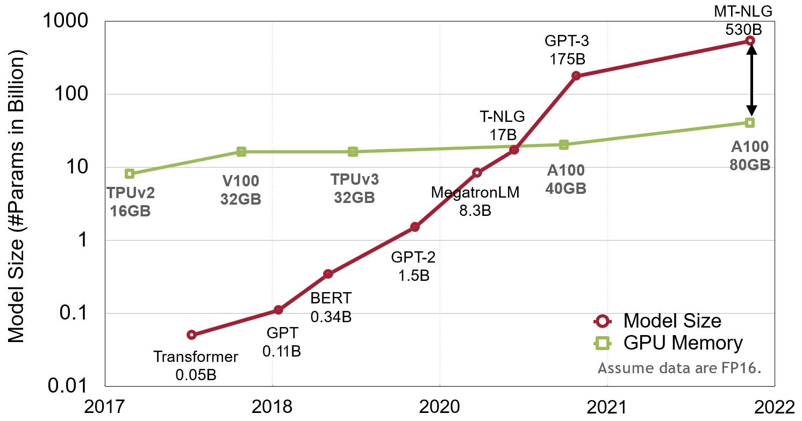
Deep Learning Continues to Scale

Slide 3
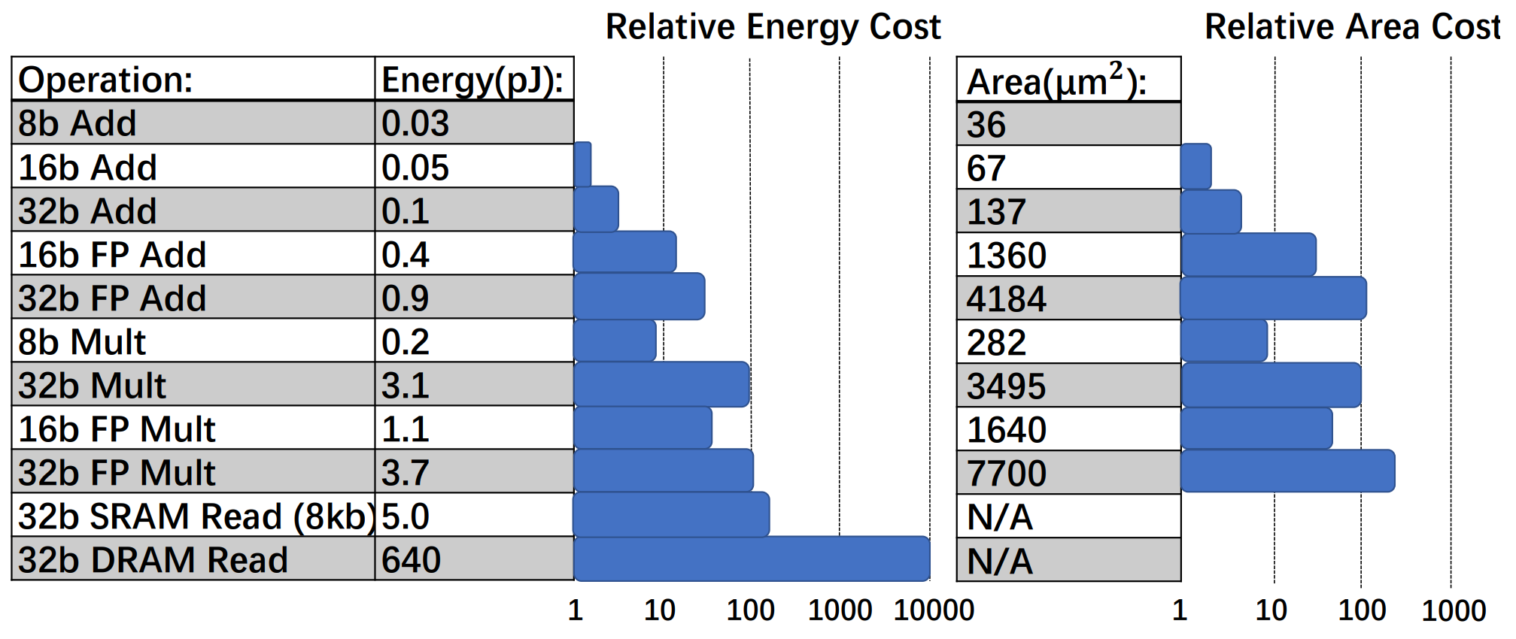






Low Bit-Width Operations are Much Cheaper
$$×30$$
$$×116$$
$$×18.5$$
$$×27.3$$
Computing's Energy Problem (and What We Can Do About it) [Horowitz, M., IEEE ISSCC 2014]

Slide 4
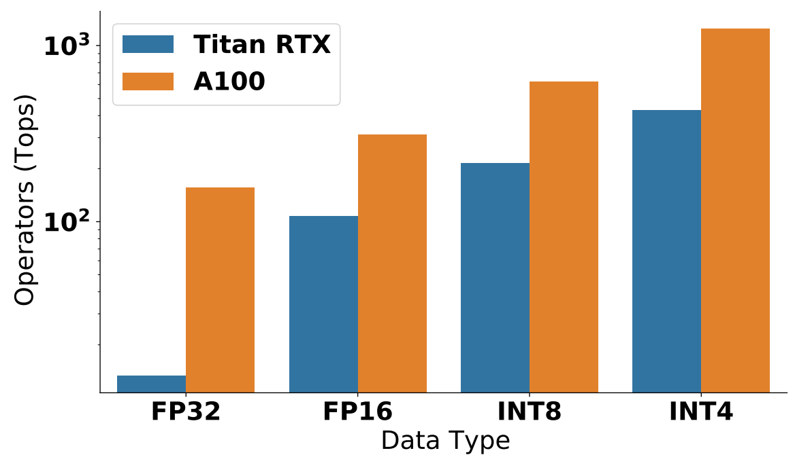
Peak Throughput Comparison: Titan RTX vs. A100

Slide 5
Outline
(Review) Numeric Data Types
Introduction to Quantization
Quantization Methods
  K-Means-based weight quantization
  Linear quantization
Post-Training Quantization (PTQ)
Quantization-Aware Training (QAT)

Slide 6
Numeric Data Types

Slide 7

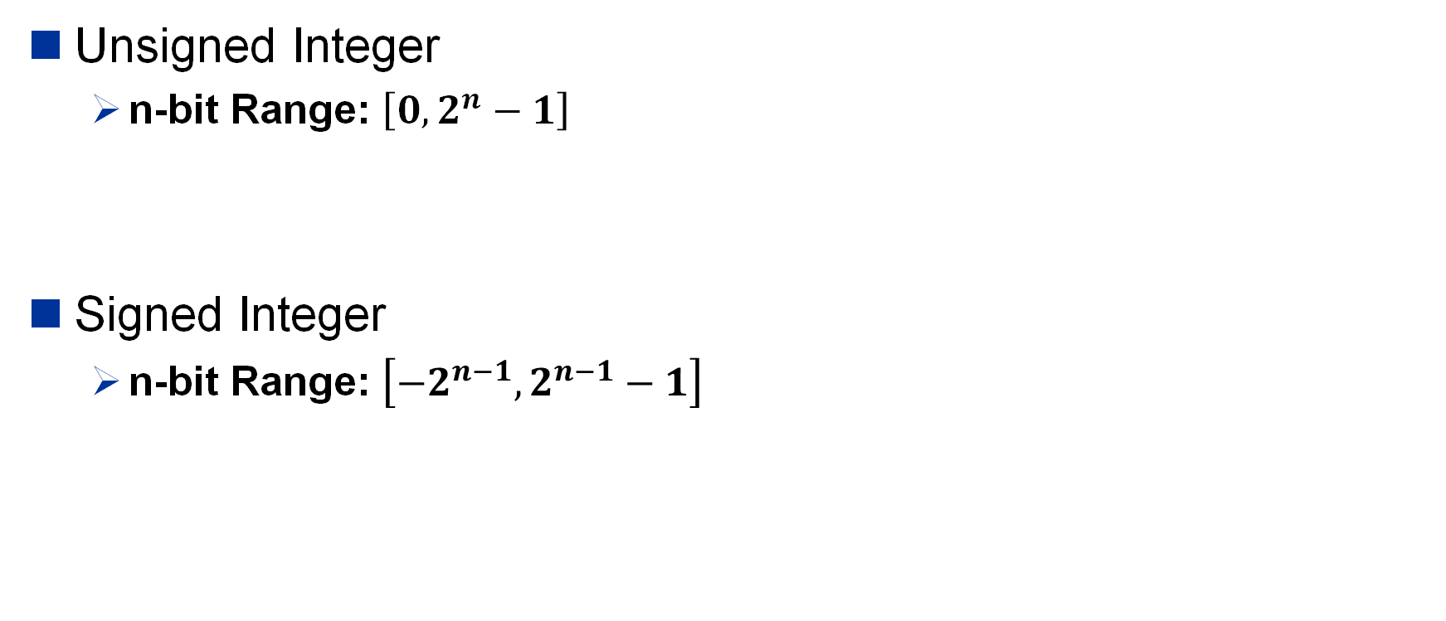






















Integer
Unsigned Integer
  n-bit Range: $\left[0,2^{n}−1\right]$
Signed Integer
  n-bit Range: $\left[{−2}^{n−1},2^{n−1}−1\right]$
UINT8
0 | 0 | 1 | 1 | 0 | 0 | 0 | 1
$$×$$
$$×$$
$$×$$
$$×$$
$$×$$
$$×$$
$$×$$
$$×$$
$$+$$
$$+$$
$$+$$
$$+$$
$$+$$
$$+$$
$$+$$
$$2^{7}$$
$$2^{6}$$
$$2^{5}$$
$$2^{4}$$
$$2^{3}$$
$$2^{2}$$
$$2^{1}$$
$$2^{0}$$
$$=49$$
Sign
INT8
1 | 0 | 1 | 1 | 0 | 0 | 0 | 1
$$×$$
$$×$$
$$×$$
$$×$$
$$×$$
$$×$$
$$×$$
$$×$$
$$+$$
$$+$$
$$+$$
$$+$$
$$+$$
$$+$$
$$+$$
$$=−49$$
$${−2}^{7}$$
$$2^{6}$$
$$2^{5}$$
$$2^{4}$$
$$2^{3}$$
$$2^{2}$$
$$2^{1}$$
$$2^{0}$$

Slide 8
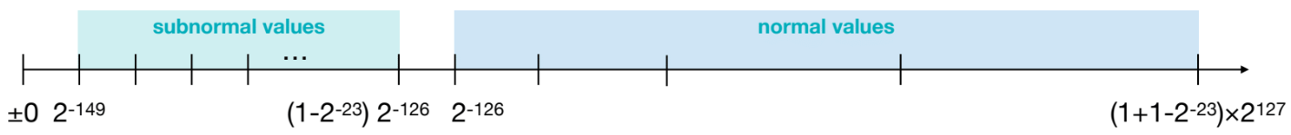



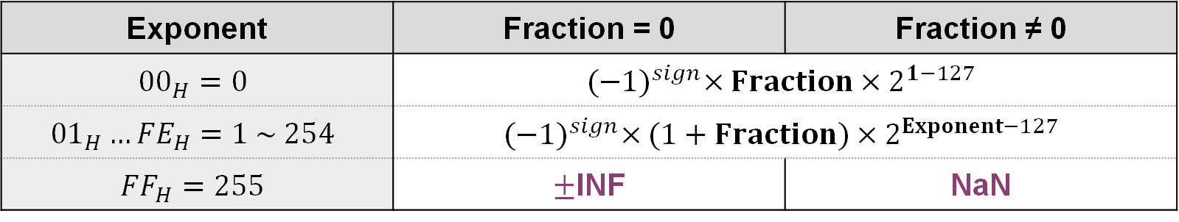




Floating-Point Number
FP32: IEEE 754 standard
$$2^{3}$$
$$2^{2}$$
$$2^{1}$$
$$2^{0}$$
$$2^{−1}$$
$$2^{−2}$$
$$2^{−3}$$
Sign
Exponent (8-bit)
Fraction
(23-bit)
Exponent | Fraction = 0 | Fraction ≠ 0
$${00}_{H}=0$$ | $${(−1)}^{sign}×Fraction×2^{1−127}$$
$${01}_{H}…{FE}_{H}=1 \sim 254$$ | $${(−1)}^{sign}×(1+Fraction)×2^{Exponent−127}$$
$${FF}_{H}=255$$ | $±$INF | NaN
(Exponent = 0)
(Exponent ≠ 0)

Slide 9

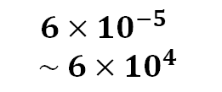




Floating-Point Number
Exponent width → Range, Fraction Width → Precision
Total bits
Range
IEEE 754 Single Precision 32-bit Float (IEEE FP32)
$$32$$
$${10}^{−38} \sim {10}^{38}$$
1
8
23
Sign
Exponent
Fraction
IEEE 754 Half Precision 16-bit Float (IEEE FP16)
$$6×{10}^{−5}$$
$$\sim 6×{10}^{4}$$
$$16$$
1
5
10
Google Brain Float (BF16)
$$16$$
$${10}^{−38} \sim {10}^{38}$$
1
8
7

Slide 10
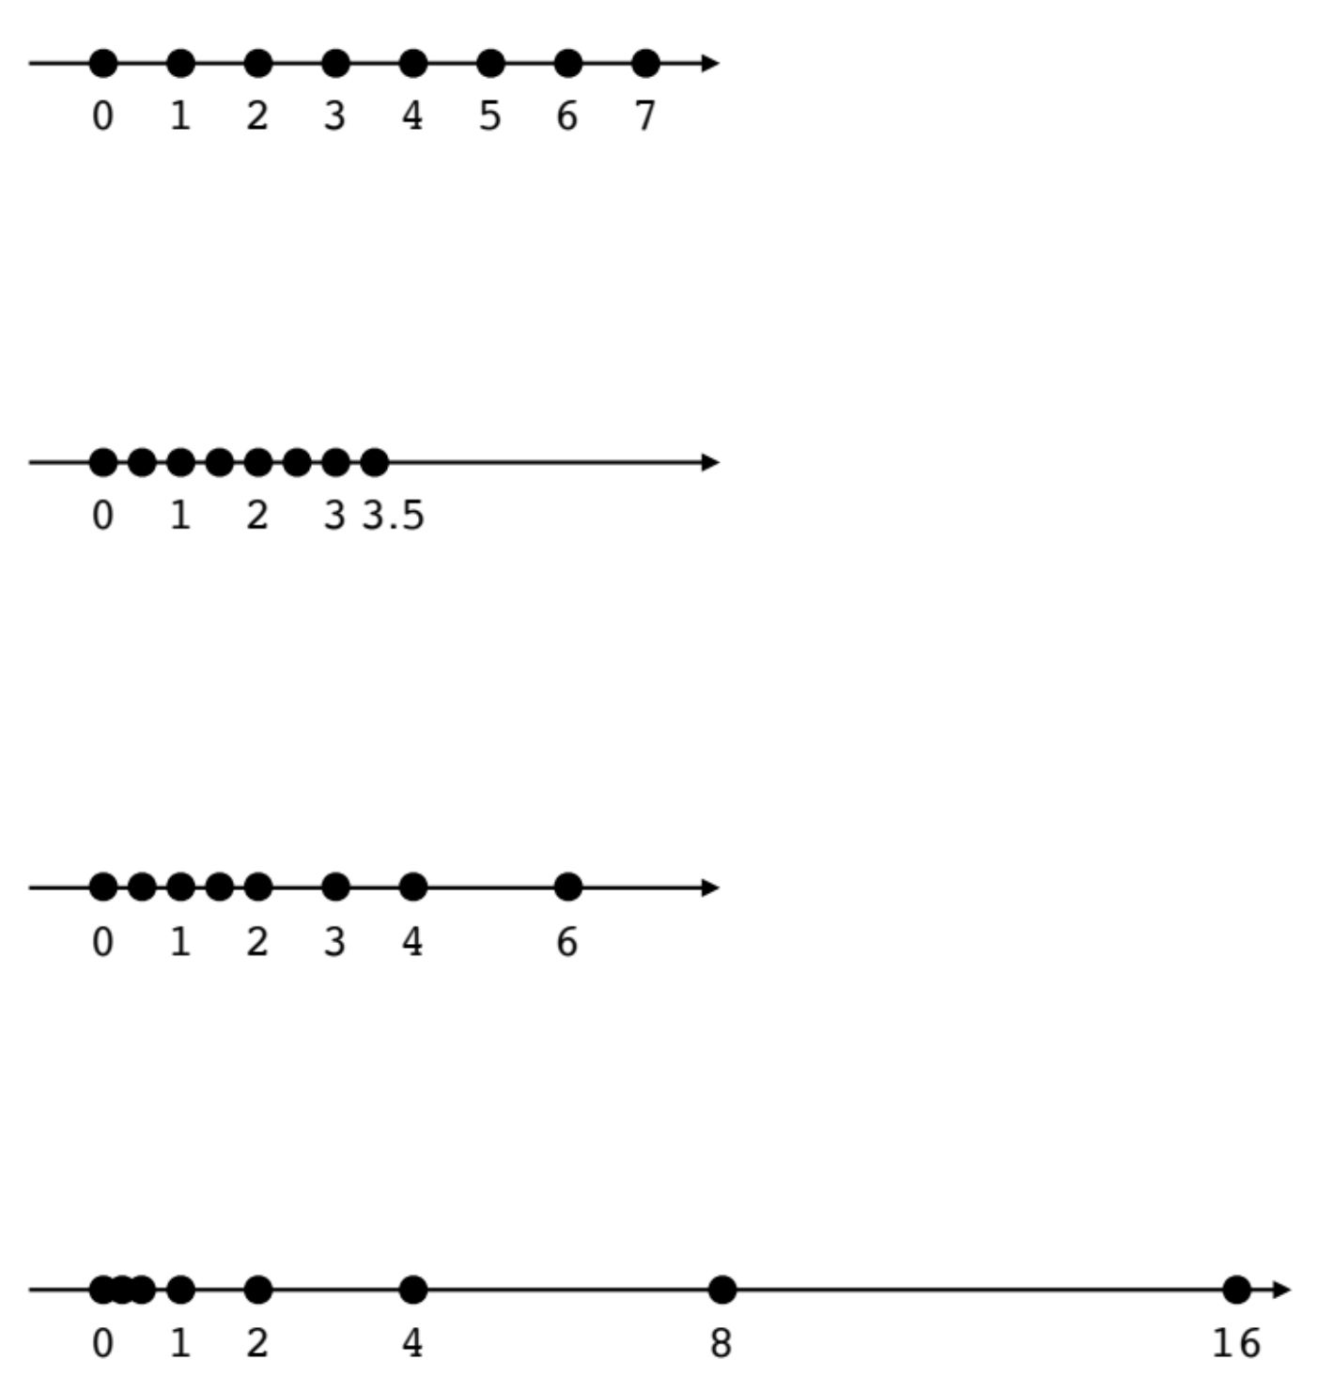







INT4 and FP4
Total bits
Range
INT4
S
$$4$$
$$−8 \sim 7$$
FP4 (E1M2)
S | E | M | M
$$4$$
$$−3.5 \sim 3.5$$
FP4 (E2M1)
S | E | E | M
$$4$$
$$−6 \sim 6$$
FP4 (E3M0)
S | E | E | E
$$4$$
$$−16 \sim 16$$

Slide 11
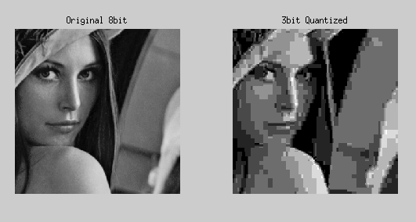
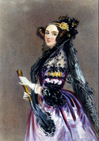
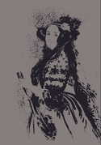
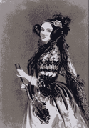
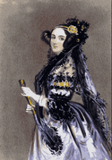
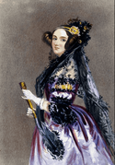
Introduction to Quantization
Original 8-bit
What is Quantization?
  Quantization is the process of mapping a large set of values
  into a smaller set of discrete finite values
(binning)
3-bit Quantized
Original
2 colors
5 colors
15 colors
100 colors

Slide 12
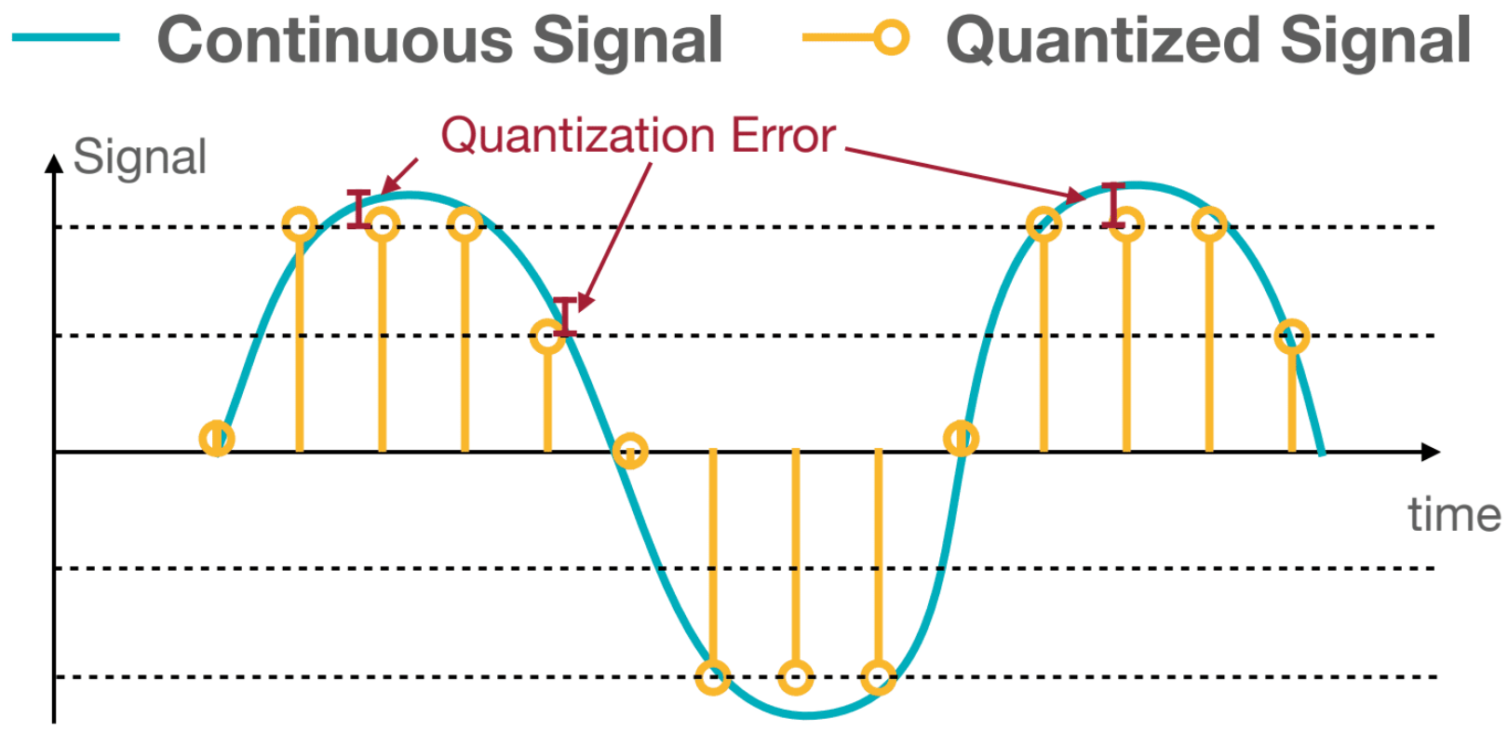
Introduction to Quantization
Original 8-bit
What is Quantization?
  Quantization is the process of mapping a large set of values
  into a smaller set of discrete finite values
(binning)
3-bit Quantized
The difference between an input value and its quantized value is referred to as quantization error.

Slide 13
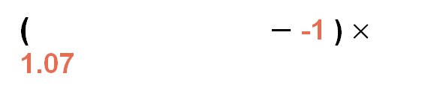
Quantization Methods
3 | 0 | 2 | 1
1 | 1 | 0 | 3
0 | 3 | 1 | 0
3 | 1 | 2 | 2
3:
2:
1:
0:
2.00
1.50
0.00
-1.00
1 | -2 | 0 | -1
-1 | -1 | -2 | 1
-2 | 1 | -1 | -2
1 | -1 | 0 | 0
2.09 | -0.98 | 1.48 | 0.09
0.05 | -0.14 | -1.09 | 2.12
-0.97 | 1.92 | 0 | -1.03
1.87 | 0 | 1.53 | 1.49
($−$ -1 ) $×$ 1.07
K-Means-based
Weight Quantization
Linear
Quantization
Storage | Floating-Point Weights
Computation | Floating-Point Arithmetic

Slide 14
Quantization Methods
3 | 0 | 2 | 1
1 | 1 | 0 | 3
0 | 3 | 1 | 0
3 | 1 | 2 | 2
3:
2:
1:
0:
2.00
1.50
0.00
-1.00
1 | -2 | 0 | -1
-1 | -1 | -2 | 1
-2 | 1 | -1 | -2
1 | -1 | 0 | 0
2.09 | -0.98 | 1.48 | 0.09
0.05 | -0.14 | -1.09 | 2.12
-0.97 | 1.92 | 0 | -1.03
1.87 | 0 | 1.53 | 1.49
($−$ -1 ) $×$ 1.07
K-Means-based
Weight Quantization
Linear
Quantization
Storage | Floating-Point Weights | Integer Weights; Floating-Point Codebook
Computation | Floating-Point Arithmetic | Floating-Point Arithmetic

Slide 15
K-Means-based
Weight Quantization
A look-up table mapping real numbers to integers

Slide 16
K-Means-based Weight Quantization
weights
(32-bit float)
2.09 | -0.98 | 1.48 | 0.09
0.05 | -0.14 | -1.09 | 2.12
-0.97 | 1.92 | 0 | -1.03
1.87 | 0 | 1.53 | 1.49
Deep Compression [Han et al., ICLR 2016]

Slide 17
K-Means-based Weight Quantization
weights
(32-bit float)
cluster index
(2-bit int)
reconstructed weights
(32-bit float)
centroids
2.09 | -0.98 | 1.48 | 0.09
0.05 | -0.14 | -1.09 | 2.12
-0.97 | 1.92 | 0 | -1.03
1.87 | 0 | 1.53 | 1.49
3 | 0 | 2 | 1
1 | 1 | 0 | 3
0 | 3 | 1 | 0
3 | 1 | 2 | 2
3:
2:
1:
0:
2.00
1.50
0.00
-1.00
2.00 | -1.00 | 1.50 | 0.00
0.00 | 0.00 | -1.00 | 2.00
-1.00 | 2.00 | 0.00 | -1.00
2.00 | 0.00 | 1.50 | 1.50
cluster
indexes
codebook
quantization error
0.09 | 0.02 | -0.02 | 0.09
0.05 | -0.14 | -0.08 | 0.12
-0.09 | -0.08 | 0 | -0.03
-0.13 | 0 | 0.03 | -0.01
Deep Compression [Han et al., ICLR 2016]

Slide 18
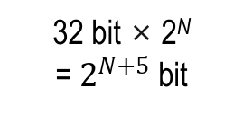
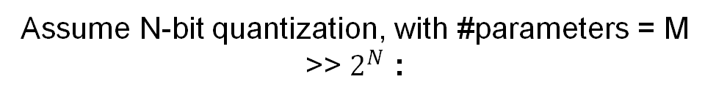
K-Means-based Weight Quantization
weights
(32-bit float)
cluster index
(2-bit int)
reconstructed weights
(32-bit float)
centroids
2.09 | -0.98 | 1.48 | 0.09
0.05 | -0.14 | -1.09 | 2.12
-0.97 | 1.92 | 0 | -1.03
1.87 | 0 | 1.53 | 1.49
3 | 0 | 2 | 1
1 | 1 | 0 | 3
0 | 3 | 1 | 0
3 | 1 | 2 | 2
3:
2:
1:
0:
2.00
1.50
0.00
-1.00
2.00 | -1.00 | 1.50 | 0.00
0.00 | 0.00 | -1.00 | 2.00
-1.00 | 2.00 | 0.00 | -1.00
2.00 | 0.00 | 1.50 | 1.50
cluster
indexes
codebook
Storage:
(required bits)
32 bit × 16
= 512 bit
2 bit × 16
= 32 bit
32 bit × 4
= 128 bit
quantization error
160 bit
0.09 | 0.02 | -0.02 | 0.09
0.05 | -0.14 | -0.08 | 0.12
-0.09 | -0.08 | 0 | -0.03
-0.13 | 0 | 0.03 | -0.01
× 3.2 smaller
Assume N-bit quantization, with #parameters = M >> $2^{N}$ :
32 bit × M
= 32M bit
N bit × M
= NM bit
32 bit × 2^{N}
= $2^{N+5}$ bit
× 32/N smaller
ignore
Deep Compression [Han et al., ICLR 2016]

Slide 19
Fine-tuning quantized weights (updating codebook):
weights
(32-bit float)
cluster index
(2-bit int)
centroids
2.09 | -0.98 | 1.48 | 0.09
0.05 | -0.14 | -1.09 | 2.12
-0.97 | 1.92 | 0 | -1.03
1.87 | 0 | 1.53 | 1.49
3 | 0 | 2 | 1
1 | 1 | 0 | 3
0 | 3 | 1 | 0
3 | 1 | 2 | 2
3:
2:
1:
0:
2.00
1.50
0.00
-1.00
1.96
1.48
-0.04
-0.97
cluster
update codebook
gradient
-0.03 | -0.01 | 0.03 | 0.02
-0.01 | 0.01 | -0.02 | 0.12
-0.01 | 0.02 | 0.04 | 0.01
-0.07 | -0.02 | 0.01 | -0.02
-0.03 | 0.12 | 0.02 | -0.07
0.03 | 0.01 | -0.02
0.02 | -0.01 | 0.01 | 0.04 | -0.02
-0.01 | -0.02 | -0.01 | 0.01
2.00
1.50
0.00
-1.00
backprop
group by
reduce
Deep Compression [Han et al., ICLR 2016]

Slide 20




On Inference Time:
$$float$$
output
RELU
weights
(32-bit float)
cluster index
(2-bit int)
centroids
bias
$$float$$
$$+$$
2.00 | -1.00 | 1.50 | 0.00
0.00 | 0.00 | -1.00 | 2.00
-1.00 | 2.00 | 0.00 | -1.00
2.00 | 0.00 | 1.50 | 1.50
3 | 0 | 2 | 1
1 | 1 | 0 | 3
0 | 3 | 1 | 0
3 | 1 | 2 | 2
3:
2:
1:
0:
2.00
1.50
0.00
-1.00
$$float$$
decode
Conv
$$float$$
$$float$$
input
weight
$$float$$
decode
$$uint$$
During Computation
In Storage
quantized weights
codebook (float)
Weights are decompressed using a lookup table (i.e. codebook) on runtime inference.
“K-Means-based Weight Quantization” only saves storage cost.
  All computation & memory access are still floating-points.
Deep Compression [Han et al., ICLR 2016]

Slide 21
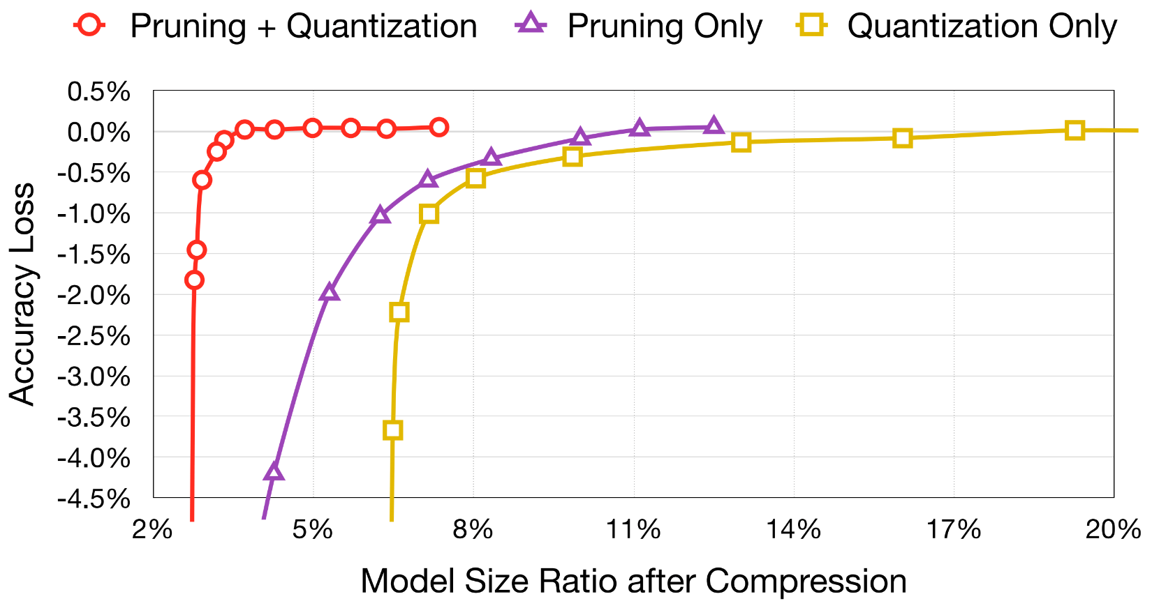
Accuracy vs. compression rate for AlexNet on ImageNet dataset
Deep Compression [Han et al., ICLR 2016]

Slide 22
Quantization Methods
3 | 0 | 2 | 1
1 | 1 | 0 | 3
0 | 3 | 1 | 0
3 | 1 | 2 | 2
3:
2:
1:
0:
2.00
1.50
0.00
-1.00
1 | -2 | 0 | -1
-1 | -1 | -2 | 1
-2 | 1 | -1 | -2
1 | -1 | 0 | 0
2.09 | -0.98 | 1.48 | 0.09
0.05 | -0.14 | -1.09 | 2.12
-0.97 | 1.92 | 0 | -1.03
1.87 | 0 | 1.53 | 1.49
($−$ -1 ) $×$ 1.07
K-Means-based
Weight Quantization
Linear
Quantization
Storage | Floating-Point Weights | Integer Weights; Floating-Point Codebook
Computation | Floating-Point Arithmetic | Floating-Point Arithmetic

Slide 23
Quantization Methods
3 | 0 | 2 | 1
1 | 1 | 0 | 3
0 | 3 | 1 | 0
3 | 1 | 2 | 2
3:
2:
1:
0:
2.00
1.50
0.00
-1.00
1 | -2 | 0 | -1
-1 | -1 | -2 | 1
-2 | 1 | -1 | -2
1 | -1 | 0 | 0
2.09 | -0.98 | 1.48 | 0.09
0.05 | -0.14 | -1.09 | 2.12
-0.97 | 1.92 | 0 | -1.03
1.87 | 0 | 1.53 | 1.49
($−$ -1 ) $×$ 1.07
K-Means-based
Weight Quantization
Linear
Quantization
Storage | Floating-Point Weights | Integer Weights; Floating-Point Codebook | Integer Weights
Computation | Floating-Point Arithmetic | Floating-Point Arithmetic | Integer Arithmetic

Slide 24
Linear Quantization
Affine mapping between real numbers and integers

Slide 25
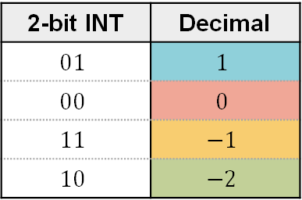
Linear Quantization
weights
(32-bit float)
2.09 | -0.98 | 1.48 | 0.09
0.05 | -0.14 | -1.09 | 2.12
-0.97 | 1.92 | 0 | -1.03
1.87 | 0 | 1.53 | 1.49
2-bit INT | Decimal
$$01$$ | $$1$$
$$00$$ | $$0$$
$$11$$ | $$−1$$
$$10$$ | $$−2$$

Slide 26
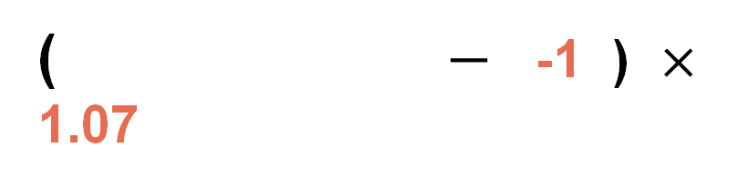
Linear Quantization
weights
(32-bit float)
quantized weights
(2-bit signed int)
zero point
(2-bit signed int)
scale
(32-bit float)
reconstructed weights
(32-bit float)
2.09 | -0.98 | 1.48 | 0.09
0.05 | -0.14 | -1.09 | 2.12
-0.97 | 1.92 | 0 | -1.03
1.87 | 0 | 1.53 | 1.49
1 | -2 | 0 | -1
-1 | -1 | -2 | 1
-2 | 1 | -1 | -2
1 | -1 | 0 | 0
2.14 | -1.07 | 1.07 | 0
0 | 0 | -1.00 | 2.14
-1.07 | 2.14 | 0 | -1.07
2.14 | 0 | 1.07 | 1.07
approx
( $−$ -1 ) $×$ 1.07
=
Affine mapping of integers to real numbers
quantization error
-0.05 | 0.09 | 0.41 | 0.09
0.05 | -0.14 | -0.01 | -0.12
0.16 | -0.08 | 0 | 0.04
-0.27 | 0 | 0.46 | 0.42
2-bit INT | Decimal
$$01$$ | $$1$$
$$00$$ | $$0$$
$$11$$ | $$−1$$
$$10$$ | $$−2$$

Slide 27
Linear Quantization
weights
(32-bit float)
quantized weights
(2-bit signed int)
zero point
(2-bit signed int)
scale
(32-bit float)
2.09 | -0.98 | 1.48 | 0.09
0.05 | -0.14 | -1.09 | 2.12
-0.97 | 1.92 | 0 | -1.03
1.87 | 0 | 1.53 | 1.49
1 | -2 | 0 | -1
-1 | -1 | -2 | 1
-2 | 1 | -1 | -2
1 | -1 | 0 | 0
approx
( $−$ -1 ) $×$ 1.07
$$r = \left( q − Z \right) × S$$
Floating-point
Integer
Integer
Floating-point
How to determine these values?

Slide 28















$$r = \left( q − Z \right) × S$$
Floating-point
Integer
Integer
Floating-point
$${r }_{min}$$
$$0$$
$${r }_{max}$$
$$r$$
floating-point range
$$q$$
3-bit Integer
$−$4
$−$3
$−$2
$$−1$$
$$0$$
$$1$$
$$2$$
$$3$$
$${\text{q} }_{min}$$
$${\text{q} }_{max}$$

Slide 29



$$r = \left( q − Z \right) × S$$
Floating-point
Integer
Integer
Floating-point
$${r }_{min}$$
$$0$$
$${r }_{max}$$
$$r$$
floating-point range
$$×S$$
$$q′$$
$$−Z$$
$$q$$
3-bit Integer
$−$4
$−$3
$−$2
$$−1$$
$$0$$
$$1$$
$$2$$
$$3$$
$${\text{q} }_{min}$$
$${\text{q} }_{max}$$

Slide 30

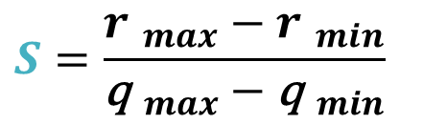




$$r = \left( q − Z \right) × S$$
Floating-point
Integer
Integer
Floating-point
$$S:$$
$${r }_{min}$$
$${r }_{max}$$
Calculate Scale
$$0$$
$$r$$
floating-point range
$$r=f(q)$$
$${r }_{max}=({\text{q} }_{max}−Z)×S$$
$$×S$$
$$−$$
$${r }_{min}=({\text{q} }_{min}−Z)×S$$
$$q′$$
$$S=\frac{{r }_{max}−{r }_{min}}{{\text{q} }_{max}−{\text{q} }_{min}}$$
$$−Z$$
$$q$$
3-bit Integer
$−$4
$−$3
$−$2
$$−1$$
$$0$$
$$1$$
$$2$$
$$3$$
$${\text{q} }_{min}$$
$${\text{q} }_{max}$$

Slide 31
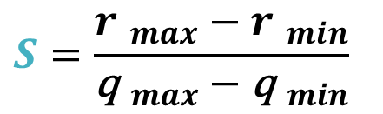

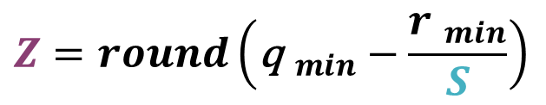

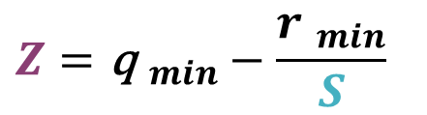
$$r = \left( q − Z \right) × S$$
Floating-point
Integer
Integer
Floating-point
$$S:$$
$${r }_{min}$$
$${r }_{max}$$
Calculate Scale
$$0$$
$$r$$
floating-point range
$$S=\frac{{r }_{max}−{r }_{min}}{{\text{q} }_{max}−{\text{q} }_{min}}$$
$$×S$$
Calculate Zero Point
$$Z:$$
$$q′$$
$${r }_{min}=\left({\text{q} }_{min}−Z\right)×S$$
$$−Z$$
$$Z={\text{q} }_{min}−\frac{{r }_{min}}{S}$$
$$q$$
3-bit Integer
$−$4
$−$3
$−$2
$$−1$$
$$0$$
$$1$$
$$2$$
$$3$$
$${\text{q} }_{min}$$
$${\text{q} }_{max}$$
$$Z=round\left({\text{q} }_{min}−\frac{{r }_{min}}{S}\right)$$

Slide 32
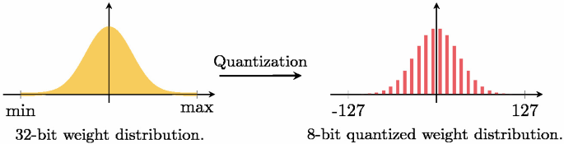

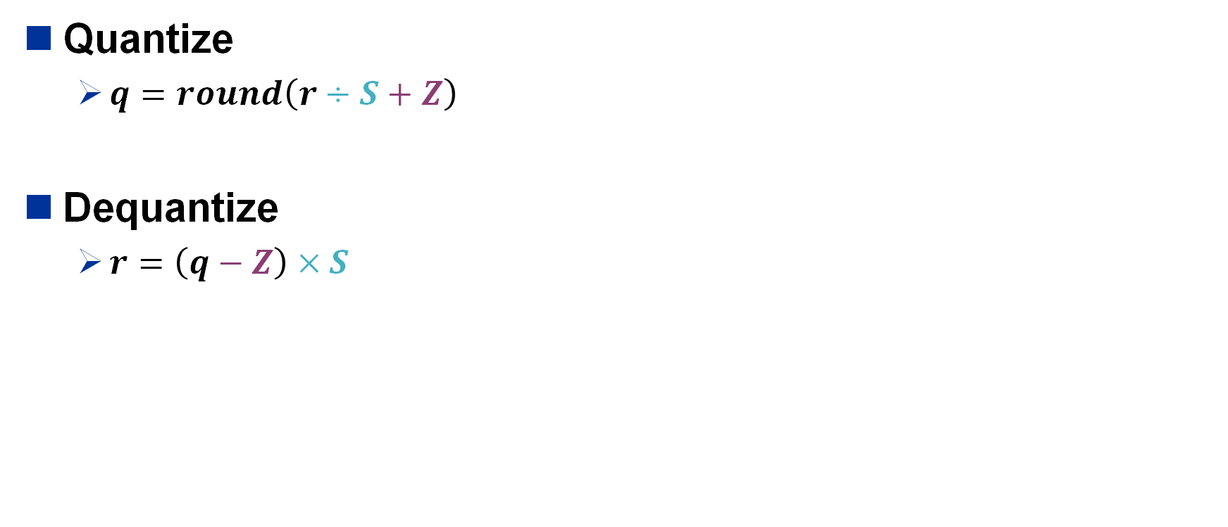



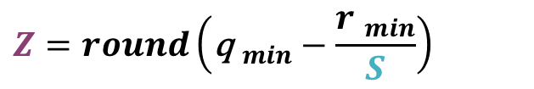

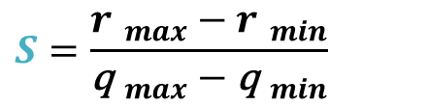

Linear Quantization
Quantize
  $q=round\left(r÷S+Z\right)$
Dequantize
  $r=\left(q−Z\right)×S$
Try to quantize the following matrix to 2-bit int:
$${\text{r} }_{min}=$$
$${\text{q} }_{min}=$$
2.09 | -0.98 | 1.48 | 0.09
0.05 | -0.14 | -1.09 | 2.12
-0.97 | 1.92 | 0 | -1.03
1.87 | 0 | 1.53 | 1.49
$${\text{r} }_{max}=$$
$${\text{q} }_{max}=$$
$$S=\frac{{r }_{max}−{r }_{min}}{{\text{q} }_{max}−{\text{q} }_{min}}$$
$$S=$$
$$Z=round\left({\text{q} }_{min}−\frac{{r }_{min}}{S}\right)$$
$$Z=$$

Slide 33

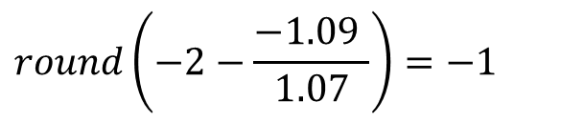
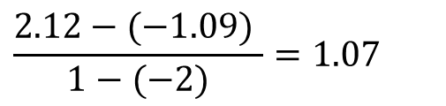



Linear Quantization
Quantize
  $q=round\left(r÷S+Z\right)$
Dequantize
  $r=\left(q−Z\right)×S$
Try to quantize the following matrix to 2-bit int:
$${\text{r} }_{min}=$$
$$−1.09$$
$${\text{q} }_{min}=$$
$$−2$$
2.09 | -0.98 | 1.48 | 0.09
0.05 | -0.14 | -1.09 | 2.12
-0.97 | 1.92 | 0 | -1.03
1.87 | 0 | 1.53 | 1.49
$${\text{r} }_{max}=$$
$$2.12$$
$${\text{q} }_{max}=$$
$$1$$
$$S=\frac{{r }_{max}−{r }_{min}}{{\text{q} }_{max}−{\text{q} }_{min}}$$
$$\frac{2.12−(−1.09) }{1−(−2)}=1.07$$
$$S=$$
$$Z=round\left({\text{q} }_{min}−\frac{{r }_{min}}{S}\right)$$
$$round\left(−2−\frac{−1.09 }{1.07}\right)=−1$$
$$Z=$$

Slide 34


Linear Quantization
Quantize
  $q=round\left(r÷S+Z\right)$
Dequantize
  $r=\left(q−Z\right)×S$
Try to quantize the following matrix to 2-bit int:
2.09 | -0.98 | 1.48 | 0.09
0.05 | -0.14 | -1.09 | 2.12
-0.97 | 1.92 | 0 | -1.03
1.87 | 0 | 1.53 | 1.49
1 | -2 | 0 | -1
-1 | -1 | -2 | 1
-2 | 1 | -1 | -2
1 | -1 | 0 | 0
quantize
$$S=\frac{{r }_{max}−{r }_{min}}{{\text{q} }_{max}−{\text{q} }_{min}}$$
$$S=1.07$$
$$Z=round\left({\text{q} }_{min}−\frac{{r }_{min}}{S}\right)$$
$$Z=−1$$

Slide 35









Integer-Arithmetic-Only Quantization
MAC (Multiply and Accumulate) operation
$$fp32$$
Accumulate
$$W_{ij}$$
Multiply
$$fp32$$
$$×$$
$$+$$
$$Y_{j}$$
$$X_{j}$$
$$fp32$$
$$Y=WX$$
Quantization and Training of Neural Networks for Efficient Integer-Arithmetic-Only Inference [Jacob et al., CVPR 2018]

Slide 36










Integer-Arithmetic-Only Quantization
Requires more bits
to avoid overflow.
MAC (Multiply and Accumulate) operation
$$int8$$
Accumulate
$$q_{W_{ij}}$$
Multiply
$$×$$
$$+$$
Rescale
$$int8$$
$$q_{Y_{j}}$$
$$q_{Y_{j}}$$
$$int32$$
$$×\frac{S_{W}S_{X}}{S_{Y}}$$
$$int8$$
$$q_{X_{j} }$$
$$Y=WX$$
$$S_{Y} \left(q_{Y}−Z_{Y}\right)=S_{W}\left(q_{W}−Z_{W}\right)∙S_{X}\left(q_{X}−Z_{X}\right)$$
$$q_{Y} =\frac{S_{W}S_{X}}{S_{Y}}\left(q_{W}−Z_{W}\right)\left(q_{X}−Z_{X}\right)+Z_{Y}$$
Quantization and Training of Neural Networks for Efficient Integer-Arithmetic-Only Inference [Jacob et al., CVPR 2018]

Slide 37

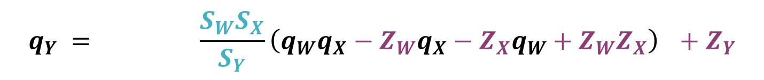


Integer-Arithmetic-Only Inference
$$Y=WX$$
$$int8$$
$$fp32$$
$$q_{Y} =round\left(\frac{S_{W}S_{X}}{S_{Y}}\left(q_{W}q_{X}−Z_{W}q_{X}−Z_{X}q_{W}+Z_{W}Z_{X}\right)\right)+Z_{Y}$$
Quantization and Training of Neural Networks for Efficient Integer-Arithmetic-Only Inference [Jacob et al., CVPR 2018]

Slide 38
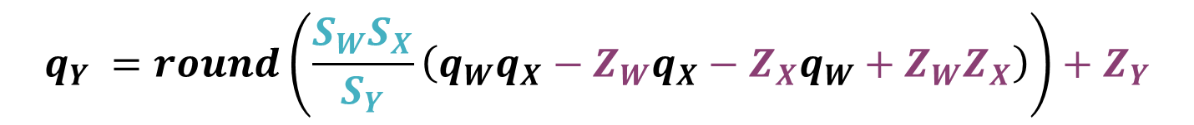
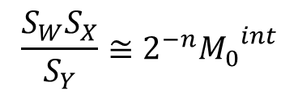
Integer-Arithmetic-Only Inference
Dyadic Scaling:
$$Y=WX$$
$$\frac{S_{W}S_{X}}{S_{Y}}≅2^{−n}{M_{0}}^{int}$$
$$int8$$
$$fp32$$
$$q_{Y} =round\left(\frac{S_{W}S_{X}}{S_{Y}}\left(q_{W}q_{X}−Z_{W}q_{X}−Z_{X}q_{W}+Z_{W}Z_{X}\right)\right)+Z_{Y}$$
Can we avoid the floating-point operation here?
Quantization and Training of Neural Networks for Efficient Integer-Arithmetic-Only Inference [Jacob et al., CVPR 2018]

Slide 39
Integer-Arithmetic-Only Inference
Dyadic Scaling:
$$Y=WX$$
$$\frac{S_{W}S_{X}}{S_{Y}}≅2^{−n}{M_{0}}^{int}$$
$$int8$$
$$fp32$$
$$q_{Y} =round\left(\frac{S_{W}S_{X}}{S_{Y}}\left(q_{W}q_{X}−Z_{W}q_{X}−Z_{X}q_{W}+Z_{W}Z_{X}\right)\right)+Z_{Y}$$
$$q_{Y} =round\left(2^{−n}M_{0}∙\left(q_{W}q_{X}−Z_{W}q_{X}−Z_{X}q_{W}+Z_{W}Z_{X}\right)\right)+Z_{Y}$$
Round to nearest bit-shift
$$q_{Y} =\left(M_{0}∙\left(q_{W}q_{X}−Z_{W}q_{X}−Z_{X}q_{W}+Z_{W}Z_{X}\right)\right)≫n+Z_{Y}$$
Quantization and Training of Neural Networks for Efficient Integer-Arithmetic-Only Inference [Jacob et al., CVPR 2018]

Slide 40
Integer-Arithmetic-Only Quantization
Requires more bits
to avoid overflow.
MAC (Multiply and Accumulate) operation
$$int8$$
Accumulate
$$q_{W_{ij}}$$
Multiply
$$×$$
$$+$$
Rescale
$$int8$$
$$q_{Y_{j}}$$
$$q_{Y_{j}}$$
$$int32$$
$$×\frac{S_{W}S_{X}}{S_{Y}}$$
$$int8$$
$$q_{X_{j} }$$
$$Y=WX$$
$$q_{Y} =\frac{S_{W}S_{X}}{S_{Y}}\left(q_{W}q_{X}−Z_{W}q_{X}−Z_{X}q_{W}+Z_{W}Z_{X}\right)+Z_{Y}$$
Quantization and Training of Neural Networks for Efficient Integer-Arithmetic-Only Inference [Jacob et al., CVPR 2018]

Slide 41


Integer-Arithmetic-Only Quantization
Requires more bits
to avoid overflow.
MAC (Multiply and Accumulate) operation
$$int8$$
Accumulate
$$q_{W_{ij}}$$
Multiply
$$×$$
$$+$$
Rescale
$$int8$$
$$q_{Y_{j}}$$
$$q_{Y_{j}}$$
$$int32$$
$$×2^{−n}M_{0}$$
$$int8$$
$$q_{X_{j} }$$
+b
$$Y=WX$$
$$q_{Y} =\left(M_{0}∙\left(q_{W}q_{X}−Z_{W}q_{X}−Z_{X}q_{W}+Z_{W}Z_{X}\right)\right)≫n+Z_{Y}$$
precompute,
can be fused into bias term
$$Z_{W}=0?$$
Quantization and Training of Neural Networks for Efficient Integer-Arithmetic-Only Inference [Jacob et al., CVPR 2018]

Slide 42




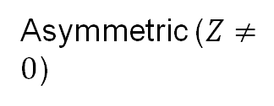




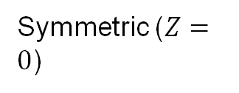
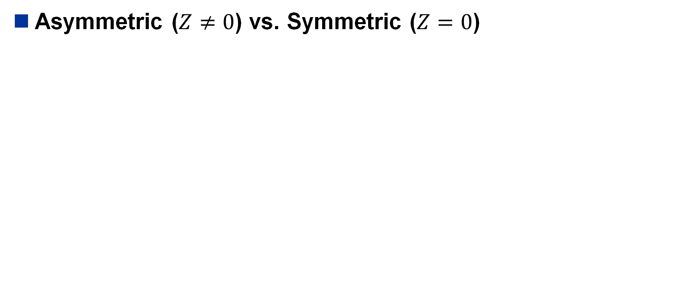





















Symmetric Linear Quantization
Asymmetric ($Z≠0$) vs. Symmetric ($Z=0$)
$${r }_{min}$$
$$0$$
$${r }_{max}$$
$${−\left|r\right|}_{max}$$
$$0$$
$${\left|r\right|}_{max}$$
$$r$$
floating-point range
$$r$$
floating-point range
$$×S$$
$$×S$$
$$q′$$
$$q$$
3-bit
Integer
$−$4
$−$3
$−$2
$$−1$$
0
$$1$$
$$2$$
$$3$$
$$−Z$$
$${\text{q} }_{min}$$
$${\text{q} }_{max}$$
$$q$$
3-bit Integer
$−$4
$−$3
$−$2
$$−1$$
$$0$$
$$1$$
$$2$$
$$3$$
$${\text{q} }_{min}$$
$${\text{q} }_{max}$$
Asymmetric ($Z≠0$)
Symmetric ($Z=0$)

Slide 43
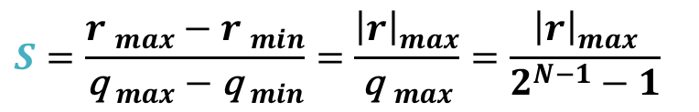
Symmetric Linear Quantization
Asymmetric ($Z≠0$) vs. Symmetric ($Z=0$)
$${r }_{min}$$
$$0$$
$${r }_{max}$$
$${−\left|r\right|}_{max}$$
$$0$$
$${\left|r\right|}_{max}$$
$$r$$
floating-point range
$$r$$
floating-point range
$$×S$$
$$×S$$
$$q′$$
$$q$$
3-bit
Integer
$−$4
$−$3
$−$2
$$−1$$
0
$$1$$
$$2$$
$$3$$
$$−Z$$
$${\text{q} }_{min}$$
$${\text{q} }_{max}$$
$$q$$
3-bit Integer
$−$4
$−$3
$−$2
$$−1$$
$$0$$
$$1$$
$$2$$
$$3$$
$$S=\frac{{r }_{max}−{r }_{min}}{{\text{q} }_{max}−{\text{q}}_{ min}}=\frac{{\left|r\right|}_{max}}{{\text{q} }_{max}}=\frac{{\left|r\right|}_{max}}{2^{N−1}−1}$$
$${\text{q} }_{min}$$
$${\text{q} }_{max}$$
Asymmetric ($Z≠0$)
Symmetric ($Z=0$)

Slide 44



So far, we have ignored the bias term.
Now we consider the following fully-connected layer with bias.
Integer-Arithmetic-Only Inference
$$Y=WX+b$$
$$S_{Y} \left(q_{Y}−Z_{Y}\right)=S_{W}\left(q_{W}−Z_{W}\right)∙S_{X}\left(q_{X}−Z_{X}\right)+S_{b}\left(q_{b}−Z_{b}\right)$$
$$Z_{W}=0$$
$$S_{Y} \left(q_{Y}−Z_{Y}\right)=S_{W}S_{X}\left(q_{W}q_{X}−Z_{X}q_{W}\right)+S_{b}\left(q_{b}−Z_{b}\right)$$
$Z_{b}=0$, $S_{b}=S_{W}S_{X}$
$$S_{Y} \left(q_{Y}−Z_{Y}\right)=S_{W}S_{X}\left(q_{W}q_{X}−Z_{X}q_{W}+q_{b}\right)$$
$$q_{Y}=\frac{S_{W}S_{X}}{S_{Y}}\left(q_{W}q_{X}−Z_{X}q_{W}+q_{b}\right)+Z_{Y}$$
Quantization and Training of Neural Networks for Efficient Integer-Arithmetic-Only Inference [Jacob et al., CVPR 2018]

Slide 45
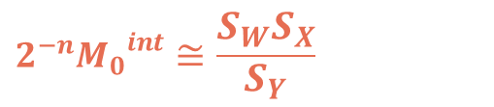


So far, we have ignored the bias term.
Now we consider the following fully-connected layer with bias.
Integer-Arithmetic-Only Inference
$$Y=WX+b$$
$Z_{W}=0$ , $Z_{b}=0$, $S_{b}=S_{W}S_{X}$
precompute
$$q_{Y}=\frac{S_{W}S_{X}}{S_{Y}}\left(q_{W}q_{X}−Z_{X}q_{W}+q_{b}\right)+Z_{Y}$$
$$q_{bias}=q_{b}−Z_{X}q_{W}$$
$$q_{Y}=\frac{S_{W}S_{X}}{S_{Y}}\left(q_{W}q_{X}+q_{bias}\right)+Z_{Y}$$
$$2^{−n}{M_{0}}^{int}≅\frac{S_{W}S_{X}}{S_{Y}}$$
$$q_{Y}=\left(M_{0}∙\left(q_{W}q_{X}+q_{bias}\right)\right)≫n+Z_{Y}$$
Quantization and Training of Neural Networks for Efficient Integer-Arithmetic-Only Inference [Jacob et al., CVPR 2018]

Slide 46

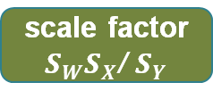
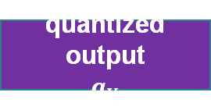
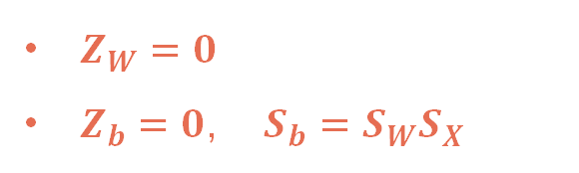


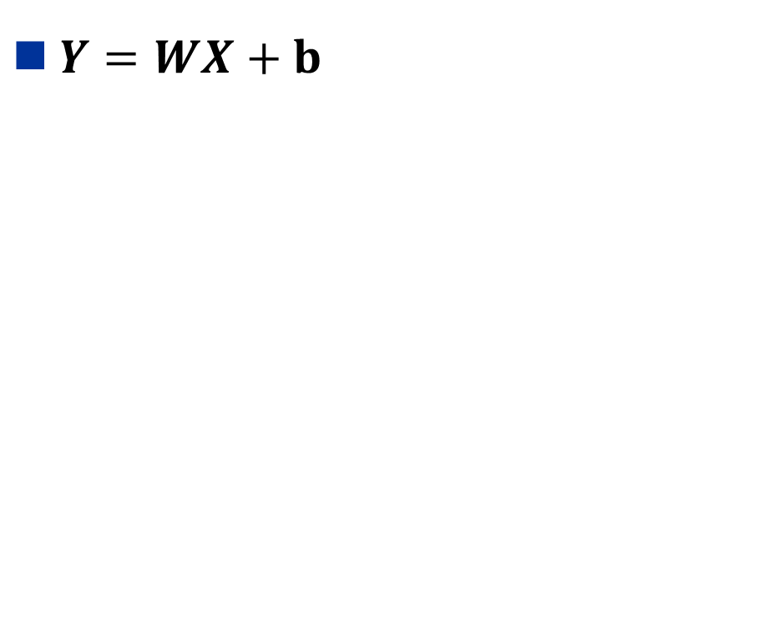

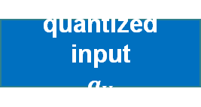
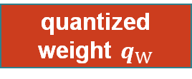


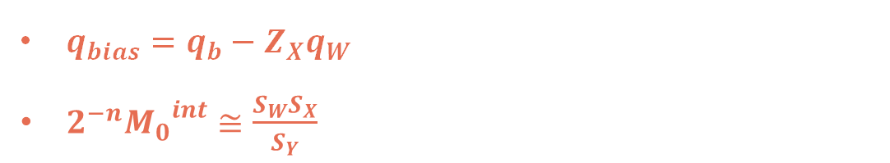

Linear Quantized Fully-Connected Layer
$Y=WX+b$
Weight: symmetric quant
Activation: asymmetric quant
Zero point
$$Z_{Y}$$
$$int8$$
$$int8$$
quantized output
$$q_{Y}$$
$$+$$
$Z_{W}=0$
$Z_{b}=0$, $S_{b}=S_{W}S_{X}$
$$int8$$
scale factor
$S_{W}S_{X}$/ $S_{Y}$
$$×$$
$q_{bias}=q_{b}−Z_{X}q_{W}$
$2^{−n}{M_{0}}^{int}≅\frac{S_{W}S_{X}}{S_{Y}}$
$$int32$$
quantized bias
$$q_{bias}$$
$$+$$
$$int32$$
Matmul
$$int8$$
$$int8$$
8-bit Int Mult.
32-bit Int Add.
8-bit Int Add.
$$q_{Y}=\left(M_{0}∙\left(q_{W}q_{X}+q_{bias}\right)\right)≫n+Z_{Y}$$
quantized input
$$q_{X}$$
quantized weight $q_{W}$
8-bit Int Matmul.
Rounding bit-shift
Quantization and Training of Neural Networks for Efficient Integer-Arithmetic-Only Inference [Jacob et al., CVPR 2018]

Slide 47

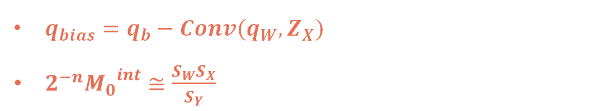
Linear Quantized Convolution Layer
$Y=Conv(W, X)+b$
Zero point
$$Z_{Y}$$
$$int8$$
$$int8$$
quantized output
$$q_{Y}$$
$$+$$
$Z_{W}=0$
$Z_{b}=0$, $S_{b}=S_{W}S_{X}$
$$int8$$
scale factor
$S_{W}S_{X}$/ $S_{Y}$
$$×$$
$q_{bias}=q_{b}−Conv(q_{W},Z_{X})$
$2^{−n}{M_{0}}^{int}≅\frac{S_{W}S_{X}}{S_{Y}}$
$$int32$$
quantized bias
$$q_{bias}$$
$$+$$
$$int32$$
Conv
$$int8$$
$$int8$$
8-bit Int Mult.
32-bit Int Add.
8-bit Int Add.
$$q_{Y}=\left(M_{0}∙\left({Conv(q}_{W},q_{X})+q_{bias}\right)\right)≫n+Z_{Y}$$
quantized input
$$q_{X}$$
quantized weight $q_{W}$
8-bit Int Conv.
Rounding bit-shift
Quantization and Training of Neural Networks for Efficient Integer-Arithmetic-Only Inference [Jacob et al., CVPR 2018]

Slide 48
Outline
Post-Training Quantization (PTQ)
Quantize-Aware Training (QAT)
Quantizing Large Models

Slide 49
Post-Training Quantization (PTQ)
How do we obtain optimal linear quantization parameters (S, Z) ?

Slide 50
Post-Training Quantization (PTQ)
Quantization Granularity
Dynamic Range Clipping
Rescaling
Rounding

Slide 51
Post-Training Quantization (PTQ)
Quantization Granularity
Dynamic Range Clipping
Rescaling
Rounding

Slide 52
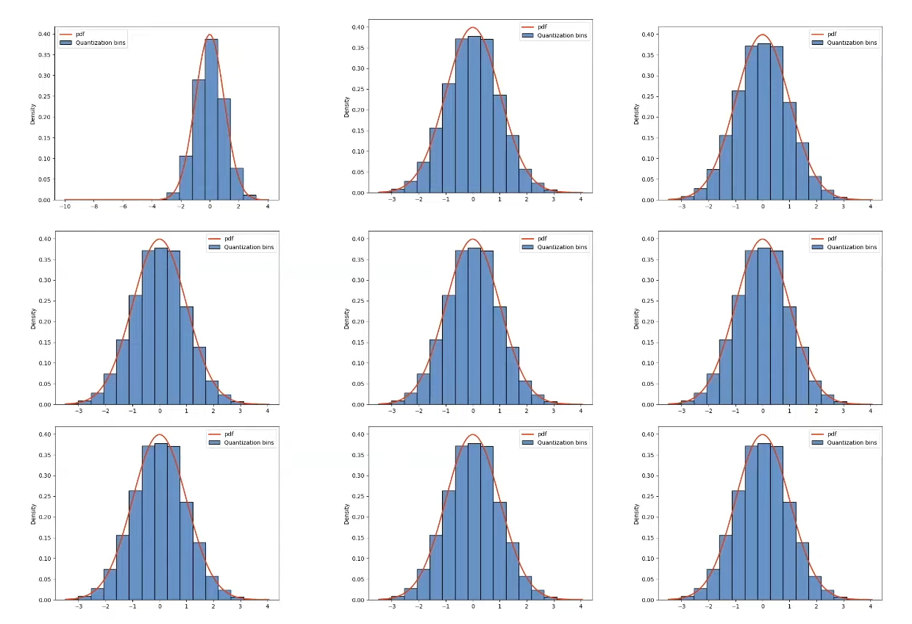
Quantization Granularity

Slide 53
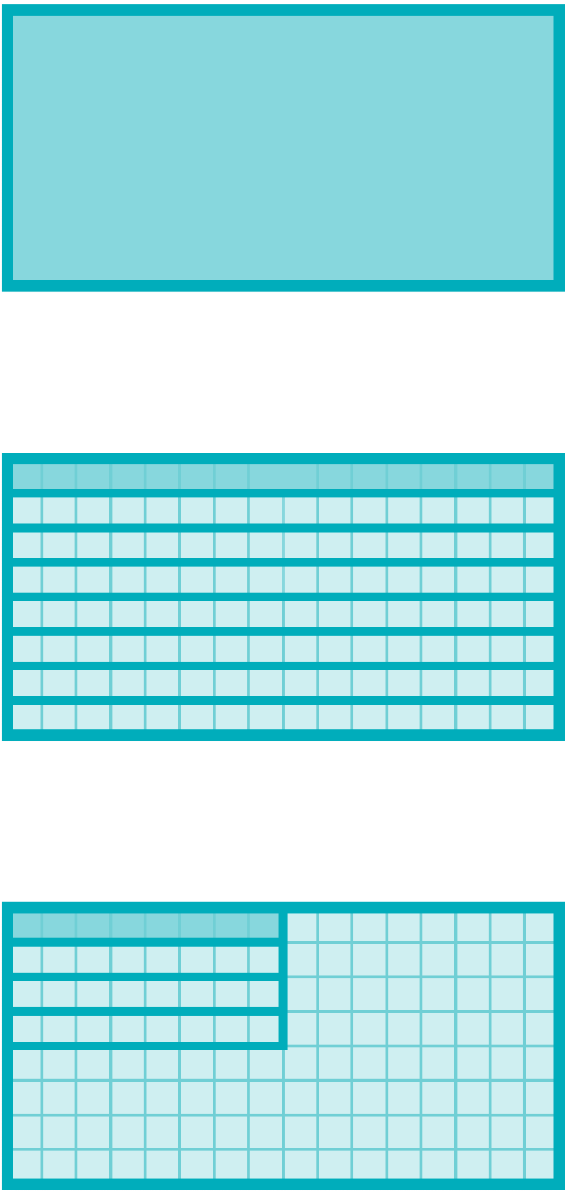

Quantization Granularity
Per-tensor(per-layer) Quantization
Per-channel Quantization
Group-wise Quantization
  Per-Vector Quantization

Slide 54
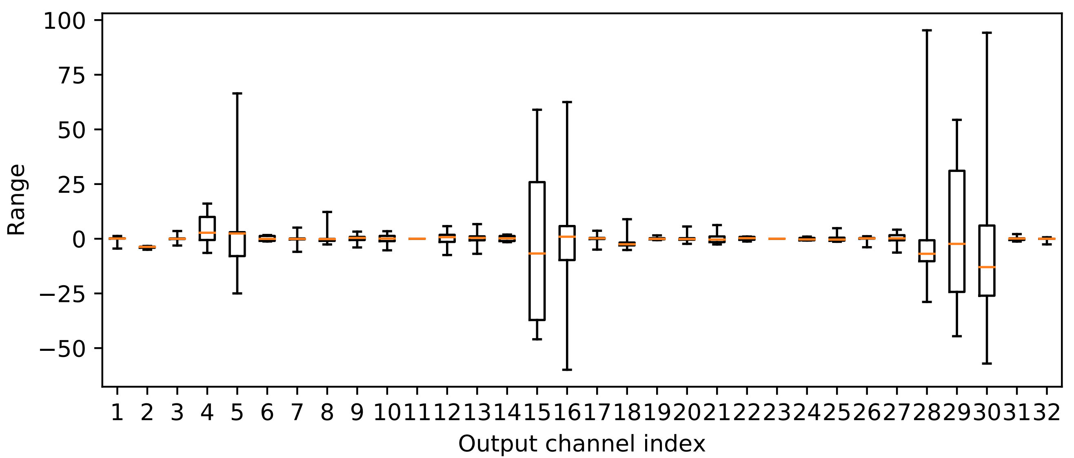



Per-Tensor Weight Quantization
$${\left|r\right|}_{max}={\left|W\right|}_{max}$$
$$S=\frac{{\left|r\right|}_{max}}{q_{max}}$$
Symmetric Linear Quantization on Weights
Per-Tensor Quantization
Applies a uniform scale $S$ across the entire weight tensor
  Works well for larger models
  Accuracy drops for small models
Large differences (more than 100x) in ranges of different channels
  Outliers
Data-Free Quantization Through Weight Equalization and Bias Correction [Nagel et al., ICCV 2019]

Slide 55
Per-Tensor Weight Quantization
$${\left|r\right|}_{max}={\left|W\right|}_{max}$$
$$S=\frac{{\left|r\right|}_{max}}{q_{max}}$$
Symmetric Linear Quantization on Weights
Per-Tensor Quantization
Applies a uniform scale $S$ across the entire weight tensor
  Works well for larger models
  Accuracy drops for small models
Large differences (more than 100x) in ranges of different channels
  Outliers
How can we reduce the impact of an outlier value?
  Per-Channel Quantization
Data-Free Quantization Through Weight Equalization and Bias Correction [Nagel et al., ICCV 2019]

Slide 56




Per-Channel Weight Quantization
Example: 2-bit linear quantization
$$ic$$
Per-Channel Quantization
Per-Tensor Quantization
2.09 | -0.98 | 1.48 | 0.09
0.05 | -0.14 | -1.09 | 2.12
-0.97 | 1.92 | 0 | -1.03
1.87 | 0 | 1.53 | 1.49
$${\left|r\right|}_{max}=2.12$$
$$oc$$
$$S=\frac{{\left|r\right|}_{max}}{q_{max}}=\frac{2.12}{2^{2−1}−1}=2.12$$
1 | 0 | 1 | 0
0 | 0 | -1 | 1
0 | 1 | 0 | 0
1 | 0 | 1 | 1
2.12 | 0 | 2.12 | 0
0 | 0 | -2.12 | 2.12
0 | 2.12 | 0 | 0
2.12 | 0 | 2.12 | 2.12
Quantized
Reconstructed

Slide 57










Per-Channel Weight Quantization
Example: 2-bit linear quantization
$$ic$$
Per-Channel Quantization
Per-Tensor Quantization
2.09 | -0.98 | 1.48 | 0.09
0.05 | -0.14 | -1.09 | 2.12
-0.97 | 1.92 | 0 | -1.03
1.87 | 0 | 1.53 | 1.49
$${\left|r\right|}_{max}=2.09$$
$$S_{0}=2.09$$
$${\left|r\right|}_{max}=2.12$$
$${\left|r\right|}_{max}=2.12$$
$$S_{1}=2.12$$
$$oc$$
$$S=\frac{{\left|r\right|}_{max}}{q_{max}}=\frac{2.12}{2^{2−1}−1}=2.12$$
$${\left|r\right|}_{max}=1.92$$
$$S_{2}=1.92$$
$${\left|r\right|}_{max}=1.87$$
$$S_{3}=1.87$$
1 | 0 | 1 | 0
0 | 0 | -1 | 1
0 | 1 | 0 | -1
1 | 0 | 1 | 1
2.09 | 0 | 2.09 | 0
0 | 0 | -2.12 | 2.12
0 | 1.92 | 0 | -1.92
1.87 | 0 | 1.87 | 1.87
1 | 0 | 1 | 0
0 | 0 | -1 | 1
0 | 1 | 0 | 0
1 | 0 | 1 | 1
2.12 | 0 | 2.12 | 0
0 | 0 | -2.12 | 2.12
0 | 2.12 | 0 | 0
2.12 | 0 | 2.12 | 2.12
Quantized
Reconstructed
Quantized
Reconstructed
$${\left\|W−Sq_{W}\right\|}_{F}$$
<
$${\left\|W−Sq_{W}\right\|}_{F}$$

Slide 58



VS-Quant: Per-vector Scaled Quantization
  $r=\left(q−Z\right)∙S$ → $r=\left(q−Z\right)∙S_{q}∙γ$
  $S_{q}$: Per-vector scale vector (integer)
  $γ$ : Coarse grained scale factor (floating-point)
  Achieves a balance between accuracy and hardware efficiency by
    less expensive INT scale at finer granularity
    more expensive FP scale at coarser granularity
  Memory overhead of two-level scaling:
Assume 4-bit quantization, 4-bit per-vector scale, group_size=16.
The effective bit width is: 4 + 4/16 = 4.25 bits
VS-Quant: Per-Vector Scaled Quantization for Accurate Low-Precision Neural Network Inference [Steve Dai,et al.]

Slide 59








Group Quantization – Multi-level scaling scheme
L0
$$W_{01}$$
  $r=\left(q−Z\right)∙S$ →
$$W_{11}$$
$$W_{21}$$
$r=\left(q−Z\right)∙S_{l_{0}}∙S_{l_{1}}∙$ ⋯
$$W_{31}$$
  $r$ : real number value
  $q$ : quantized value
  $z$ : zero point (z=0 is symmetric quant)
  $s$ : scale factors of different levels
Method | Data Type | L0 Group Size | L0 Scale Data Type | L1 Group Size | L1 Scale Data Type | Effective Bit-Width
Per-Channel Quant | INT4 | Per Channel | FP16 | - | - | 4

Slide 60

Group Quantization – Multi-level scaling scheme
L0
$$W_{01}$$
  $r=\left(q−Z\right)∙S$ →
$$W_{11}$$
$$W_{21}$$
$r=\left(q−Z\right)∙S_{l_{0}}∙S_{l_{1}}∙$ ⋯
$$W_{31}$$
  $r$ : real number value
  $q$ : quantized value
  $z$ : zero point (z=0 is symmetric quant)
  $s$ : scale factors of different levels
L1
Method | Data Type | L0 Group Size | L0 Scale Data Type | L1 Group Size | L1 Scale Data Type | Effective Bit-Width
Per-Channel Quant | INT4 | Per Channel | FP16 | - | - | 4
VSQ | INT4 | $$16$$ | UINT4 | Per Channel | FP16 | 4+4/16=4.25

Slide 61

VS-Quant Accuracy Comparison
Bitwidths | $$S_{w}=3 bit$$ $$S_{a}=4 bit$$ | $$S_{w}=4 bit$$ $$S_{a}=4 bit$$ | $$S_{w}=6 bit$$ $$S_{a}=6 bit$$ | $$S=fp32$$ | Best Per-channel
Wt=4 Act=3U | $$73.64$$ | $$73.53$$ | $$74.69$$ | $$74.71$$ | $$67.20$$
Wt=4 Act=4U | $$73.39$$ | $$74.36$$ | $$75.35$$ |  | $$70.76$$
Wt=4 Act=8U | $$73.65$$ | $$74.66$$ | $$75.42$$ | $$75.42$$ | $$72.30$$
Wt=8 Act=4U | $$74.48$$ | $$75.08$$ | $$75.96$$ | $$75.91$$ | $$75.11$$
Wt=8 Act=8U | $$74.61$$ | $$75.15$$ | $$76.10$$ | $$76.15$$ | $$76.16$$
ResNet50 on ImageNet with integer per-vector scale factors

Slide 62








Microscaling Formats (MX)
(Block size)
Format Name | Block Size | Scale Data Format | Scale Bits | Element Data Format | Element Bit-Width
MXFP8 | 32 | E8M0 | 8 | FP8 (E4M3 / E5M2) | 8
MXFP6 | 32 | E8M0 | 8 | FP6 (E2M3 / E3M2) | 6
MXFP6 | 32 | E8M0 | 8 | FP4 (E2M1) | 4
MXINT8 | 32 | E8M0 | 8 | INT8 | 8
OCP Microscaling Formats (MX) Specification Version 1.0, Sep 2023

Slide 63
Post-Training Quantization (PTQ)
Quantization Granularity
Dynamic Range Clipping
Rescaling
Rounding

Slide 64










Linear Quantization on Activations
Unlike weights, activation ranges vary by input.
Before deploying the model, we need to first collect activation statistics to determine the average range.
Values higher than the specified range will be clipped.
$${r }_{min}$$
$$0$$
$${r }_{max}$$
$$r$$
floating-point range
$$×S$$
$$q′$$
$$−Z$$
$$q$$
3-bit Integer
$−$4
$−$3
$−$2
$$−1$$
$$0$$
$$1$$
$$2$$
$$3$$
$${\text{q} }_{min}$$
$${\text{q} }_{max}$$

Slide 65

Dynamic Range for Activation Quantization
Reduces quantization noise
Increases outliers’ error
Clipping (or Clamping)
large quantization noise
low-density data

Slide 66










Dynamic Range for Activation Quantization
$${r }_{min}$$
$$0$$
$${r }_{max}$$
Min-max
  Obtain ranges by finding the min/max value of the tensor
$$r$$
floating-point range
$$×S$$
$$q′$$
$$−Z$$
$$q$$
3-bit Integer
$−$4
$−$3
$−$2
$$−1$$
$$0$$
$$1$$
$$2$$
$$3$$
$${\text{q} }_{min}$$
$${\text{q} }_{max}$$

Slide 67

Dynamic Range for Activation Quantization
$${\left({\hat{r}}_{min},{\hat{r}}_{max}\right)}^{t}$$
$$=α∙{\left(r_{min},r_{max}\right)}^{t}+\left(1−α\right)∙{\left({\hat{r}}_{min},{\hat{r}}_{max}\right)}^{t−1}$$
$${r }_{min}$$
$$0$$
$${r }_{max}$$
Min-max
  Obtain ranges by finding the min/max value of the tensor
Exponential Moving Average (EMA)
  Smoothed version of min-max
  Observed ranges are smoothed across hundreds of calibration steps.
$$r$$
floating-point range
$$×S$$
$$q′$$
$$−Z$$
$$q$$
3-bit Integer
$−$4
$−$3
$−$2
$$−1$$
$$0$$
$$1$$
$$2$$
$$3$$
$${\text{q} }_{min}$$
$${\text{q} }_{max}$$

Slide 68

Dynamic Range for Activation Quantization
$${\left({\hat{r}}_{min},{\hat{r}}_{max}\right)}^{t}$$
$$=α∙{\left(r_{min},r_{max}\right)}^{t}+\left(1−α\right)∙{\left({\hat{r}}_{min},{\hat{r}}_{max}\right)}^{t−1}$$
$${r }_{min}$$
$$0$$
$${r }_{max}$$
Min-max
  Obtain ranges by finding the min/max value of the tensor
Exponential Moving Average (EMA)
  Smoothed version of min-max
  Observed ranges are smoothed across hundreds of calibration steps.
Mean-Square-Error (MSE)
  Find min/max value that minimize the MSE between the original and the quantized tensor:
$$r$$
floating-point range
$$×S$$
$$q′$$
$$−Z$$
$$q$$
3-bit Integer
$−$4
$−$3
$−$2
$$−1$$
$$0$$
$$1$$
$$2$$
$$3$$
$${\text{q} }_{min}$$
$${\text{q} }_{max}$$
$$\underset{q_{min},q_{max}}{argmin}{\left\|W−\tilde{W}(q_{min},q_{max})\right\|}_{F}^{2}$$

Slide 69

MSE vs. min-max Comparison
MSE outperforms min-max on low bit-widths

Slide 70
Post-Training Quantization (PTQ)
Quantization Granularity
Dynamic Range Clipping
Rescaling
Rounding

Slide 71







Cross-Layer Equalization (CLE)
Rescale adjacent weight ranges in advance without affecting the output.
Output channel ${a }_{i}$
Input channel ${b }_{i}$
$${b }_{i}∙{\text{s} }_{i}$$
$$relu\left(x\right)=max\left(0,x\right)$$
$${a }_{i}÷{\text{s} }_{i}$$
We have that
$$relu\left(sx\right)=s∙relu\left(x\right)$$
Data-Free Quantization Through Weight Equalization and Bias Correction [Nagel et al., ICCV 2019]

Slide 72



Cross-Layer Equalization (CLE)
Apply CLE to the weights before the quantization process.
CLE
Method | Top-1 Accuracy (INT8)
Per-Tensor | $$0.1$$
Per-Channel | $$69.7$$
DFQ (per-tensor) | $$71.2$$
Current method
MobileNetV2 results for ImageNet $(fp32 acc: 71.71)$

Slide 73





SmoothQuant
$$×0.1$$
$$Y=XW$$
$$×10$$
Activation is harder to quantize due to outliers
Migrate the quantization difficulty from activation to weight
OPT-IML-30B | LAMBADA ↑ | WikiText ↓
FP16 | $$69.12\%$$ | $$14.26$$
W8A8 | $$4.21\%$$ | $$576.53$$
SmoothQuant | $$69.77\%$$ | $$14.37$$
SmoothQuant: Accurate and Efficient Post-Training Quantization for Large Language Models [Xiao et al., ICML 2023]

Slide 74
Post-Training Quantization (PTQ)
Quantization Granularity
Dynamic Range Clipping
Rescaling
Rounding

Slide 75


Adaptive Rounding for PTQ
Weights are correlated with each other.
The best rounding for each weight is not the best rounding for the whole tensor.
AdaRound can only be used on quantizing weights.
AdaRound
  Rounding-to-nearest is sub-optimal
What kind of rounding is optimal?
  Rounding that best reconstructs the original activation
Up or Down? Adaptive Rounding [Nagel et al., ICML 2020]

Slide 76





Adaptive Rounding for PTQ
Instead of $\left\lfloor \left.w\right\rceil \right.$ , we want to choose between $\left\{\left\lfloor w\right\rfloor , \left\lceil w\right\rceil \right\}$ for best reconstruction:
$$\tilde{w}=\left\lfloor \left.\left\lfloor w\right\rfloor +δ\right\rceil \right., δ∈\left[0, 1\right]$$
AdaRound applies a learning-based method to optimize the following equation:
$${argmin}_{V}{\left\|Wx−\tilde{W}x\right\|}_{F}^{2}+\text{λ}f_{reg}\left(V\right)$$
$${argmin}_{V}{\left\|Wx−\left\lfloor \left.\left\lfloor w\right\rfloor +h\left(V\right)\right\rceil \right.x\right\|}_{F}^{2}+\text{λ}f_{reg}\left(V\right)$$
$x:$ Input of the layer, $V$: a random variable with the same shape
$h()$: a function to map distribution to (0, 1). (rectified sigmoid)
$f_{reg}\left(V\right)$: a regularization term that encourages $h\left(V\right)$ to be binary
Up or Down? Adaptive Rounding [Nagel et al., ICML 2020]

Slide 77

AdaRound Accuracy Comparison
Optimization | #bits W/A | ResNet18 | MobileNetV2
FP16 | $$32/32$$ | $$69.68$$ | $$71.72$$
DFQ | $$8/8$$ | $$69.7$$ | $$71.2$$
Nearest | $$4/32$$ | $$23.99$$ | $$8.09$$
DFQ | $$4/8$$ | $$38.98$$ | $$46.57$$
AdaRound | $$4/8$$ | $$68.55$$ | $$69.25$$
Results for models in terms of ImageNet validation accuracy (%)
Up or Down? Adaptive Rounding [Nagel et al., ICML 2020]

Slide 78
Quantization-Aware Training (QAT)
Can we train the model while taking quantization into consideration?

Slide 79

Quantization-Aware Training (QAT)
QAT vs. PTQ
Survey of Quantization Methods for Efficient NN inference [Amir Gholami et al., Book: Low-Power Computer Vision]

Slide 80








Quantization-Aware Training (QAT)
Train model while taking quantization into consideration
$$int8$$
$$fp32$$
$$int8$$
$int$32
$int$32
$$int8$$
$$int8$$
$$fp32$$
Quantization and Training of Neural Networks for Efficient Integer-Arithmetic-Only Inference [Jacob et al., CVPR 2018]

Slide 81




Straight-Through Estimator (STE)
Train model while taking quantization into consideration
The network will learn nothing since gradients become 0 and weights won’t update.
$$Q(W)=clip(\left\lfloor \left.\frac{W}{S}\right\rceil \right.,{\text{q} }_{min} ,{\text{q} }_{max})$$
$$g_{W}=\frac{∂L}{∂W}=\frac{∂L}{∂Q(W)}∙\frac{∂Q(W)}{∂W}=0$$
Quantization is discrete-valued, and thus the derivative is 0 almost everywhere.
STE passes the gradients through quantization as if it is an identity function.
$$\frac{∂Q(W)}{∂W}=0$$
$$g_{W}=\frac{∂L}{∂W}=\frac{∂L}{∂Q(W)}$$
Estimating or Propagating Gradients Through Stochastic Neurons for Conditional Computation [Bengio et al., arXiv 2013]

Slide 82

Straight-Through Estimator (STE)
Survey of Quantization Methods for Efficient NN inference [Amir Gholami et al., Book: Low-Power Computer Vision]
Estimating or Propagating Gradients Through Stochastic Neurons for Conditional Computation [Bengio et al., arXiv 2013]

Slide 83

INT8 Linear Quantization-Aware Training
Experimental results (ImageNet)
 | Floating-Point | Post-Training Quantization |  | Quantization-Aware Training
 |  | Asymmetric | Symmetric | Asymmetric | Symmetric
 |  | Per-Tensor | Per-Channel | Per-Tensor | Per-Channel
MobileNetV1 | $$70.9\%$$ | $$0.1\%$$ | $$59.1\%$$ | $$70.0\%$$ | $$70.7\%$$
MobileNetV2 | $$71.9\%$$ | $$0.1\%$$ | $$69.8\%$$ | $$70.9\%$$ | $$71.1\%$$
NASNET-Mobile | $$74.9\%$$ | $$72.2\%$$ | $$72.1\%$$ | $$73.0\%$$ | $$73.0\%$$
Quantizing Deep Convolutional Networks for Efficient Inference: A Whitepaper [Raghuraman Krishnamoorthi, arXiv 2018]

Slide 84














Summary of this Chapter
The basic concept of neural network quantization, is to remap weights and activations into a limited discrete set of numbers
Two common quantization methods
  K-means-based Quantization
  Linear Quantization
$${r }_{min}$$
$$0$$
$${r }_{max}$$
$$r$$
floating-point range
$$×S$$
$$q′$$
$$−Z$$
$$q$$
3-bit Integer
$−$4
$−$3
$−$2
$$−1$$
$$0$$
$$1$$
$$2$$
$$3$$
$${\text{q} }_{min}$$
$${\text{q} }_{max}$$

Slide 85
Summary of this Chapter
Post-Training Quantization (PTQ) quantizes an already-trained floating-point model.
  Per-tensor vs. per-channel vs. group-wise
  How to determine the dynamic range for activation
Quantization-Aware Training (QAT) emulates inference-time quantization during training/fine-tuning.
  Straight Through Estimator (STE)

